Slide 1
Sinograph Explorer
Track 2: Custom DNN Model
Yoonkyu Lee
TA: Jinghua & Paul

Slide 2
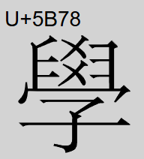
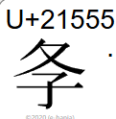
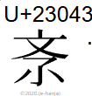
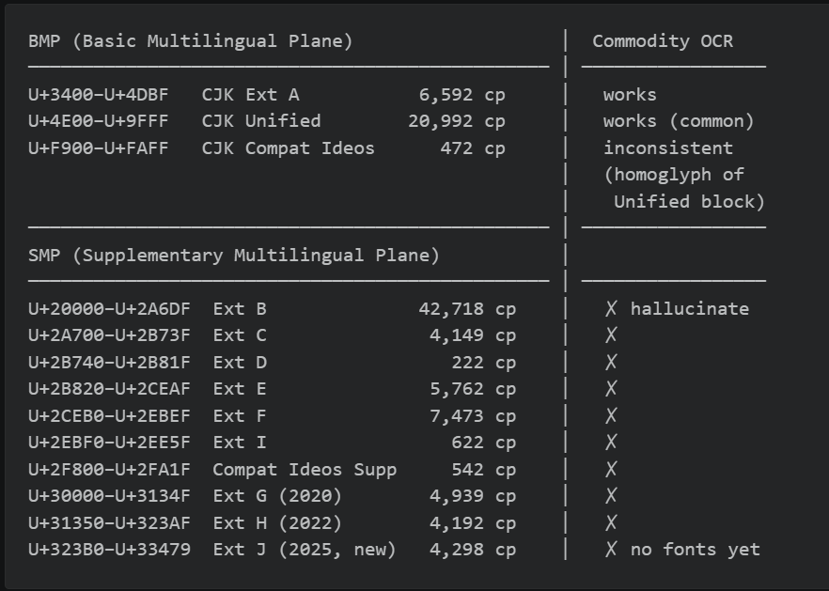
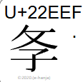
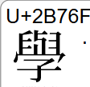
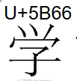

Problem Statement
← BMP: everyday Chinese/Japanese/Korean text lives here (as well as some region specific characters)
← SMP: uncommon / historical / dialectal / newly-standardized characters lives here

Slide 3
Project Goal
Implementing OCR that reads Chinese characters including uncommon characters, CJK Ext B, and variant forms that commodity engines miss.
“Sinograph” means any individual logographic character used in the Chinese writing system.
Traditional Chinese Characters
Jiantizi (Mainland Simplified)
Hanja (Korean)
Kanji, Shinjitai (Japanese)
chữ Nôm (Vietnamese)
…
⊂ Sinographs

Slide 4
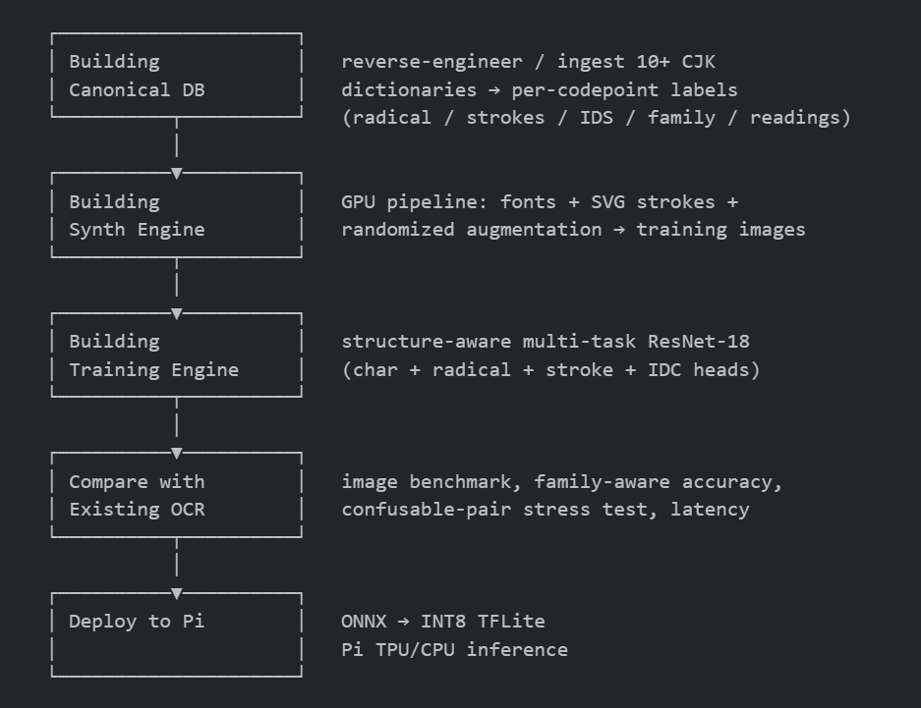
Overall Workflow

Slide 5
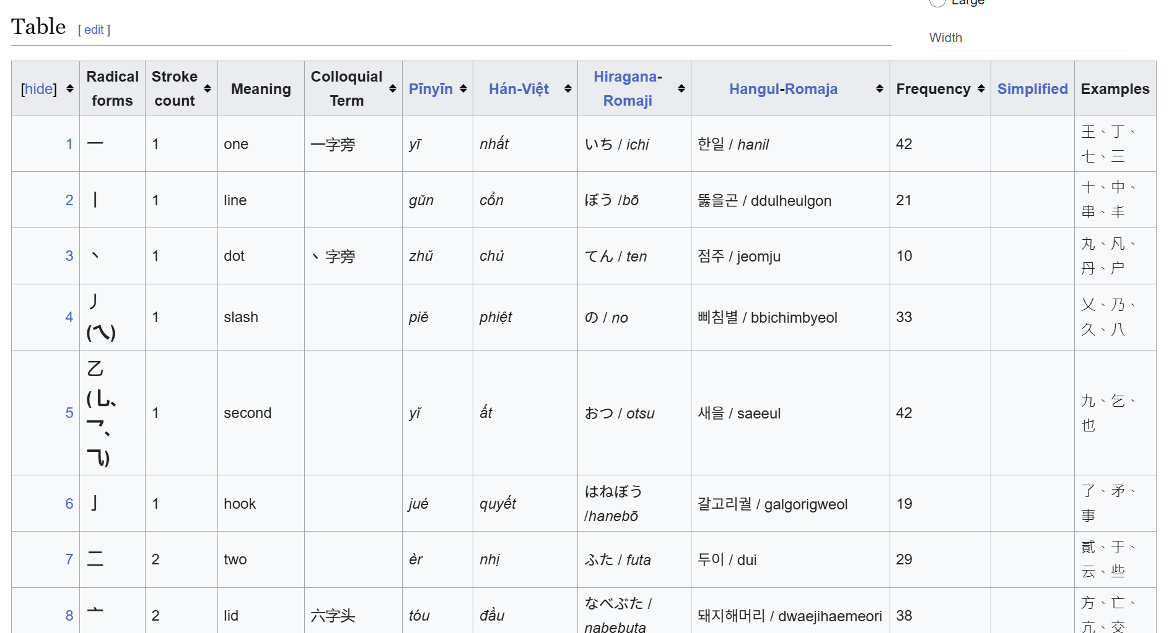
Canonical DB
Despite not being the Track-2 contribution directly, the DB is the prerequisite for structure-aware training.
Useful fields (per codepoint):
radical (1–214) - classical radical index
total_strokes + residual_strokes
IDS decomposition tree (e.g. 鑑 = ⿰金監)
IDS top-level IDC (12-way layout: ⿰⿱⿲⿳⿴⿵⿶⿷⿸⿹⿺⿻)
variant family + canonical representative (for evaluation)
en.wikipedia.org/wiki/Kangxi_radicals

Slide 6
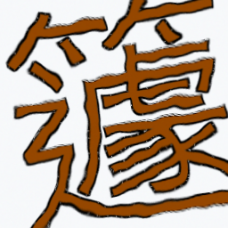
Synth Engine
A kind of sinograph (or one codepoint) is a class.
Trained 10923 classes until midpoint for experiment
Aiming to train 76k classes among 103k
Uses font (and SVG if available)
Applies randomized augmentation:
Perspective, rotation, Gaussian blur, JPEG compression, chromatic aberration, neon glow, paper texture, elastic warp, color jitter, inversion, noise, binarization, saturated-background overlay, etc.
U+7C67 ->

Slide 7
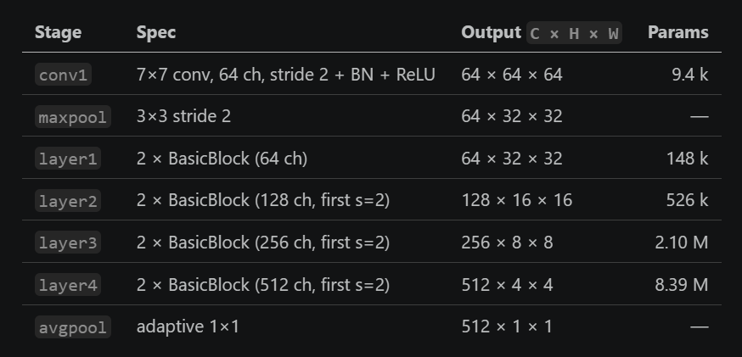
Training Engine
Input: RGB 128 × 128 × 3, normalized (pixel/255 − 0.5)/0.5 → [−1, 1].
ResNet-18 trained from scratch:

Slide 8
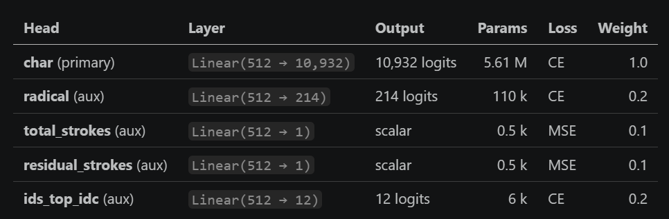
Training Engine
Loss: L = CE(char) + 0.2·CE(radical) + 0.1·MSE(total) + 0.1·MSE(residual) + 0.2·CE(IDC)
Why this design: radical, stroke count, and IDC are exactly the features a human would use to distinguish similar 未/末, 田/由/甲/申, or 媤/媳. The net is forced to attend to them explicitly, rather than hoping pixel-only training discovers them.

Slide 9
Training Engine
Goal: identify what a character is made of and what it is easy to confuse with.
Component multi-label head
Each codepoint carries a multi-hot vector over a shared component vocabulary (e.g. 鑑 → {金, 監}).
the char head alone learns codepoint identity. the component head forces the backbone to additionally encode part identity. (This is where pixel-only training fails on 鑑 /鐱)
Confusable-pair margin loss
The model hard pairs from the validation confusion matrix and from a heuristic (same radical + stroke-count Δ ≤ 1).
Why?: The failure is concentrated on a few hundred visually adjacent pairs (鑑/鍳, 媤/媳, 未/末, 𤨒/璁). A margin loss targets exactly those pairs instead of reweighting.

Slide 10
Final Demo Goals
Pi-hardware inference: actual per-character latency measured on the Raspberry Pi (CPU and Coral TPU) with the INT8 TFLite model. Target: confirm real-time with Coral TPU
Accuracy Increase (structure-aware model vs softmax)
image benchmark
a new confusable-pair stress set (未/末, 田/由/甲/申, 己/已/巳, 媤/媳, …) where the midpoint baseline is known to struggle
(if time permits,) use photo taken by pi camera

