Slide 1
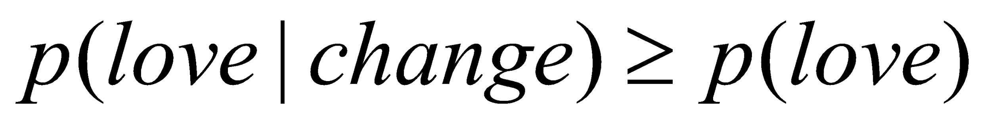
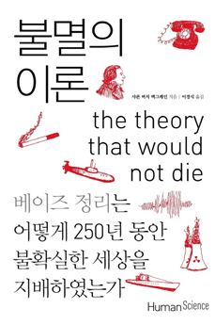
CHAPTER 5
Bayes’ Rule
I’ll love you forever in every respect
(I’ll marginalize all your glaring defects)
But if you could change some to be more like me
I‘d love you today unconditionally.
Bayes’ rule is merely the mathematical relation between the prior allocation of credibility and the posterior reallocation of credibility conditional on data.
베이즈 정리
한 대상에 대해 가지고 있던 초기의 믿음을 객관적이고도 새로운 정보로 업데이트할 때, 보다 개선된 새로운 믿음을 얻을 수 있다.

Slide 2


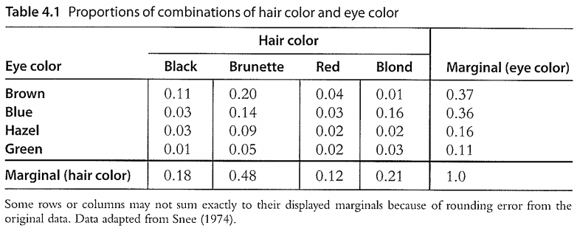

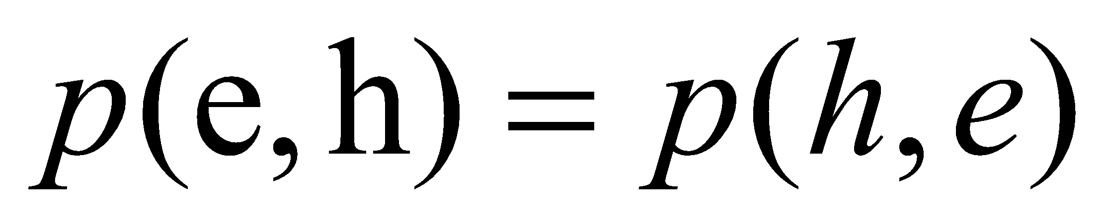
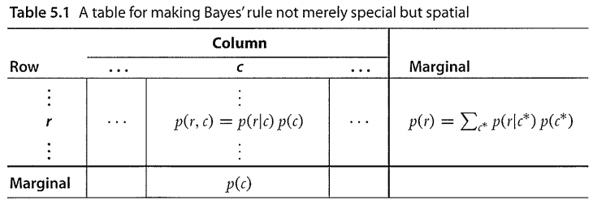

CHAPTER 5
Bayes’ Rule
5.1.1 Derived from definitions of conditional probability
The notation for joint probabilities is symmetric:
“prior” (marginal) beliefs, “posterior” (conditional) beliefs

Slide 3
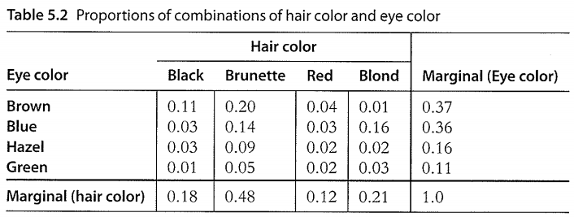
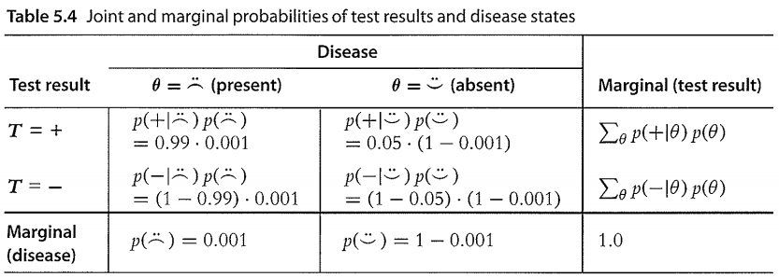
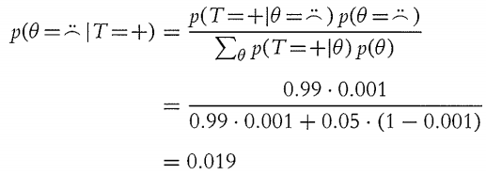
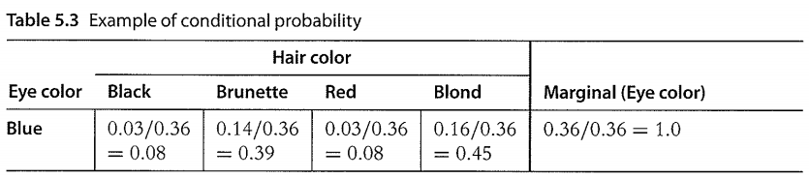
CHAPTER 5
Bayes’ Rule
5.1.2 Bayes’ rule intuited from a two-way discrete table
Remember that here we have assumed that the person was selected at random from the population, and there were no other symptoms that motivated getting the test. If there were other symptoms that indicated the disease, those data would also have to be taken into account.

Slide 4

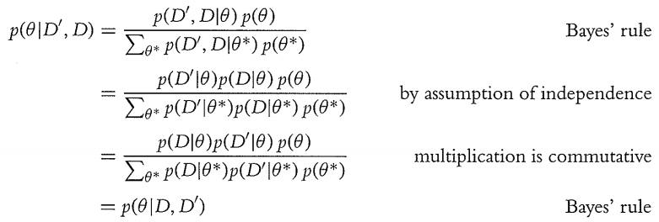
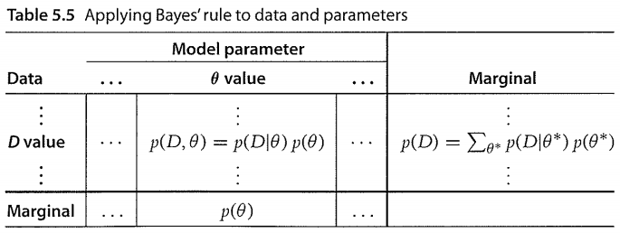



CHAPTER 5
Bayes’ Rule
5.2 APPLIED TO PARAMETERS AND DATA
5.2 Data-order invariance
For continuous variables,

Slide 5
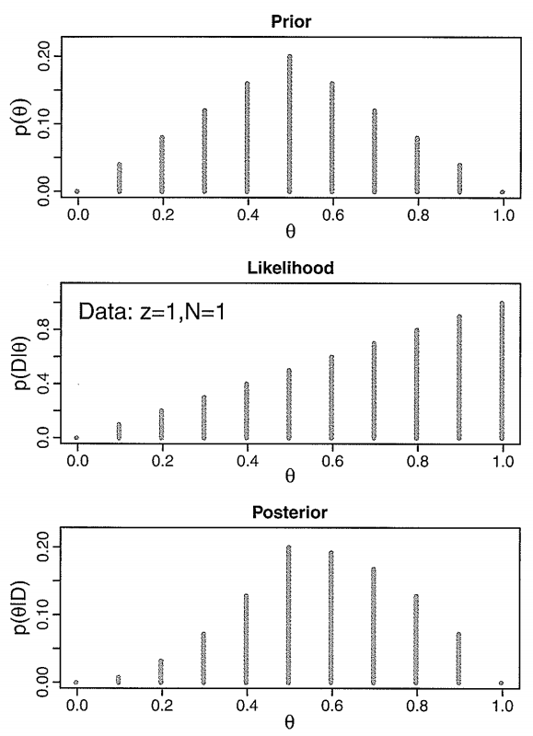
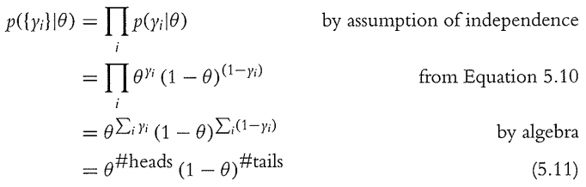
CHAPTER 5
Bayes’ Rule
5.3 COMPELETE EXAMPLES: ESTIMATING BIAS IN A COIN
실험 결과가 단지 두 개의 사건 중 어느 하나만으로 나타날 때 이를 베르누이 시행이라고 한다.

Slide 6
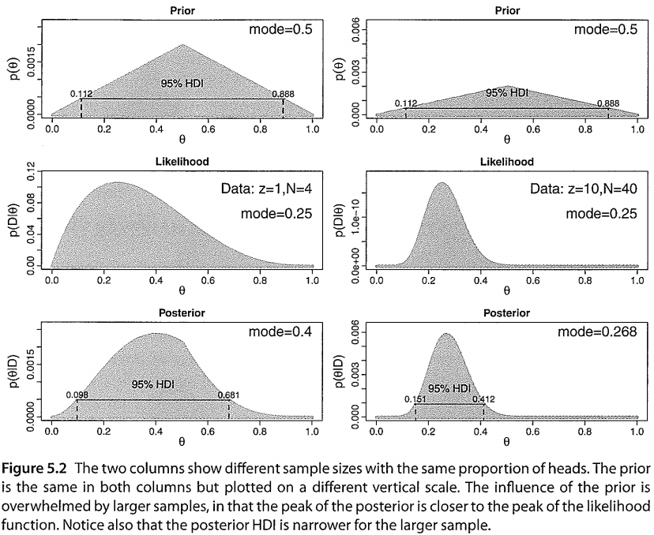
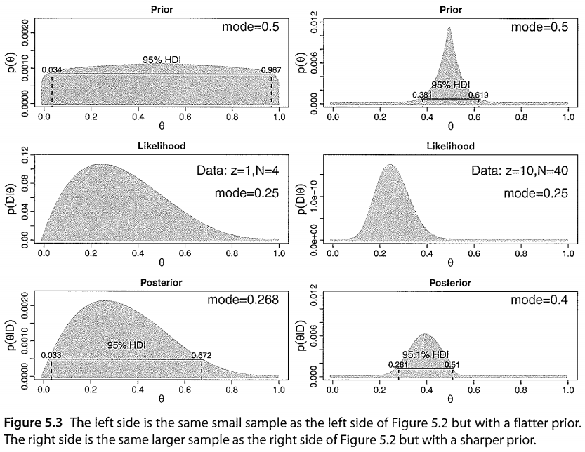
CHAPTER 5
Bayes’ Rule
5.3.1 Influence of sample size on the posterior
5.3.2 Influence of the prior on the posterior

