Slide 1





Defining Classes – Part 1
Classes, Fields, Constructors, Methods, Properties
Object-Oriented Programming
Telerik Software Academy
Object-Oriented
http://academy.telerik.com

Slide 2
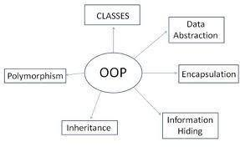

Table of Contents
Defining Simple Classes
Fields
Access Modifiers
Using Classes and Objects
Constructors
Methods
Properties
Enumerations (Enums)
Keeping the Object State

Slide 3
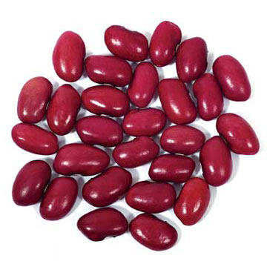
Defining Simple Classes

Slide 4
Classes in OOP
Classes model real-world objects and define
Attributes (state, properties, fields)
Behavior (methods, operations)
Classes describe the structure of objects
Objects describe particular instance of a class
Properties hold information about the modeled object relevant to the problem
Operations implement object behavior

Slide 5
Classes in C#
Classes in C# can have members:
Fields, constants, methods, properties, indexers, events, operators, constructors, destructors, …
Inner types (inner classes, structures, interfaces, delegates, ...)
Members can have access modifiers (scope)
public, private, protected, internal
Members can be
static (common) or specific for a given object

Slide 6
Simple Class Definition
Begin of class definition
public class Cat : Animal {
private string name;
private string owner;
public Cat(string name, string owner)
{
this.name = name;
this.owner = owner;
}
public string Name
{
get { return this.name; }
set { this.name = value; }
}
Inherited (base) class
Fields
Constructor
Property

Slide 7

Simple Class Definition (2)
public string Owner
{
get { return this.owner; }
set { this.owner = value; }
}
public void SayMiau()
{
Console.WriteLine("Miauuuuuuu!");
}
}
Method
End of class definition

Slide 8

Class Definition and Members
Class definition consists of:
Class declaration
Inherited class or implemented interfaces
Fields (static or not)
Constructors (static or not)
Properties (static or not)
Methods (static or not)
Events, inner types, etc.

Slide 9

Fields
Defining and Using Data Fields
Data Fields

Slide 10
Fields
Fields are data members defined inside a class
Fields hold the internal object state
Can be static or per instance
Can be private / public / protected / …
class Dog
{
private string name;
private string breed;
private int age;
protected Color color;
}
Field declarations

Slide 11
Constant Fields
Constant fields are of two types:
Compile-time constants – const
Replaced by their value during the compilation
Can contain only values, known at compile time
Runtime constants – readonly
Assigned once only at object creation
Can contain values, calculated run time
class Math
{
public const float PI = 3.14159;
public readonly Color =
Color.FromRGBA(25, 33, 74, 128);
}
More info

Slide 12
Constant Fields – Example
public class Constants
{
public const double PI = 3.1415926535897932385;
public readonly double Size;
public Constants(int size)
{
this.Size = size; // Cannot be further modified!
}
static void Main()
{
Console.WriteLine(Constants.PI);
Constants c = new Constants(5);
Console.WriteLine(c.Size);
c.Size = 10; // Compilation error: readonly field
Console.WriteLine(Constants.Size); // compile error
}
}

Slide 13


Access Modifiers
Public, Private, Protected, Internal

Slide 14
Access Modifiers
Class members can have access modifiers
Restrict the access to them from outer sources
Supports the OOP principle "encapsulation"
Class members can be:
public – accessible from any class
protected – accessible from the class itself and all its descendent classes
private – accessible from the class itself only
internal (default) – accessible from the current assembly, i.e. the current VS project

Slide 15
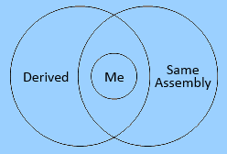
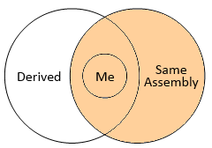
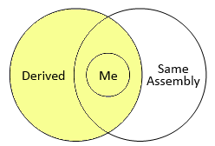
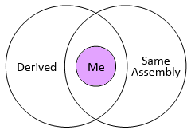
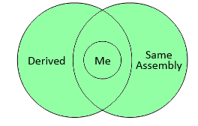
Access Modifiers Explained
public
internal
protected
private
protected internal

Slide 16
The 'this' Keyword
The keyword this inside a method points to the current instance of the class
Example:
class Dog
{
private string name;
public void PrintName()
{
Console.WriteLine(this.name);
// The same like Console.WriteLine(name);
}
}

Slide 17

Defining Simple Classes
Example

Slide 18
Task: Define a Class "Dog"
Our task is to define a simple class that represents information about a dog
The dog should have name and breed
Optional fields (could be null)
The class allows to view and modify the name and the breed at any time
The dog should be able to bark
Notes:
Mew = мяукам!

Slide 19

Defining Class Dog – Example
public class Dog {
private string name;
private string breed;
public Dog()
{
}
public Dog(string name, string breed)
{
this.name = name;
this.breed = breed;
}
(the example continues)

Slide 20

Defining Class Dog – Example (2)
public string Name
{
get { return this.name; }
set { this.name = value; }
}
public string Breed
{
get { return this.breed; }
set { this.breed = value; }
}
public void SayBau()
{
Console.WriteLine("{0} said: Bauuuuuu!",
this.name ?? "[unnamed dog]");
}
}

Slide 21

Using Classes and Objects

Slide 22


How to Use Classes (Non-Static)?
Create an instance
Initialize its properties / fields
Manipulate the instance
Read / modify its properties
Invoke methods
Handle events
Release the occupied resources
Performed automatically in most cases

Slide 23
Task: Dog Meeting
Our task is as follows:
Create 3 dogs
The first should be named “Sharo”, the second – “Rex” and the last – left without name
Put all dogs in an array
Iterate through the array elements and ask each dog to bark
Note:
Use the Dog class from the previous example!

Slide 24
Dog Meeting – Example
static void Main()
{
Console.Write("Enter first dog's name: ");
string dogName = Console.ReadLine();
Console.Write("Enter first dog's breed: ");
string dogBreed = Console.ReadLine();
// Use the Dog constructor to assign name and breed
Dog firstDog = new Dog(dogName, dogBreed);
// Use Dog's parameterless constructor
Dog secondDog = new Dog();
// Use properties to assign name and breed
Console.Write("Enter second dog's name: ");
secondDog.Name = Console.ReadLine();
Console.Write("Enter second dog's breed: ");
secondDog.Breed = Console.ReadLine();
(the example continues)

Slide 25
Dog Meeting – Example (2)
// Create a Dog with no name and breed
Dog thirdDog = new Dog();
// Save the dogs in an array
Dog[] dogs = new Dog[] {
firstDog, secondDog, thirdDog };
// Ask each of the dogs to bark
foreach(Dog dog in dogs)
{
dog.SayBau();
}
}

Slide 26

Dog Meeting
Live Demo

Slide 27
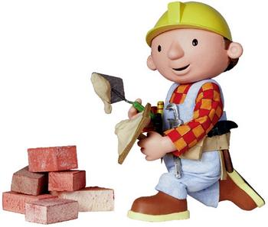
Constructors
Defining and Using Class Constructors

Slide 28
What is Constructor?
Constructors are special methods
Invoked at the time of creating a new instance of an object
Used to initialize the fields of the instance
Constructors has the same name as the class
Have no return type
Can have parameters
Can be private, protected, internal, public

Slide 29

Defining Constructors
Class Point with parameterless constructor:
public class Point
{
private int xCoord;
private int yCoord;
// Simple parameterless constructor
public Point()
{
this.xCoord = 0;
this.yCoord = 0;
}
// More code …
}

Slide 30

Defining Constructors (2)
public class Person
{
private string name;
private int age;
// Parameterless constructor
public Person()
{
this.name = null;
this.age = 0;
}
// Constructor with parameters
public Person(string name, int age)
{
this.name = name;
this.age = age;
}
// More code …
}
As rule constructors should initialize all own class fields.

Slide 31
Constructors and Initialization
Pay attention when using inline initialization!
public class AlarmClock
{
private int hours = 9; // Inline initialization
private int minutes = 0; // Inline initialization
// Parameterless constructor (intentionally left empty)
public AlarmClock()
{ }
// Constructor with parameters
public AlarmClock(int hours, int minutes)
{
this.hours = hours; // Invoked after the inline
this.minutes = minutes; // initialization!
}
// More code …
}

Slide 32

Chaining Constructors Calls
Reusing constructors (chaining)
public class Point
{
private int xCoord;
private int yCoord;
public Point() : this(0, 0) // Reuse the constructor
{
}
public Point(int xCoord, int yCoord)
{
this.xCoord = xCoord;
this.yCoord = yCoord;
}
// More code …
}

Slide 33

Constructors
Live Demo

Slide 34
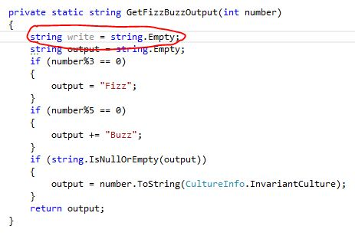


Methods
Defining and Invoking Methods

Slide 35
Methods
Methods are class members that execute some action (some code, some algorithm)
Could be static / per instance
Could be public / private / protected / …
public class Point
{
private int xCoord;
private int yCoord;
public double CalcDistance(Point p)
{
return Math.Sqrt(
(p.xCoord - this.xCoord) * (p.xCoord - this.xCoord) +
(p.yCoord - this.yCoord) * (p.yCoord - this.yCoord));
}
}

Slide 36
Using Methods
Invoking instance methods is done through the object (class instance):
class TestMethods
{
static void Main()
{
Point p1 = new Point(2, 3);
Point p2 = new Point(3, 4);
System.Console.WriteLine(p1.CalcDistance(p2));
}
}

Slide 37
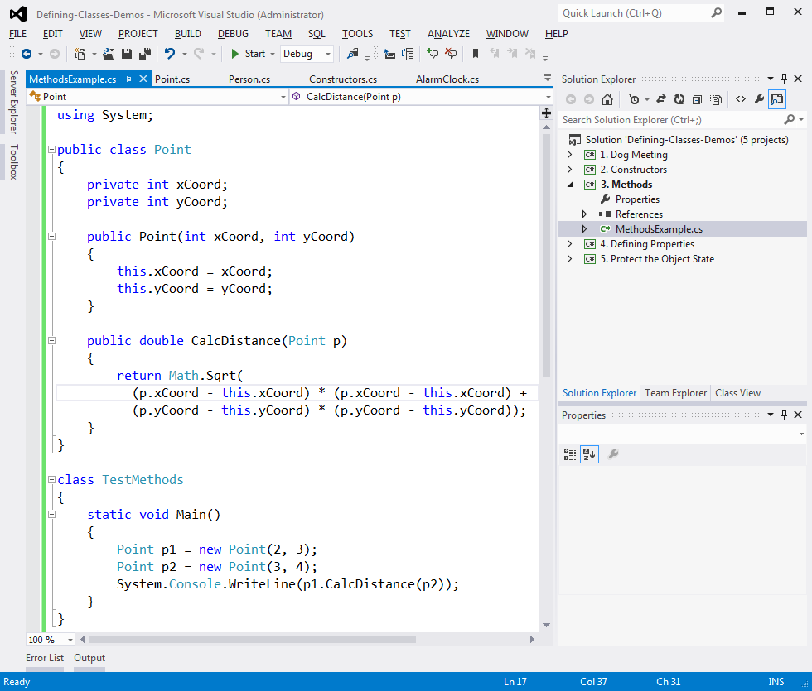
Methods
Live Demo

Slide 38
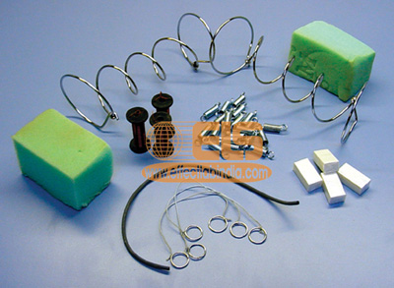
Properties
Defining and Using Properties

Slide 39
The Role of Properties
Properties expose object's data to the world
Control how the data is manipulated
Ensure the internal object state is correct
E.g. price should always be kept positive
Properties can be:
Read-only
Write-only (examples)
Read and write
Simplify the writing of code

Slide 40
Defining Properties
Properties work as a pair of methods
Getter and setter
Properties should have:
Access modifier (public, protected, etc.)
Return type
Unique name
Get and / or Set part
Can contain code processing data in specific way, e.g. apply validation

Slide 41
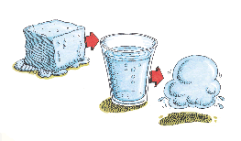
Defining Properties – Example
public class Point
{
private int xCoord;
private int yCoord;
public int XCoord
{
get { return this.xCoord; }
set { this.xCoord = value; }
}
public int YCoord
{
get { return this.yCoord; }
set { this.yCoord = value; }
}
// More code ...
}

Slide 42
Dynamic Properties
Properties are not obligatory bound to a class field – can be calculated dynamically:
public class Rectangle
{
private double width;
private double height;
// More code …
public double Area
{
get
{
return width * height;
}
}
}

Slide 43
Automatic Properties
Properties could be defined without an underlying field behind them
It is automatically created by the compiler
class UserProfile
{
public int UserId { get; set; }
public string FirstName { get; set; }
public string LastName { get; set; }
}
…
UserProfile profile = new UserProfile() {
FirstName = "Steve",
LastName = "Balmer",
UserId = 91112
};

Slide 44

Properties
Live Demo

Slide 45

Enumerations
Defining and Using Enumerated Types

Slide 46
Enumerations in C#
Enumerations are types that hold a value from a fixed set of named constants
Declared by enum keyword in C#
public enum DayOfWeek
{
Mon, Tue, Wed, Thu, Fri, Sat, Sun
}
class EnumExample
{
static void Main()
{
DayOfWeek day = DayOfWeek.Wed;
Console.WriteLine(day); // Wed
}
}

Slide 47
Enumerations – Example
public enum CoffeeSize
{
Small = 100, Normal = 150, Double = 300
}
public class Coffee
{
private CoffeeSize size;
public Coffee(CoffeeSize size)
{
this.size = size;
}
public CoffeeSize Size
{
get { return this.size; }
}
}
(the example continues)

Slide 48
Enumerations – Example (2)
public class CoffeeMachine
{
static void Main()
{
Coffee normalCoffee = new Coffee(CoffeeSize.Normal);
Coffee doubleCoffee = new Coffee(CoffeeSize.Double);
Console.WriteLine("The {0} coffee is {1} ml.",
normalCoffee.Size, (int)normalCoffee.Size);
// The Normal coffee is 150 ml.
Console.WriteLine("The {0} coffee is {1} ml.",
doubleCoffee.Size, (int)doubleCoffee.Size);
// The Double coffee is 300 ml.
}
}

Slide 49

Enumerations
Live Demo

Slide 50


Keeping the Object State Correct

Slide 51
Keep the Object State Correct
Constructors and properties can keep the object's state correct
This is known as encapsulation in OOP
Can force validation when creating / modifying the object's internal state
Constructors define which properties are mandatory and which are optional
Property setters should validate the new value before saving it in the object field
Invalid values should cause an exception

Slide 52
Keep the Object State – Example
public class Person
{
private string name;
public Person(string name)
{
this.Name = name;
}
public string Name
{
get { return this.name; }
set
{
if (String.IsNullOrEmpty(value))
throw new ArgumentException("Invalid name!");
this.name = value;
}
}
}
We have only one constructor, so we cannot create person without specifying a name.
Incorrect name cannot be assigned

Slide 53

Keeping the Object State Correct
Live Demo

Slide 54
Summary
Classes define specific structure for objects
Objects are particular instances of a class
Classes define fields, methods, constructors, properties and other members
Access modifiers limit the access to class members
Constructors are invoked when creating new class instances and initialize the object's internal state
Enumerations define a fixed set of constants
Properties expose the class data in safe, controlled way

Slide 55
Defining Classes – Part 1
http://academy.telerik.com

Slide 56




Free Trainings @ Telerik Academy
C# Programming @ Telerik Academy
csharpfundamentals.telerik.com
Telerik Software Academy
academy.telerik.com
Telerik Academy @ Facebook
facebook.com/TelerikAcademy
Telerik Software Academy Forums
forums.academy.telerik.com

