Slide 1
Philip Morris
Data Science Assessment – Taxi Mobility
By
Pravat Ranjan Pasayat

Slide 2
Agenda
Who am I?
Understanding business
Understanding data
Solution approach
Conclusion
Business goal

Slide 3







Who am I?
Software Developer
(2012-2013)
Data Analytics Consultant
(2014-2018)
Master in Business Analytics & Big Data
(2018-2019)
Data Scientist
(2019-2020)
https://www.linkedin.com/in/pravat-pasayat-b6b846ab/

Slide 4









Business Understanding – Cab Taxi
Select destination
Pickup location
Details to driver
Taxi arrival
Customer
Taxi driver
Driver’s cut
Travel to drop-off location
Commission
Payment
Admin

Slide 5
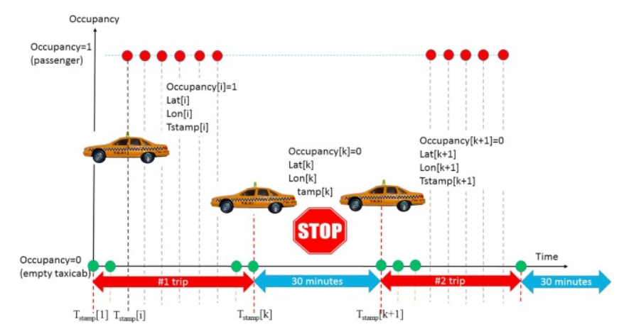
Data understanding
Mobility traces of
537 taxi cabs
Across San Francisco
Over 23 days
Details include
Latitude
Longitude
Occupancy
Time

Slide 6

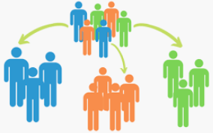

Business goal
‘Environmental suitability’ - The goal is to make the taxi cab business more environmental friendly.
Bring more awareness among drivers
Strategize targeted policies
Optimize the operational aspects
1. Impact analysis
How much value can it bring?
2. Driver segmentation
Awareness campaigns and policies should be targeted to which drivers?
3. Predictor for drivers
Can be improve the way drivers operate?

Slide 7
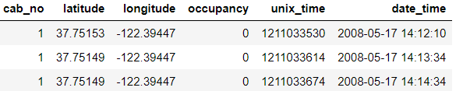
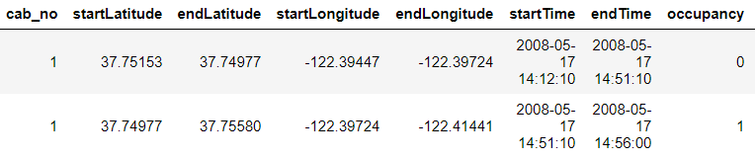
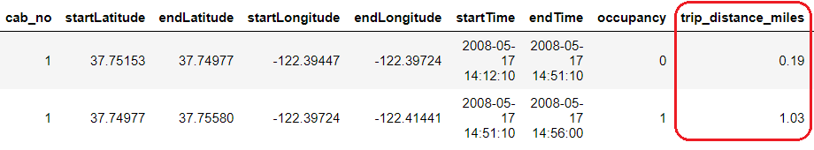
1. Impact analysis
Potential for yearly reduction in CO2 emissions
Caused by taxi cabs roaming without passengers
Considering a 10% change in cab fleet (from combustion engine to electric powered
404 grams of CO2 emission per mile
Data preparation:
Cab data segregation
Extract trip information
Feature engineering
TRIP DISTANCE (miles)*
Notes:
Assumption:
TRIP distance is calculated as straight line distance. This might be true in the case of a real trip.

Slide 8
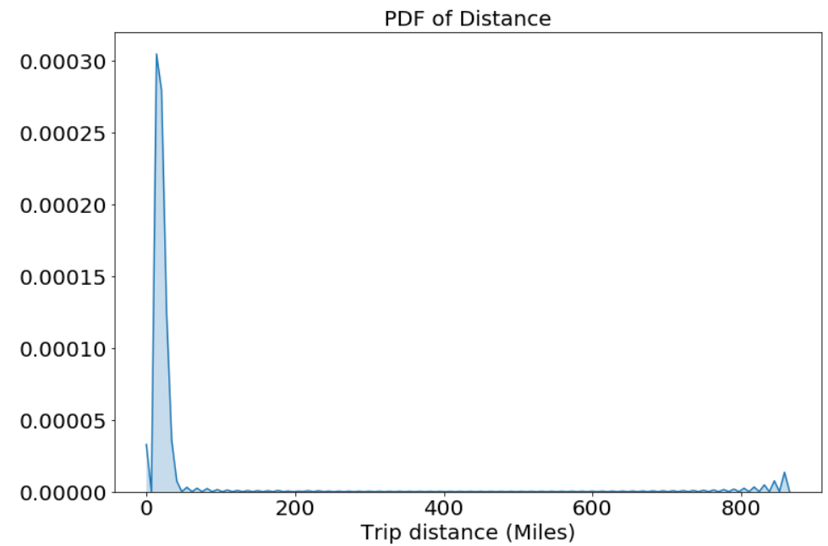
EDA:
Analysis of ‘TRIP DISTANCE’
No action taken
Trips with zero distance.
Circular trip – same pickup and drop off location
Final calculation:
CO2 emission with no fleet change:
# of taxi cabs * avg. unoccupied time per month per taxi * CO2 emission per mile * 12
CO2 emission with a fleet change:
Calculation considering a continuous decrease in the number of combustion powered taxi
46%
Notes:
Outlier analysis of ‘TRIP DISTANCE’
Till 99.9th percentile, value of trip distance when the cabs were unoccupied is (25.05 miles). On 100th percentile values are huge deviation, with a trip distance of 865.37 miles. However, the trip of that long distance is quite possible.
Expected CO2 emmisions (grams) in next year from all taxis while unoccupied (no fleet change) = 4467257387.69 = 4.4 * 10^9 grams
Expected CO2 emmisions (grams) in next year from all taxis while unoccupied (10% fleet change) = 2404178965.74 = 2.4 * 10^9 grams

Slide 9

2. Driver segmentation
“An approximate answer to a right question is far better than an right answer to an approximate question.”
-- John Tukey
Goal:
Become more environmentally sustainable through “Awareness” among drivers
“Driver Segmentation” - categorize drivers into groups with similar driving behavior
“Targeted actions” - Reward, teach or penalize drivers based on their driving behavior
But how??

Slide 10
Data preparation:
Feature engineering
TRIP DURATION (minutes)
TRIP SPEED (miles/hour)
DAY OF THE WEEK (Sunday, Monday ….)
IS WEEKEND (True/False)
PHASE OF THE DAY (Morning, Afternoon, Evening, Night)
Data cleaning
Circular trip
Pickup coordinates = Drop off coordinates
TRIP DISTANCE = 0
TRIP SPEED = 0
Action: Records are removed to avoid any bias due to incorrect facts.
Outlier removal:
TRIP DURATION:
Action: For the safety of both driver and rider, maximum allowed single trip duration is 4 hours (Assumption).
TRIP SPEED:
Action: SF allows a maximum speed of 100 miles/hour for taxi cabs (Assumption).
Notes:
Outlier analysis of ‘TRIP DURATION’
Till 99th percentile value of trip duration (235 min or approx 4 hours), everything looks legit. On 100th percentile values are huge deviation, with a trip duration of 1435 mins or 24 hours.
Let's assume that for the safety of both driver and rider, the maximum allowed single trip duration is 4 hours i.e 240 mins.
Based on this, let's remove these outliers.
Outlier analysis of ‘TRIP SPEED’
Here, 100th percentile value of a speed is 41940.0 miles/hr which is BIZZARE. Furthermore, zero speed in a trip is impossible. The 99.6th percentile value of speed is 80 miles/hr, which is possible.
SF allows a maximum speed of 100 miles/hour for taxi cabs (Assumption). So, we are removing all the data points where speed is greater than 100 miles/hr.
Outlier analysis of ‘TRIP DISTANCE’
After removing huge outliers from features such as trip duration and speed, it seems that the outliers for the distance feature have been automatically removed. The distance data in the quantiles looks legit. So, we don't need to remove any outliers.

Slide 11
EDA:
Occupancy vs Trip distance
Avg. trip distance when occupied is 2.5 miles and when unoccupied is 1.5 miles.
Occupancy vs Trip duration
Avg. trip duration when occupied is around 11 mins. and when unoccupied is 16.5 mins.
Occupancy vs Trip speed
Avg. trip speed when occupied is around 12.6 miles/hr and when unoccupied is 7.3 miles/hr.
Demand across different days
Sunday, Saturday, Monday and Friday see highest demand for taxis.
Demand in weekend
Daily demand of taxis is 1.5 times over the weekends compared to weekdays.
Demand in different phase of the day
Demand is the higher during NIGHT (from 21:00 till 5:00) and MORNING (from 5:00 till 12:00) and least during AFTERNOON (from 12:00 till 17:00) and EVENING (from 17:00 till 21:00).
Notes:
Avg. distance travelled by a taxi when occupied is 2.5 miles and when unoccupied is 1.5 miles.
Average trip duration of a taxi when occupied is around 11 minutes and when unoccupied is 16.5 minutes. This means that the taxis spend around 1.5 times the time they spend with passengers.

Slide 12
Data transformation:
Trip data to driver characteristics
Driver behavior when with passenger and without passenger.
Characteristics such as
# of trips
distance-duration-speed when occupied
distance-duration-speed when unoccupied
demand fulfillment index
Data skewness
Most features are right/positive skewed.
Moderate skewness allowed (-1 <= skewness <= 1)
Logarithmic, square root and cube root transformation used
Data standardization
Clustering technique is sensitive to scale.
Unify the scale across numeric features.
Standard scaler used (Mean = 0, SD = 1)
Notes:
Driver characteristics:
trip_count,
mean_trip_distance_occupied, mean_trip_duration_occupied, mean_speed_occupied
mean_trip_distance_unoccupied, mean_trip_duration_unoccupied, mean_speed_unoccupied
demand_fulfilment_index

Slide 13
Machine Leaning Modeling:
Model used: K-Means
Metric used: Cluster inertia (intra-cluster distance)
Model optimization: Elbow curve technique (optimum cluster no.)
Model Input: Trip count, speed occupied, distance unoccupied, demand fulfillment index
Model output: Cluster labels
Result interpretation:
Showstopper
Standard
Backbencher
Smallest group
Less # of trips
Small distance trips
Safer for passenger
Energy efficient
High demand fulfilment
Largest group
High # of trips
Avg. coverage range
Avg. ride speed
Avg. energy efficiency
Average demand fulfilment
Small group
High # of trips
High coverage range
High ride speed
Energy inefficient
Low demand fulfilment
Notes:
Driver characteristics:
trip_count,
mean_trip_distance_occupied, mean_trip_duration_occupied, mean_speed_occupied
mean_trip_distance_unoccupied, mean_trip_duration_unoccupied, mean_speed_unoccupied
demand_fulfilment_index

Slide 14


3. Predictor for taxi drivers
Goal:
Become more environmentally sustainable by “Process Optimization”
How can we help drivers become more energy efficient by advising them on cab demand?
“Region Segmentation” – Divide SF into multiple regions based on cab’s coverage and reachability.
“Time window” – Driver would like to know about the demand every 10 minutes.
“Predictor” - For a given location in SF, our goal is to predict the number of pickups in next 10 minutes.
Constraints:
Latency: Medium latency requirement (delay of few seconds)
Interpretability: No interpretability required

Slide 15
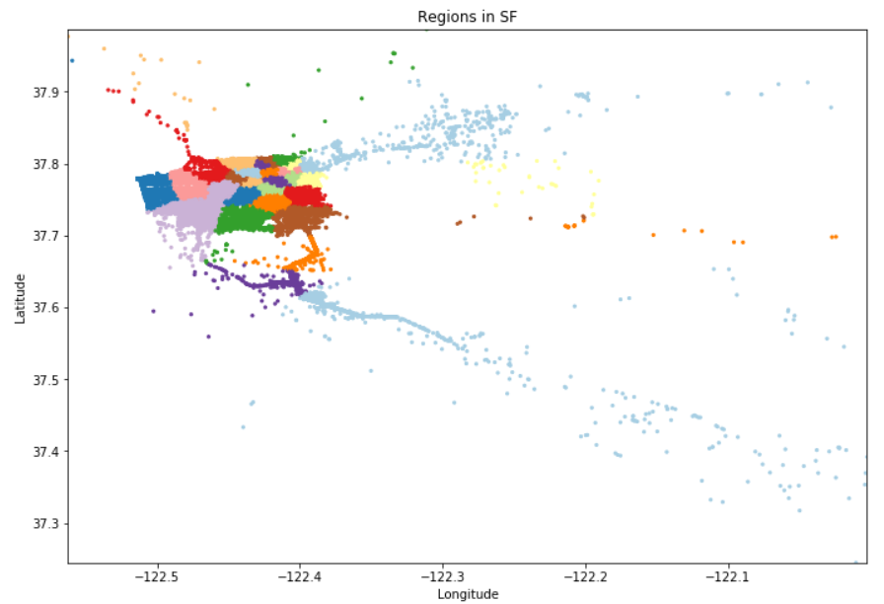
Data preparation & Feature engineering:
Region segmentation
Application of KMeans clustering
Use of pickup coordinates as input
Output of 30 clusters i.e. regions within San Francisco
* Assumption: Inter-cluster distance to be less 0.5 miles
Time-binning
Divide the time into 10 minute time-bins
Assign each trip to appropriate time-bin based on pickup time
Fill missing values
Cluster time-bins with no trip is assigned zero value.
Notes:
Assumption:
Taxi’s average speed = 10.2 miles/hour
Distance covered in 10 mins = approx. 2 miles
Inter cluster distance of 0.5 miles, allows taxi drivers to travel to nearby high demand regions within 10 minutes.

Slide 16
Data transformation for modeling:
Data aggregation
Trip data aggregated per cluster per time-bin
Adding observations from previous time-bins as new features
Previous 5 time-bins
One-hot encoding
Handling categorical variables
Day of the week, IsWeekend
Train test split
80-20 Train and test
Split per region cluster
Ordered date-wise (not random)
Notes:
Previous 5 time-bins: Most recent
we know intuitively that the future is more likely to be similar to the latest values and less similar to the older values. Weighted importance converts this analogy into a mathematical relationship giving the highest weight while computing the averages to the latest previous value and decreasing weights to the subsequent older ones

Slide 17
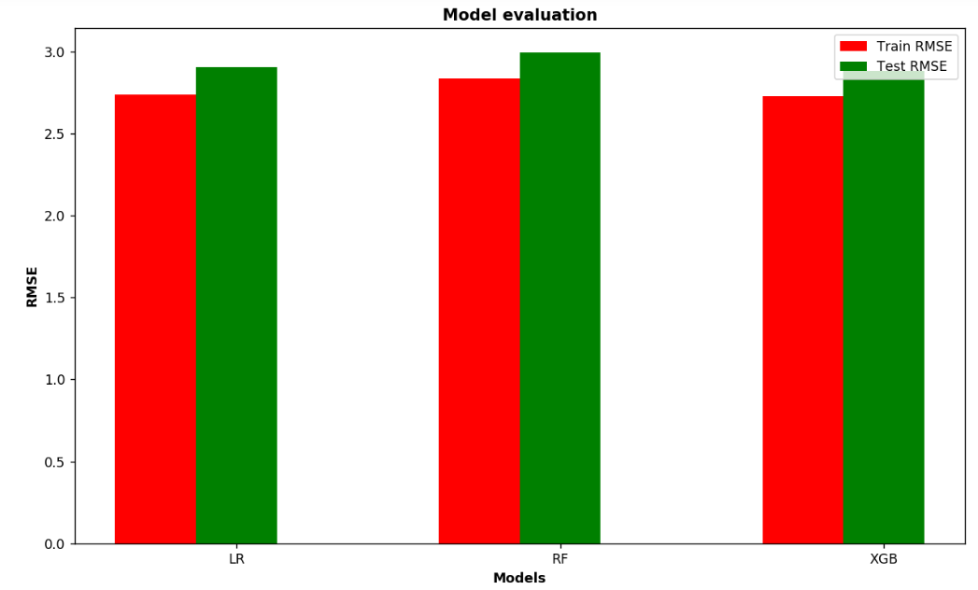
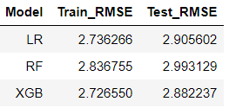
Machine Leaning Modeling:
Model used: Linear regression, Random forest regressor, XGBoost regressor
Metric used: Root mean Square Error (RMSE)
Model optimization: Hyper-parameter optimization (Cross-validation using grid search)
Model Input: Previous 5 time-bin observations, Region, Day of week, IsWeekend, Phase of the day
Model output: Predicted cab rides in next 10 mins per region
Evaluation of models:
Best model: XGBoost regressor
Criteria: Model overfitting, Test RMSE

Slide 18
Thanks for your attention
Questions?
Pasayat.pravat@gmail.com

