Slide 1
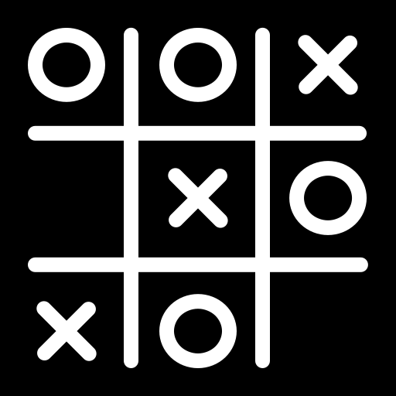
Python TIC-TAC-TOE GUI
By: Ethan Collins

Slide 2
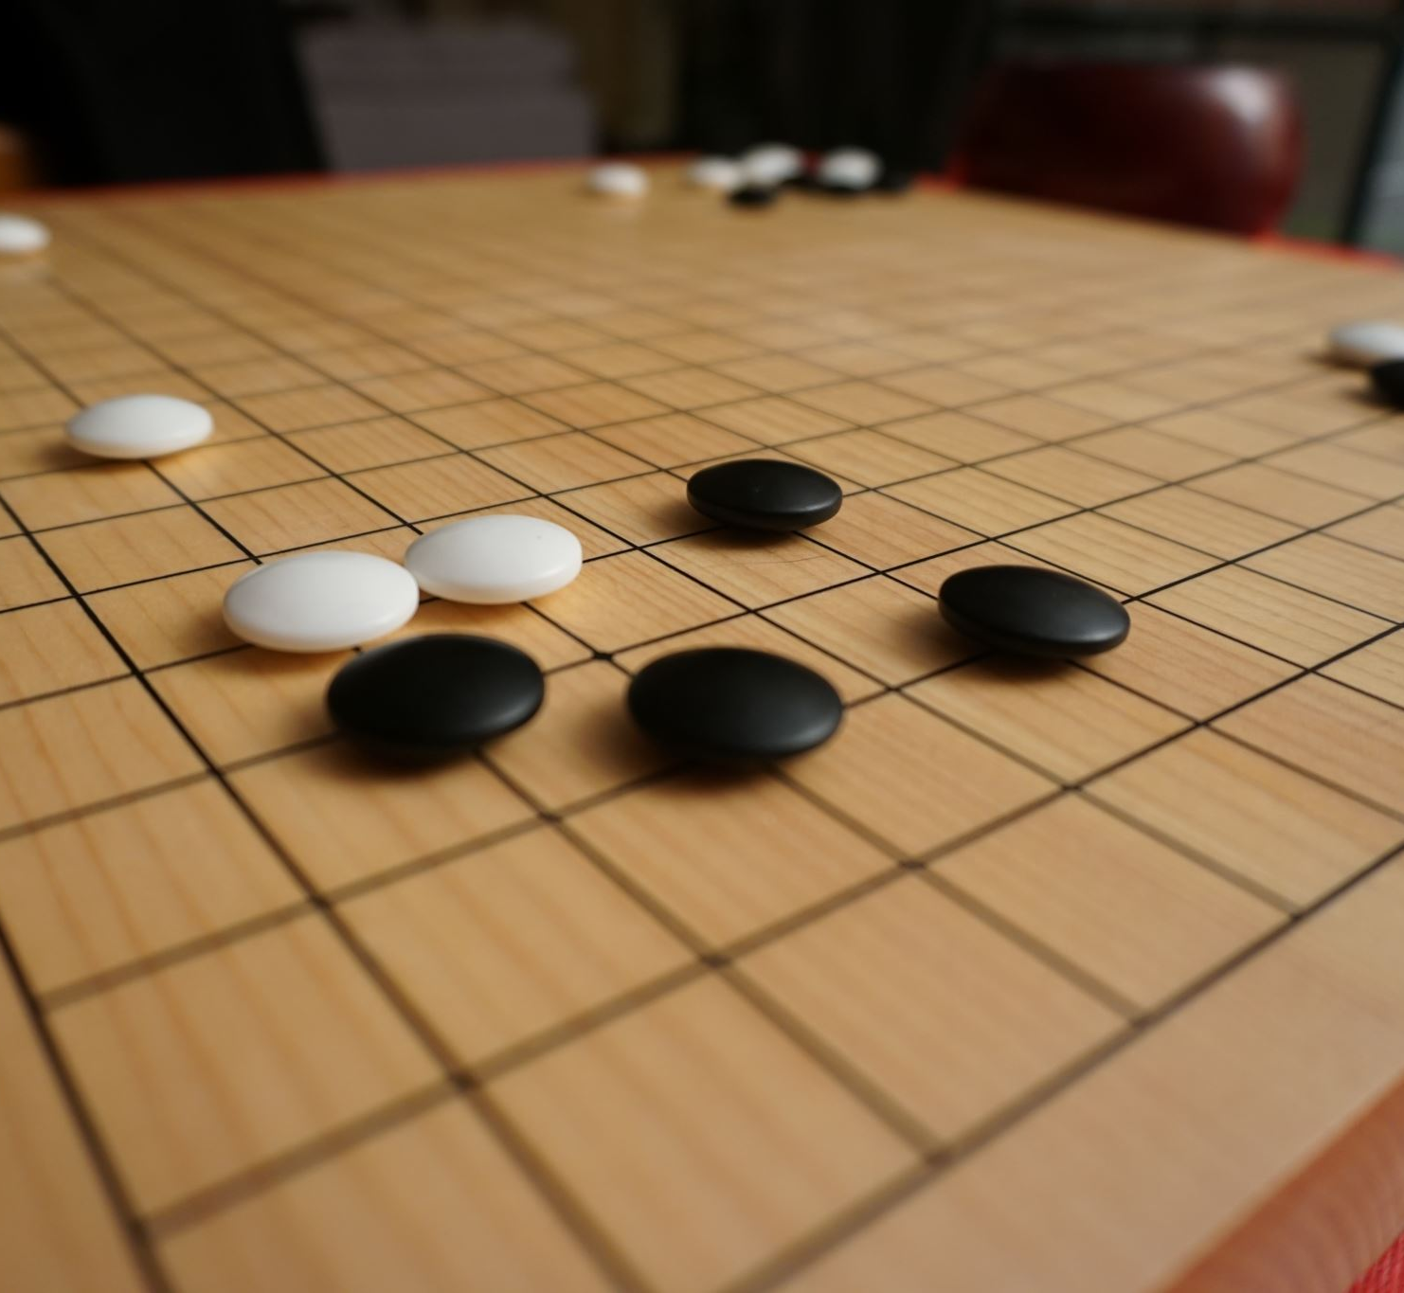
WHAT IS THE PROJECT?
This project is a refinement of the previous Tic-Tac-Toe project using the Tkinter library in Python. The goal is to create a graphical user interface (GUI) for Tic-Tac-Toe allowing two players to take turns making moves and determining the winner or a tie game.

Slide 3

WHAT'S THE PROBLEM?
The problem is to create a playable Tic-Tac-Toe game with a GUI in which :
Two players can take turns making moves.
The game declares a tie if the board is full, and no player has won

Slide 4
TIC-TAC-TOE CLASS: TICTACTOE_GUI
__init__(self, root): Initializes the GUI, sets up the game board buttons, and initializes game-related attributes.
on_click(self, position): Handles button clicks, updates the game state, and checks for a winner or a tie.
place_marker(self, position): Places the current player's marker on the game board.
update_button(self, position): Updates the button text with the player's marker and sets the color based on the marker.
switch_turn(self): Switches the turn between "player 1" and "player 2."
reset_game(self): Resets the game when it's over, allowing players to play again or exit the application.

Slide 5
TIC-TAC-TOE FUNCTIONS
marker_choice:
This function is assumed to be defined in the TicTacToe_finished module.
It determines the markers for player 1 and player 2.
Returns the markers for player 1 and player 2.
choose_first:
This function is assumed to be defined in the TicTacToe_finished module.
It determines which player goes first.
Returns the string "player 1" or "player 2."
has_won:
This function is assumed to be defined in the TicTacToe_finished module.
It likely checks if a player has won the game based on the current state of the game board.
Returns a boolean indicating whether a player has won.
board_isfull:
This function is assumed to be defined in the TicTacToe_finished module.
It likely checks if the game board is full (no empty spaces remaining).
Returns a boolean indicating whether the board is full.
replay:
This function is assumed to be defined in the TicTacToe_finished module.
It likely prompts the players if they want to play again.
Returns a boolean indicating whether the players want to replay.
main:
The main function that sets up the Tkinter window, initializes the TicTacToeGUI object, and starts the Tkinter main loop.

Slide 6
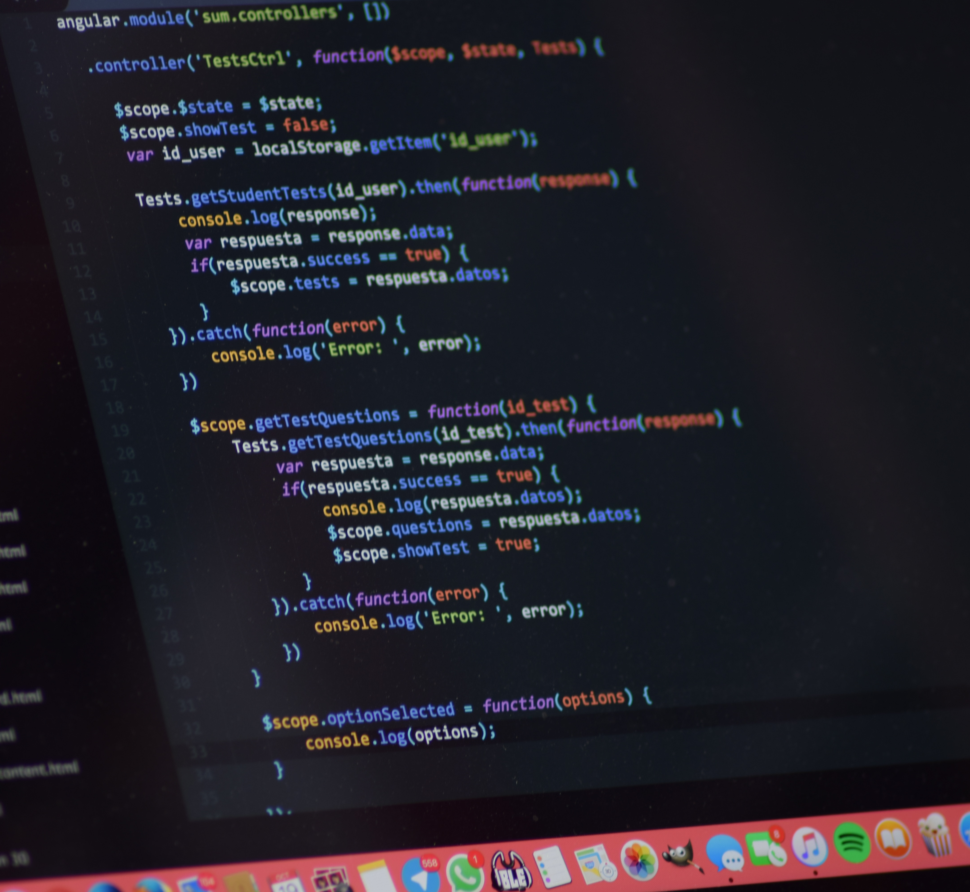
INSTRUCTIONS:
Run the Program:
Execute the program by running the script in a Python environment.
Player Markers:
"Player 1" or "Player 2" will select the marker of (❌ or 🔵).
First Move:
The program will announce which player goes first ("Player 1" or "Player 2").
Tic Tac Toe GUI:
A graphical user interface (GUI) window will appear titled "Tic Tac Toe."
Game Board:
The Tic Tac Toe grid consists of nine buttons arranged in a 3x3 grid.
Gameplay:
Players take turns clicking on the buttons to place their markers.
Winning Condition:
The game checks after each move for a winning condition (three markers in a row, horizontally, vertically, or diagonally).
Winner Announcement:
If a player wins, a pop-up message will declare the winner ("Player 1" or "Player 2").
Tie Game:(Conditional)
If the board is full and no player has won, a tie game message will appear.
Replay Option: (Optional)
After each game (win or tie), the program will prompt whether you want to play again.
Exit Game:
If you choose not to replay, the program will print a "Thank you. :) Goodbye!" message and close the GUI.

Slide 7
PROBLEMS ENCOUNTERED:
Calling functions from original Tic-tac-toe Project to be used in the GUI
Trying to decide how to add the blue aspect to the program

Slide 8

SOMETHING OLD:
The old content from the course I am choosing is the original Tic-tac-toe project. I have called functions from it to do help the GUI that I created for the final project.
The functions called from the original program were marker_choice, choose_first , has_won, board_isfull, replay
This Photo by Unknown author is licensed under CC BY.

Slide 9
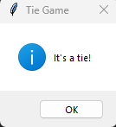
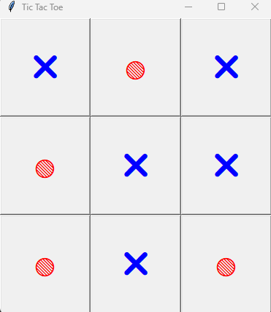
SOMETHING NEW:
The graphical user interface (GUI) is the new program I created for the final project.
The GUI creates a better ease of use for users to play TicTacToe without having interact with the terminal as much.
This is an example of the GUI being used:

Slide 10
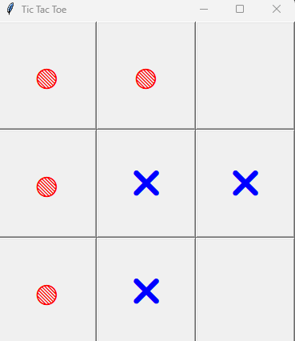
SOMETHING BLUE:
I opted to implement a color-coded scheme in the graphical user interface (GUI), assigning the color blue to the 'X' player and red to the 'O' player.
marker_text: Determines the text that will be displayed on the button. If the marker on the board at the given position matches self.player1_marker, the text will be '❌' (cross). Otherwise, it will be '🔵' (blue circle).
marker_text '❌', the color is set to 'blue'; otherwise, it's set to 'red'.

