Slide 1
Evaluation scope and metric correction
Population | Cases | Meaning
Candle / cashew replay | 350 | Previously exposed published test cases
New-category development | 255 | PCB1, capsules, chewinggum published test partition
New-category final | 255 | Separate frozen partition from the same published data
All fixed methods | 88 rows | Eleven methods on each of eight population groups
Historical AU-PRO values are invalid for comparison
Corrected scoring reuses unchanged baseline maps. Original papers and slides remain preserved with a separate correction notice.
No physical part or lot independence is established. Reviews remain unresolved. Candidate remains local.
REFLEX Verified research evidence
1
Notes:
Frozen REFLEX v2 results, 24–25 October 2026. Source ledger: sources/evidence.json. Source CSVs retain full precision. VisA: Amazon Science / Zou et al., ECCV2022, CC BY4.0, https://github.com/amazon-science/spot-diff. Historical AU-PRO is superseded by independently checked v2 scoring. Publisher byte parity remains blocked. No factory validation or method superiority follows.

Slide 2
Primary outcomes by population
Population / method | Detected / defects | False clears | False alerts / normals | Reviews / cases
replay / v1 | 112 / 200 | 88 / 200 | 5 / 150 | 0 / 350
replay / primary | 155 / 200 | 41 / 200 | 6 / 150 | 4 / 350
development / v1 | 94 / 150 | 56 / 150 | 4 / 105 | 0 / 255
development / primary | 101 / 150 | 44 / 150 | 9 / 105 | 10 / 255
final / v1 | 92 / 150 | 58 / 150 | 9 / 105 | 0 / 255
final / primary | 105 / 150 | 42 / 150 | 14 / 105 | 11 / 255
Counts use all original denominators. Improved detected count can coexist with lower AUROC and more false alerts.
REFLEX Verified research evidence
2
Notes:
Frozen REFLEX v2 results, 24–25 October 2026. Source ledger: sources/evidence.json. Source CSVs retain full precision. VisA: Amazon Science / Zou et al., ECCV2022, CC BY4.0, https://github.com/amazon-science/spot-diff. Historical AU-PRO is superseded by independently checked v2 scoring. Publisher byte parity remains blocked. No factory validation or method superiority follows.

Slide 3
Normal false-alert burden
Normal reviews add workload beyond these false alerts. A normal-calibration p95 threshold does not guarantee future 5% FPR.
REFLEX Verified research evidence
3
Notes:
Frozen REFLEX v2 results, 24–25 October 2026. Source ledger: sources/evidence.json. Source CSVs retain full precision. VisA: Amazon Science / Zou et al., ECCV2022, CC BY4.0, https://github.com/amazon-science/spot-diff. Historical AU-PRO is superseded by independently checked v2 scoring. Publisher byte parity remains blocked. No factory validation or method superiority follows.

Slide 4
candle: replay fixed methods
N=200. All fixed seeds remain visible. Raw score recall precedes the review/detail policy. No test winner is promoted.
REFLEX Verified research evidence
4
Notes:
Frozen REFLEX v2 results, 24–25 October 2026. Source ledger: sources/evidence.json. Source CSVs retain full precision. VisA: Amazon Science / Zou et al., ECCV2022, CC BY4.0, https://github.com/amazon-science/spot-diff. Historical AU-PRO is superseded by independently checked v2 scoring. Publisher byte parity remains blocked. No factory validation or method superiority follows.

Slide 5
cashew: replay fixed methods
N=150. All fixed seeds remain visible. Raw score recall precedes the review/detail policy. No test winner is promoted.
REFLEX Verified research evidence
5
Notes:
Frozen REFLEX v2 results, 24–25 October 2026. Source ledger: sources/evidence.json. Source CSVs retain full precision. VisA: Amazon Science / Zou et al., ECCV2022, CC BY4.0, https://github.com/amazon-science/spot-diff. Historical AU-PRO is superseded by independently checked v2 scoring. Publisher byte parity remains blocked. No factory validation or method superiority follows.

Slide 6
pcb1: development fixed methods
N=100. All fixed seeds remain visible. Raw score recall precedes the review/detail policy. No test winner is promoted.
REFLEX Verified research evidence
6
Notes:
Frozen REFLEX v2 results, 24–25 October 2026. Source ledger: sources/evidence.json. Source CSVs retain full precision. VisA: Amazon Science / Zou et al., ECCV2022, CC BY4.0, https://github.com/amazon-science/spot-diff. Historical AU-PRO is superseded by independently checked v2 scoring. Publisher byte parity remains blocked. No factory validation or method superiority follows.

Slide 7
pcb1: final fixed methods
N=100. All fixed seeds remain visible. Raw score recall precedes the review/detail policy. No test winner is promoted.
REFLEX Verified research evidence
7
Notes:
Frozen REFLEX v2 results, 24–25 October 2026. Source ledger: sources/evidence.json. Source CSVs retain full precision. VisA: Amazon Science / Zou et al., ECCV2022, CC BY4.0, https://github.com/amazon-science/spot-diff. Historical AU-PRO is superseded by independently checked v2 scoring. Publisher byte parity remains blocked. No factory validation or method superiority follows.

Slide 8
capsules: development fixed methods
N=80. All fixed seeds remain visible. Raw score recall precedes the review/detail policy. No test winner is promoted.
REFLEX Verified research evidence
8
Notes:
Frozen REFLEX v2 results, 24–25 October 2026. Source ledger: sources/evidence.json. Source CSVs retain full precision. VisA: Amazon Science / Zou et al., ECCV2022, CC BY4.0, https://github.com/amazon-science/spot-diff. Historical AU-PRO is superseded by independently checked v2 scoring. Publisher byte parity remains blocked. No factory validation or method superiority follows.

Slide 9
capsules: final fixed methods
N=80. All fixed seeds remain visible. Raw score recall precedes the review/detail policy. No test winner is promoted.
REFLEX Verified research evidence
9
Notes:
Frozen REFLEX v2 results, 24–25 October 2026. Source ledger: sources/evidence.json. Source CSVs retain full precision. VisA: Amazon Science / Zou et al., ECCV2022, CC BY4.0, https://github.com/amazon-science/spot-diff. Historical AU-PRO is superseded by independently checked v2 scoring. Publisher byte parity remains blocked. No factory validation or method superiority follows.

Slide 10
chewinggum: development fixed methods
N=75. All fixed seeds remain visible. Raw score recall precedes the review/detail policy. No test winner is promoted.
REFLEX Verified research evidence
10
Notes:
Frozen REFLEX v2 results, 24–25 October 2026. Source ledger: sources/evidence.json. Source CSVs retain full precision. VisA: Amazon Science / Zou et al., ECCV2022, CC BY4.0, https://github.com/amazon-science/spot-diff. Historical AU-PRO is superseded by independently checked v2 scoring. Publisher byte parity remains blocked. No factory validation or method superiority follows.

Slide 11
chewinggum: final fixed methods
N=75. All fixed seeds remain visible. Raw score recall precedes the review/detail policy. No test winner is promoted.
REFLEX Verified research evidence
11
Notes:
Frozen REFLEX v2 results, 24–25 October 2026. Source ledger: sources/evidence.json. Source CSVs retain full precision. VisA: Amazon Science / Zou et al., ECCV2022, CC BY4.0, https://github.com/amazon-science/spot-diff. Historical AU-PRO is superseded by independently checked v2 scoring. Publisher byte parity remains blocked. No factory validation or method superiority follows.

Slide 12
Localization on the common evaluation grid
Category / population | v1 pixel AP | Primary pixel AP | v1 IoU | Primary IoU | Primary AU-PRO
candle replay | 0.163 | 0.175 | 0.055 | 0.077 | 0.931
cashew replay | 0.521 | 0.549 | 0.234 | 0.270 | 0.913
pcb1 development | 0.847 | 0.839 | 0.147 | 0.204 | 0.791
pcb1 final | 0.833 | 0.823 | 0.139 | 0.187 | 0.836
capsules development | 0.188 | 0.320 | 0.170 | 0.204 | 0.582
capsules final | 0.399 | 0.499 | 0.244 | 0.336 | 0.506
chewinggum development | 0.475 | 0.517 | 0.087 | 0.134 | 0.779
chewinggum final | 0.484 | 0.555 | 0.072 | 0.105 | 0.843
Full-frame max-side256 maps include normal images. AU-PRO uses corrected exact events, eight-connected regions and FPR≤0.30.
REFLEX Verified research evidence
12
Notes:
Frozen REFLEX v2 results, 24–25 October 2026. Source ledger: sources/evidence.json. Source CSVs retain full precision. VisA: Amazon Science / Zou et al., ECCV2022, CC BY4.0, https://github.com/amazon-science/spot-diff. Historical AU-PRO is superseded by independently checked v2 scoring. Publisher byte parity remains blocked. No factory validation or method superiority follows.

Slide 13
Review routing and crop contribution
Category / population | Active crops | ROI-off / chosen false clears | Chosen added true alerts | Chosen added false alerts
candle replay | 16 | 18 / 18 | 9 | 3
capsules development | 0 | 36 / 36 | 0 | 0
capsules final | 0 | 34 / 34 | 0 | 0
cashew replay | 0 | 23 / 23 | 0 | 0
chewinggum development | 3 | 1 / 1 | 0 | 0
chewinggum final | 1 | 2 / 2 | 0 | 0
pcb1 development | 12 | 7 / 7 | 5 | 0
pcb1 final | 14 | 6 / 6 | 3 | 1
Chosen, random and ROI-off have identical false-clear case sets in every group. Crops resolve reviews into positive findings and false alerts.
REFLEX Verified research evidence
13
Notes:
Frozen REFLEX v2 results, 24–25 October 2026. Source ledger: sources/evidence.json. Source CSVs retain full precision. VisA: Amazon Science / Zou et al., ECCV2022, CC BY4.0, https://github.com/amazon-science/spot-diff. Historical AU-PRO is superseded by independently checked v2 scoring. Publisher byte parity remains blocked. No factory validation or method superiority follows.

Slide 14
Inspection controls: replay
Category / policy | Extra calls | Detected | False alerts | False clears | Reviews
candle static | 0 | 69 | 3 | 31 | 0
candle chosen | 16 | 78 | 6 | 18 | 4
candle random | 16 | 74 | 4 | 18 | 10
candle quality off | 16 | 78 | 6 | 18 | 4
candle ROI off | 0 | 69 | 3 | 18 | 16
cashew static | 0 | 77 | 0 | 23 | 0
cashew chosen | 0 | 77 | 0 | 23 | 0
cashew random | 0 | 77 | 0 | 23 | 0
cashew quality off | 0 | 77 | 0 | 23 | 0
cashew ROI off | 0 | 77 | 0 | 23 | 0
Counterfactual outcomes reuse one full pass and a four-tile batch. Chosen/random logical policies each use one equal-size crop.
REFLEX Verified research evidence
14
Notes:
Frozen REFLEX v2 results, 24–25 October 2026. Source ledger: sources/evidence.json. Source CSVs retain full precision. VisA: Amazon Science / Zou et al., ECCV2022, CC BY4.0, https://github.com/amazon-science/spot-diff. Historical AU-PRO is superseded by independently checked v2 scoring. Publisher byte parity remains blocked. No factory validation or method superiority follows.

Slide 15
Full image and detail fusion: replay
Category / control | Image AUROC | Image AP | Pixel AP | Pixel IoU | Extra calls / case
candle chosen | 0.954 | 0.954 | 0.189 | 0.073 | 1
candle random | 0.953 | 0.954 | 0.180 | 0.073 | 1
candle all4 | 0.959 | 0.958 | 0.191 | 0.066 | 4
cashew chosen | 0.958 | 0.980 | 0.548 | 0.262 | 1
cashew random | 0.967 | 0.985 | 0.549 | 0.263 | 1
cashew all4 | 0.961 | 0.981 | 0.547 | 0.250 | 4
Maximum normalized component score. The union has no joint 5% FPR calibration. Crops use original available pixels, not a new physical view.
REFLEX Verified research evidence
15
Notes:
Frozen REFLEX v2 results, 24–25 October 2026. Source ledger: sources/evidence.json. Source CSVs retain full precision. VisA: Amazon Science / Zou et al., ECCV2022, CC BY4.0, https://github.com/amazon-science/spot-diff. Historical AU-PRO is superseded by independently checked v2 scoring. Publisher byte parity remains blocked. No factory validation or method superiority follows.

Slide 16
Inspection controls: development 1
Category / policy | Extra calls | Detected | False alerts | False clears | Reviews
pcb1 static | 0 | 33 | 6 | 17 | 0
pcb1 chosen | 12 | 38 | 6 | 7 | 7
pcb1 random | 12 | 37 | 6 | 7 | 8
pcb1 quality off | 12 | 38 | 6 | 7 | 7
pcb1 ROI off | 0 | 33 | 6 | 7 | 12
capsules static | 0 | 14 | 2 | 36 | 0
capsules chosen | 0 | 14 | 2 | 36 | 0
capsules random | 0 | 14 | 2 | 36 | 0
capsules quality off | 0 | 14 | 2 | 36 | 0
capsules ROI off | 0 | 14 | 2 | 36 | 0
Counterfactual outcomes reuse one full pass and a four-tile batch. Chosen/random logical policies each use one equal-size crop.
REFLEX Verified research evidence
16
Notes:
Frozen REFLEX v2 results, 24–25 October 2026. Source ledger: sources/evidence.json. Source CSVs retain full precision. VisA: Amazon Science / Zou et al., ECCV2022, CC BY4.0, https://github.com/amazon-science/spot-diff. Historical AU-PRO is superseded by independently checked v2 scoring. Publisher byte parity remains blocked. No factory validation or method superiority follows.

Slide 17
Inspection controls: development 2
Category / policy | Extra calls | Detected | False alerts | False clears | Reviews
chewinggum static | 0 | 49 | 1 | 1 | 0
chewinggum chosen | 3 | 49 | 1 | 1 | 3
chewinggum random | 3 | 49 | 1 | 1 | 3
chewinggum quality off | 3 | 49 | 1 | 1 | 3
chewinggum ROI off | 0 | 49 | 1 | 1 | 3
Counterfactual outcomes reuse one full pass and a four-tile batch. Chosen/random logical policies each use one equal-size crop.
REFLEX Verified research evidence
17
Notes:
Frozen REFLEX v2 results, 24–25 October 2026. Source ledger: sources/evidence.json. Source CSVs retain full precision. VisA: Amazon Science / Zou et al., ECCV2022, CC BY4.0, https://github.com/amazon-science/spot-diff. Historical AU-PRO is superseded by independently checked v2 scoring. Publisher byte parity remains blocked. No factory validation or method superiority follows.

Slide 18
Full image and detail fusion: development
Category / control | Image AUROC | Image AP | Pixel AP | Pixel IoU | Extra calls / case
pcb1 chosen | 0.928 | 0.921 | 0.856 | 0.189 | 1
pcb1 random | 0.912 | 0.906 | 0.844 | 0.190 | 1
pcb1 all4 | 0.925 | 0.920 | 0.860 | 0.160 | 4
capsules chosen | 0.702 | 0.829 | 0.409 | 0.236 | 1
capsules random | 0.719 | 0.827 | 0.376 | 0.228 | 1
capsules all4 | 0.699 | 0.820 | 0.450 | 0.229 | 4
chewinggum chosen | 0.990 | 0.996 | 0.531 | 0.132 | 1
chewinggum random | 0.990 | 0.996 | 0.522 | 0.131 | 1
chewinggum all4 | 0.996 | 0.998 | 0.534 | 0.124 | 4
Maximum normalized component score. The union has no joint 5% FPR calibration. Crops use original available pixels, not a new physical view.
REFLEX Verified research evidence
18
Notes:
Frozen REFLEX v2 results, 24–25 October 2026. Source ledger: sources/evidence.json. Source CSVs retain full precision. VisA: Amazon Science / Zou et al., ECCV2022, CC BY4.0, https://github.com/amazon-science/spot-diff. Historical AU-PRO is superseded by independently checked v2 scoring. Publisher byte parity remains blocked. No factory validation or method superiority follows.

Slide 19
Inspection controls: final 1
Category / policy | Extra calls | Detected | False alerts | False clears | Reviews
pcb1 static | 0 | 38 | 8 | 12 | 0
pcb1 chosen | 14 | 41 | 9 | 6 | 10
pcb1 random | 14 | 41 | 9 | 6 | 10
pcb1 quality off | 14 | 41 | 9 | 6 | 10
pcb1 ROI off | 0 | 38 | 8 | 6 | 14
capsules static | 0 | 16 | 1 | 34 | 0
capsules chosen | 0 | 16 | 1 | 34 | 0
capsules random | 0 | 16 | 1 | 34 | 0
capsules quality off | 0 | 16 | 1 | 34 | 0
capsules ROI off | 0 | 16 | 1 | 34 | 0
Counterfactual outcomes reuse one full pass and a four-tile batch. Chosen/random logical policies each use one equal-size crop.
REFLEX Verified research evidence
19
Notes:
Frozen REFLEX v2 results, 24–25 October 2026. Source ledger: sources/evidence.json. Source CSVs retain full precision. VisA: Amazon Science / Zou et al., ECCV2022, CC BY4.0, https://github.com/amazon-science/spot-diff. Historical AU-PRO is superseded by independently checked v2 scoring. Publisher byte parity remains blocked. No factory validation or method superiority follows.

Slide 20
Inspection controls: final 2
Category / policy | Extra calls | Detected | False alerts | False clears | Reviews
chewinggum static | 0 | 48 | 4 | 2 | 0
chewinggum chosen | 1 | 48 | 4 | 2 | 1
chewinggum random | 1 | 48 | 4 | 2 | 1
chewinggum quality off | 1 | 48 | 4 | 2 | 1
chewinggum ROI off | 0 | 48 | 4 | 2 | 1
Counterfactual outcomes reuse one full pass and a four-tile batch. Chosen/random logical policies each use one equal-size crop.
REFLEX Verified research evidence
20
Notes:
Frozen REFLEX v2 results, 24–25 October 2026. Source ledger: sources/evidence.json. Source CSVs retain full precision. VisA: Amazon Science / Zou et al., ECCV2022, CC BY4.0, https://github.com/amazon-science/spot-diff. Historical AU-PRO is superseded by independently checked v2 scoring. Publisher byte parity remains blocked. No factory validation or method superiority follows.

Slide 21
Full image and detail fusion: final
Category / control | Image AUROC | Image AP | Pixel AP | Pixel IoU | Extra calls / case
pcb1 chosen | 0.899 | 0.892 | 0.836 | 0.175 | 1
pcb1 random | 0.901 | 0.900 | 0.830 | 0.176 | 1
pcb1 all4 | 0.910 | 0.904 | 0.841 | 0.152 | 4
capsules chosen | 0.674 | 0.819 | 0.562 | 0.349 | 1
capsules random | 0.719 | 0.837 | 0.547 | 0.347 | 1
capsules all4 | 0.724 | 0.849 | 0.634 | 0.348 | 4
chewinggum chosen | 0.994 | 0.997 | 0.560 | 0.102 | 1
chewinggum random | 0.985 | 0.994 | 0.559 | 0.102 | 1
chewinggum all4 | 0.988 | 0.995 | 0.563 | 0.097 | 4
Maximum normalized component score. The union has no joint 5% FPR calibration. Crops use original available pixels, not a new physical view.
REFLEX Verified research evidence
21
Notes:
Frozen REFLEX v2 results, 24–25 October 2026. Source ledger: sources/evidence.json. Source CSVs retain full precision. VisA: Amazon Science / Zou et al., ECCV2022, CC BY4.0, https://github.com/amazon-science/spot-diff. Historical AU-PRO is superseded by independently checked v2 scoring. Publisher byte parity remains blocked. No factory validation or method superiority follows.

Slide 22
Derived robustness: candle
replay population. Dependent stress copies add no independent cases. Defect downsize uses evaluator-only masks.
REFLEX Verified research evidence
22
Notes:
Frozen REFLEX v2 results, 24–25 October 2026. Source ledger: sources/evidence.json. Source CSVs retain full precision. VisA: Amazon Science / Zou et al., ECCV2022, CC BY4.0, https://github.com/amazon-science/spot-diff. Historical AU-PRO is superseded by independently checked v2 scoring. Publisher byte parity remains blocked. No factory validation or method superiority follows.

Slide 23
Derived robustness: cashew
replay population. Dependent stress copies add no independent cases. Defect downsize uses evaluator-only masks.
REFLEX Verified research evidence
23
Notes:
Frozen REFLEX v2 results, 24–25 October 2026. Source ledger: sources/evidence.json. Source CSVs retain full precision. VisA: Amazon Science / Zou et al., ECCV2022, CC BY4.0, https://github.com/amazon-science/spot-diff. Historical AU-PRO is superseded by independently checked v2 scoring. Publisher byte parity remains blocked. No factory validation or method superiority follows.

Slide 24
Derived robustness: pcb1
final population. Dependent stress copies add no independent cases. Defect downsize uses evaluator-only masks.
REFLEX Verified research evidence
24
Notes:
Frozen REFLEX v2 results, 24–25 October 2026. Source ledger: sources/evidence.json. Source CSVs retain full precision. VisA: Amazon Science / Zou et al., ECCV2022, CC BY4.0, https://github.com/amazon-science/spot-diff. Historical AU-PRO is superseded by independently checked v2 scoring. Publisher byte parity remains blocked. No factory validation or method superiority follows.

Slide 25
Derived robustness: capsules
final population. Dependent stress copies add no independent cases. Defect downsize uses evaluator-only masks.
REFLEX Verified research evidence
25
Notes:
Frozen REFLEX v2 results, 24–25 October 2026. Source ledger: sources/evidence.json. Source CSVs retain full precision. VisA: Amazon Science / Zou et al., ECCV2022, CC BY4.0, https://github.com/amazon-science/spot-diff. Historical AU-PRO is superseded by independently checked v2 scoring. Publisher byte parity remains blocked. No factory validation or method superiority follows.

Slide 26
Derived robustness: chewinggum
final population. Dependent stress copies add no independent cases. Defect downsize uses evaluator-only masks.
REFLEX Verified research evidence
26
Notes:
Frozen REFLEX v2 results, 24–25 October 2026. Source ledger: sources/evidence.json. Source CSVs retain full precision. VisA: Amazon Science / Zou et al., ECCV2022, CC BY4.0, https://github.com/amazon-science/spot-diff. Historical AU-PRO is superseded by independently checked v2 scoring. Publisher byte parity remains blocked. No factory validation or method superiority follows.

Slide 27
Independent PatchCore image reference
Category / population | v1 AUROC | Primary AUROC | Reference AUROC | Reference recall | Reference N
candle replay | 0.900 | 0.957 | 0.991 | 0.910 | 200
cashew replay | 0.948 | 0.960 | 0.975 | 0.830 | 150
pcb1 development | 0.893 | 0.911 | 0.999 | 0.980 | 100
pcb1 final | 0.849 | 0.878 | 0.964 | 0.960 | 100
capsules development | 0.703 | 0.668 | 0.716 | 0.360 | 80
capsules final | 0.723 | 0.671 | 0.800 | 0.520 | 80
chewinggum development | 0.968 | 0.991 | 0.993 | 0.940 | 75
chewinggum final | 0.984 | 0.974 | 0.984 | 0.940 | 75
Pinned WRN50 source, 10% coreset and center-crop224 protocol. Candle/PCB1 use explicitly labeled disk-backed feature assembly.
REFLEX Verified research evidence
27
Notes:
Frozen REFLEX v2 results, 24–25 October 2026. Source ledger: sources/evidence.json. Source CSVs retain full precision. VisA: Amazon Science / Zou et al., ECCV2022, CC BY4.0, https://github.com/amazon-science/spot-diff. Historical AU-PRO is superseded by independently checked v2 scoring. Publisher byte parity remains blocked. No factory validation or method superiority follows.

Slide 28
Reference crop-only localization and coverage
Category / population | Crop pixel AP | Crop AU-PRO | Native defect visible | Crop-only pixels
candle replay | 0.254 | 0.961 | 99.7% | 10035200
cashew replay | 0.616 | 0.927 | 99.8% | 7526400
pcb1 development | 0.900 | 0.930 | 99.7% | 5017600
pcb1 final | 0.889 | 0.922 | 100.0% | 5017600
capsules development | 0.546 | 0.844 | 59.9% | 4014080
capsules final | 0.781 | 0.876 | 84.7% | 4014080
chewinggum development | 0.450 | 0.810 | 100.0% | 3763200
chewinggum final | 0.488 | 0.838 | 100.0% | 3763200
Reference224center crops exclude source pixels. These numbers have a different spatial denominator from REFLEX full-frame localization.
REFLEX Verified research evidence
28
Notes:
Frozen REFLEX v2 results, 24–25 October 2026. Source ledger: sources/evidence.json. Source CSVs retain full precision. VisA: Amazon Science / Zou et al., ECCV2022, CC BY4.0, https://github.com/amazon-science/spot-diff. Historical AU-PRO is superseded by independently checked v2 scoring. Publisher byte parity remains blocked. No factory validation or method superiority follows.

Slide 29
Dedicated AWS latency and memory
Same finite 1 vCPU / 2 GiB task, 100 real fixtures and 10 warmups per variant. Three measured rounds plus a concurrency-two probe.
REFLEX Verified research evidence
29
Notes:
Frozen REFLEX v2 results, 24–25 October 2026. Source ledger: sources/evidence.json. Source CSVs retain full precision. VisA: Amazon Science / Zou et al., ECCV2022, CC BY4.0, https://github.com/amazon-science/spot-diff. Historical AU-PRO is superseded by independently checked v2 scoring. Publisher byte parity remains blocked. No factory validation or method superiority follows.

Slide 30
AWS measured stage spans
Span (ms) | v1 mean | v2 mean | v2 p95
agent_policy_ms | 20.89 | 21.74 | 54.08
artifacts_and_payload_ms | 235.93 | 250.19 | 279.73
decode_validate_ms | 9.25 | 8.03 | 9.87
detail_inspection_ms | 0.00 | 12.38 | 0.00
feature_aggregation_projection_ms | N/A | 36.68 | 74.66
feature_extraction_ms | N/A | 350.11 | 410.51
feature_pipeline_ms | N/A | 413.06 | 470.00
opencv_preprocess_ms | N/A | 26.25 | 28.29
patch_distance_ms | N/A | 193.47 | 244.98
profile_load_ms | 1.62 | 45.88 | 52.83
quality_and_regions_ms | N/A | 124.27 | 167.48
score_map_reconstruction_ms | N/A | 3.72 | 6.15
Nested spans overlap and quantiles do not add. Detail inspection occurs only on a subset. Raw samples retain every request.
REFLEX Verified research evidence
30
Notes:
Frozen REFLEX v2 results, 24–25 October 2026. Source ledger: sources/evidence.json. Source CSVs retain full precision. VisA: Amazon Science / Zou et al., ECCV2022, CC BY4.0, https://github.com/amazon-science/spot-diff. Historical AU-PRO is superseded by independently checked v2 scoring. Publisher byte parity remains blocked. No factory validation or method superiority follows.

Slide 31
Public demo over the internet
Deployed v1, 10 warmups + 100 measured, 62-second pacing and one retained interrupted interval. Throughput is guard-limited.
REFLEX Verified research evidence
31
Notes:
Frozen REFLEX v2 results, 24–25 October 2026. Source ledger: sources/evidence.json. Source CSVs retain full precision. VisA: Amazon Science / Zou et al., ECCV2022, CC BY4.0, https://github.com/amazon-science/spot-diff. Historical AU-PRO is superseded by independently checked v2 scoring. Publisher byte parity remains blocked. No factory validation or method superiority follows.

Slide 32
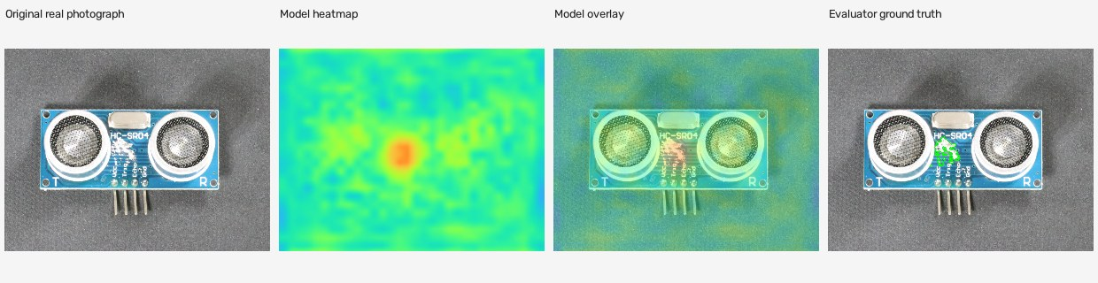
pcb1: detected defect
development / bad/071.JPG Decision: DEFECT_FOUND
First membership-order illustration of this outcome. Evaluator ground truth follows prediction. The complete gallery retains all 860 cases.
REFLEX Verified research evidence
32
Notes:
Frozen REFLEX v2 results, 24–25 October 2026. Source ledger: sources/evidence.json. Source CSVs retain full precision. VisA: Amazon Science / Zou et al., ECCV2022, CC BY4.0, https://github.com/amazon-science/spot-diff. Historical AU-PRO is superseded by independently checked v2 scoring. Publisher byte parity remains blocked. No factory validation or method superiority follows.

Slide 33
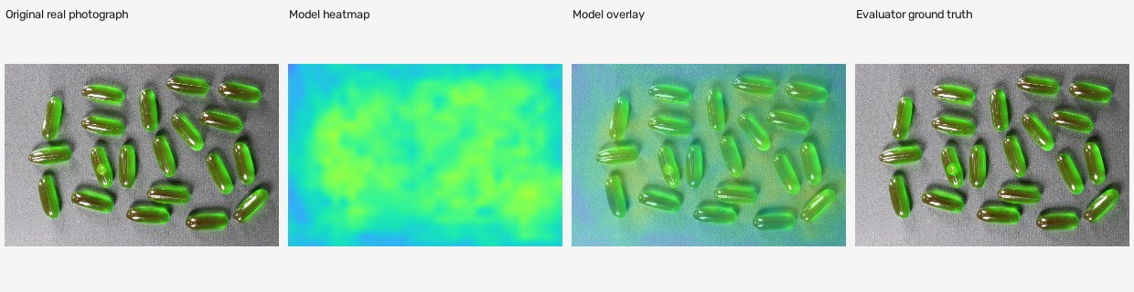
capsules: false clear
development / bad/020.JPG Decision: PASS
First membership-order illustration of this outcome. Evaluator ground truth follows prediction. The complete gallery retains all 860 cases.
REFLEX Verified research evidence
33
Notes:
Frozen REFLEX v2 results, 24–25 October 2026. Source ledger: sources/evidence.json. Source CSVs retain full precision. VisA: Amazon Science / Zou et al., ECCV2022, CC BY4.0, https://github.com/amazon-science/spot-diff. Historical AU-PRO is superseded by independently checked v2 scoring. Publisher byte parity remains blocked. No factory validation or method superiority follows.

Slide 34
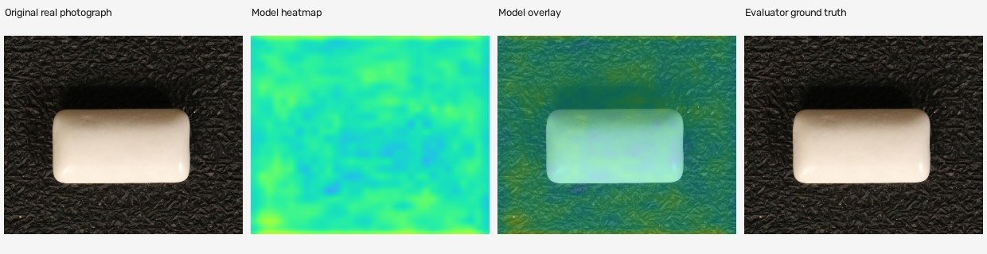
chewinggum: false alert
development / good/497.JPG Decision: DEFECT_FOUND
First membership-order illustration of this outcome. Evaluator ground truth follows prediction. The complete gallery retains all 860 cases.
REFLEX Verified research evidence
34
Notes:
Frozen REFLEX v2 results, 24–25 October 2026. Source ledger: sources/evidence.json. Source CSVs retain full precision. VisA: Amazon Science / Zou et al., ECCV2022, CC BY4.0, https://github.com/amazon-science/spot-diff. Historical AU-PRO is superseded by independently checked v2 scoring. Publisher byte parity remains blocked. No factory validation or method superiority follows.

Slide 35
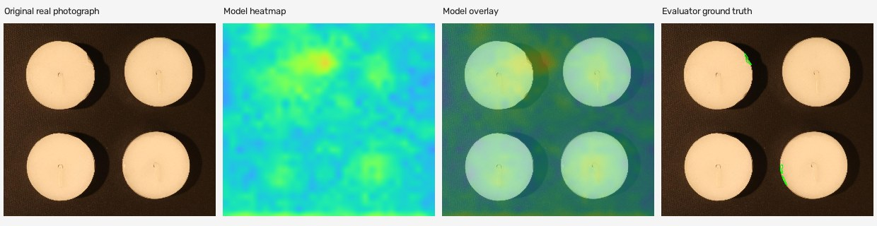
candle: defect review
replay / bad/029.JPG Decision: NEEDS_REVIEW
First membership-order illustration of this outcome. Evaluator ground truth follows prediction. The complete gallery retains all 860 cases.
REFLEX Verified research evidence
35
Notes:
Frozen REFLEX v2 results, 24–25 October 2026. Source ledger: sources/evidence.json. Source CSVs retain full precision. VisA: Amazon Science / Zou et al., ECCV2022, CC BY4.0, https://github.com/amazon-science/spot-diff. Historical AU-PRO is superseded by independently checked v2 scoring. Publisher byte parity remains blocked. No factory validation or method superiority follows.

Slide 36
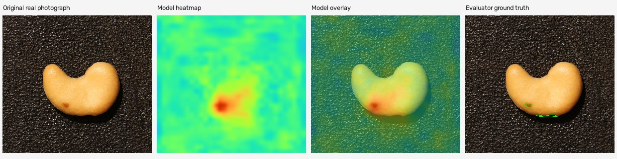
cashew: detected defect
replay / bad/000.JPG Decision: DEFECT_FOUND
First membership-order illustration of this outcome. Evaluator ground truth follows prediction. The complete gallery retains all 860 cases.
REFLEX Verified research evidence
36
Notes:
Frozen REFLEX v2 results, 24–25 October 2026. Source ledger: sources/evidence.json. Source CSVs retain full precision. VisA: Amazon Science / Zou et al., ECCV2022, CC BY4.0, https://github.com/amazon-science/spot-diff. Historical AU-PRO is superseded by independently checked v2 scoring. Publisher byte parity remains blocked. No factory validation or method superiority follows.

Slide 37
Candidate release hold
Requirement | Measured limitation
Capsules final | 16/50 defects detected, 34/50 automatically passed
Normal workload | Final false alerts rise from 9 to 14/105 normals, plus 8 normal reviews
Final ranking | Equal-category AUROC falls despite more threshold detections
Runtime and memory | AWS handler p95 +17.35%, peak RSS +43.90%
Independent validation | No new factory captures, physical-lot independence or real retake study
Keep the live v1 release. Preserve every fixed arm and seed. A future method needs new independent validation and a new protocol.
REFLEX Verified research evidence
37
Notes:
Frozen REFLEX v2 results, 24–25 October 2026. Source ledger: sources/evidence.json. Source CSVs retain full precision. VisA: Amazon Science / Zou et al., ECCV2022, CC BY4.0, https://github.com/amazon-science/spot-diff. Historical AU-PRO is superseded by independently checked v2 scoring. Publisher byte parity remains blocked. No factory validation or method superiority follows.

