Slide 1
REFLEX
Industrial visual inspection with inspectable evidence
Team name
Team members
Institution / affiliation
Contact / submission details
REFLEX Verified research evidence
1
Notes:
Frozen REFLEX v2 results, 24–25 October 2026. Source ledger: sources/evidence.json. Source CSVs retain full precision. VisA: Amazon Science / Zou et al., ECCV2022, CC BY4.0, https://github.com/amazon-science/spot-diff. Historical AU-PRO is superseded by independently checked v2 scoring. Publisher byte parity remains blocked. No factory validation or method superiority follows.

Slide 2
Problem Statement
Subtle defects can receive an automatic PASS
Quality teams need the original photograph, localized evidence and an explicit review decision. A single anomaly threshold does not certify a part.
Our earlier real-image detector missed 88/200 defects on reused VisA candle/cashew cases. That failure defines the improvement study.
Observed prototype limitation. Benchmark prevalence and public photographs do not establish factory error rates.
REFLEX Verified research evidence
2
Notes:
Frozen REFLEX v2 results, 24–25 October 2026. Source ledger: sources/evidence.json. Source CSVs retain full precision. VisA: Amazon Science / Zou et al., ECCV2022, CC BY4.0, https://github.com/amazon-science/spot-diff. Historical AU-PRO is superseded by independently checked v2 scoring. Publisher byte parity remains blocked. No factory validation or method superiority follows.

Slide 3
Proposed Solution
Stage | Implemented behavior
Capture checks | OpenCV 5 decode, dimensions, exposure and focus checks
Normal patch comparison | Frozen pretrained ResNet50 features and normal-only patch memory
Selective detail inspection | One evidence-selected crop with a separate normal reference
Evidence and review | Original photograph, heatmap, overlay, trace and unresolved review
Candidate replay: 155/200 defects detected, 41 false clears, 4 unresolved. Candidate remains local because categories and cost regress.
REFLEX Verified research evidence
3
Notes:
Frozen REFLEX v2 results, 24–25 October 2026. Source ledger: sources/evidence.json. Source CSVs retain full precision. VisA: Amazon Science / Zou et al., ECCV2022, CC BY4.0, https://github.com/amazon-science/spot-diff. Historical AU-PRO is superseded by independently checked v2 scoring. Publisher byte parity remains blocked. No factory validation or method superiority follows.

Slide 4
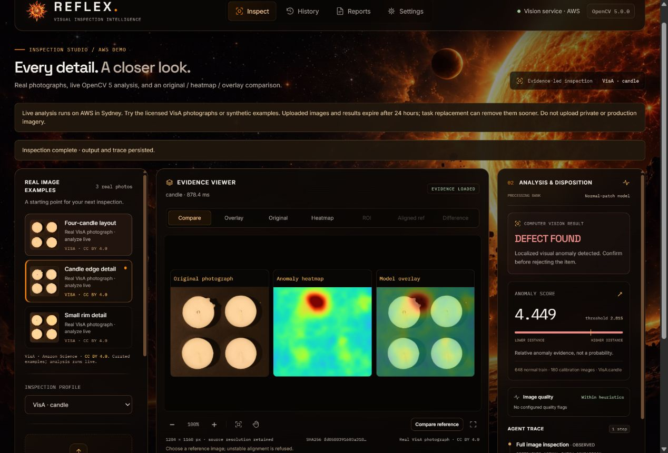
Working Prototype - Live Demo
Open the AWS demo
Choose candle or cashew
Analyze a real photograph
Compare image and heatmap
Review or export
100 measured real-image requests
Median roundtrip 3.90 seconds
Actual AWS v1 screenshot, 24 October 2026. The live demo remains v1. Candidate v2 results are separate offline evidence.
REFLEX Verified research evidence
4
Notes:
Frozen REFLEX v2 results, 24–25 October 2026. Source ledger: sources/evidence.json. Source CSVs retain full precision. VisA: Amazon Science / Zou et al., ECCV2022, CC BY4.0, https://github.com/amazon-science/spot-diff. Historical AU-PRO is superseded by independently checked v2 scoring. Publisher byte parity remains blocked. No factory validation or method superiority follows.

Slide 5
Target Users and Business Feasibility
Target user | Proposed application
Small inspection teams | Operator-assisted triage for a fixed product category
Quality engineers | Review images, localized evidence and retained decisions
Pilot partner | Supply new captures and measure misses, alerts and review time
Proposed model: product-specific setup followed by a site subscription. Customers, pricing, savings and unit economics remain unvalidated.
The public prototype uses temporary storage. Production access controls, storage and operational validation remain separate work.
REFLEX Verified research evidence
5
Notes:
Frozen REFLEX v2 results, 24–25 October 2026. Source ledger: sources/evidence.json. Source CSVs retain full precision. VisA: Amazon Science / Zou et al., ECCV2022, CC BY4.0, https://github.com/amazon-science/spot-diff. Historical AU-PRO is superseded by independently checked v2 scoring. Publisher byte parity remains blocked. No factory validation or method superiority follows.

Slide 6
Roadmap and Support Required
Next gate | Support needed
Independent validation | Permissioned normal/defect captures grouped by product lot
Lower false-clear and alert burden | Quality-engineer review of failure slices on new development data
Capture suitability | Camera fixture and labeled retake / occlusion examples
Pilot feasibility | Review-time measurements, secure storage and operating costs
Submission completion | Team details, presenter, demonstration video and submission receipt
Current evidence supports a working demonstrator. Factory readiness remains unproved.
REFLEX Verified research evidence
6
Notes:
Frozen REFLEX v2 results, 24–25 October 2026. Source ledger: sources/evidence.json. Source CSVs retain full precision. VisA: Amazon Science / Zou et al., ECCV2022, CC BY4.0, https://github.com/amazon-science/spot-diff. Historical AU-PRO is superseded by independently checked v2 scoring. Publisher byte parity remains blocked. No factory validation or method superiority follows.

