Slide 1
REFLEX Safety
Vision-assisted bench assembly review
Intelligent Mistake Prevention & Systemic Safety
Team name
Team members
Institution / affiliation
Contact
YMCA CYPHER-DigiWeek 2026. Advisory teaching-fixture prototype.
REFLEX Safety YMCA Theme 04
1
Notes:
REFLEX YMCA extension review, 25 October 2026. Numeric authority: sources/results.json, results.csv, run_manifest.json and VERIFICATION.json. All18held-out videos are SYNTHETIC SOFTWARE TEST;54rows repeat three policies, not54independent clips. No physically recorded procedural benchmark, live capture-to-alert timing, extension AWS execution, UI/CUA verification, fatigue inference, machine actuation or safety certification. All three policies tie; no agent accuracy gain. Official sources: https://api.unstop.com/hackathons/cypher-digiweek-jc-bose-university-of-science-and-technology-ymca-faridabad-1771873 and https://opencv26.devpost.com/rules. Sources/CONTEST_VERIFICATION.md records verification. User supplied logo artwork is separate from MIT source; no independent image license is asserted.

Slide 2
Problem Statement
A visible assembly mistake can survive the next step
A missing spacer, wrong component or skipped prerequisite needs evidence before an operator continues.
Visible condition | Inspection need
Wrong part in a required slot | Compare the observed class and geometry with a recipe
Later component appears too early | Check observed prerequisites and uncertain history
Occluded or low-quality capture | Hold the result and request usable evidence
Scope: a nonhazardous tabletop fixture under human control. No worker identity or fatigue scoring.
REFLEX Safety YMCA Theme 04
2
Notes:
REFLEX YMCA extension review, 25 October 2026. Numeric authority: sources/results.json, results.csv, run_manifest.json and VERIFICATION.json. All18held-out videos are SYNTHETIC SOFTWARE TEST;54rows repeat three policies, not54independent clips. No physically recorded procedural benchmark, live capture-to-alert timing, extension AWS execution, UI/CUA verification, fatigue inference, machine actuation or safety certification. All three policies tie; no agent accuracy gain. Official sources: https://api.unstop.com/hackathons/cypher-digiweek-jc-bose-university-of-science-and-technology-ymca-faridabad-1771873 and https://opencv26.devpost.com/rules. Sources/CONTEST_VERIFICATION.md records verification. User supplied logo artwork is separate from MIT source; no independent image license is asserted.
Official YMCA Theme04 text verified in the five-page PDF, page3. No accident-cost, incidence, fatigue-state or market-size statistics are asserted.

Slide 3
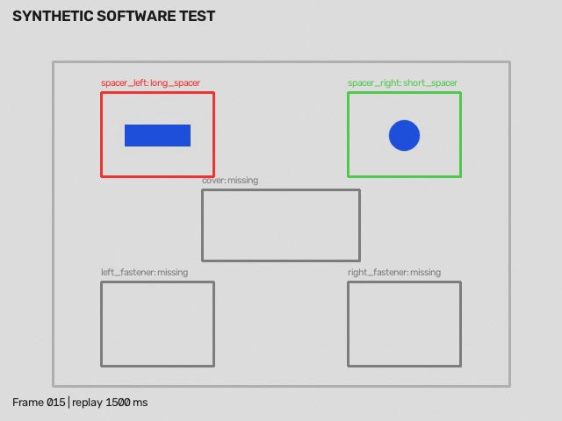
Specific case: the wrong spacer
Recipe expectation
Two short blue spacers before the cover
Supported finding
WRONG_COMPONENT_CLASS
First matching warning: 1,500 ms
SYNTHETIC SOFTWARE TEST. Warning is 700 ms after generator onset and 500 ms before its declared boundary.
REFLEX Safety YMCA Theme 04
3
Notes:
REFLEX YMCA extension review, 25 October 2026. Numeric authority: sources/results.json, results.csv, run_manifest.json and VERIFICATION.json. All18held-out videos are SYNTHETIC SOFTWARE TEST;54rows repeat three policies, not54independent clips. No physically recorded procedural benchmark, live capture-to-alert timing, extension AWS execution, UI/CUA verification, fatigue inference, machine actuation or safety certification. All three policies tie; no agent accuracy gain. Official sources: https://api.unstop.com/hackathons/cypher-digiweek-jc-bose-university-of-science-and-technology-ymca-faridabad-1771873 and https://opencv26.devpost.com/rules. Sources/CONTEST_VERIFICATION.md records verification. User supplied logo artwork is separate from MIT source; no independent image license is asserted.
Illustrative held-out generated clip011, agent policy,1500ms saved overlay. This is an actual computed frame output from a synthetic software case, not a photo or a physical trial.

Slide 4
Proposed Solution
Recipe step | Observable evidence | Gate
1. Mount spacers | Both required spacer slots match | Confirm stable evidence
2. Install cover | Cover follows observed prerequisites | Hold uncertain history
3. Add fasteners | Both fasteners present at checkpoint | Report final recommendation
PASS
HOLD FOR REVIEW
REJECT RECOMMENDATION
Recipe evidence complete
Evidence remains incomplete
Visible rule violation, human confirms
A calibrated color/shape demonstration supports this fixture. Arbitrary industrial components remain outside scope.
REFLEX Safety YMCA Theme 04
4
Notes:
REFLEX YMCA extension review, 25 October 2026. Numeric authority: sources/results.json, results.csv, run_manifest.json and VERIFICATION.json. All18held-out videos are SYNTHETIC SOFTWARE TEST;54rows repeat three policies, not54independent clips. No physically recorded procedural benchmark, live capture-to-alert timing, extension AWS execution, UI/CUA verification, fatigue inference, machine actuation or safety certification. All three policies tie; no agent accuracy gain. Official sources: https://api.unstop.com/hackathons/cypher-digiweek-jc-bose-university-of-science-and-technology-ymca-faridabad-1771873 and https://opencv26.devpost.com/rules. Sources/CONTEST_VERIFICATION.md records verification. User supplied logo artwork is separate from MIT source; no independent image license is asserted.
Versioned demo_panel_v1 recipe requires two short spacers, cover then two fasteners. Recipe engine tests actual observed evidence. Stable support uses3frames separated by>=150ms; unknown history leads to review.

Slide 5
Technical Architecture
Stage | Implementation | Retained evidence
Capture / replay | Bounded upload or supplied camera frame | Source hash, source time, mode
OpenCV 5 | Perspective transform, color/shape and quality | Function names, slot coordinates, flags
Recipe engine | Stable slot state and prerequisite checks | Versioned recipe, supporting frame IDs
Inspection policy | Next-frame budget or request new input | Action reason, actual output and cost
Operator review | PASS / HOLD / REJECT recommendation | Append-only review and JSON/HTML report
Existing anomaly inspection and prior AWS proof remain distinct. Safety Station cloud video execution: NOT RUN.
REFLEX Safety YMCA Theme 04
5
Notes:
REFLEX YMCA extension review, 25 October 2026. Numeric authority: sources/results.json, results.csv, run_manifest.json and VERIFICATION.json. All18held-out videos are SYNTHETIC SOFTWARE TEST;54rows repeat three policies, not54independent clips. No physically recorded procedural benchmark, live capture-to-alert timing, extension AWS execution, UI/CUA verification, fatigue inference, machine actuation or safety certification. All three policies tie; no agent accuracy gain. Official sources: https://api.unstop.com/hackathons/cypher-digiweek-jc-bose-university-of-science-and-technology-ymca-faridabad-1771873 and https://opencv26.devpost.com/rules. Sources/CONTEST_VERIFICATION.md records verification. User supplied logo artwork is separate from MIT source; no independent image license is asserted.
Editable architecture table. Implemented source snapshots: sources/implementation/api.py,engine.py,recipe.py,vision.py. Existing anomaly implementation remains separate. API namespace/api/safety; backend capability tokens protect sessions; lifecycle/cancellation/evidence routes. No new cloud execution inferred.

Slide 6
Differentiation: an inspectable second look
Each extra action has a trace
Action | Information contribution
Observe next replay frame | Additional temporal pixels from the supplied video
Request an alternate view | Wait for a genuinely supplied capture
Ask an operator | Keep uncertainty and the original machine finding
Observed weakness: the current policy spends its extra-frame budget during initialization
SYNTHETIC SOFTWARE TEST. No measured accuracy advantage over the base or seeded random policy.
REFLEX Safety YMCA Theme 04
6
Notes:
REFLEX YMCA extension review, 25 October 2026. Numeric authority: sources/results.json, results.csv, run_manifest.json and VERIFICATION.json. All18held-out videos are SYNTHETIC SOFTWARE TEST;54rows repeat three policies, not54independent clips. No physically recorded procedural benchmark, live capture-to-alert timing, extension AWS execution, UI/CUA verification, fatigue inference, machine actuation or safety certification. All three policies tie; no agent accuracy gain. Official sources: https://api.unstop.com/hackathons/cypher-digiweek-jc-bose-university-of-science-and-technology-ymca-faridabad-1771873 and https://opencv26.devpost.com/rules. Sources/CONTEST_VERIFICATION.md records verification. User supplied logo artwork is separate from MIT source; no independent image license is asserted.
The implemented uncertainty policy selects extra replay frames from actual slot/quality observations, maximum2. The completed synthetic run uses its two early100/200ms frames, which does not improve accuracy. A second physical view exists only after a supplied capture; the request is not an executed capture.

Slide 7
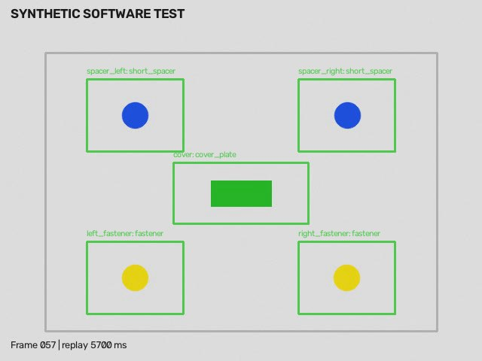
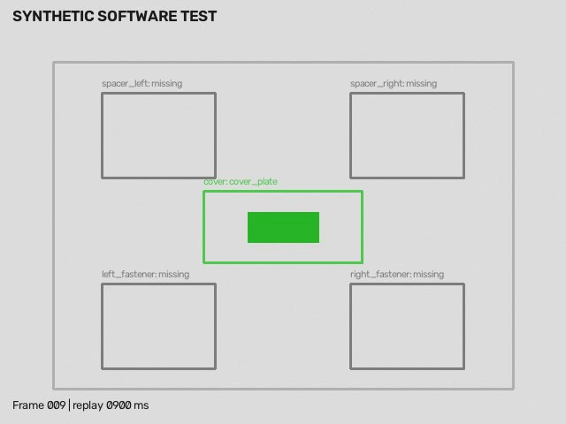
Working Prototype: successes and retained failure
Ordered normal: PASS
Wrong order: HOLD, specific error missed
SYNTHETIC SOFTWARE TEST. Left frame: 5,700 ms. Right frame: 900 ms. Right final HOLD misses the specific order error.
REFLEX Safety YMCA Theme 04
7
Notes:
REFLEX YMCA extension review, 25 October 2026. Numeric authority: sources/results.json, results.csv, run_manifest.json and VERIFICATION.json. All18held-out videos are SYNTHETIC SOFTWARE TEST;54rows repeat three policies, not54independent clips. No physically recorded procedural benchmark, live capture-to-alert timing, extension AWS execution, UI/CUA verification, fatigue inference, machine actuation or safety certification. All three policies tie; no agent accuracy gain. Official sources: https://api.unstop.com/hackathons/cypher-digiweek-jc-bose-university-of-science-and-technology-ymca-faridabad-1771873 and https://opencv26.devpost.com/rules. Sources/CONTEST_VERIFICATION.md records verification. User supplied logo artwork is separate from MIT source; no independent image license is asserted.
Both images are actual saved inference overlays from synthetic held-out clips. Clip010 ordered normal finalPASS. Clip013 cover-before-spacers finalHOLD_FOR_REVIEW, expectedREJECT_RECOMMENDATION. Specific wrong-order event missed; do not count generic review as detection. UI/CUA verification is not asserted.

Slide 8
Feasibility and evidence boundaries
Capability | Evidence available | Current limit
Procedure software | 18 generated clips, 54 policy rows | No physically recorded benchmark
Real anomaly evaluation | 860 VisA population cases, 5 categories | Candidate remains local after regressions
Existing AWS anomaly service | Verified OpenCV inference/log evidence | Safety Station video not run on AWS
Human workflow | Review/report routes implemented | Real operator burden and prevention unmeasured
New-category anomaly ranking also regressed: AUROC 0.852 to 0.841
Separate datasets, methods and denominators. No factory readiness, certified safety or physical actuation claim.
REFLEX Safety YMCA Theme 04
8
Notes:
REFLEX YMCA extension review, 25 October 2026. Numeric authority: sources/results.json, results.csv, run_manifest.json and VERIFICATION.json. All18held-out videos are SYNTHETIC SOFTWARE TEST;54rows repeat three policies, not54independent clips. No physically recorded procedural benchmark, live capture-to-alert timing, extension AWS execution, UI/CUA verification, fatigue inference, machine actuation or safety certification. All three policies tie; no agent accuracy gain. Official sources: https://api.unstop.com/hackathons/cypher-digiweek-jc-bose-university-of-science-and-technology-ymca-faridabad-1771873 and https://opencv26.devpost.com/rules. Sources/CONTEST_VERIFICATION.md records verification. User supplied logo artwork is separate from MIT source; no independent image license is asserted.
Prior frozen anomaly study:860cases across5VisA categories and88method/population rows. v2 candidate remainsHOLD_CANDIDATE_LOCAL. New-category finalmacroAUROC.852044to.840978, normalfalsealerts9to14. PriorAWSrealimageprofile exists but does not validate SafetyStation video.

Slide 9
Evaluation: all three policies tie
Policy | Extra frames | p95 ms
Base | 0 | 289.4
Random | 2 | 259.9
Uncertainty | 2 | 249.9
5/7 supported error findings
2/4 normal clips falsely held
No observed agent accuracy gain
SYNTHETIC SOFTWARE TEST, N=18. Offline processing includes evidence writes on a shared host. No live timing claim.
REFLEX Safety YMCA Theme 04
9
Notes:
REFLEX YMCA extension review, 25 October 2026. Numeric authority: sources/results.json, results.csv, run_manifest.json and VERIFICATION.json. All18held-out videos are SYNTHETIC SOFTWARE TEST;54rows repeat three policies, not54independent clips. No physically recorded procedural benchmark, live capture-to-alert timing, extension AWS execution, UI/CUA verification, fatigue inference, machine actuation or safety certification. All three policies tie; no agent accuracy gain. Official sources: https://api.unstop.com/hackathons/cypher-digiweek-jc-bose-university-of-science-and-technology-ymca-faridabad-1771873 and https://opencv26.devpost.com/rules. Sources/CONTEST_VERIFICATION.md records verification. User supplied logo artwork is separate from MIT source; no independent image license is asserted.
Source summary:results.json. SYNTHETIC_SOFTWARE_TEST,18held-out clips and54repeated-policy predictions. Exactstatuses15/18 each, matchingerrorfindings5/7 each, two falseHOLDs among4normalclips. 0falsePASS in this small generator grammar does not prove safety.

Slide 10
Team, roadmap and support required
Team and institution
Next evidence gates
Team name
Record 12 consented clips across 4 fault types
Verify the camera workflow and operator burden
Run a bounded AWS safety-video check
Complete presenter video and submission receipt
Members / roles
Institution
Contact
Support: safe fixture, camera access and a reviewer for labels
PPT cutoff: 25 Oct, 23:59 IST. Review material only. Real procedural validation and organizer submission remain pending.
REFLEX Safety YMCA Theme 04
10
Notes:
REFLEX YMCA extension review, 25 October 2026. Numeric authority: sources/results.json, results.csv, run_manifest.json and VERIFICATION.json. All18held-out videos are SYNTHETIC SOFTWARE TEST;54rows repeat three policies, not54independent clips. No physically recorded procedural benchmark, live capture-to-alert timing, extension AWS execution, UI/CUA verification, fatigue inference, machine actuation or safety certification. All three policies tie; no agent accuracy gain. Official sources: https://api.unstop.com/hackathons/cypher-digiweek-jc-bose-university-of-science-and-technology-ymca-faridabad-1771873 and https://opencv26.devpost.com/rules. Sources/CONTEST_VERIFICATION.md records verification. User supplied logo artwork is separate from MIT source; no independent image license is asserted.
Team names, institution and contact intentionallyblankforhumancompletion. OfficialYMCA requires3-4sameinstitutionmembers. Timeline/deadline confirmedinCONTEST_VERIFICATION. No submissionreceipt/videoandno12physicallyrecordedclipsclaimed.

