Slide 1

IOT TRAINING - FINAL PROJECT
THIRD EYE
IoT-Based Object Detection And Accessibility For The Visually Impaired
Asmaa Abdelkader -2203145
Christine Guirguis - 2206162
Habiba Hammad -2203167
Rana Gaber -2203180
Yara Allam -2203178

Slide 2

Contents
Overview
Computer Vision Using the ESP-CAM
Maquette Design
Flutter App Design & Implementation
ESP32 and Sensor Circuitry
MQTT and System Lifecycle

Slide 3
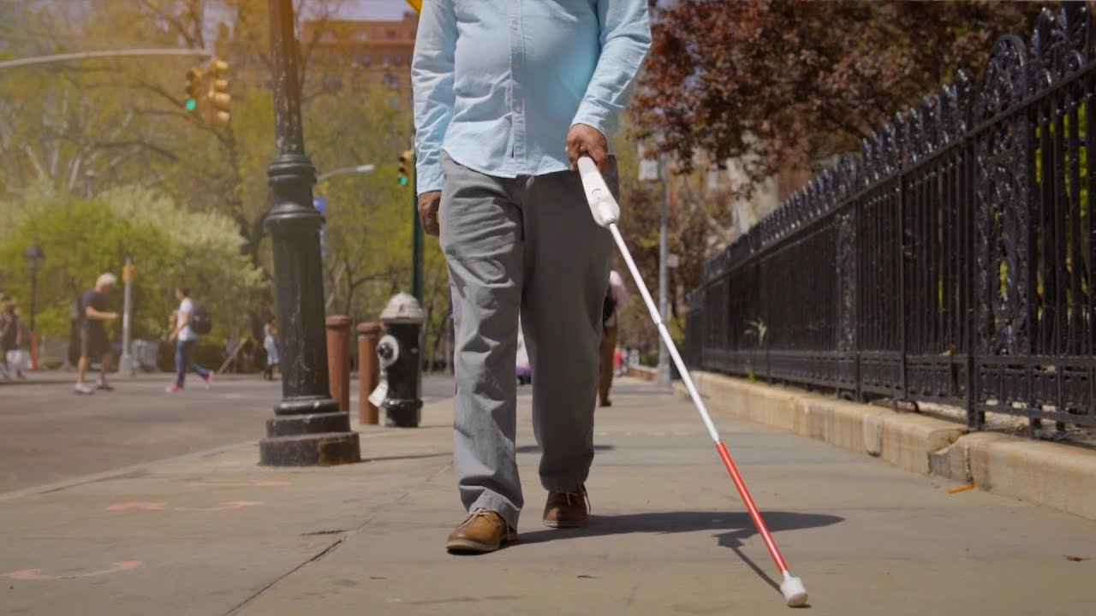
Overview
The main objective of the project is to aid the visually impaired by providing an additional measure of interacting with the world around them using a smart cane. It also gives a way of keeping an eye on their health by actively monitoring the heart rate.

Slide 4
Challenges and Tasks
To make the smart cane “smart”, it needed to recognize and classify the object in front of it, so the blind person could know what it is, how far away it is, and how to move.
A mobile application was also needed to communicate the detected heartrate, inform the user of the classified objects, as well as have an emergency contact phone or name on hand in case of any unpredictable situations.
Of course, the application and smart cane needed to communicate with each other to send sensor readings to the mobile application and send voice commands to the speaker. This was done with the help of MQTT and Firebase.

Slide 5
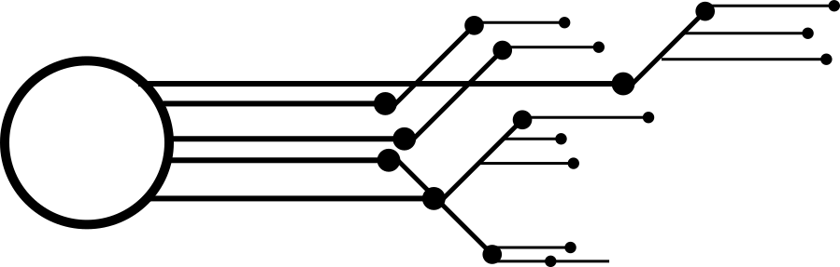



Workload
CIRCUITRY
Asmaa Abdelkader
Rana Gaber
CLOUD
Habiba Hammad
Christine Guirguis
MOBILE APP
Yara Allam

Slide 6
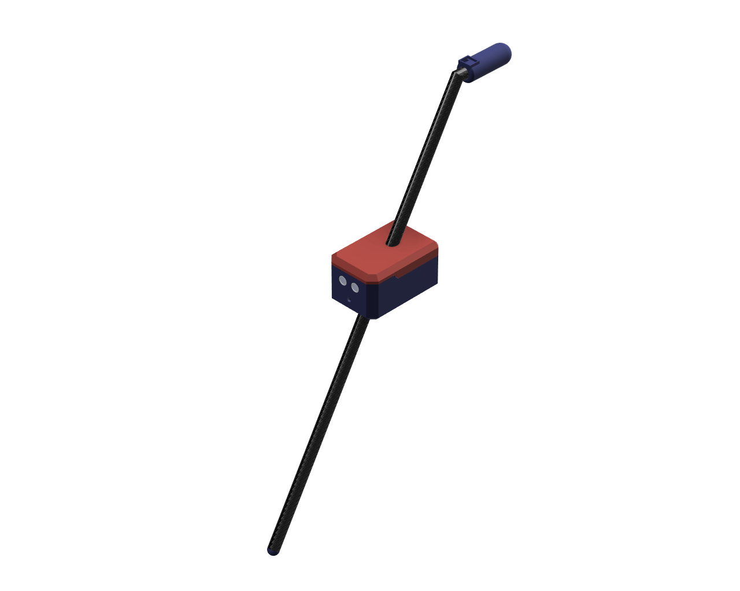
Maquette
Using a carbon fiber stick with the handle and the component box both 3D-printed, we were able to keep the parts unexposed and provide a seamless, unobtrusive experience for the user.

Slide 7
Parts Included
ESP-CAM
ESP32
Heart Rate Sensor
Ultrasonic Sensor
Speaker Module
Amplifier
Carbon Fiber Stick
3D Printed Component Box

Slide 8
Maquette Design
Following much of the idea of a regular cane, a carbon fiber stick was outfitted with two 3D-printed components:
A component box with a clear opening for the ultrasonic sensor’s transmitter and receiver, as well as an acrylic lens cover for the ESP-CAM. The back of the box also has holes to enhance speaker audio.
2. A handle at the top of the stick with a slot for the heart rate sensor for easy access.
3. Wires from the heart rate sensor travel down the carbon fiber stick and through the box, connecting all components to the power source.
Approx. weight: 350-400 grams.
Approx. height: 80 cm.

Slide 9
Logic and Circuitry

Slide 10
With the challenge of two ESPs: one solely for capturing images, and another for handling the rest of the sensor data, the program’s flow worked as follows:
Heart Rate Sensor
Speaker
Continuously providing data that is fed directly to the broker, and by extension, the application.
Responsible for ultrasonic sensor data, and label data from the ESP-CAM and the YOLOV8 model. Also has an amplifier attached for better audio.
Ultrasonic Sensor
Flutter Application
Its data was handled without the broker: if any object is deemed too close, the speaker immediately notifies the user.
The user can access object label data and heart rate sensor readings with the help of the MQTT protocol.

Slide 11

Computer Vision

Slide 12
The handling of the computer vision model was slightly tricky: we first needed to upload the model on the ESP-CAM itself by transforming the model into a .tflite file and then into a C-Array to optimize storage as much as possible.
However, even with optimization, the file was still much too large.
And thus came the idea: why upload the model into the ESP-CAM? Why not use the camera for only its intended use and only capture pictures?
This was done by uploading code onto it that connects it directly to the internet and providing a unique URL to the camera, after which we embed the camera’s URL with python code utilizing the pre-trained YOLOV8 model imported from the ultralytics library.
The predicted labels from the model are fetched and retrieved using the MQTT protocol and HiveMQ.

Slide 13
System Lifecycle

Slide 14
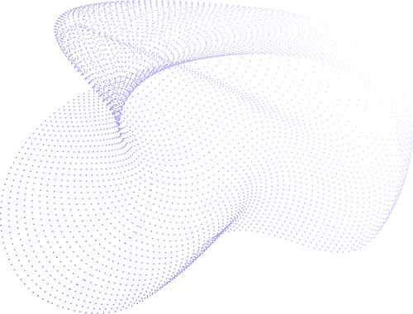
Firebase
Flutter
User Authentication
ESP32
MQTT Broker
Flutter
Sensor Readings
Speaker Module
Python File
Firebase
MQTT Broker
Object Detection
Flutter
Cloud Connections

Slide 15
Flutter
Application

Slide 16
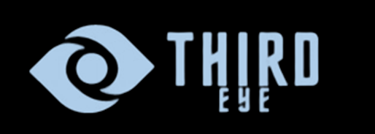

With a logo chosen intuitively and a color palette of muted
blues, the application looked and felt simple and
unobtrusive in practical use.
A specific font was also chosen from the google fonts
library: Sora.
UI Design

Slide 17
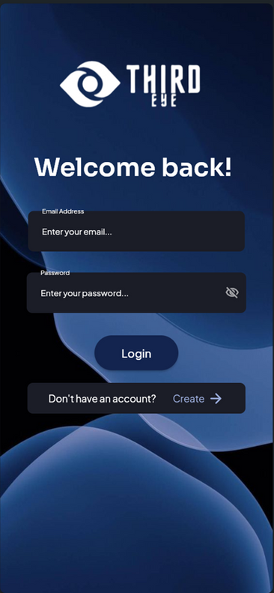
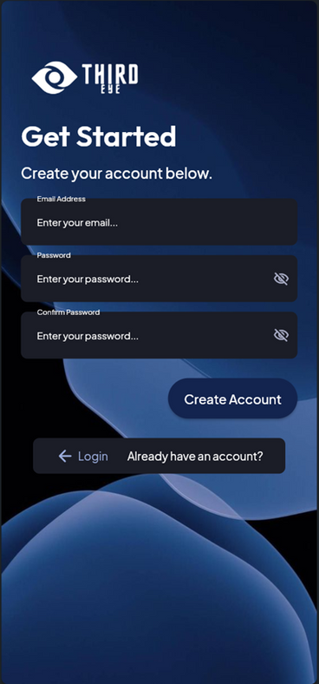
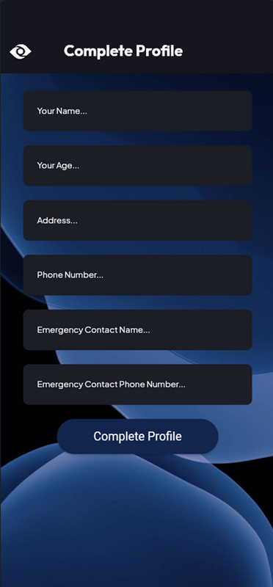
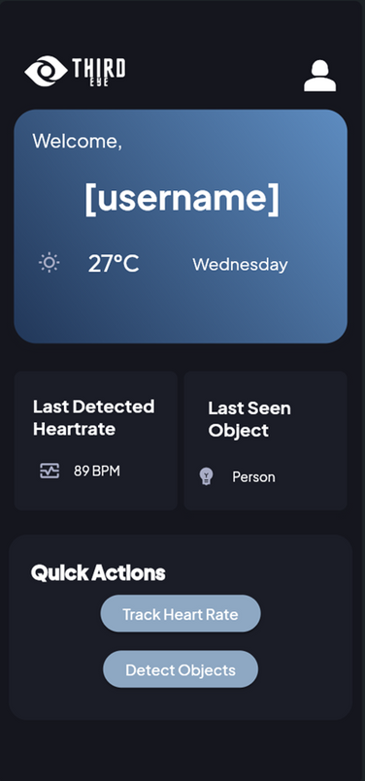
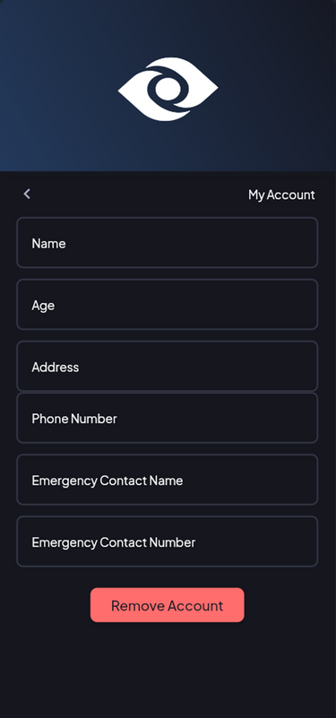
Login
Register
Home
Complete
Profile
Account Details

Slide 18
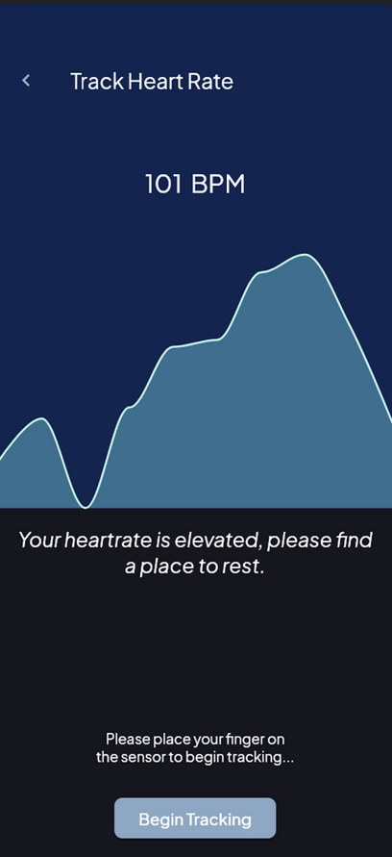
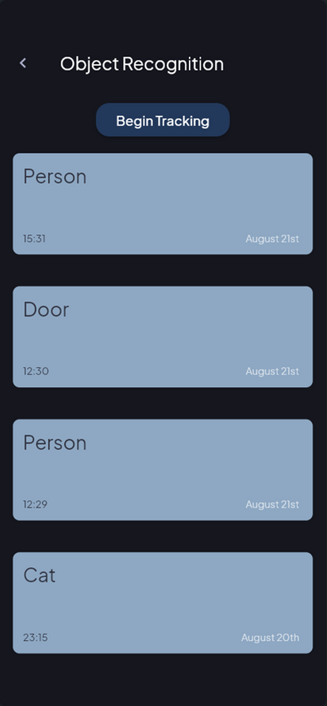
User Authentication
Using Firebase for user authentication and Firestore for fetching and retrieving.
The shared preferences package was also used to keep track of last seen data.
Heartrate
Tracker
Object
Recognition

Slide 19
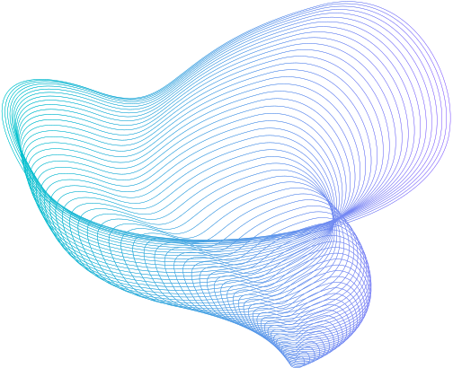
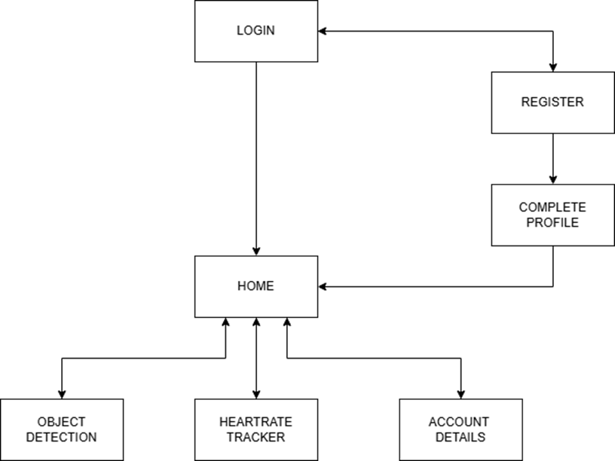
Application Flow

Slide 20
Need More
Specifics?
Please feel free to consult the provided report for more details on code.

Slide 21
Thank You
For Your Time!

