Slide 1
多种排序算法的算法实现及性能比较
张跃 2015160180

Slide 2
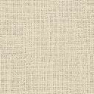
实验总体思路：
使用命令行参数改变每次排序测试所使用的排序算法、数据规模和随机种子值。
性能测试方法使用获取执行排序函数执行前后的时钟时间，通过时间相减得到排序算法运行时间。
为了控制无关因素，生成随机样本时通过控制随机种子值一致使每组样本数据一致。并且本次实验算法在云服务器环境上运行，排除减少硬件的无关负载的影响，使实验结果更有说服力。
使用shell和Python脚本帮助自动化运行测试程序并统计数据。

Slide 3
O(n²)复杂度的排序算法分析
选择排序
冒泡排序
插入排序

Slide 4
选择排序算法思路
每次挑选待排序数组的最值，与前置元素（在已排好序的数组末端）交换位置，然后继续挑选剩余元素的最值并重复操作。

Slide 5
选择排序算法伪代码实现
repeat (numOfElements - 1) times
set the first unsorted element as the minimum
for each of the unsorted elements
if element < currentMinimum
set element as new minimum
swap minimum with first unsorted position

Slide 6
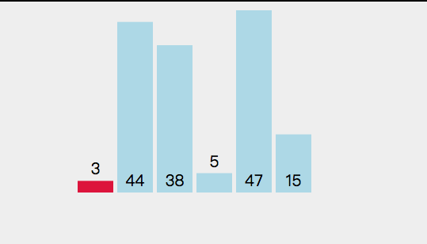
选择排序算法可视化
repeat (numOfElements - 1) times
set the first unsorted element as the minimum
for each of the unsorted elements
if element < currentMinimum
set element as new minimum
swap minimum with first unsorted position

Slide 7
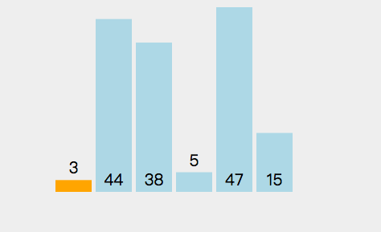
选择排序算法可视化
repeat (numOfElements - 1) times
set the first unsorted element as the minimum
for each of the unsorted elements
if element < currentMinimum
set element as new minimum
swap minimum with first unsorted position

Slide 8
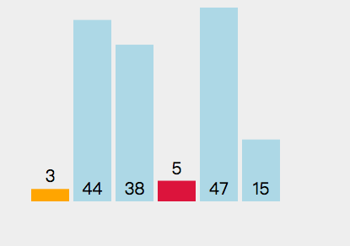
选择排序算法可视化
repeat (numOfElements - 1) times
set the first unsorted element as the minimum
for each of the unsorted elements
if element < currentMinimum
set element as new minimum
swap minimum with first unsorted position

Slide 9
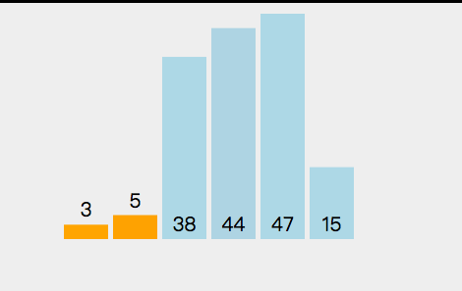
选择排序算法可视化
repeat (numOfElements - 1) times
set the first unsorted element as the minimum
for each of the unsorted elements
if element < currentMinimum
set element as new minimum
swap minimum with first unsorted position

Slide 10
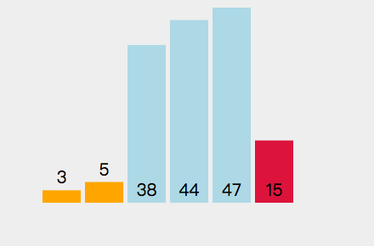
选择排序算法可视化
repeat (numOfElements - 1) times
set the first unsorted element as the minimum
for each of the unsorted elements
if element < currentMinimum
set element as new minimum
swap minimum with first unsorted position

Slide 11
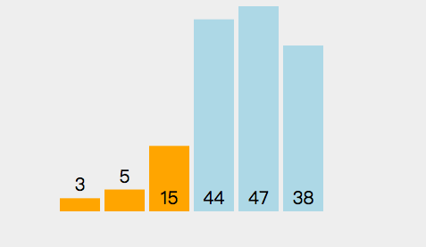
选择排序算法可视化
repeat (numOfElements - 1) times
set the first unsorted element as the minimum
for each of the unsorted elements
if element < currentMinimum
set element as new minimum
swap minimum with first unsorted position

Slide 12
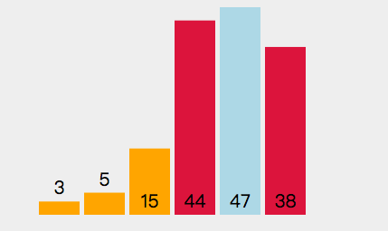
选择排序算法可视化
repeat (numOfElements - 1) times
set the first unsorted element as the minimum
for each of the unsorted elements
if element < currentMinimum
set element as new minimum
swap minimum with first unsorted position

Slide 13
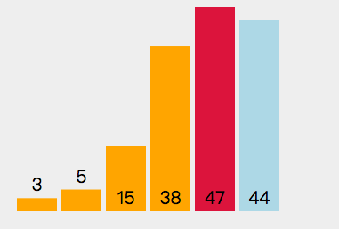
选择排序算法可视化
repeat (numOfElements - 1) times
set the first unsorted element as the minimum
for each of the unsorted elements
if element < currentMinimum
set element as new minimum
swap minimum with first unsorted position

Slide 14
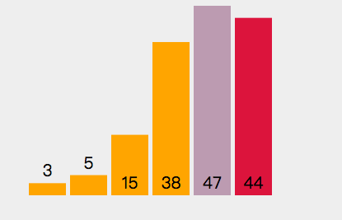
选择排序算法可视化
repeat (numOfElements - 1) times
set the first unsorted element as the minimum
for each of the unsorted elements
if element < currentMinimum
set element as new minimum
swap minimum with first unsorted position

Slide 15
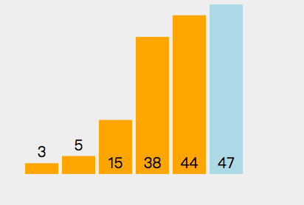
选择排序算法可视化
repeat (numOfElements - 1) times
set the first unsorted element as the minimum
for each of the unsorted elements
if element < currentMinimum
set element as new minimum
swap minimum with first unsorted position

Slide 16
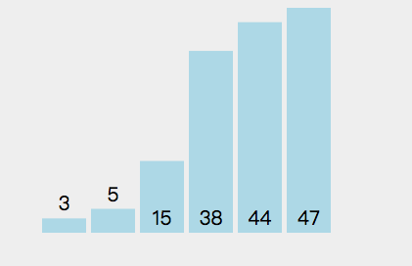
选择排序算法可视化
repeat (numOfElements - 1) times
set the first unsorted element as the minimum
for each of the unsorted elements
if element < currentMinimum
set element as new minimum
swap minimum with first unsorted position

Slide 17
选择排序算法测试数据
数据规模 | 10000 | 20000 | 30000 | 40000 | 50000
算法用时(s) | 0.17033665 | 0.6984899 | 1.581282 | 2.8249735 | 4.389343
数据规模 | 100 | 1000 | 10000 | 100000 | 1000000
算法用时(s) | 0.0000528 | 0.00183915 | 0.17521625 | 17.61875 | 1736.591

Slide 18
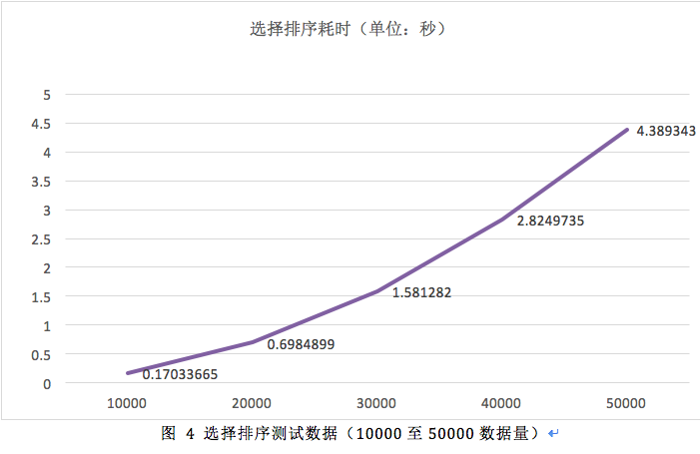

Slide 19
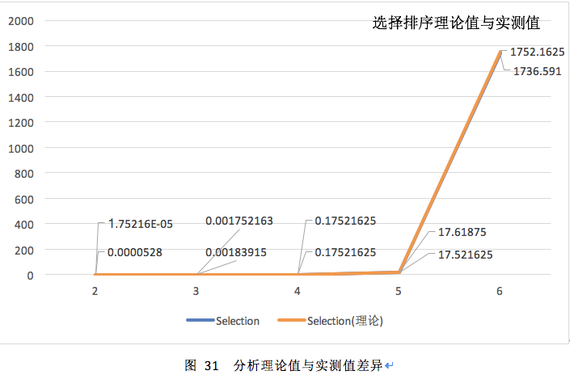
计算算法耗时理论值（以10000数据量为基准），与实测数据比较，横坐标取对数

Slide 20
冒泡排序算法思路
冒泡排序通过多次重复两两比较每对相邻的元素，并按某种顺序交换他们，最终把数据排序。一直重复下去。算法的过程中每个循环的待排序数组中的最值就像一个个“气泡”冒到顶端。

Slide 21
冒泡排序算法伪代码实现（最优化）
do
swapped = false
for i = 1 to indexOfLastUnsortedElement-1
if leftElement > rightElement
swap(leftElement, rightElement)
swapped = true
while swapped

Slide 22
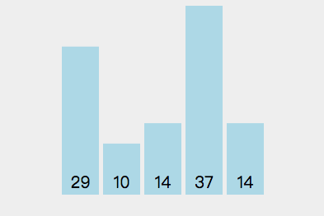
冒泡排序算法可视化
do
swapped = false
for i = 1 to indexOfLastUnsortedElement-1
if leftElement > rightElement
swap(leftElement, rightElement)
swapped = true
while swapped

Slide 23
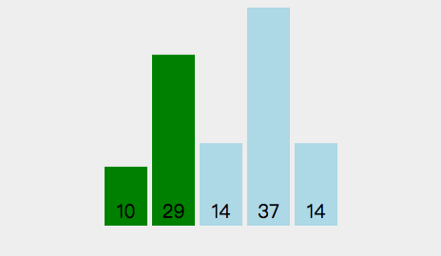
冒泡排序算法可视化
do
swapped = false
for i = 1 to indexOfLastUnsortedElement-1
if leftElement > rightElement
swap(leftElement, rightElement)
swapped = true
while swapped

Slide 24
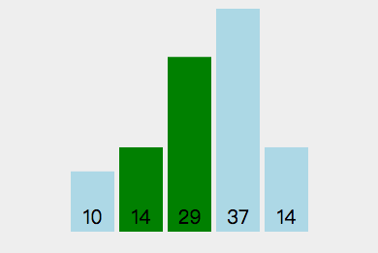
冒泡排序算法可视化
do
swapped = false
for i = 1 to indexOfLastUnsortedElement-1
if leftElement > rightElement
swap(leftElement, rightElement)
swapped = true
while swapped

Slide 25
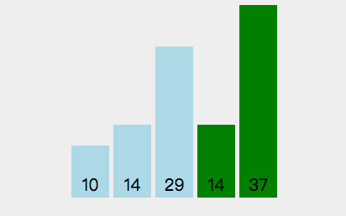
冒泡排序算法可视化
do
swapped = false
for i = 1 to indexOfLastUnsortedElement-1
if leftElement > rightElement
swap(leftElement, rightElement)
swapped = true
while swapped

Slide 26
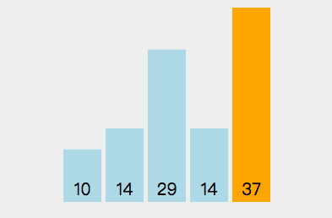
冒泡排序算法可视化
do
swapped = false
for i = 1 to indexOfLastUnsortedElement-1
if leftElement > rightElement
swap(leftElement, rightElement)
swapped = true
while swapped

Slide 27
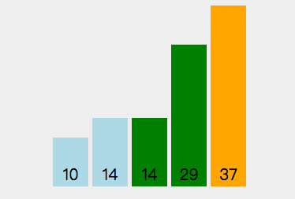
冒泡排序算法可视化
do
swapped = false
for i = 1 to indexOfLastUnsortedElement-1
if leftElement > rightElement
swap(leftElement, rightElement)
swapped = true
while swapped

Slide 28
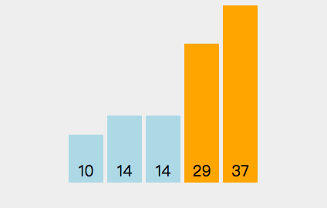
冒泡排序算法可视化
do
swapped = false
for i = 1 to indexOfLastUnsortedElement-1
if leftElement > rightElement
swap(leftElement, rightElement)
swapped = true
while swapped

Slide 29
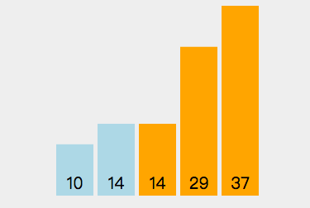
冒泡排序算法可视化
do
swapped = false
for i = 1 to indexOfLastUnsortedElement-1
if leftElement > rightElement
swap(leftElement, rightElement)
swapped = true
while swapped

Slide 30
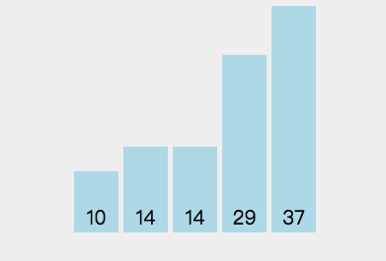
冒泡排序算法可视化
do
swapped = false
for i = 1 to indexOfLastUnsortedElement-1
if leftElement > rightElement
swap(leftElement, rightElement)
swapped = true
while swapped

Slide 31
冒泡排序算法测试数据
数据规模 | 10000 | 20000 | 30000 | 40000 | 50000
算法用时(s) | 0.8901906 | 3.523429 | 7.87541 | 14.291035 | 22.093355
数据规模 | 100 | 1000 | 10000 | 100000 | 1000000
算法用时(s) | 0.00011535 | 0.00759215 | 0.8799935 | 87.676805 | 9021.8885

Slide 32
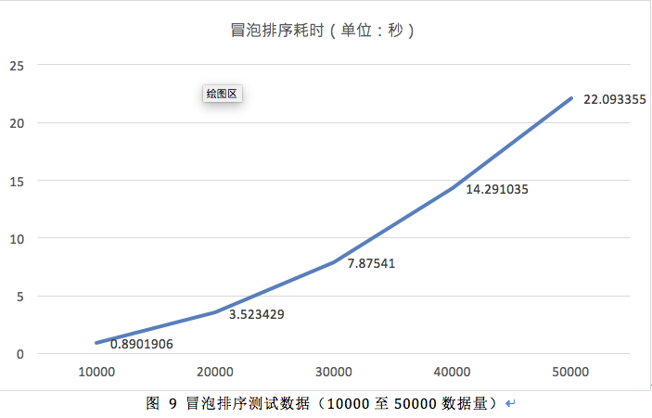

Slide 33
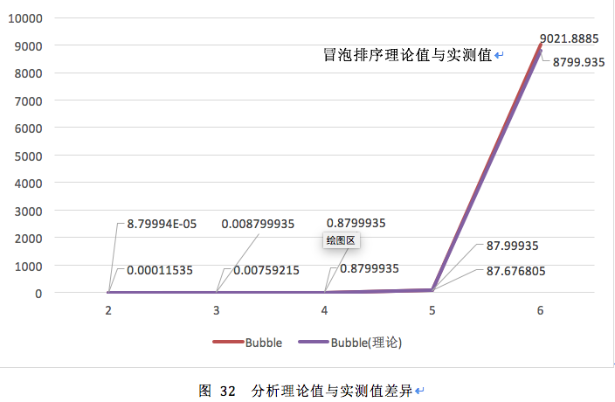
计算算法耗时理论值（以10000数据量为基准），与实测数据比较，横坐标取对数

Slide 34
插入排序算法思路
插入排序逐个处理待排序的记录，每个新纪录都与前面已排序的子序列进行比较，并找到相应的位置进行插入。可归纳为以下步骤：
（1）设待排序数组为a[0, 1, …, n-1]，开始时，令a[0]成为1个有序序列（即将第一个元素看成已经被排序），未排序的为a[1..n-1]。令i=1；
（2）将a[i]插入当前的有序区a[0,…,i-1]中，形成a[0,…,i]的有序区间。
（3）i++，重复第二步直到i==n-1，排序完成。

Slide 35
插入排序算法伪代码实现（最优化）
mark first element as sorted
for each unsorted element X
'extract' the element X
for j = lastSortedIndex down to 0
if current element j > X
move sorted element to the right by 1
break loop and insert X here

Slide 36
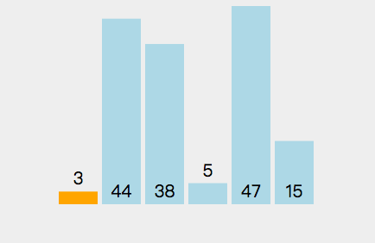
插入排序算法可视化
mark first element as sorted
for each unsorted element X
'extract' the element X
for j = lastSortedIndex down to 0
if current element j > X
move sorted element to the right by 1
break loop and insert X here

Slide 37
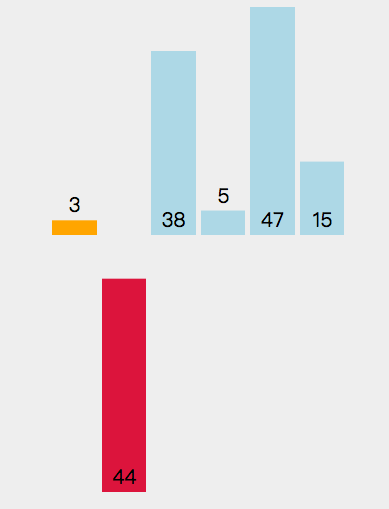
插入排序算法可视化
mark first element as sorted
for each unsorted element X
'extract' the element X
for j = lastSortedIndex down to 0
if current element j > X
move sorted element to the right by 1
break loop and insert X here

Slide 38
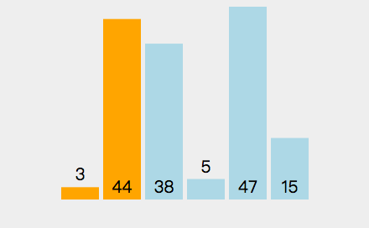
插入排序算法可视化
mark first element as sorted
for each unsorted element X
'extract' the element X
for j = lastSortedIndex down to 0
if current element j > X
move sorted element to the right by 1
break loop and insert X here

Slide 39
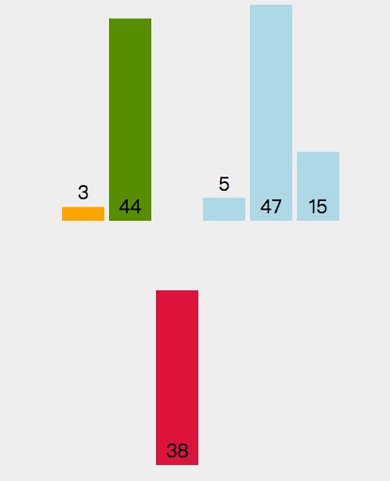
插入排序算法可视化
mark first element as sorted
for each unsorted element X
'extract' the element X
for j = lastSortedIndex down to 0
if current element j > X
move sorted element to the right by 1
break loop and insert X here

Slide 40
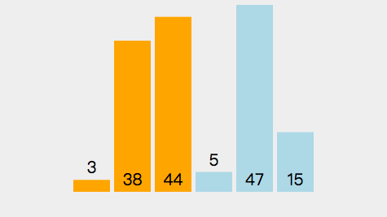
插入排序算法可视化
mark first element as sorted
for each unsorted element X
'extract' the element X
for j = lastSortedIndex down to 0
if current element j > X
move sorted element to the right by 1
break loop and insert X here

Slide 41
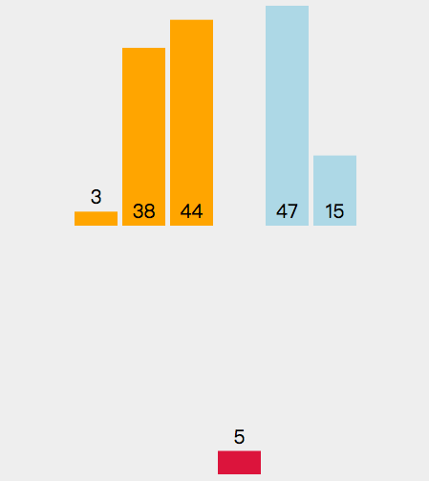
插入排序算法可视化
mark first element as sorted
for each unsorted element X
'extract' the element X
for j = lastSortedIndex down to 0
if current element j > X
move sorted element to the right by 1
break loop and insert X here

Slide 42
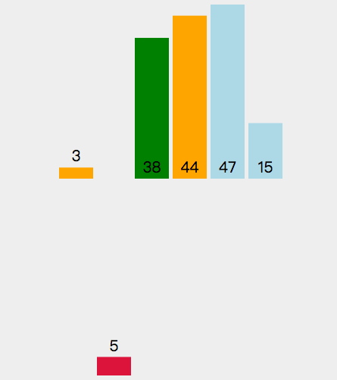
插入排序算法可视化
mark first element as sorted
for each unsorted element X
'extract' the element X
for j = lastSortedIndex down to 0
if current element j > X
move sorted element to the right by 1
break loop and insert X here

Slide 43
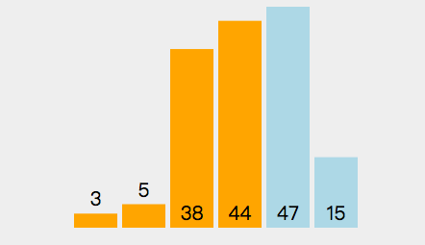
插入排序算法可视化
mark first element as sorted
for each unsorted element X
'extract' the element X
for j = lastSortedIndex down to 0
if current element j > X
move sorted element to the right by 1
break loop and insert X here

Slide 44
插入排序算法可视化
。
。
。
。
。
。

Slide 45
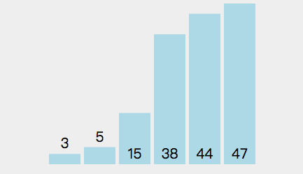
插入排序算法可视化
mark first element as sorted
for each unsorted element X
'extract' the element X
for j = lastSortedIndex down to 0
if current element j > X
move sorted element to the right by 1
break loop and insert X here

Slide 46
插入排序算法测试数据
数据规模 | 10000 | 20000 | 30000 | 40000 | 50000
算法用时(s) | 0.410771 | 1.6665865 | 3.79498 | 6.6102355 | 10.3750545
数据规模 | 100 | 1000 | 10000 | 100000 | 1000000
算法用时(s) | 0.00008245 | 0.00405375 | 0.3780098 | 40.885905 | 4260.82

Slide 47
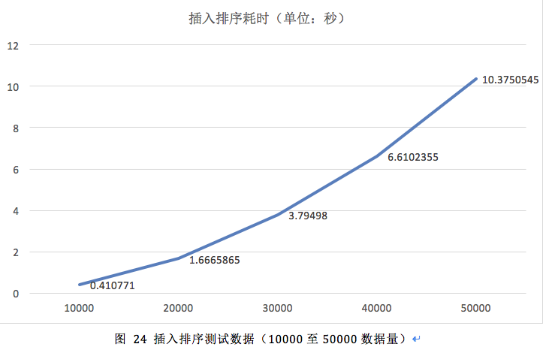

Slide 48
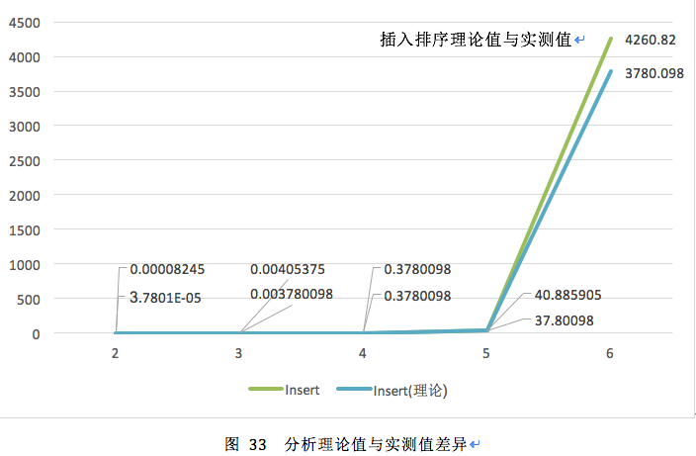
计算算法耗时理论值（以10000数据量为基准），与实测数据比较，横坐标取对数

Slide 49
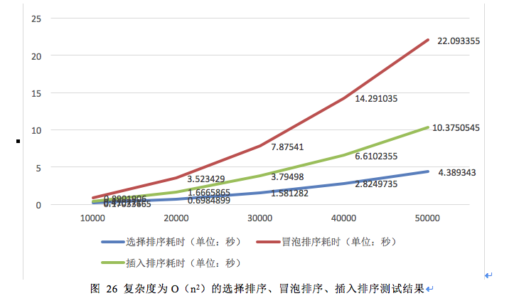
实验分析：将选择排序、冒泡排序、插入排序三种排序的测试结果描点绘制在同一图表，如图所示。

Slide 50
计算三种排序算法的理论值
 | 10000 | 20000 | 30000 | 40000 | 50000
冒泡理论值 | 0.8901906 | 3.5607624 | 8.0117154 | 14.2430496 | 22.254765
插入理论值 | 0.410771 | 1.643084 | 3.696939 | 6.572336 | 10.269275
选择理论值 | 0.17033665 | 0.6813466 | 1.53302985 | 2.7253864 | 4.25841625

Slide 51
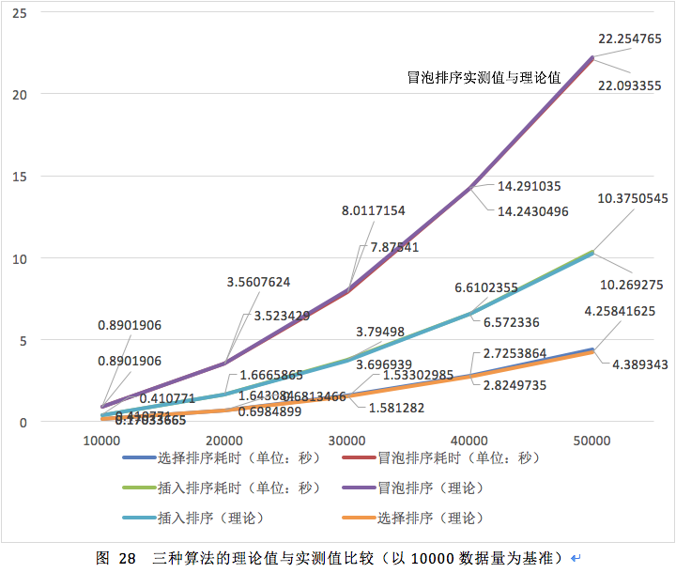

Slide 52
实验分析
三种算法的耗时与n的关系为二次函数，这与理论复杂度是相符合的。

Slide 53
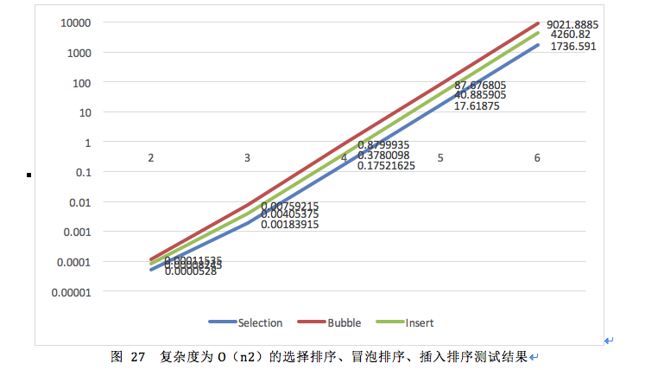
实验分析

Slide 54
实验分析
分析：由上图可以发现实测曲线基本呈线性增长，这是符合预期的。其中冒泡排序算法耗时最多，插入排序次之，选择排序最小。原因是冒泡排序和插入排序的元素移动方面效率非常低下，其中冒泡排序（未优化）的比较次数为（n-1）*（n-1）约等于n²，而插入排序为n！，约等于0.5n²，故冒泡排序效率比插入排序低。选择排序的移动效率最高，平均移动次数最少，故选择排序效率最高。

Slide 55
联系理论与实际进行对比，算法耗时与数据规模的关系可以用函数T = n²表示，横坐标增加1，即n扩大10，则T扩大100。以n = 10000为基准，计算理论耗时，制作表格如下图所示。
 | 2 | 3 | 4 | 5 | 6
Bubble | 8.79994E-05 | 0.008799935 | 0.8799935 | 87.99935 | 8799.935
Insert | 3.7801E-05 | 0.003780098 | 0.3780098 | 37.80098 | 3780.098
Selection | 1.75216E-05 | 0.001752163 | 0.17521625 | 17.521625 | 1752.1625

Slide 56
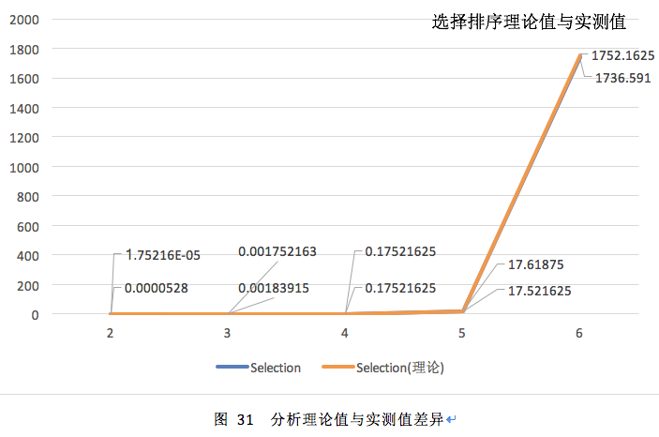

Slide 57
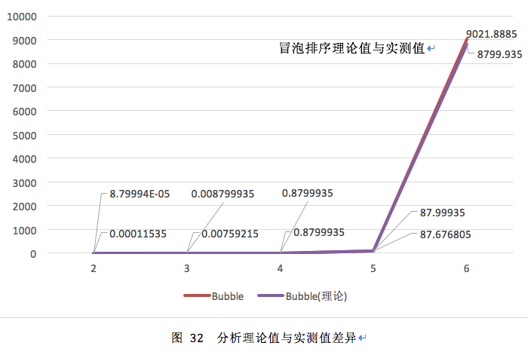

Slide 58
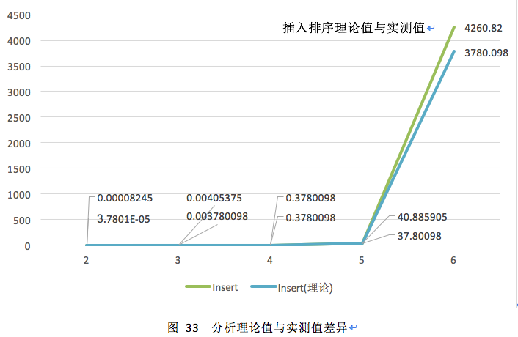

Slide 59
分析：三种算法的耗时与n的关系为二次函数，这与理论复杂度是相符合的。

Slide 60
O(nlogn )复杂度的排序算法分析
快速排序
归并排序

Slide 61
快速排序算法思路
（1）从数据列表中，选择一个元素，称为枢轴值
（2）重新排序列表，把所有数值小于枢轴的元素排到基准之前，所有数值大于基准的排基准之后(相等的值可以有较多的选择)。在这个分区退出之后，该基准就处于数列的中间位置。这个称为分区(partition)操作；
（3）分别递归排序较大元素的子列表和较小的元素的子列表。当列表元素个数<=1

Slide 62
快速排序算法伪代码实现
for each (unsorted) partition
set first element as pivot
storeIndex = pivotIndex + 1
for i = pivotIndex + 1 to rightmostIndex
if element[i] < element[pivot]
swap(i, storeIndex); storeIndex++
swap(pivot, storeIndex - 1)

Slide 63
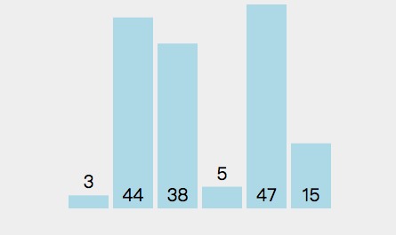
快速排序算法可视化
for each (unsorted) partition
set first element as pivot
storeIndex = pivotIndex + 1
for i = pivotIndex + 1 to rightmostIndex
if element[i] < element[pivot]
swap(i, storeIndex); storeIndex++
swap(pivot, storeIndex - 1)

Slide 64
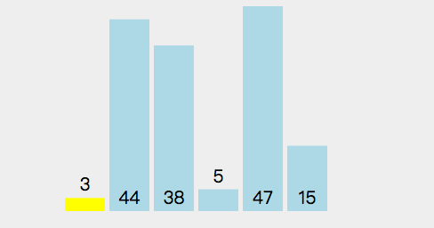
快速排序算法可视化
for each (unsorted) partition
set first element as pivot
storeIndex = pivotIndex + 1
for i = pivotIndex + 1 to rightmostIndex
if element[i] < element[pivot]
swap(i, storeIndex); storeIndex++
swap(pivot, storeIndex - 1)

Slide 65
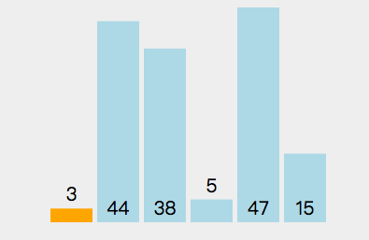
快速排序算法可视化
for each (unsorted) partition
set first element as pivot
storeIndex = pivotIndex + 1
for i = pivotIndex + 1 to rightmostIndex
if element[i] < element[pivot]
swap(i, storeIndex); storeIndex++
swap(pivot, storeIndex - 1)

Slide 66
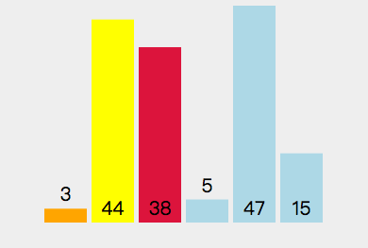
快速排序算法可视化
for each (unsorted) partition
set first element as pivot
storeIndex = pivotIndex + 1
for i = pivotIndex + 1 to rightmostIndex
if element[i] < element[pivot]
swap(i, storeIndex); storeIndex++
swap(pivot, storeIndex - 1)

Slide 67
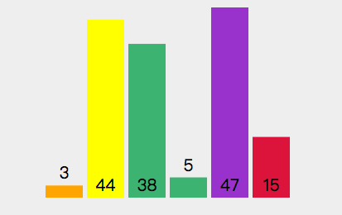
快速排序算法可视化
for each (unsorted) partition
set first element as pivot
storeIndex = pivotIndex + 1
for i = pivotIndex + 1 to rightmostIndex
if element[i] < element[pivot]
swap(i, storeIndex); storeIndex++
swap(pivot, storeIndex - 1)

Slide 68
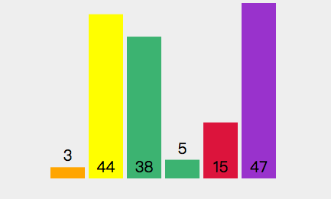
快速排序算法可视化
for each (unsorted) partition
set first element as pivot
storeIndex = pivotIndex + 1
for i = pivotIndex + 1 to rightmostIndex
if element[i] < element[pivot]
swap(i, storeIndex); storeIndex++
swap(pivot, storeIndex - 1)

Slide 69
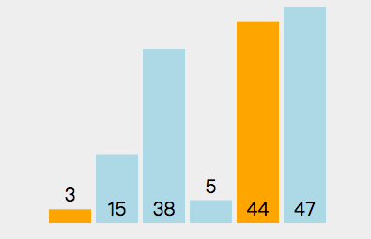
快速排序算法可视化
for each (unsorted) partition
set first element as pivot
storeIndex = pivotIndex + 1
for i = pivotIndex + 1 to rightmostIndex
if element[i] < element[pivot]
swap(i, storeIndex); storeIndex++
swap(pivot, storeIndex - 1)

Slide 70
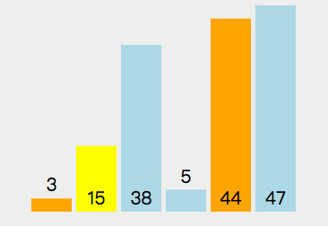
快速排序算法可视化
for each (unsorted) partition
set first element as pivot
storeIndex = pivotIndex + 1
for i = pivotIndex + 1 to rightmostIndex
if element[i] < element[pivot]
swap(i, storeIndex); storeIndex++
swap(pivot, storeIndex - 1)

Slide 71

快速排序算法可视化
for each (unsorted) partition
set first element as pivot
storeIndex = pivotIndex + 1
for i = pivotIndex + 1 to rightmostIndex
if element[i] < element[pivot]
swap(i, storeIndex); storeIndex++
swap(pivot, storeIndex - 1)

Slide 72

快速排序算法可视化
for each (unsorted) partition
set first element as pivot
storeIndex = pivotIndex + 1
for i = pivotIndex + 1 to rightmostIndex
if element[i] < element[pivot]
swap(i, storeIndex); storeIndex++
swap(pivot, storeIndex - 1)

Slide 73

快速排序算法可视化
for each (unsorted) partition
set first element as pivot
storeIndex = pivotIndex + 1
for i = pivotIndex + 1 to rightmostIndex
if element[i] < element[pivot]
swap(i, storeIndex); storeIndex++
swap(pivot, storeIndex - 1)

Slide 74

快速排序算法可视化
for each (unsorted) partition
set first element as pivot
storeIndex = pivotIndex + 1
for i = pivotIndex + 1 to rightmostIndex
if element[i] < element[pivot]
swap(i, storeIndex); storeIndex++
swap(pivot, storeIndex - 1)

Slide 75

快速排序算法可视化
for each (unsorted) partition
set first element as pivot
storeIndex = pivotIndex + 1
for i = pivotIndex + 1 to rightmostIndex
if element[i] < element[pivot]
swap(i, storeIndex); storeIndex++
swap(pivot, storeIndex - 1)

Slide 76

快速排序算法可视化
for each (unsorted) partition
set first element as pivot
storeIndex = pivotIndex + 1
for i = pivotIndex + 1 to rightmostIndex
if element[i] < element[pivot]
swap(i, storeIndex); storeIndex++
swap(pivot, storeIndex - 1)

Slide 77
快速排序算法测试数据
数据规模 | 10000 | 20000 | 30000 | 40000 | 50000
算法用时(s) | 0.0014632 | 0.00371065 | 0.00477245 | 0.0070987 | 0.0087756
数据规模 | 100 | 1000 | 10000 | 100000 | 1000000
算法用时(s) | 0.0000352 | 0.00017485 | 0.00141265 | 0.0185158 | 0.2124974

Slide 78


Slide 79

计算算法耗时理论值（以10000数据量为基准），与实测数据比较，横坐标取对数

Slide 80
归并排序算法思路
归并排序基于分治的思想，将一个待排序序列分成两个长度相等的子序列，为每个子序列排序，然后再将两个序列合并起来。

Slide 81
归并排序算法伪代码实现
split each element into partitions of size 1
recursively merge adjancent partitions
for i = leftPartStartIndex to rightPartLastIndex inclusive
if leftPartHeadValue <= rightPartHeadValue
copy leftPartHeadValue
else: copy rightPartHeadValue
copy elements back to original array

Slide 82

归并排序算法可视化
split each element into partitions of size 1
recursively merge adjancent partitions
for i = leftPartStartIndex to rightPartLastIndex inclusive
if leftPartHeadValue <= rightPartHeadValue
copy leftPartHeadValue
else: copy rightPartHeadValue
copy elements back to original array

Slide 83

归并排序算法可视化
split each element into partitions of size 1
recursively merge adjancent partitions
for i = leftPartStartIndex to rightPartLastIndex inclusive
if leftPartHeadValue <= rightPartHeadValue
copy leftPartHeadValue
else: copy rightPartHeadValue
copy elements back to original array

Slide 84

归并排序算法可视化
split each element into partitions of size 1
recursively merge adjancent partitions
for i = leftPartStartIndex to rightPartLastIndex inclusive
if leftPartHeadValue <= rightPartHeadValue
copy leftPartHeadValue
else: copy rightPartHeadValue
copy elements back to original array

Slide 85

归并排序算法可视化
split each element into partitions of size 1
recursively merge adjancent partitions
for i = leftPartStartIndex to rightPartLastIndex inclusive
if leftPartHeadValue <= rightPartHeadValue
copy leftPartHeadValue
else: copy rightPartHeadValue
copy elements back to original array

Slide 86

归并排序算法可视化
split each element into partitions of size 1
recursively merge adjancent partitions
for i = leftPartStartIndex to rightPartLastIndex inclusive
if leftPartHeadValue <= rightPartHeadValue
copy leftPartHeadValue
else: copy rightPartHeadValue
copy elements back to original array

Slide 87

归并排序算法可视化
split each element into partitions of size 1
recursively merge adjancent partitions
for i = leftPartStartIndex to rightPartLastIndex inclusive
if leftPartHeadValue <= rightPartHeadValue
copy leftPartHeadValue
else: copy rightPartHeadValue
copy elements back to original array

Slide 88

归并排序算法可视化
split each element into partitions of size 1
recursively merge adjancent partitions
for i = leftPartStartIndex to rightPartLastIndex inclusive
if leftPartHeadValue <= rightPartHeadValue
copy leftPartHeadValue
else: copy rightPartHeadValue
copy elements back to original array

Slide 89

归并排序算法可视化
split each element into partitions of size 1
recursively merge adjancent partitions
for i = leftPartStartIndex to rightPartLastIndex inclusive
if leftPartHeadValue <= rightPartHeadValue
copy leftPartHeadValue
else: copy rightPartHeadValue
copy elements back to original array

Slide 90

归并排序算法可视化
split each element into partitions of size 1
recursively merge adjancent partitions
for i = leftPartStartIndex to rightPartLastIndex inclusive
if leftPartHeadValue <= rightPartHeadValue
copy leftPartHeadValue
else: copy rightPartHeadValue
copy elements back to original array

Slide 91

归并排序算法可视化
split each element into partitions of size 1
recursively merge adjancent partitions
for i = leftPartStartIndex to rightPartLastIndex inclusive
if leftPartHeadValue <= rightPartHeadValue
copy leftPartHeadValue
else: copy rightPartHeadValue
copy elements back to original array

Slide 92
归并排序算法测试数据
数据规模 | 10000 | 20000 | 30000 | 40000 | 50000
算法用时(s) | 0.00210685 | 0.00452215 | 0.00662955 | 0.0112717 | 0.01204225
数据规模 | 100 | 1000 | 10000 | 100000 | 1000000
算法用时(s) | 0.0000447 | 0.0001811 | 0.0024956 | 0.02646335 | 0.295913 7

Slide 93


Slide 94

计算算法耗时理论值（以10000数据量为基准），与实测数据比较，横坐标取对数

Slide 95

实验分析：将归并排序、快速排序的测试结果描点绘制在同一图表，如图所示。

Slide 96
计算归并排序和快速排序算法的理论值
数据量 | 10000 | 20000 | 30000 | 40000 | 50000
Merge理论 | 0.00210685 | 0.004530813 | 0.007074467 | 0.00969585 | 0.012375031
Quick理论 | 0.0014632 | 0.003146634 | 0.004913193 | 0.006733734 | 0.008594416

Slide 97

将上表的数据描点绘制在图表上，如图所示。

Slide 98
由图可以得出三种算法的理论耗时与实际耗时十分贴合。与n的关系为nlogn函数，这与理论复杂度是相符合的。

Slide 99

将横坐标取对数

Slide 100
同样是O（nlogn）但快速排序更快：快速排序出现最差的情况并不是由于输入数据，而是选取到的随机数本身，选到极端的情况非常小，所以对于绝大部分数据而言都是能达O（nlogn）的复杂度，而合并排序需要赋值（复制）的操作较多，受输入数据的影响比快排大，所以当数据规模较大时，不受输入数据影响的快速排序更快。

Slide 101
然后进行理论对比分析。联系理论与实际进行对比，算法耗时与数据规模的关系可以用函数T = nlogn表示，横坐标增加1，即n扩大10，则T扩大10倍并加一。以n = 10000为基准，计算理论耗时，制作表格如下图所示。
 | 2 | 3 | 4 | 5 | 6
Merge | 0.000024956 | 0.00024956 | 0.0024956 | 0.024956 | 0.24956
Quick | 1.41265E-05 | 0.000141265 | 0.00141265 | 0.0141265 | 0.141265

Slide 102

分析理论值与实测值差异，可以看到实测效率与理论效率基本一致

Slide 103

分析理论值与实测值差异，可以看到实测效率与理论效率基本一致

Slide 104

将上述五种算法的测试数据统计成一张图表，如图所示。

Slide 105
分析总结：
（1） O(n²)性能分析
平均性能为O(n²)的直接插入排序，选择排序，冒泡排序：
在数据规模较小时，各算法效率差不多。当数据较大时，冒泡排序算法的时间代价最高。
解释：时间复杂度同样为o（n²）的选择、冒泡和插入排序，在对于相同数据的处理上相差的比较大，其中冒泡排序平均耗时最多，其主要原因是：冒泡排序在比较次数上达到了o（n²），但这种排序同时也受交换次数的影响，而且最大时间复杂度也是o（n²）。因此，虽然同样是o（n²）的复杂度，冒泡排序的二次项系数会比另外两个大不少，最为耗时。

Slide 106
分析总结：
（2） O(nlogn)性能分析
平均性能为O(nlogn)的快速排序，归并排序：
其中，快排效率最高，但在待排序列基本有序的情况下，会变成冒泡排序，接近O(n²)。
解释：同样是O（nlogn）但快速排序更快：快速排序出现最差的情况并不是由于输入数据，而是选取到的随机数本身，选到极端的情况非常小，所以对于绝大部分数据而言都是能达O（nlogn）的复杂度，而合并排序需要赋值的操作较多，受输入数据的影响比快排大，所以当数据规模较大时，不受输入数据影响的快速排序更快。

Slide 107
分析总结：
（3） 排序稳定性
插入排序，冒泡排序，归并排序都是稳定的
选择排序，快速排序是不稳定的。

Slide 108
实验心得
本次实验花费了我很多的时间。但加深了我对这几种排序算法的认识。
各种排序算法都有各自的优缺点，适用于不同的条件。因此在选择一种排序算法解决实际问题之前，应当先分析实际问题的类型，再结合各算法的特性，选择一种最合适的算法。

Slide 109
谢谢

