Slide 1
York Code Dojo
Chris Maughan
mornymorny@gmail.com
Coder @ NVIDIA

Slide 2
Puzzles – Why?
Learn better/different ways to do things
Loop(char*) -> for_each(string) -> std::inner_product(string.begin) -> ….?
for(int I = 0… ) -> foreach(…)-> List.Any(item=>….)
Practice new languages
Learn how to optimize
Key: Specific practice vs day-to-day coding
Fun ;)

Slide 3
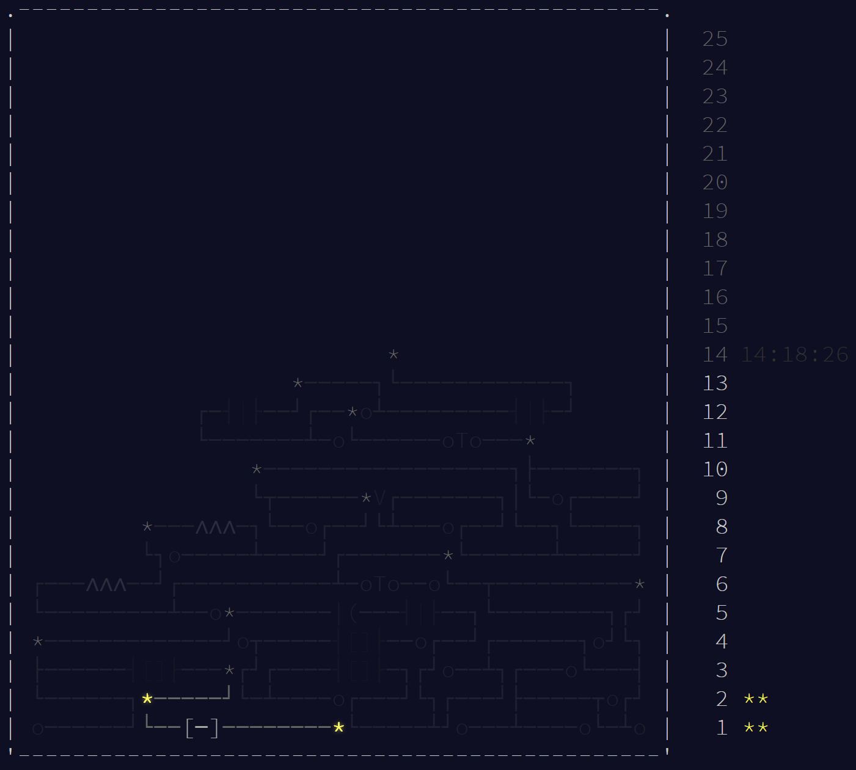
www.adventofcode.com

Slide 4
Approach
Start at the bottom of the tree
Each stage has 2 puzzles, the second is unlocked by the first
Try to solve the problem first
Then try to make it cleaner/easier to read
Premature optimization is the route of all evil
But fun to try making things faster….
Test your solution on the sample data
Too many attempts locks you out for 5 minutes!

Slide 5
First Problem…
“Search a list of numbers and for each [n] == [n+1], accumulate that number into a counter”
Example 4112234 == (1 + 2 + 4)
Because 1 & 1 are pairs, 2 & 2 are pairs, 3 has no pair, 4 wraps!!
Remember the last digit wraps to the first to find if it is part of a pair
Leaderboard code: 243760-b8c600c7

