Slide 1
Unit Testing Game
David Betteridge
david@yorkdevelopers.org
@da_betteridge

Slide 2
Agenda
Quick Introduction
Explain the problem
Work in pairs till 8.45pm
Opportunity to show off solutions
Pub about 9pm

Slide 3
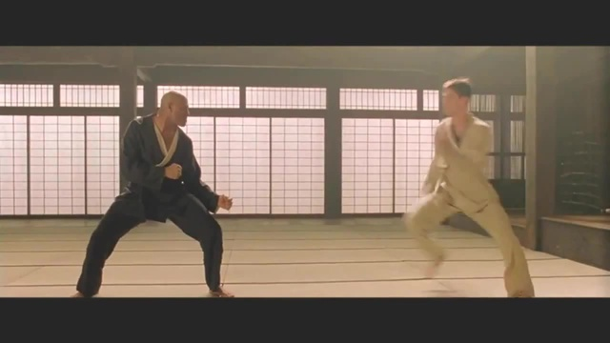
Code Dojo
Notes:
Who has been to a code dojo before?
What is the point?
It’s a place to practice coding safely. By that we mean it doesn’t matter if you haven’t solved the problem by the end of the evening. No one will judge you on it. It’s a place to practice, learn and try out new things.
For example you could use a language you have never used before, partner with someone new, try a different approach to solving the problem. You could add your own constraints; like my functions won’t have more than three lines; or I’m not going to use any IF statements.
(It’s also meant to be fun) It’s driving a car to work every day, you might cover a lot of miles, but if you are doing the same journey then does your driving ability really improve?
It’s driving a car to work every day, you might cover a lot of miles, but if you are doing the same journey then does your driving ability really improve?

Slide 4
The Game
1. Code up a solution to the problem, along with unit tests
2. Extend your solution with your additional requirement
3. Ensure your requirement has unit tests. The unit tests cannot include any comments and can’t duplicate the logic from the requirement.
4. Group-by-group you give me your unit tests, and we all try and implement the functionality by reading your tests
Notes:
Code up a solution to the problem which I will describe in a moment.
Extend your solution with your additional requirement. I will give each group a different requirement.
Ensure your requirement has unit tests. The unit tests cannot include any comments.
Group-by-group you give me your unit tests, and we all try and implement your requirement just using your unit test

Slide 5
Bad Example
[Fact]
public void BadUnitTest()
{
// Check that we can add together two integers
var number1 = 2;
var number2 = 10;
var actual = Add(number1, number2);
Assert.Equal(number1 + number2, actual);
}

Slide 6
How Evil?
It’s up to you to decide how descriptive you make your unit test names
Warning - Future requirements may break your unit tests

Slide 7
The Problem
Eric the elf has invented a new game with some very complicated scoring rules.
Initially you play 100 rounds of the game, each round giving you a numeric score.
Your final score is the sum of each round.
Your first task is to write a function which takes 100 scores as a parameter and then returns the total score.
public int CalculateScore(List<int> rounds)

Slide 8
York Developers
Games Developers (Last Thursday of the month)
Code and Coffee (Monday and Wednesday mornings)
Agile York (3rd Wednesday of the month)
Dot Net York

