Slide 1
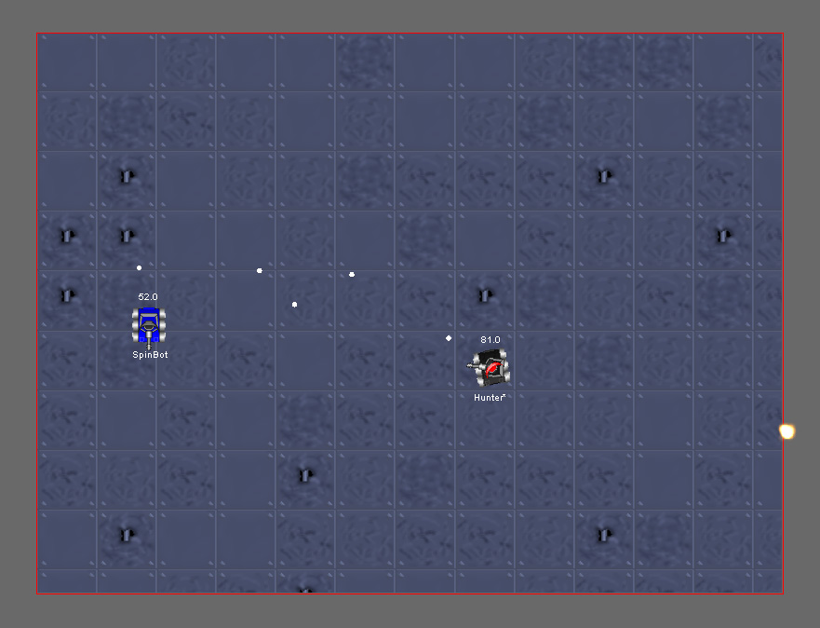

Kevin Smith
@kev_bite / kevsoft.net
@YorkCodeDojo
Notes:
Codeeeee

Slide 2
What’s Robocode?
Robocode is a programming game where the goal is to code a robot battle tank to compete against other robots in a battle arena.
Runs on the Java Runtime but bots can be developed in Java or any language that is compiled down to IL (C#, F#, VB.NET)

Slide 3
What do I need?
Java Standard Edition - https://java.com/en/download/
Robocode - https://sourceforge.net/projects/robocode/files/robocode/1.9.2.6/
robocode-1.9.2.6-setup.jar
robocode.dotnet-1.9.2.6-setup.jar
An IDE – Eclipse, NetBeans, Visual Studio etc…
or notepad & javac/csc
or use my VM

Slide 4
No JavaScript?!
RoboJS – Robocode in JavaScript
Port of Robocode
Only runs JavaScript
Requires hacking HTML
Can’t play in battle at end
http://gumuz.nl/projects/robojs/

Slide 5
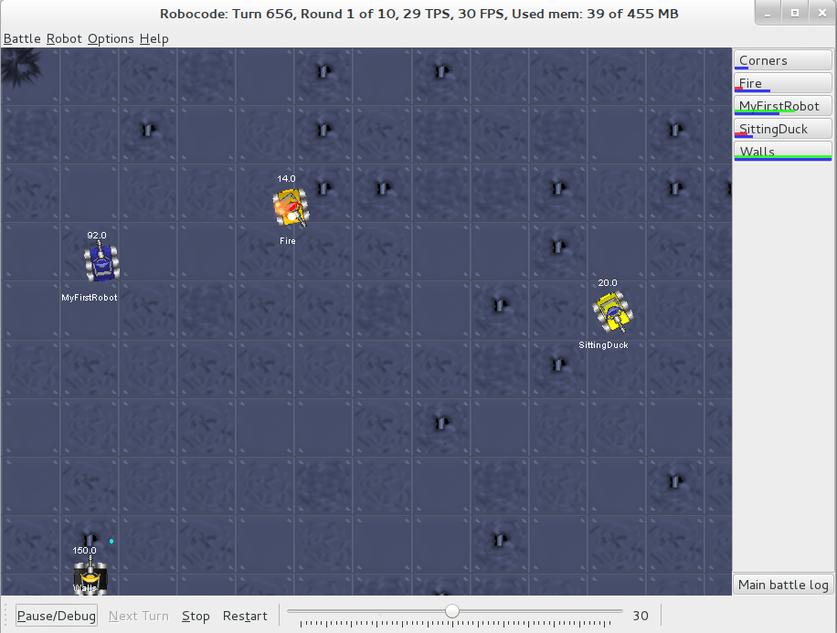
The Arena

Slide 6
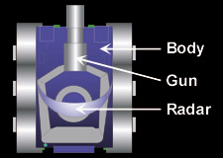
Robot Anatomy
Body - Carries the gun with the radar on top. The body is used for moving the robot ahead and back, as well as turning left or right.
Gun - Mounted on the body and is used for firing energy bullets. The gun can turn left or right.
Radar - Mounted on the gun and is used to scan for other robots when moved. The radar can turn left or right. The radar generates onScannedRobot events when robots are detected.

Slide 7

Movements
Backward
Forward
Turn Left
Turn Right

Slide 8
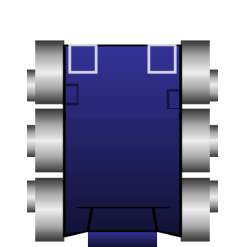
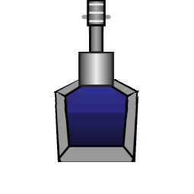

Attacking
Turn Radar Left
Turn Radar Right
Turn Gun Right
Turn Gun Left
Fire
Scanning

Slide 9
Battles

Slide 10
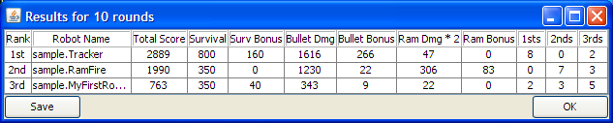
Scoring
Total Score
Survival Score
Last Survivor Bonus
Bullet Damage
Bullet Damage Bonus
Ram Damage
Ram Damage Bonus
1sts, 2nds, 3rds
Notes:
Total Score - This is everything else added up, and determines each robot's rank in this battle.
Survival Score - Each robot that's still alive scores 50 points every time another robot dies.
Last Survivor Bonus - The last robot alive scores 10 additional points for each robot that died before it.
Bullet Damage - Robots score 1 point for each point of damage they do to enemies.
Bullet Damage Bonus - When a robot kills an enemy, it scores an additional 20% of all the damage it did to that enemy.
Ram Damage - Robots score 2 points for each point of damage they cause by ramming enemies.
Ram Damage Bonus - When a robot kills an enemy by ramming, it scores an additional 30% of all the damage it did to that enemy.
1sts, 2nds, 3rds - These do not actually contribute to score, but are there to show how long the robot survived, i.e. the number of rounds the robot was placed 1st, 2nd, and 3rd.

Slide 11
Show me some code
Inherit/Extend `Robot` class
Override `void Run()`
Override `void OnScannedRobot(ScannedRobotEvent e)`
Override `void OnHitByBullet(HitByBulletEvent e)`
Override `void OnHitRobot(HitRobotEvent e)`
C# - https://github.com/robo-code/robocode/blob/master/plugins/dotnet/robocode.dotnet.samples/src/SampleCs/MyFirstRobot.cs
Java - https://github.com/robo-code/robocode/blob/master/robocode.samples/src/main/java/sample/MyFirstRobot.java

Slide 12
More code…
Ahead(double distance) / Back(double distance)
TurnGunLeft(double degrees) / TurnGunRight(double degrees)
TurnLeft(double degrees) / TurnRight(double degrees)
TurnRadarLeft(double degrees) / TurnRadarRight(double degrees)
DoNothing()
Fire(double power)
Stop()
Resume()
Scan()

Slide 13
Let me code (Java)
package {team-name};
import robocode.HitByBulletEvent;
import robocode.HitRobotEvent;
import robocode.Robot;
public class {bot-name} extends Robot { }

Slide 14
Let me code (C#)
using Robocode;
using Robocode.Util;
namespace {team-name}
{
public class {bot-name}: Robot { }
}

Slide 15
Example Robot
public class Fire extends Robot {
public void run() {
// Spin the gun around slowly... forever
while (true) {
turnGunRight(5);
fire(1);
}
}
public void onHitRobot(HitRobotEvent e) {
double turnGunAmt =
normalRelativeAngleDegrees(e.getBearing() + getHeading() - getGunHeading());
turnGunRight(turnGunAmt);
fire(3);
}
}

Slide 16
Resources
Wiki - http://robowiki.net/
Java Examples - https://github.com/robo-code/robocode/blob/master/robocode.samples/src/main/java/sample/
C# Examples - https://github.com/robo-code/robocode/blob/master/plugins/dotnet/robocode.dotnet.samples/src/SampleCs

Slide 17
Bot Ideas
Running and Firing
Scan, Fire then Ram
Spin and Fire
Artificial Intelligence
Machine Learning

Slide 18
Packing Robot
Java - http://robowiki.net/wiki/Robocode/Package_Robot
.NET – Send Dlls

Slide 19
Exercises
Pair Up
Make an Awesome Bot
Explain Ideas & Battle
Notes:
Time permitting

