Slide 1
Mapping Teacher Recruitment, Retention and Development in the ERP Newsletter 30th March 2026 Louise Yorke l.yorke@ucl.ac.uk

Slide 2
Key Question: What does the ERP newsletter reveal about how teacher recruitment, retention and development (TRRD) is framed, and what are the gaps that we should pay attention to?
Who contributes to the conversation?
How is TRRD discussed and how has this shifted over time?
How are teachers discussed across EdTech and mental health & wellbeing?

Slide 3
Overview

Slide 4
ERP Newsletter Overview
How the newsletter works:
Weekly digest of education content curated by the ERP team
12–20 items per issue, categorised into themes and subthemes
Descriptions drawn directly from the original source
The full dataset:
107 issues, 102 in this analysis
1,654 items, 212 organisations
July 2023 - March 2026

Slide 5
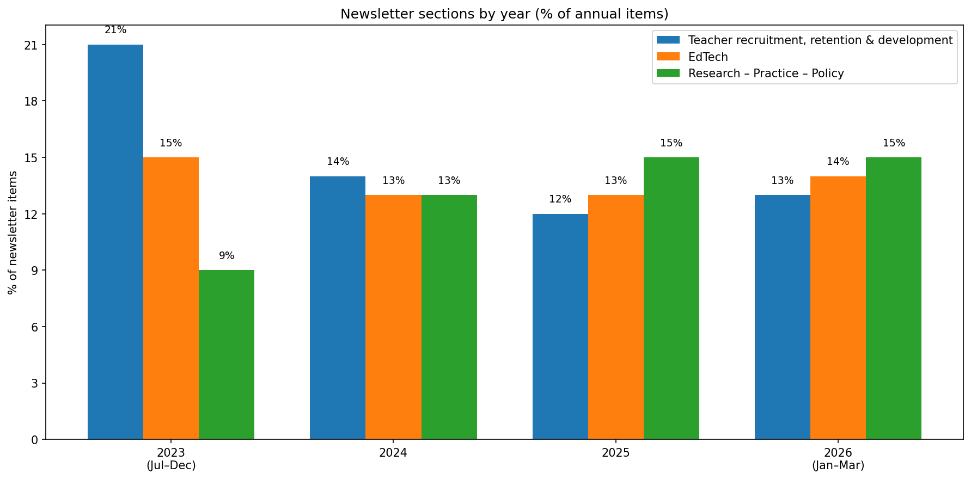
TRRD in the Newsletter
233 items (14% of the newsletter) from 42 unique organisations
Media (n=386); Government (n=327); Academic & research (n=342); Civil society & think tanks (n=275); Other (n=69)
Note: 2023 and 2026 are partial years - figures should be interpreted with caution.

Slide 6
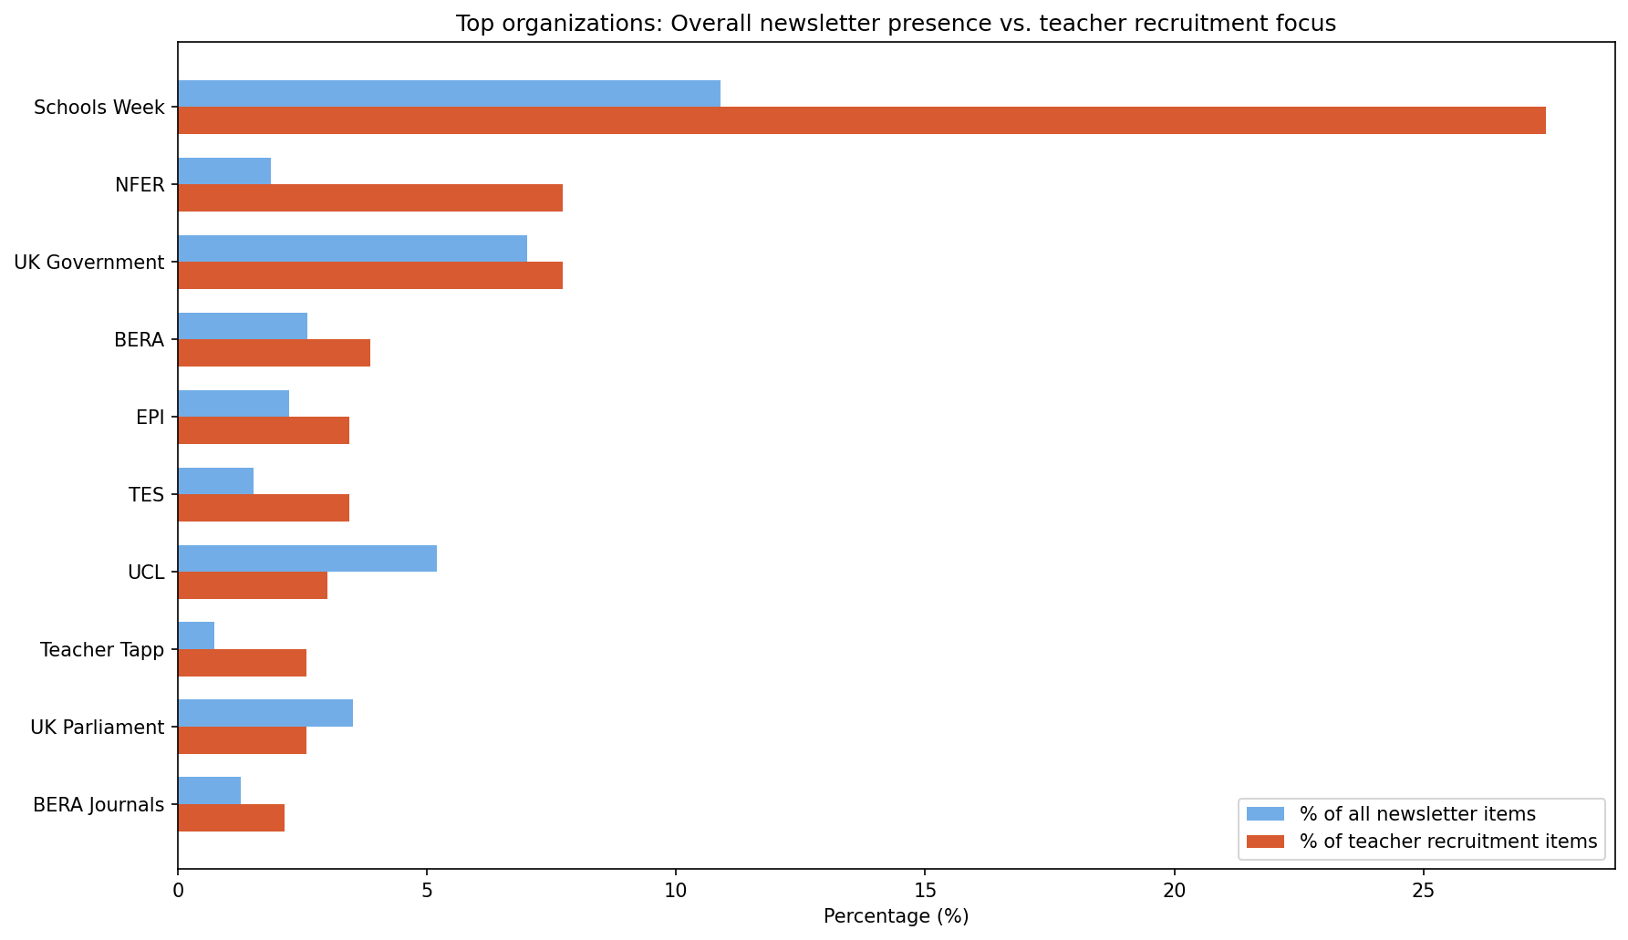
Who dominates the discourse on TRRD?
The conversation is shaped by high-output media and selective expertise
Schools Week dominates by volume (27% of TRRD coverage)
NFER contributes selectively - 2% of overall dataset but nearly half its items are on TRRD

Slide 7
How is TRRD discussed?

Slide 8
How TRRD is discussed:
 | Definition | Top 5 Keywords | Percent
Supply & pipeline | Refers to the systems and processes involved in attracting, training, and retaining sufficient numbers of teachers to meet workforce demand. | recruitment, retention, training, shortage, workforce | 53%
Crisis & Reform | Refers to how teaching and education are represented through political narratives, including policy agendas, crisis discourse, and proposed reforms. | crisis, reform, targets, parliament, DfE | 38%
Professional development | Refers to structured and ongoing opportunities for teachers to develop skills, progress in their careers, and take on leadership roles. | CPD, career, leadership, NPQ, ECF | 35%
Working conditions | Refers to the material and psychological conditions of teachers’ work, including pay, workload, and overall wellbeing. | pay, workload, wellbeing, stress, burnout | 30%
Diversity & equity | Refers to efforts to promote inclusion, representation, and equitable support for diverse and disadvantaged groups within education. | diversity, disadvantaged, SEND, inclusion, communities | 12%
Frames were defined by the researchers and applied through keyword matching - items can carry multiple frames, so percentages sum to more than 100%.

Slide 9
How key organisations discuss teacher recruitment
 | Supply & Pipeline | Working Conditions | Professional Development | Diversity & Equity | Crisis & Reform | No. Items
British Educational Research Association (BERA) | 44% | 33% | 67% | 11% | 33% | 9
Chartered College of Teaching (CCT) | 20% | — | 100% | 60% | — | 5
Education Endowment Foundation (EEF) | 100% | 33% | — | — | 67% | 3
Education Policy Institute (EPI) | 38% | 25% | 63% | 13% | 25% | 8
Nat. Foundation for Educational Research (NFER) | 72% | 17% | 28% | 33% | 33% | 18
UK Government | 44% | 39% | 39% | 6% | 61% | 18
UK Parliament | 100% | — | 17% | — | 83% | 6
Government and media focus on supply and crisis while academic bodies focus on professional development.
Notes:
Note: Selected organisations represent key policy, research and practitioner voices.
Supply & Pipeline is the most common frame; Professional Development and Crisis & Reform are similarly prevalent; Diversity & Equity is the least represented.

Slide 10
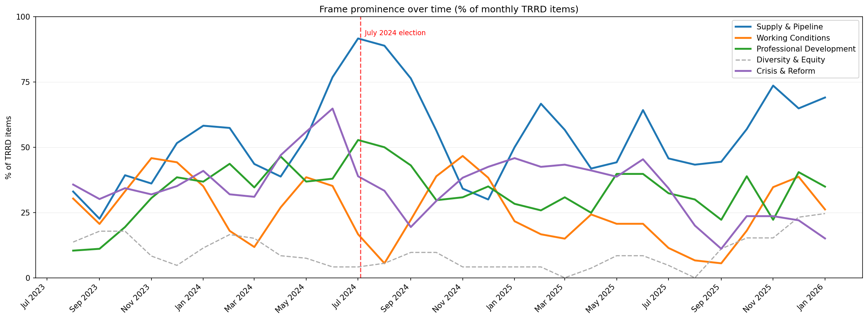
Discourse on TRRD over time
Supply & Pipeline dominates throughout, the election temporarily amplified crisis framing
Notes:
Prominence of each frame over time relative to the total TRRD coverage each month, with a 3-month rolling average to smooth out the natural spikiness of monthly newsletter data.

Slide 11
How are teachers discussed across EdTech and Mental Health & Wellbeing?

Slide 12
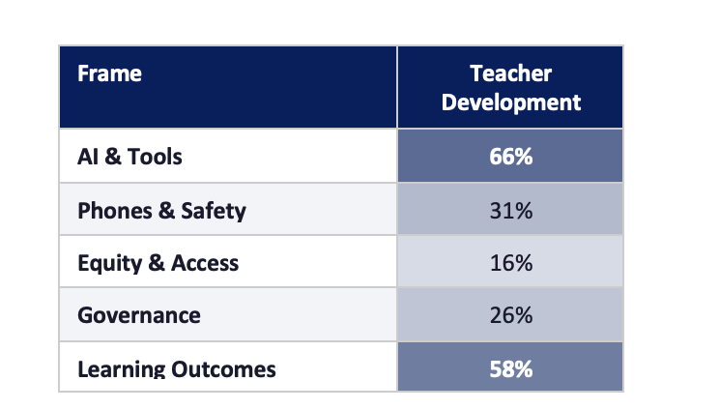
Teachers in the EdTech Conversation
In the EdTech section, 67 items discuss teachers (keywords: ‘teacher’, ‘CPD’, ‘professional development’, ‘workforce’, ‘leadership’)
Government and parliament lead the teacher conversation in EdTech;
Practitioner bodies (Chartered College, Teacher Tapp, Nuffield) are well represented
When teachers appear in EdTech coverage, the conversation is primarily about AI tools and learning outcomes

Slide 13
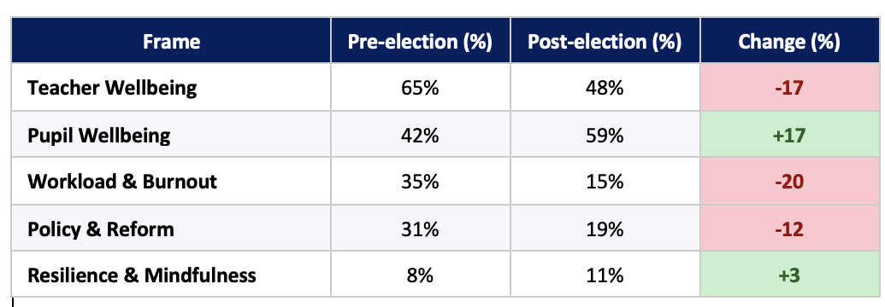
Mental Health & Wellbeing
53 items discuss mental health & wellbeing - drawn from Teacher RRD and What Matters in Education sections (stable coverage across time)
Parliamentary and media sources lead the conversation
After the election, mental health discourse shifted from teacher conditions toward pupil wellbeing
Post-election, attention shifted from teacher conditions to pupil wellbeing
Notes:
Schools Week, BERA, Teacher Tapp, Education Support Charity and UK Government discuss teacher and MH&W specifically

Slide 14
Summary and Key Insights

Slide 15
Key Insights
Three insights around these questions
Who contributes to the conversation?
How is TRRD discussed and how has this shifted over time?
How are teachers discussed across EdTech and mental health & wellbeing?

Slide 16
Extra Slides

Slide 17
***EXTRA SLIDES***

Slide 18
Teachers and Mental Health & Wellbeing
 | Definition | Top 5 Keywords | Percent
Teacher wellbeing | Refers to the mental health, professional satisfaction and working conditions of teachers and school staff | teacher, staff, workforce, professional, wellbeing | 57%
Pupil wellbeing | Refers to the emotional, mental and physical health of pupils and young people, including pastoral care and safeguarding | pupil, student, children, pastoral, safeguarding | 51%
Workload & burnout | Refers to the pressures and demands of work that affect the mental and physical health of teachers and pupils | workload, burnout, stress, overwork, pressures | 25%
Policy & reform | Refers to government and institutional responses to mental health in education, including guidance and regulatory frameworks | policy, government, DfE, reform, guidance | 25%
Resilience | Refers to approaches that build emotional coping capacity, including mindfulness programmes and resilience strategies | resilience, mindfulness, emotional, anxiety, coping | 9%

Slide 19
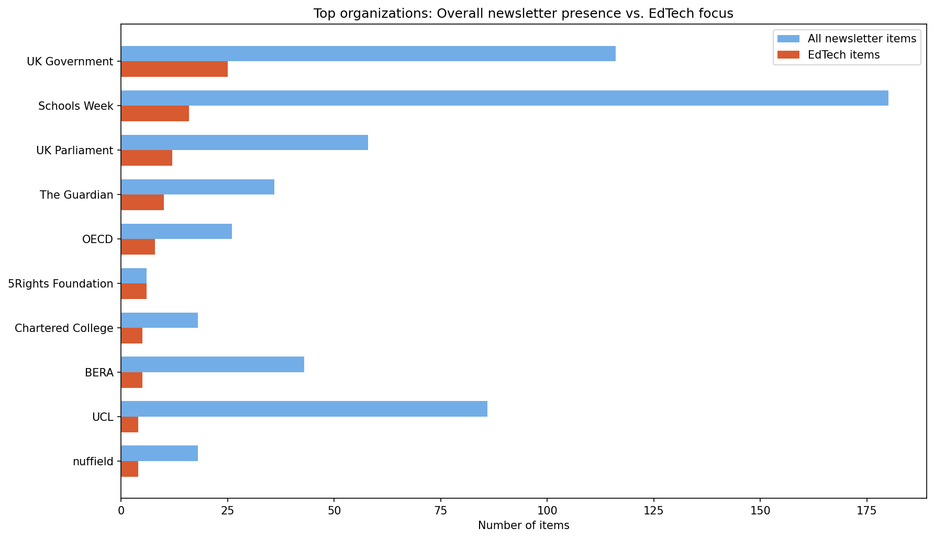
Who dominates the discourse on EdTech?

Slide 20
Who dominates the discourse on EdTech?
Key insights
UK Government and Schools Week dominate by volume
5Rights Foundation is small overall but almost exclusively EdTech
UCL and BERA are largely absent from EdTech
Compared to TRRD
Both sections dominated by high-volume generalist sources
Academic organisations are more absent from EdTech than TRRD, the research voice is weaker
TRRD has a clearer academic vs media split; EdTech is more uniformly media and government led
NFER is the selective specialist in TRRD; 5Rights plays an equivalent but smaller role in EdTech

