Slide 1
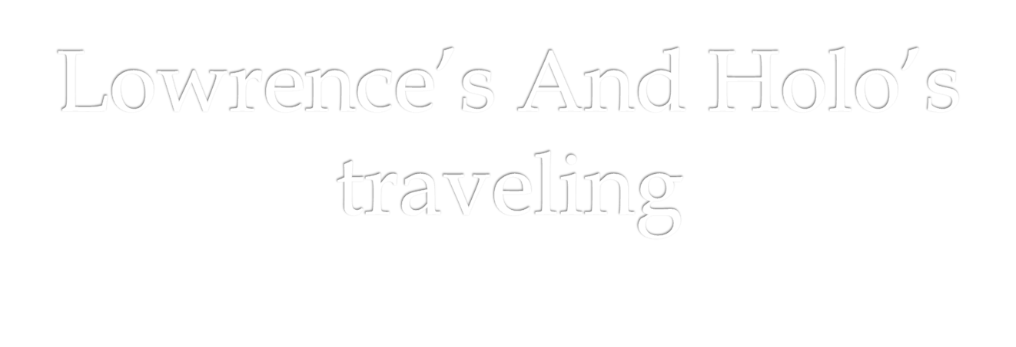

Slide 2
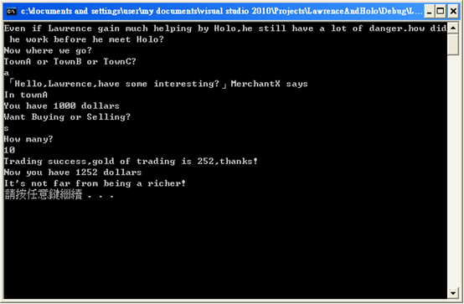

Slide 3
class BaseMerchand
{
private:
int Wariness;
int Negotiation;
public:
void SetWariness(int Value){Wariness=Value;}
void SetNegotiation(int Value){Negotiation=Value;}
int GetWariness(){return Wariness;}
int GetNegotiation(){return Negotiation;}

Slide 4
class TravelingMerchant : public BaseMerchand
{
public:
double PriceReduction() //override
{
return GetNegotiation()*0.11;
}
double PriceRising() //override
{
return GetNegotiation()*0.13+Traveling(Distance);
}
double Traveling(int Distance){return Distance*0.15;}
};

Slide 5
if(Destination=="townA"||Destination=="towna"||Destination=="A"||Destination=="a")
{
UniformDestination='A';
}
else if(Destination=="townB"||Destination=="townb"||Destination=="B"||Destination=="b")
{
UniformDestination='B';
}
else if(Destination=="townC"||Destination=="townc"||Destination=="C"||Destination=="c")
{
UniformDestination='C';
}

Slide 6
#include <stdlib.h>
#include <time.h>
srand((unsigned) time(&t));
TradingMerchant.SetWariness(rand()%10);
srand((unsigned) time(&t));
TradingMerchant.SetNegotiation(rand()%10);

Slide 7
switch(UniformKindOfTrading)
//0 means selling ; 1 means buying
case 0://Lawrence is selling
if(Lawrence.PriceRising()-TradingMerchant.PriceReduction()>0) {
GoldOFTradeRadio=(Lawrence.PriceRising()- TradingMerchant.PriceReduction())*(10- TradingMerchant.GetWariness())*0.1;
}
else {
GoldOFTradeRadio=(TradingMerchant.PriceReduction()- Lawrence.PriceRising())*(10-Lawrence.GetWariness())*0.1;
}
break;

Slide 8
switch(UniformDestination)
case 'A':
GoldOFTrade=GoldOFTradeRadio*PriceOfMerchandiseA*NumOfTrading;
break;
case 'B':
GoldOFTrade=GoldOFTradeRadio*PriceOfMerchandiseB*NumOfTrading;
break;
case 'C':
GoldOFTrade=GoldOFTradeRadio*PriceOfMerchandiseC*NumOfTrading;
break;

