Slide 1
DEEP LEARNING · SESSION 2
Convolutional
Neural Networks
From the convolution operation to the architectures that power modern computer vision
Based on Goodfellow, Bengio & Courville (2016) and Stanford CS231n

Slide 2
ROADMAP
What we will cover today
01
The convolution operation
Kernels, feature maps, non-linearity and multi-channel filters
02
Why convolution works
Sparse interactions, parameter sharing, equivariance
03
Anatomy of a conv layer
Stride, padding, pooling and counting parameters
04
Landmark architectures
LeNet, AlexNet, VGG, GoogLeNet, ResNet, transfer learning
05
Beyond classification
Detection, semantic and instance segmentation

Slide 3
01
How a kernel slides over a grid to build a feature map
Why we apply an element-wise non-linearity afterwards
The convolution
operation
From a single filter to a full 3D output volume

Slide 4
DEFINITION
What is a convolutional neural network?
A specialised kind of neural network for processing data with a known, grid-like topology.
A typical CNN pipeline
Input image
Convolution · learn filters
Grid data: images (2D grid of pixels), time series (1D grid of samples), video, audio spectrograms
Convolutional networks use convolution in place of general matrix multiplication in at least one of their layers
The kernel is a small set of repeated weights that is reused everywhere in the input
Non-linearity · ReLU
Pooling · downsample
…repeat the block…
Fully connected → softmax

Slide 5
THE CORE OPERATION
2D convolution: how it works
Slide the kernel over the input, one step at a time — the step size is the stride
At every position, multiply element-wise and sum the products
Each sum becomes one cell of the output, called the feature map or convolved feature
The kernel weights are shared: the same 9 numbers are used at every position
Input image (5 × 5)
Kernel (3 × 3)
Feature map (3 × 3)
1
1
1
0
0
1
0
1
4
3
4
0
1
1
1
0
0
1
0
2
4
3
0
0
1
1
1
1
0
1
2
3
4
0
0
1
1
0
0
1
1
0
0
1·1 + 1·0 + 1·1 + 0·0 + 1·1 + 1·0 + 0·1 + 0·0 + 1·1 = 4
Output cell = Σ (input patch × kernel), element by element

Slide 6
AFTER THE CONVOLUTION
Non-linearity, and what filters actually detect
Element-wise non-linearity
The same operation, different weights
After obtaining a feature map we apply an element-wise non-linear transformation — usually ReLU — to obtain the transformed feature map. Without it, stacking convolutions would collapse into a single linear operation.
0
0
0
0
1
0
Identity
0
0
0
1
0
-1
0
0
0
Edge detection
Feature map
ReLU: max(0, x)
-1
0
1
0
-1
0
Negative activations are clipped to zero, so each filter reports only where its pattern is present — never how strongly it is absent.
-1
5
-1
Sharpen
0
-1
0
1
1
1
1
1
1
Box blur (× 1/9)
1
1
1
Kernel examples: en.wikipedia.org/wiki/Kernel_(image_processing)

Slide 7
DEPTH
One filter, one feature map — so we use many
A single kernel detects a single pattern. Using K filters produces K feature maps, stacked into an output volume.
Filters always span the full depth of their input: for an RGB image a 5 × 5 filter is really 5 × 5 × 3.
The filter slides only in width and height — never in depth — so the output of one filter is always 2-D.
Output volume = W' × H' × K, where K is the number of filters, also called the kernel depth.
Using 3 filters produces 3 feature maps
3 filters
5 × 5 × 3
Input 32 × 32 × 3
3 feature maps → one output volume
Early layers learn edges and colour blobs; deeper layers combine them into textures, parts and objects.

Slide 8
02
Sparse interactions — small kernels, few connections
Parameter sharing — one kernel reused everywhere
Why convolution
works
Equivariant representations — shift in, shift out

Slide 9
WHY CONVOLUTION WORKS
Key idea 1 — Sparse interactions
Traditional fully connected layers use a separate parameter for every input–output pair, so every output unit interacts with every input unit. Convolutional layers make the kernel smaller than the input, so each output sees only a local patch.
Sparse connections — kernel of width 3
Dense connections — fully connected layer
s₁
s₂
s₃
s₄
s₅
s₁
s₂
s₃
s₄
s₅
x₁
x₂
x₃
x₄
x₅
x₁
x₂
x₃
x₄
x₅
Only three inputs — x₂, x₃, x₄ — affect s₃
Every one of the five inputs affects s₃
Dense layer
Convolutional layer
Fewer parameters → lower memory cost and better statistical efficiency
Fewer operations → the forward pass gets dramatically cheaper
An image may have millions of pixels, yet edges are detectable with kernels covering only tens of pixels
m × n
k × n
parameters, O(m × n) runtime
parameters, with k ≪ m
Figure after Goodfellow, Bengio & Courville, 2016 — Section 9.2

Slide 10
DEPTH COMPOUNDS LOCALITY
Sparse now, global later: growing receptive fields
Units in deeper layers connect only to a small patch of the layer below — but that patch was itself built from a patch of the layer below it.
So deeper layers indirectly interact with a much larger portion of the input.
The network describes complicated interactions among many variables using simple building blocks that each describe only sparse interactions.
This is the same argument VGG later turns into a design rule: stack small filters instead of using one large one.
Two stacked convolutional layers, kernel width 3
output g
g₁
g₂
g₃
g₄
g₅
hidden h
h₁
h₂
h₃
h₄
h₅
input x
x₁
x₂
x₃
x₄
x₅
Two layers of width-3 kernels already give the top unit a receptive field of five inputs — and it keeps growing with depth.
g₃ sees only three units of h — but through them it is influenced by all five inputs.

Slide 11
WHY CONVOLUTION WORKS
Key idea 2 — Parameter sharing
Parameter sharing means using the same parameter for more than one function in a model. In a traditional network each weight is used exactly once; in a CNN each member of the kernel is used at every position of the input.
One kernel, every location
Tied weights
w₁
w₂
w₃
When the weight applied to one input is tied to a weight applied to another input, the network is said to have tied weights. Rather than learning a separate set of parameters for every location, we learn only one set.
w₄
w₅
w₆
w₇
w₈
w₉
9 learned weights
Runtime is unchanged — still O(k × n) for the forward pass
Storage drops to just k parameters instead of m × n
Since m and n are usually similar, k is practically insignificant next to m × n
applied at every position of the input

Slide 12
WHY CONVOLUTION WORKS
Key idea 3 — Equivariance to translation
A function f is equivariant to a function g if f( g(x) ) = g( f(x) )
Shifting the input and then convolving gives the same result as convolving and then shifting the output.
If we move an object in the image, its representation moves by the same amount in the feature map.
This is useful whenever a function of a few neighbouring pixels is worth applying everywhere — edge detection is the classic example, since the same edges appear all over an image.
input
feature map
Careful: convolution is NOT naturally equivariant to scaling or rotation. Those need other mechanisms — data augmentation, multi-scale features, or specialised architectures.
input shifted right
feature map shifts too

Slide 13
03
Output size, stride and zero padding
Pooling: what it summarises and why
Anatomy of a
convolutional layer
A fully worked parameter-counting problem

Slide 14
COUNTING WEIGHTS
The parameters of a convolutional layer
The layer's parameters are a set of learnable filters.
Each neuron connects only to a local region of the input volume — its receptive field, which is exactly the filter size.
A filter always spans the full depth of the input volume, plus one bias term.
5 × 5 × 3 + 1
width × height × input depth + bias
= 76 parameters per filter
three filters → 76 × 3 = 228 parameters in the whole layer
Worked example
Input 32 × 32 × 3 (an RGB CIFAR-10 image), three 5 × 5 filters with stride 1.
How many parameters does one filter have?
The rule to memorise
params = ( K × K × D_in + 1 ) × K_out
Notice what is absent: the spatial size of the input. A conv layer costs the same whether it sees a 32 × 32 or a 512 × 512 image.

Slide 15
SIZING A LAYER
Output size and stride
Output size = ( N − K ) / S + 1
N = input size K = kernel size S = stride
The result must be an integer, otherwise the filter does not fit the input cleanly.
Try it
Stride is a downsampling knob
N = 5
K = 3
S = 1
(5 − 3)/1 + 1 = 3
stride 1 — dense, overlapping windows
N = 7
K = 3
S = 2
(7 − 3)/2 + 1 = 3
stride 2 — the window jumps, output halves
N = 32
K = 5
S = 1
(32 − 5)/1 + 1 = 28
Larger strides mean fewer computations and a smaller output — an alternative to pooling for downsampling.
N = 6
N = 6
K = 3
K = 3
S = 2
S = 2
(6 − 3)/2 + 1 = 2.5 ✗
(6 − 3)/2 + 1 = 2.5 ✗

Slide 16
BORDERS
Zero padding: keeping the output the same size
Without padding, the edges of the image are only partially processed and the output is smaller than the input.
Padding surrounds the input with zeros so the kernel can be centred on border pixels too.
With stride 1, a padding of P = (K − 1) / 2 gives an output exactly the same size as the input — often called 'same' padding.
With padding, the size formula becomes ( N − K + 2P ) / S + 1.
5 × 5 input padded with one ring of zeros → 7 × 7
0
0
0
0
0
0
0
0
0
2
2
0
1
0
0
2
1
0
1
1
0
0
2
1
1
0
2
0
0
0
0
2
2
1
0
0
1
2
2
0
2
0
0
0
0
0
0
0
0
K = 3 → P = 1 K = 5 → P = 2 K = 7 → P = 3
The 3 × 3 kernel can now start centred on the true corner pixel, so the output stays 5 × 5.

Slide 17
DESIGN CHOICES
The four hyper-parameters of a conv layer
K
Kernel width
K_out
Kernel depth
How big a patch each neuron sees. Wider kernels add parameters and shrink the output, but capture more context.
How many filters we use — this becomes the depth of the output volume and controls representational capacity.
S
Stride
P
Zero padding
How far the filter moves between positions, typically 1 or 2. Larger strides downsample the representation.
How many rings of zeros surround the input. Keeps the representation large, at extra time and memory cost.

Slide 18
POOLING
Pooling: the third stage of a conv layer
A typical layer of a convolutional network runs in three stages:
1
Convolution stage
2
Detector stage
3
Pooling stage
Several convolutions run in parallel to produce a set of linear activations (an affine transform).
Each linear activation is passed through a non-linear activation function, such as ReLU.
A pooling function modifies the output further, replacing it with a summary of nearby values.
Common pooling functions
What pooling does
Max pooling — the maximum output within a rectangular neighbourhood (Zhou & Chellappa, 1988)
A pooling function replaces the output of the net at a certain location with a summary statistic of the nearby outputs.
Average pooling — the mean of a rectangular neighbourhood
L2-norm pooling — the L2 norm of a rectangular neighbourhood
Weighted average — weighted by distance from the central pixel

Slide 19
POOLING
Max pooling in action
Single depth slice (4 × 4)
Output (2 × 2)
Pooling uses the same size formula
1
1
2
4
6
8
( 4 − 2 ) / 2 + 1 = 2
5
6
7
8
3
4
Pooling has no learnable parameters at all — it is a fixed function, so it adds zero weights to the model.
3
2
1
0
max pool, 2 × 2 filter,
stride 2
1
2
3
4
A 2 × 2 max pool with stride 2 discards 75 % of the activations and keeps only the strongest response in each window.
Pooling is applied independently to every depth slice, so the number of channels never changes.
Modern architectures increasingly replace pooling with strided convolutions — ResNet uses stride-2 convs, and GoogLeNet ends with global average pooling.

Slide 20
POOLING
Why pooling? Invariance to translation
Max pooling with a stride of one and a pooling width of three
Pooling helps the representation become approximately invariant to small translations of the input: if we translate the input by a small amount, the values of most of the pooled outputs do not change.
Invariance to local translation is a very useful property if we care more about whether some feature is present than exactly where it is.
When determining whether an image contains a face, we need not know the location of the eyes with pixel-perfect accuracy — only that there is an eye on the left side and an eye on the right side.
POOLING STAGE
⋯
1.
1.
1.
0.2
⋯
⋯
0.1
1.
0.2
0.1
⋯
DETECTOR STAGE
the same network, after the input has been shifted to the right by one pixel
POOLING STAGE
⋯
0.3
1.
1.
1.
⋯
Every value in the detector row has changed, but only half of the values in the pooling row have changed.
⋯
0.3
0.1
1.
0.2
⋯
DETECTOR STAGE

Slide 21
POOLING
Why pooling? Learning invariances
In this example we use three filters, each tuned to a slightly different orientation of the digit 5.
When a 5 appears in the input, the corresponding filter matches it and causes a large activation in one detector unit.
The max-pooling unit then has a large activation regardless of which detector unit was activated.
If we pool over the outputs of separately parameterized convolutions, the features can learn which transformations to become invariant to.
Three filters, each matching a different orientation — one shared pooling unit
Large response
in pooling unit
Large response
in pooling unit
5
5
5
5
5
5
detector units
detector units
5
5
Same pooling output, different detector — the invariance is learned, not built in.
input matches detector unit 1
input matches detector unit 3

Slide 22
POOLING
Why pooling? Down sampling
Max pooling with a pool width of three and a stride between pools of two
1.
0.2
0.1
3 pooling units
0.1
1.
0.2
0.1
0.0
0.1
6 detector units
This reduces the representation size by a factor of two, which reduces the computational and statistical burden on the next layer.
Fewer pooling units than detector units
Computational efficiency
Statistical efficiency and memory
Because pooling summarises the responses over a whole neighbourhood, we can report summary statistics for regions spaced k pixels apart rather than 1 pixel apart.
The next layer then has roughly k times fewer inputs to process — here k = 2, so the representation halves.
The reduction in input size also improves statistical efficiency and reduces the memory needed to store the parameters.

Slide 23
PRACTICE
Solved problem: counting parameters
Consider a CNN with the following layers:
Input layer
one channel, 32 × 32
Questions
a. Compute the dimensions and the number of parameters at both the convolutional and the pooling layers.
b. Determine the number of weights in the fully connected layer.
Convolutional layer
6 filters of size 5 × 5, padding 2, stride 1
Pooling layer
2 × 2 max pooling, stride 2, padding 0
Fully connected layer
N output neurons
Hint: padding adds 2 rows and 2 columns on each side — 4 in total per dimension.

Slide 24
PRACTICE
Solution, step by step
Convolutional layer — parameters
6 × ( 5 × 5 + 1 bias ) = 156
Answer (b)
Pooling layer — parameters
0 — pooling has nothing to learn
( 1 536 + 1 ) × N
Input size after padding
32 + 2 × 2 = 36
= 1 537 N weights
Size after the convolution
( 36 − 5 ) / 1 + 1 = 32 (same as the input)
for N output neurons
Convolved feature map
32 × 32 × 6
Size after pooling
( 32 − 2 ) / 2 + 1 = 16
Take-away: 156 parameters in the conv layer, but over 1 500 × N in a single dense layer. The FC layers are where the weights live.
Input to the fully connected layer
16 × 16 × 6 = 1 536 values

Slide 25
04
LeNet-5 and the ImageNet era: AlexNet, VGG
GoogLeNet inception module and the 1 × 1 trick
Landmark CNN
architectures
ResNet, residual learning and transfer learning

Slide 26
THE ORIGINAL
LeNet-5 · LeCun et al., 1998
INPUT
32 × 32
C1: feature maps
6@28 × 28
C3: f. maps
16@10 × 10
S2: f. maps
6@14 × 14
S4: f. maps
16@5 × 5
C5: layer
120
F6: layer
84
OUTPUT
10
Convolutions
Subsampling
Convolutions
Subsampling
Full connection
Full connection
Gaussian connections
Filter
6@5 × 5
stride 1
Pooling filter
size 2 × 2
stride 2
Filter
16@5 × 5
stride 1
Pooling filter
size 2 × 2
stride 2
Alternating convolution and subsampling, then fully connected layers — the blueprint every later architecture follows.
Roughly 60 000 parameters, trained to read handwritten digits on 32 × 32 grayscale images.

Slide 27
THE BENCHMARK
ImageNet — Large Scale Visual Recognition Challenge (ILSVRC) winners
First CNN
model
30
28.2
25.8
152 layers
152 layers
152 layers
25
20
16.4
15
11.7
19 layers
22 layers
10
7.3
6.7
5
shallow
8 layers
8 layers
3.6
3
2.3
0
2010
2011
2012
2013
2014
2014
2015
2016
2017
Lin et al
Sanchez &
Perronnin
Krizhevsky et al
(AlexNet)
Zeiler &
Fergus
Simonyan &
Zisserman (VGG)
Szegedy et al
(GoogLeNet)
He et al
(ResNet)
Shao et al
Hu et al
(SENet)

Slide 28
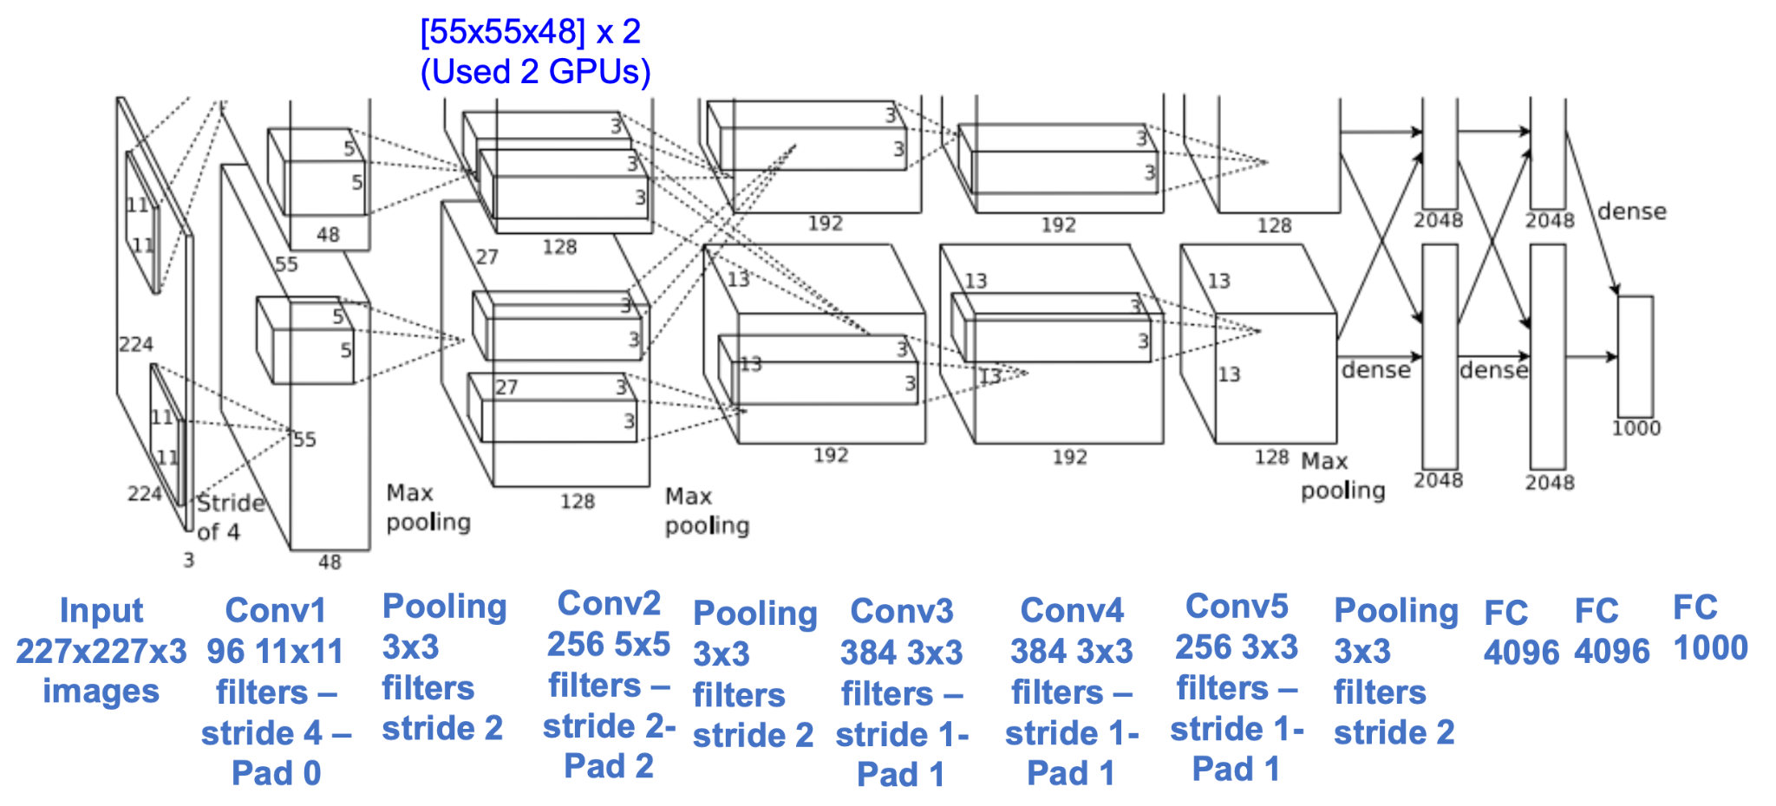
THE BREAKTHROUGH
AlexNet · Krizhevsky et al., 2012

Slide 29
TENSOR SIZES
AlexNet, volume by volume
input
CONV 11×11
stride 4, 96
Max POOL
3×3, stride 2
CONV 5×5
pad 2, 256
Max POOL
3×3, stride 2
CONV 3×3
pad 1, 384
CONV 3×3
pad 1, 384
(227−11)/4 + 1 = 55
(55−3)/2 + 1 = 27
(27+2·2−5)/1 + 1 = 27
(27−3)/2 + 1 = 13
(13+2·1−3)/1 + 1 = 13
same
55 × 55 × 96
27 × 27 × 96
27 × 27 × 256
13 × 13 × 256
13 × 13 × 384
13 × 13 × 384
227 × 227 × 3
CONV 3×3
pad 1, 256
flatten
Max POOL
3×3, stride 2
FC
FC
(13+2·1−3)/1 + 1 = 13
(13−3)/2 + 1 = 6
13 × 13 × 256
6 × 6 × 256
9216
FC 4096
FC 4096
1000 softmax
The spatial size collapses from 227 to 6 while the depth climbs from 3 to 256 — the standard trade of resolution for semantics.

Slide 30
PARAMETER BUDGET
AlexNet — number of parameters
Layer name
Tensor size
Weights
Biases
Parameters
Parameter calc
Output volume calc
Input image
227×227×3
0
0
0
Conv-1
55×55×96
34 848
96
34 944
(11×11×3 + 1) × 96
(227−11)/4 + 1 = 55
MaxPool-1
27×27×96
0
0
0
(55−3)/2 + 1 = 27
Conv-2
27×27×256
614 400
256
614 656
(5×5×96 + 1) × 256
(27+2·2−5)/1 + 1 = 27
MaxPool-2
13×13×256
0
0
0
(27−3)/2 + 1 = 13
Conv-3
13×13×384
884 736
384
885 120
(3×3×256 + 1) × 384
(13+2·1−3)/1 + 1 = 13
Conv-4
13×13×384
1 327 104
384
1 327 488
(3×3×384 + 1) × 384
(13+2·1−3)/1 + 1 = 13
Conv-5
13×13×256
884 736
256
884 992
(3×3×384 + 1) × 256
(13+2·1−3)/1 + 1 = 13
MaxPool-3
6×6×256
0
0
0
(13−3)/2 + 1 = 6
FC-1
4096×1
37 748 736
4 096
37 752 832
(6×6×256 + 1) × 4096
FC-2
4096×1
16 777 216
4 096
16 781 312
(4096 + 1) × 4096
FC-3
1000×1
4 096 000
1 000
4 097 000
(4096 + 1) × 1000
Output
1000×1
0
0
0
Total
62 378 344
94 % of all parameters sit in the three fully connected layers.
Table: learnopencv.com — number of parameters and tensor sizes in a CNN

Slide 31
TRAINING RECIPE
AlexNet — what made it work
ReLU
Local response normalisation
Dropout 0.5
One of the first attempts to use rectified linear units in deep learning — several times faster to train than saturating units.
A lateral-inhibition style normalisation across channels. Later architectures dropped it entirely.
Applied in the fully connected layers, where nearly all the parameters — and the overfitting risk — live.
SGD momentum
L2 weight decay
Heavy data augmentation
The workhorse optimiser, with a manually decayed learning rate.
Standard regularisation on top of dropout.
Random crops, horizontal flips and PCA colour jitter, effectively enlarging a 1.2 M image dataset many times over.

Slide 32
THE BENCHMARK
ILSVRC winners — 2013
ZF Net: improved
hyper-parameters
over AlexNet
30
28.2
25.8
152 layers
152 layers
152 layers
25
20
16.4
15
11.7
19 layers
22 layers
10
7.3
6.7
5
shallow
8 layers
8 layers
3.6
3
2.3
0
2010
2011
2012
2013
2014
2014
2015
2016
2017
Lin et al
Sanchez &
Perronnin
Krizhevsky et al
(AlexNet)
Zeiler &
Fergus
Simonyan &
Zisserman (VGG)
Szegedy et al
(GoogLeNet)
He et al
(ResNet)
Shao et al
Hu et al
(SENet)

Slide 33
THE BENCHMARK
ILSVRC winners — 2014
Deeper networks:
VGG and GoogLeNet
30
28.2
25.8
152 layers
152 layers
152 layers
25
20
16.4
15
11.7
19 layers
22 layers
10
7.3
6.7
5
shallow
8 layers
8 layers
3.6
3
2.3
0
2010
2011
2012
2013
2014
2014
2015
2016
2017
Lin et al
Sanchez &
Perronnin
Krizhevsky et al
(AlexNet)
Zeiler &
Fergus
Simonyan &
Zisserman (VGG)
Szegedy et al
(GoogLeNet)
He et al
(ResNet)
Shao et al
Hu et al
(SENet)

Slide 34
SMALL FILTERS, DEEPER NETWORKS
VGGNet · Simonyan & Zisserman, 2014
Only 3 × 3 conv filters, stride 1, pad 1 · only 2 × 2 max pool, stride 2
Softmax
FC 1000
FC 4096
Softmax
FC 4096
FC 1000
Pool
Key idea: small filters, deeper networks.
Intuition behind using smaller filters: a stack of three 3 × 3 conv layers (stride 1) has the same effective receptive field as one 7 × 7 conv layer.
But deeper means more non-linearities and fewer parameters: 3 · (3²C²) versus 7²C² for C channels per layer.
16 or 19 weight layers; VGG19 is only slightly better than VGG16 and needs more memory.
FC 4096
3×3 conv, 512
FC 4096
3×3 conv, 512
Pool
3×3 conv, 512
3×3 conv, 512
3×3 conv, 512
3×3 conv, 512
Pool
3×3 conv, 512
3×3 conv, 512
Pool
3×3 conv, 512
3×3 conv, 512
3×3 conv, 512
Softmax
3×3 conv, 512
3×3 conv, 512
FC 1000
3×3 conv, 512
Pool
FC 4096
Pool
3×3 conv, 256
FC 4096
3×3 conv, 256
3×3 conv, 256
Pool
3×3 conv, 256
3×3 conv, 256
3×3 conv, 256
3×3 conv, 256
3×3 conv, 256
3×3 conv, 384
Pool
Pool
3×3 conv, 384
3×3 conv, 128
3×3 conv, 128
Pool
3×3 conv, 128
3×3 conv, 128
5×5 conv, 256
Pool
Pool
Pool
3×3 conv, 64
3×3 conv, 64
11×11 conv, 96
3×3 conv, 64
3×3 conv, 64
Input
Input
Input
AlexNet
VGG16
VGG19

Slide 35
WHY SMALL FILTERS
VGGNet — receptive field (1)
Input
A1
A2
A3
Conv1 (3×3)
Conv2 (3×3)
Conv3 (3×3)
One unit in A3 is computed from a 3 × 3 window of A2. Start at the far right and trace the dependency backwards, one convolution at a time.

Slide 36
WHY SMALL FILTERS
VGGNet — receptive field (2)
Input
A1
A2
A3
Conv1 (3×3)
Conv2 (3×3)
Conv3 (3×3)
Each of those three A2 units is itself computed from a 3 × 3 window of A1 — and the three windows overlap, sliding one cell apart.

Slide 37
WHY SMALL FILTERS
VGGNet — receptive field (3)
Input
A1
A2
A3
Conv1 (3×3)
Conv2 (3×3)
Conv3 (3×3)
Taken together, the single A3 unit depends on a 5 × 5 region of A1. Two stacked 3 × 3 layers already give a 5 × 5 receptive field.

Slide 38
WHY SMALL FILTERS
VGGNet — receptive field (4)
Input
A1
A2
A3
Conv1 (3×3)
Conv2 (3×3)
Conv3 (3×3)
Repeat the argument once more: every unit in that 5 × 5 region of A1 comes from its own 3 × 3 window of the input.

Slide 39
WHY SMALL FILTERS
VGGNet — receptive field (5)
Input
A1
A2
A3
Conv1 (3×3)
Conv2 (3×3)
Conv3 (3×3)
Three stacked 3 × 3 conv layers see a 7 × 7 region of the input — the same receptive field as a single 7 × 7 conv, with 27C² parameters instead of 49C² and three ReLUs instead of one.

Slide 40
THE PRICE OF DEPTH
VGG16 — memory and parameters, layer by layer
(not counting biases)
INPUT: [224×224×3]
memory: 224*224*3 = 150K
params: 0
Most memory sits in the early conv layers
CONV3-64: [224×224×64]
memory: 224*224*64 = 3.2M
params: (3*3*3)*64 = 1 728
CONV3-64: [224×224×64]
memory: 224*224*64 = 3.2M
params: (3*3*64)*64 = 36 864
POOL2: [112×112×64]
memory: 112*112*64 = 800K
params: 0
Softmax
CONV3-128: [112×112×128]
memory: 112*112*128 = 1.6M
params: (3*3*64)*128 = 73 728
FC 1000
CONV3-128: [112×112×128]
memory: 112*112*128 = 1.6M
params: (3*3*128)*128 = 147 456
FC 4096
POOL2: [56×56×128]
memory: 56*56*128 = 400K
params: 0
FC 4096
CONV3-256: [56×56×256]
memory: 56*56*256 = 800K
params: (3*3*128)*256 = 294 912
Pool
3×3 conv, 512
CONV3-256: [56×56×256]
memory: 56*56*256 = 800K
params: (3*3*256)*256 = 589 824
3×3 conv, 512
CONV3-256: [56×56×256]
memory: 56*56*256 = 800K
params: (3*3*256)*256 = 589 824
3×3 conv, 512
POOL2: [28×28×256]
memory: 28*28*256 = 200K
params: 0
Pool
CONV3-512: [28×28×512]
memory: 28*28*512 = 400K
params: (3*3*256)*512 = 1 179 648
3×3 conv, 512
CONV3-512: [28×28×512]
memory: 28*28*512 = 400K
params: (3*3*512)*512 = 2 359 296
3×3 conv, 512
CONV3-512: [28×28×512]
memory: 28*28*512 = 400K
params: (3*3*512)*512 = 2 359 296
3×3 conv, 512
POOL2: [14×14×512]
memory: 14*14*512 = 100K
params: 0
Pool
3×3 conv, 256
CONV3-512: [14×14×512]
memory: 14*14*512 = 100K
params: (3*3*512)*512 = 2 359 296
Most parameters sit in the late FC layers
3×3 conv, 256
CONV3-512: [14×14×512]
memory: 14*14*512 = 100K
params: (3*3*512)*512 = 2 359 296
3×3 conv, 256
CONV3-512: [14×14×512]
memory: 14*14*512 = 100K
params: (3*3*512)*512 = 2 359 296
Pool
POOL2: [7×7×512]
memory: 7*7*512 = 25K
params: 0
3×3 conv, 128
FC: [1×1×4096]
memory: 4096
params: 7*7*512*4096 = 102 760 448
3×3 conv, 128
FC: [1×1×4096]
memory: 4096
params: 4096*4096 = 16 777 216
Pool
3×3 conv, 64
FC: [1×1×1000]
memory: 1000
params: 4096*1000 = 4 096 000
3×3 conv, 64
Input
TOTAL memory: 24M × 4 bytes ≈ 96 MB / image (forward only — about ×2 for the backward pass)
TOTAL params: 138M parameters
VGG16

Slide 41
VGG
VGG — practical notes
Similar training procedure to Krizhevsky 2012
No local response normalisation
SGD with momentum, weight decay, dropout in the FC layers, heavy augmentation.
LRN was dropped: it added computation and memory without improving accuracy.
VGG16 or VGG19
FC7 features generalise well
VGG19 is only slightly better and costs more memory — VGG16 is the usual choice.
The penultimate layer transfers to other tasks remarkably well, which made VGG the default feature extractor for years.

Slide 42
DEPTH WITH EFFICIENCY
GoogLeNet · Szegedy et al., 2014
Deeper network with computational efficiency
22 layers
Only 5 M parameters
12 times less than AlexNet
27 times less than VGG-16
Avoids expensive fully connected layers
stacked 9 times to build the full network
Filter concatenation
1 × 1 conv
3 × 3 conv
5 × 5 conv
3 × 3 max pool
Basic idea: design a good local network topology — a network within a network — and stack these modules on top of each other.
Previous layer
The inception module

Slide 43
INCEPTION
GoogLeNet — the naive inception module
Apply parallel filter operations on the input from the previous layer:
  multiple receptive field sizes for convolution (1 × 1, 3 × 3, 5 × 5)
  a pooling operation (3 × 3)
Concatenate all filter outputs together channel-wise.
Let the network choose which receptive field size is useful at each depth, instead of committing to one.
Filter concatenation
1 × 1 conv
3 × 3 conv
5 × 5 conv
3 × 3 max pool
Previous layer

Slide 44
INCEPTION
Example — what is the output size in this case?
Filter concatenation
1 × 1 conv
128
3 × 3 conv
192
5 × 5 conv
96
3 × 3 max pool
Previous layer
28 × 28 × 256
Each convolution uses padding so the spatial size is preserved. Work out the output of every branch, then the concatenated result.

Slide 45
INCEPTION
Example — what is the problem here?
28 × 28 × (128 + 192 + 96 + 256) = 28 × 28 × 672
Filter concatenation
28×28×128
28×28×192
28×28×96
28×28×256
1 × 1 conv
128
3 × 3 conv
192
5 × 5 conv
96
3 × 3 max pool
Previous layer
28 × 28 × 256
The pooling branch preserves the input depth, so the concatenated depth is always larger than the input depth.

Slide 46
COMPUTATIONAL COST
Problems with the naive inception module
Computationally expensive — conv ops
Depth can only grow
The pooling layer also preserves feature depth, which means the total depth after concatenation can only grow at every layer.
[1 × 1 conv, 128]
28 × 28 × 128 × 1 × 1 × 256
[3 × 3 conv, 192]
28 × 28 × 192 × 3 × 3 × 256
[5 × 5 conv, 96]
28 × 28 × 96 × 5 × 5 × 256
How can we solve this problem?
Total: 854 M ops
Nearly a billion operations inside a single module — and GoogLeNet stacks nine of them.
We need a way to cut the channel dimension without throwing away spatial resolution.

Slide 47
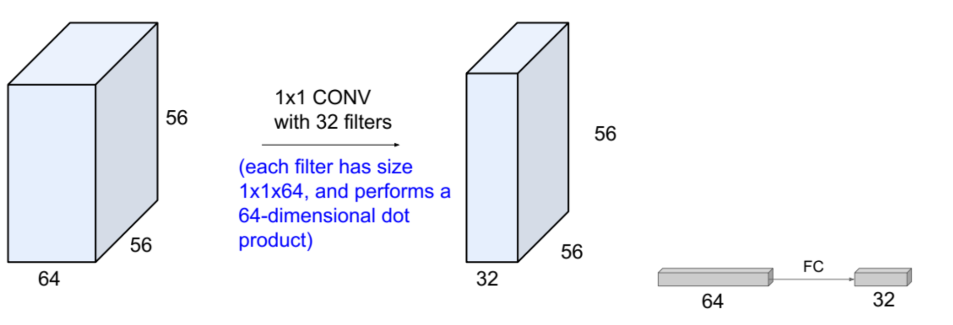
DIMENSIONALITY REDUCTION
GoogLeNet — solution: 1 × 1 convolutions
Use 1 × 1 convolutions to reduce the feature channel size.
Projects depth to a lower dimension (a combination of feature maps) while preserving the spatial dimensions.

Slide 48
INCEPTION
Inception module with dimensionality reduction
Naive inception module
With dimensionality reduction
Filter concatenation
Filter concatenation
1 × 1 conv
3 × 3 conv
5 × 5 conv
1 × 1 conv
1 × 1 conv
3 × 3 conv
5 × 5 conv
3 × 3 max pool
1 × 1 conv
1 × 1 conv
3 × 3 max pool
Previous layer
Previous layer
1 × 1 bottlenecks go before the expensive 3 × 3 and 5 × 5 branches, and after the pooling branch.

Slide 49
INCEPTION
Back to the example
28 × 28 × (128 + 192 + 96 + 64) = 28 × 28 × 480
Filter concatenation
28×28×128
28×28×192
28×28×96
28×28×64
1 × 1 conv
3 × 3 conv
5 × 5 conv
1 × 1 conv
1 × 1 conv
1 × 1 conv
3 × 3 max pool
Previous layer
28 × 28 × 256
672 channels before, 480 after — and the module is now cheaper to compute too.

Slide 50
COMPUTATIONAL COST
The same module, now 358 M ops
Conv ops
358 M ops
[1 × 1 conv, 64]
28 × 28 × 64 × 1 × 1 × 256
compare to 854 M ops for the naive module — a 58 % reduction
[1 × 1 conv, 64]
28 × 28 × 64 × 1 × 1 × 256
[1 × 1 conv, 128]
28 × 28 × 128 × 1 × 1 × 256
[3 × 3 conv, 192]
28 × 28 × 192 × 3 × 3 × 64
Where the saving comes from
[5 × 5 conv, 96]
28 × 28 × 96 × 5 × 5 × 64
The 3 × 3 and 5 × 5 convolutions now run over 64 channels instead of 256 — four times less work in exactly the branches that cost the most.
[1 × 1 conv, 64]
28 × 28 × 64 × 1 × 1 × 256

Slide 51
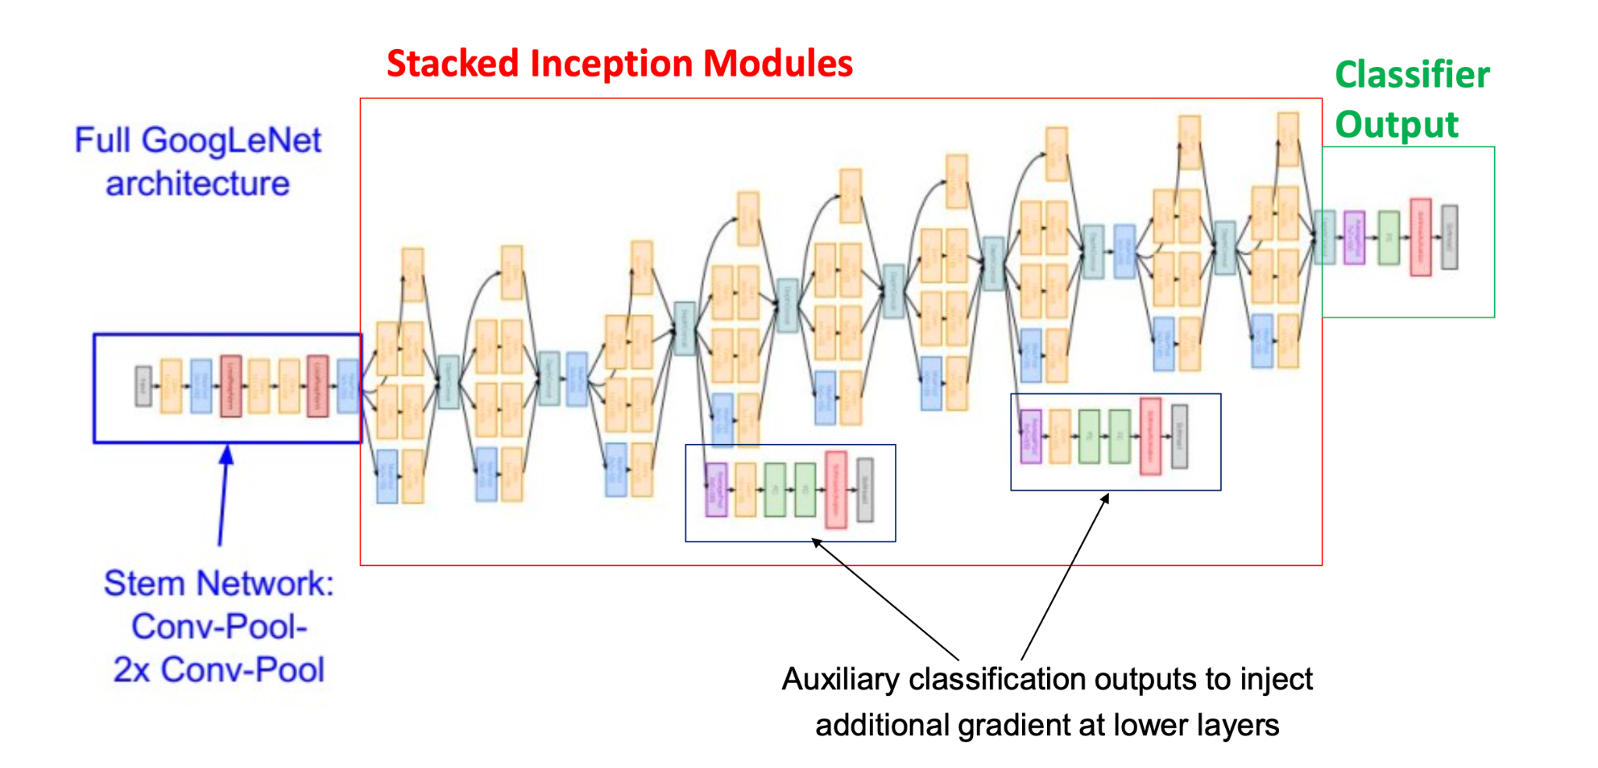
PUTTING IT TOGETHER
The full GoogLeNet
Stem network, then nine stacked inception modules, then a classifier head — 22 weight layers in total.
Two auxiliary softmax heads branch off the middle of the network during training and are discarded at inference time.
No expensive fully connected stack: global average pooling collapses the final feature map before a single FC 1000 layer.

Slide 52
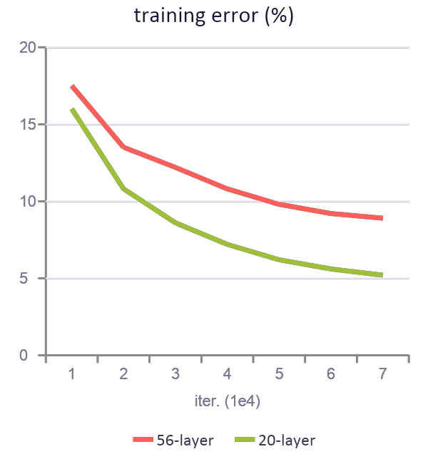
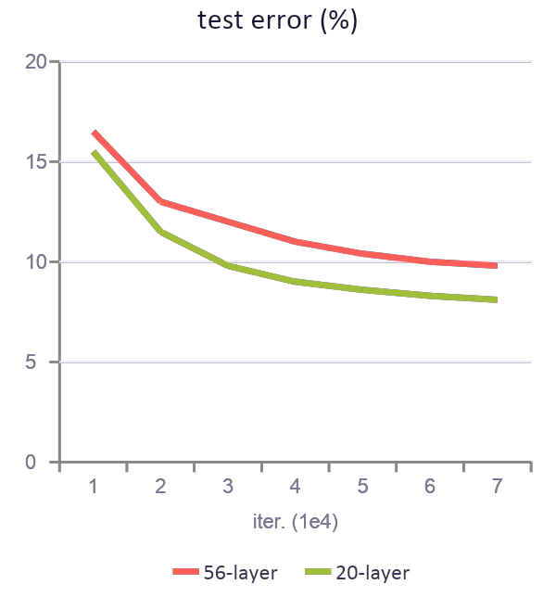
DEGRADATION
ResNet · He et al., 2015 — intuition
Is learning better networks as easy as stacking more layers?
What happens if you keep stacking layers on a “plain” network?
The deeper network has higher training error, and thus higher test error.
Fact: deep models have more representation power (more parameters) than shallower models.
Hypothesis: the problem is an optimisation problem — deeper models are harder to optimise.

Slide 53
THE RESIDUAL BLOCK
ResNet — intuition (cont.)
Basic idea: what should the deeper model learn to be at least as good as the shallower model?
relu
Identity mapping
H(x)
+
H(x) = F(x) + x
H(x) = x if F(x) = 0
conv
conv
Doing nothing becomes the easiest thing for the block to learn, so extra depth can never hurt.
relu
relu
x
identity
conv
F(x)
conv
Idea
x
F(x) = H(x) − x
x
Use the layers to fit the residual F(x) instead of fitting the desired mapping H(x) directly.
“Plain” layers
Residual block

Slide 54
RESNET
The full ResNet architecture
Stack residual blocks
Every residual block has two 3 × 3 conv layers
Periodically double the number of filters and downsample spatially using stride 2 (divide by 2 in each dimension)
Additional conv layer at the beginning (stem)
No FC layers at the end — only FC 1000 to output the classes
Total depths of 18, 34, 50, 101 and 152 layers for ImageNet
Softmax
FC 1000
Pool
3×3 conv, 512
3×3 conv, 512
3×3 conv, 512
3×3 conv, 512
3×3 conv, 512
3×3 conv, 512, /2
3×3 conv, 256
3×3 conv, 256
3×3 conv, 256
3×3 conv, 256
3×3 conv, 256
residual
connections
3×3 conv, 256, /2
3×3 conv, 128
3×3 conv, 128
3×3 conv, 128
3×3 conv, 128
3×3 conv, 128
3×3 conv, 128
3×3 conv, 128
3×3 conv, 128, /2
3×3 conv, 64
3×3 conv, 64
3×3 conv, 64
3×3 conv, 64
3×3 conv, 64
Batch normalisation after every conv layer · Xavier/He initialisation · no dropout used
3×3 conv, 64, /2
Pool
7×7 conv, 64, /2
Input
ResNet-34

Slide 55
RESNET-50 AND DEEPER
ResNet — the bottleneck block
Total depths of 18, 34, 50, 101 and 152 layers for ImageNet.
For deeper networks (ResNet-50+), use a “bottleneck” layer to improve efficiency — the same trick as GoogLeNet.
A 1 × 1 conv projects 256 channels down to 64, the 3 × 3 conv does its work cheaply, and a second 1 × 1 conv projects back up.
Batch normalisation and a ReLU follow each of the first two convolutions.
28 × 28 × 256
output
+
BN, relu
1 × 1 conv with 256 filters,
projecting back up to 28 × 28 × 256
1 × 1 conv, 256
BN, relu
3 × 3 conv operates over
only 64 feature maps
3 × 3 conv, 64
1 × 1 conv, 64 filters, to
project to 28 × 28 × 64
1 × 1 conv, 64
28 × 28 × 256
input

Slide 56
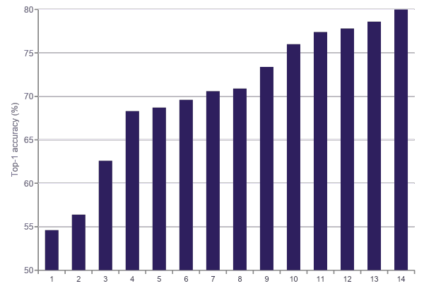
ACCURACY, OPERATIONS AND SIZE
Comparing the architectures
Inception-v4
ResNet-101
ResNet-152
Inception-v3
80
ResNet-34
VGG-16
VGG-19
75
ResNet-50
70
GoogLeNet
ResNet-18
65
BN-NIN
60
55
AlexNet
50
0
10
20
30
40
Operations [G-Ops]
bubble area ≈ number of parameters
Paper: An Analysis of Deep Neural Network Models for Practical Applications, 2017 (Canziani et al.)

Slide 57
PRACTICAL CNNS
Transfer learning: you rarely train from scratch
Take a network trained on a large dataset such as ImageNet, then reuse its learned representation on your own — usually much smaller — dataset. Early layers learn generic edges and textures that transfer almost everywhere.
Small dataset,
similar domain
Small dataset,
different domain
Large dataset,
similar domain
Large dataset,
different domain
Freeze the whole convolutional base and train only a new classifier head. The pretrained features are already right.
Freeze the early layers, retrain the later blocks. Low-level features transfer, high-level ones do not.
Fine-tune the whole network with a small learning rate, using the pretrained weights as a very good initialisation.
Fine-tune everything, or consider training from scratch if the domain is genuinely far away.
Practical recipe
Course project
Replace the final classifier · freeze the base · train the head · unfreeze the top blocks · fine-tune at a 10× smaller learning rate.
Find a dataset of interest (under ~10k images) · check the TensorFlow model garden (github.com/tensorflow/models) for a pretrained model that learns a similar representation · transfer learn to your dataset.

Slide 58
05
Object detection: what is where, with boxes
Semantic segmentation: a class for every pixel
Beyond
classification
Instance segmentation: pixels, grouped per object

Slide 59
TASK LANDSCAPE
The core computer-vision tasks
Every task below runs on the same convolutional backbone. What changes is the output head — and therefore the loss.
Classification
Classification
+ localisation
Object detection
Semantic segmentation
Instance segmentation
CAT
CAT
CAT, DOG, DOG
CAT, GRASS, SKY
CAT, DOG 1, DOG 2
One label for the whole image
One label and one bounding box
Many objects, each with a box and a label
A class for every pixel — no object identity
Per-pixel labels, separated per object

Slide 60
DETECTION
Object detection: what makes it hard
A variable number of outputs. A classifier always emits one vector; a detector must emit anywhere from zero to hundreds of boxes.
Two losses at once: classify each object and regress four box coordinates.
Huge scale variation — the same class can occupy 20 pixels or 2 000.
Extreme class imbalance: almost every candidate region is background.
Many applications need real-time inference on video.
Intersection over Union (IoU)
ground truth
IoU = area of overlap / area of union
A prediction usually counts as correct at IoU ≥ 0.5.
prediction
The reporting metric: mAP
Average precision (AP) is the area under the precision–recall curve for one class. Mean AP averages it over all classes.
COCO reports mAP@[.5 : .95] — averaged over ten IoU thresholds — which is much stricter than the older mAP@0.5.
Two ingredients almost every detector uses
Anchor boxes — a fixed set of reference shapes at every location. Non-maximum suppression (NMS) — collapse overlapping duplicate predictions.

Slide 61
DETECTION MODELS
Two-stage detectors: the R-CNN family
Stage 1 proposes regions that might contain an object. Stage 2 classifies each proposal and refines its box. Accurate, historically slower.
R-CNN
2014
Fast R-CNN
2015
Faster R-CNN
2015
Selective search proposes ~2 000 regions; each is warped and pushed through a CNN separately, then an SVM classifies it.
Run the CNN once over the whole image, then crop features per proposal with RoI pooling. One network, one multi-task loss.
Replace selective search with a Region Proposal Network that shares the backbone's features. Fully end-to-end.
Painfully slow — about 47 s per image at test time, and training is a multi-stage pipeline.
~25 × faster to train. Region proposal is now the bottleneck.
~5–7 fps and the accuracy standard for years. The base of Mask R-CNN.
Feature Pyramid Network (FPN, 2017) — a top-down pathway with lateral connections that gives every scale a semantically strong feature map. It plugs into Faster R-CNN and most one-stage detectors alike, and is still standard practice.

Slide 62
DETECTION MODELS
One-stage detectors: detection as regression
No proposal step. Predict class scores and box offsets directly from a dense grid of locations, in a single forward pass.
YOLO
You Only Look Once, 2016
SSD
Single Shot Detector, 2016
Divide the image into an S × S grid; each cell predicts boxes, confidences and class probabilities in one pass.
Predict from several feature maps at different resolutions, using default boxes of several aspect ratios per location.
RetinaNet
2017
Anchor-free
FCOS, CenterNet, 2019
One-stage accuracy had lagged because of background imbalance. Focal loss down-weights easy negatives and closes the gap.
Drop anchor boxes entirely: predict object centres and distances to the box edges. Fewer hyper-parameters to tune.
The YOLO line keeps evolving
v3 (multi-scale) → v4/v5 (engineering and training tricks) → v7/v8 (anchor-free, decoupled heads) → v9–v12. Real-time, easy to train on custom data, and the usual first thing to try in production.

Slide 63
DETECTION MODELS
The transformer era of detection
DETR · Detection Transformer, 2020
Deformable DETR
Treats detection as direct set prediction. A CNN backbone feeds a transformer encoder–decoder, and a fixed set of learned object queries each emit one box and one class.
A bipartite matching loss assigns predictions to ground truth, so no anchor boxes and no NMS are needed at all.
Attends to a sparse set of sampled points instead of the full feature map — fixes DETR's slow convergence and weak small-object performance.
DINO / DINO-DETR
Improved denoising training and query selection; pushed DETR-style models to the top of the COCO leaderboard.
RT-DETR
Which family should you pick?
A real-time DETR variant that finally matches YOLO speed without needing NMS post-processing.
Real-time video or edge device → a YOLO variant.
Maximum accuracy, offline batch → DETR-family or Faster R-CNN with FPN.
Novel classes with few labels → an open-vocabulary model.
Open-vocabulary detection
Grounding DINO, OWL-ViT and similar models detect classes described in free text, with no retraining for new categories.

Slide 64
SEGMENTATION
Semantic segmentation: a label for every pixel
Assign each pixel a class. All cats share one label — the task does not distinguish instances.
The naive approach, classifying a small patch around every pixel with a sliding window, is hopelessly expensive and ignores shared computation.
The Fully Convolutional Network (FCN, 2015) replaced the dense layers with 1 × 1 convolutions, so the network outputs a full-resolution class map in one pass.
Downsampling with pooling and strided convolutions, then upsampling with transposed convolutions or interpolation, gives the encoder–decoder shape used everywhere since.
Skip connections carry fine spatial detail from the encoder across to the decoder, recovering the boundaries that pooling destroyed.
The encoder–decoder shape
skip connection
encoder · downsample
decoder · upsample
Metrics
Mean IoU over classes (the headline number) · pixel accuracy · Dice / F1 coefficient, common in medical imaging.

Slide 65
SEGMENTATION MODELS
The main semantic segmentation architectures
FCN
2015
U-Net
2015
SegNet
2016
The first end-to-end per-pixel network. Dense layers become convolutions; coarse predictions are upsampled and fused with earlier layers.
Symmetric encoder–decoder with dense skip connections. Designed for biomedical images and still the default whenever data is scarce.
Decoder upsamples using the max-pooling indices recorded by the encoder — memory-efficient, no learned upsampling parameters.
DeepLab v3+
2018
PSPNet
2017
SegFormer / ViT-based
2021 →
Atrous (dilated) convolutions enlarge the receptive field without losing resolution; ASPP pools context at several dilation rates.
A pyramid pooling module aggregates global context at four scales before the final prediction.
Transformer encoders with lightweight all-MLP decoders. Strong global context and excellent accuracy-per-FLOP.

Slide 66
SEGMENTATION MODELS
Instance segmentation: Mask R-CNN
Detect every object and produce a pixel mask for each one — so two overlapping dogs get two separate masks, not one merged region.
Faster R-CNN, plus one extra branch
Why RoIAlign matters
class
RoI pooling rounds region coordinates to the feature-map grid. That misalignment is invisible for a box, but ruins a pixel mask.
RoIAlign uses bilinear interpolation and no rounding, which alone gave a large jump in mask accuracy.
Backbone
+ FPN
Region
Proposal Net
RoIAlign
box
mask
three parallel output heads per region
The mask head is a small FCN applied to each region, predicting a binary mask per class — the classification and mask tasks are decoupled.
Swap the mask head for a keypoint head and the same architecture does human pose estimation.
Still the standard baseline whenever accuracy matters more than speed.

Slide 67
RECENT DIRECTIONS
Where segmentation is heading
YOLACT / SOLO
Panoptic segmentation
Real-time instance segmentation. YOLACT generates prototype masks and combines them with per-instance coefficients; SOLO predicts masks directly from location and size, with no detection step at all.
Unifies the two views: every pixel gets a semantic label, and every countable object ('things') also gets an instance id, while amorphous regions ('stuff') do not.
Mask2Former
Segment Anything (SAM)
One architecture — masked attention over learned queries — that handles semantic, instance and panoptic segmentation with the same model and loss.
A promptable foundation model trained on a billion masks. Click a point or drag a box and it segments the object, zero-shot, with no task-specific training.

Slide 68
SUMMARY
One table to hold it all together
Task
Output
Representative models
Metric
Image classification
One class label
AlexNet · VGG · ResNet · EfficientNet · ViT
Top-1 / top-5 accuracy
Classification
+ localisation
One label + one box
ResNet backbone with a box-regression head
Accuracy + IoU
Object detection
N boxes + labels
+ scores
Faster R-CNN · YOLO (v3 → v12) · SSD · RetinaNet · DETR · RT-DETR
mAP@[.5:.95]
Semantic segmentation
Class label per pixel
FCN · U-Net · SegNet · DeepLab v3+ · PSPNet · SegFormer
Mean IoU · Dice
Instance segmentation
Mask + label per object
Mask R-CNN · YOLACT · SOLOv2 · Mask2Former · SAM
Mask mAP
Panoptic segmentation
Semantic + instance,
every pixel
Panoptic FPN · Mask2Former
Panoptic Quality (PQ)
All of them share the same convolutional (or transformer) backbone — only the head and the loss change.

Slide 69
KEY TAKEAWAYS
What to remember from today
01
Convolution is a constrained matrix multiply
Sparse interactions, shared parameters and translation equivariance are the three constraints — and all three are assumptions about images, not tricks.
02
Shape arithmetic is the everyday skill
( N + 2P − K ) / S + 1 for the size, ( K × K × D + 1 ) × K_out for the parameters. Almost every debugging session comes back to these two.
03
Depth is the story of the architectures
8 → 19 → 22 → 152 layers. Small filters, 1 × 1 bottlenecks and residual connections were each invented to make more depth trainable.
04
Fully connected layers are where the weights hide
94 % of AlexNet and 90 % of VGG. Global average pooling removed them at no cost in accuracy.
05
Beyond classification, only the head changes
Detection, semantic and instance segmentation all reuse the same backbone. Choose the model by the output you need and the latency you can afford.

