Slide 1

COOP Presentation SWE351 Yosef Alshammari 201616761

Slide 2
Introduction
Projects of Summer Semester
coop project (courses)
conclusion

Slide 3
Projects of Summer Semester
Data science (titanic):
In this track with d. Abdulaziz Alayba . I learn R programming , excel for data science , weka .
In last of the summer semester I fnish of the mine project in this track it’s titanic .

Slide 4
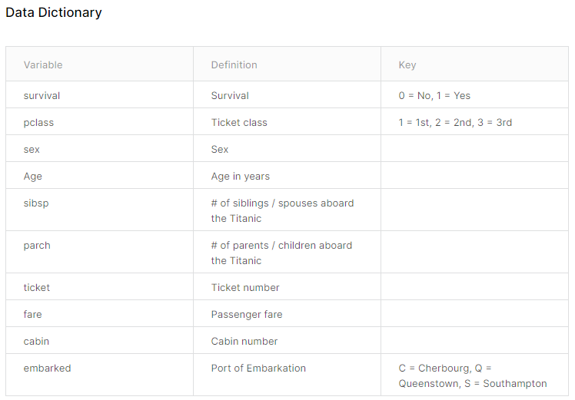
Titanic
Why Titanic dataset ?
I use this data because I can know and understand data , and before start this project I read about titanic story .
Notes:
Pclass : A proxy for socio-economic status (SES) 1st = Upper 2nd = Middle 3rd = Lower
age: Age is fractional if less than 1. If the age is estimated, is it in the form of xx.5 sibsp: The dataset defines family relations in this way... Sibling = brother, sister, stepbrother, stepsister Spouse = husband, wife (mistresses and fiancés were ignored) parch: The dataset defines family relations in this way... Parent = mother, father Child = daughter, son, stepdaughter, stepson Some children travelled only with a nanny, therefore parch=0 for them.

Slide 5
Getting started ☺.
Go to R studio

Slide 6
Web programming
In this track we use html ,css, php , js but my project I used python Django and build a blog.
Django==3.0.9
sqlite3
Blog site :
In this blog you can rejecter ,login , create your blog and comment the another blog .you edit your profile etc .

Slide 7
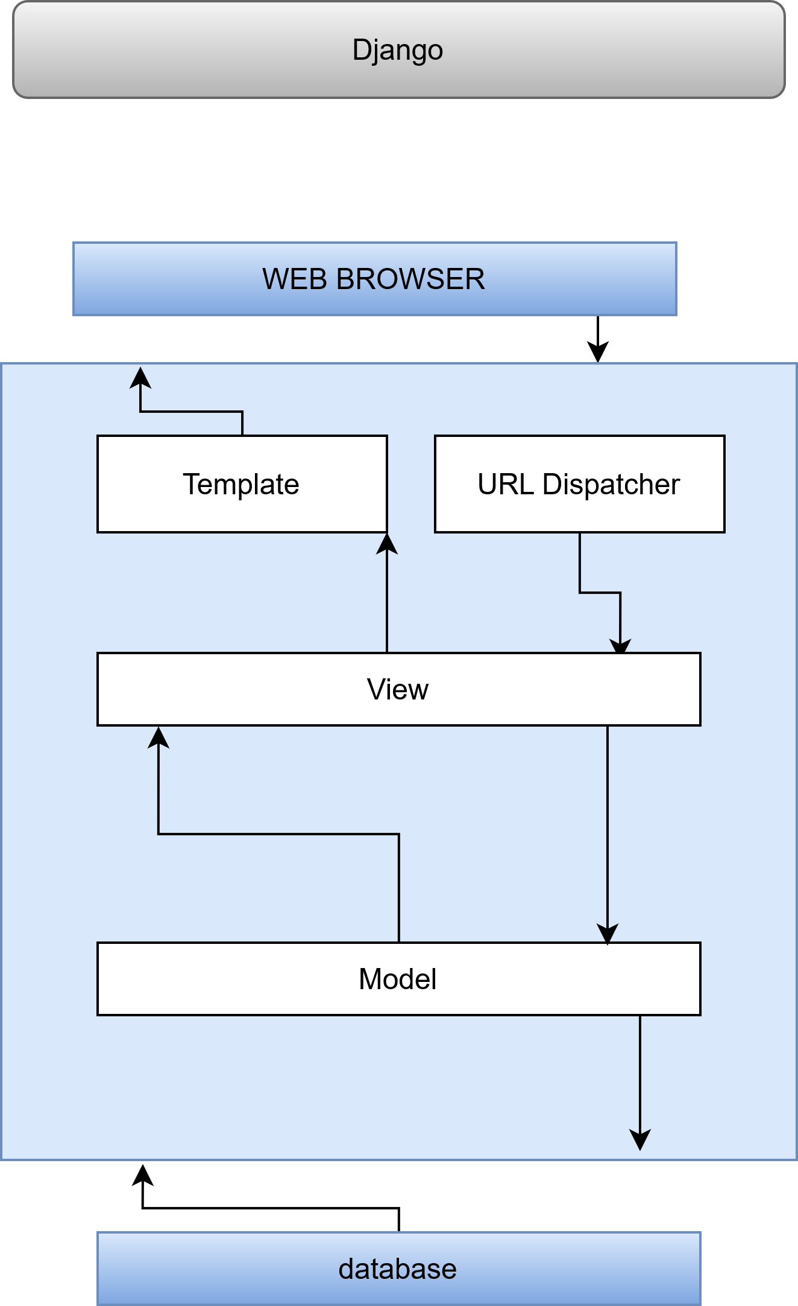
Django
Django is a framework for web application and it’s open source .it is high level python.
Django MTV
Django to help developer build a good project .
Notes:
Pclass : A proxy for socio-economic status (SES) 1st = Upper 2nd = Middle 3rd = Lower
age: Age is fractional if less than 1. If the age is estimated, is it in the form of xx.5 sibsp: The dataset defines family relations in this way... Sibling = brother, sister, stepbrother, stepsister Spouse = husband, wife (mistresses and fiancés were ignored) parch: The dataset defines family relations in this way... Parent = mother, father Child = daughter, son, stepdaughter, stepson Some children travelled only with a nanny, therefore parch=0 for them.

Slide 8
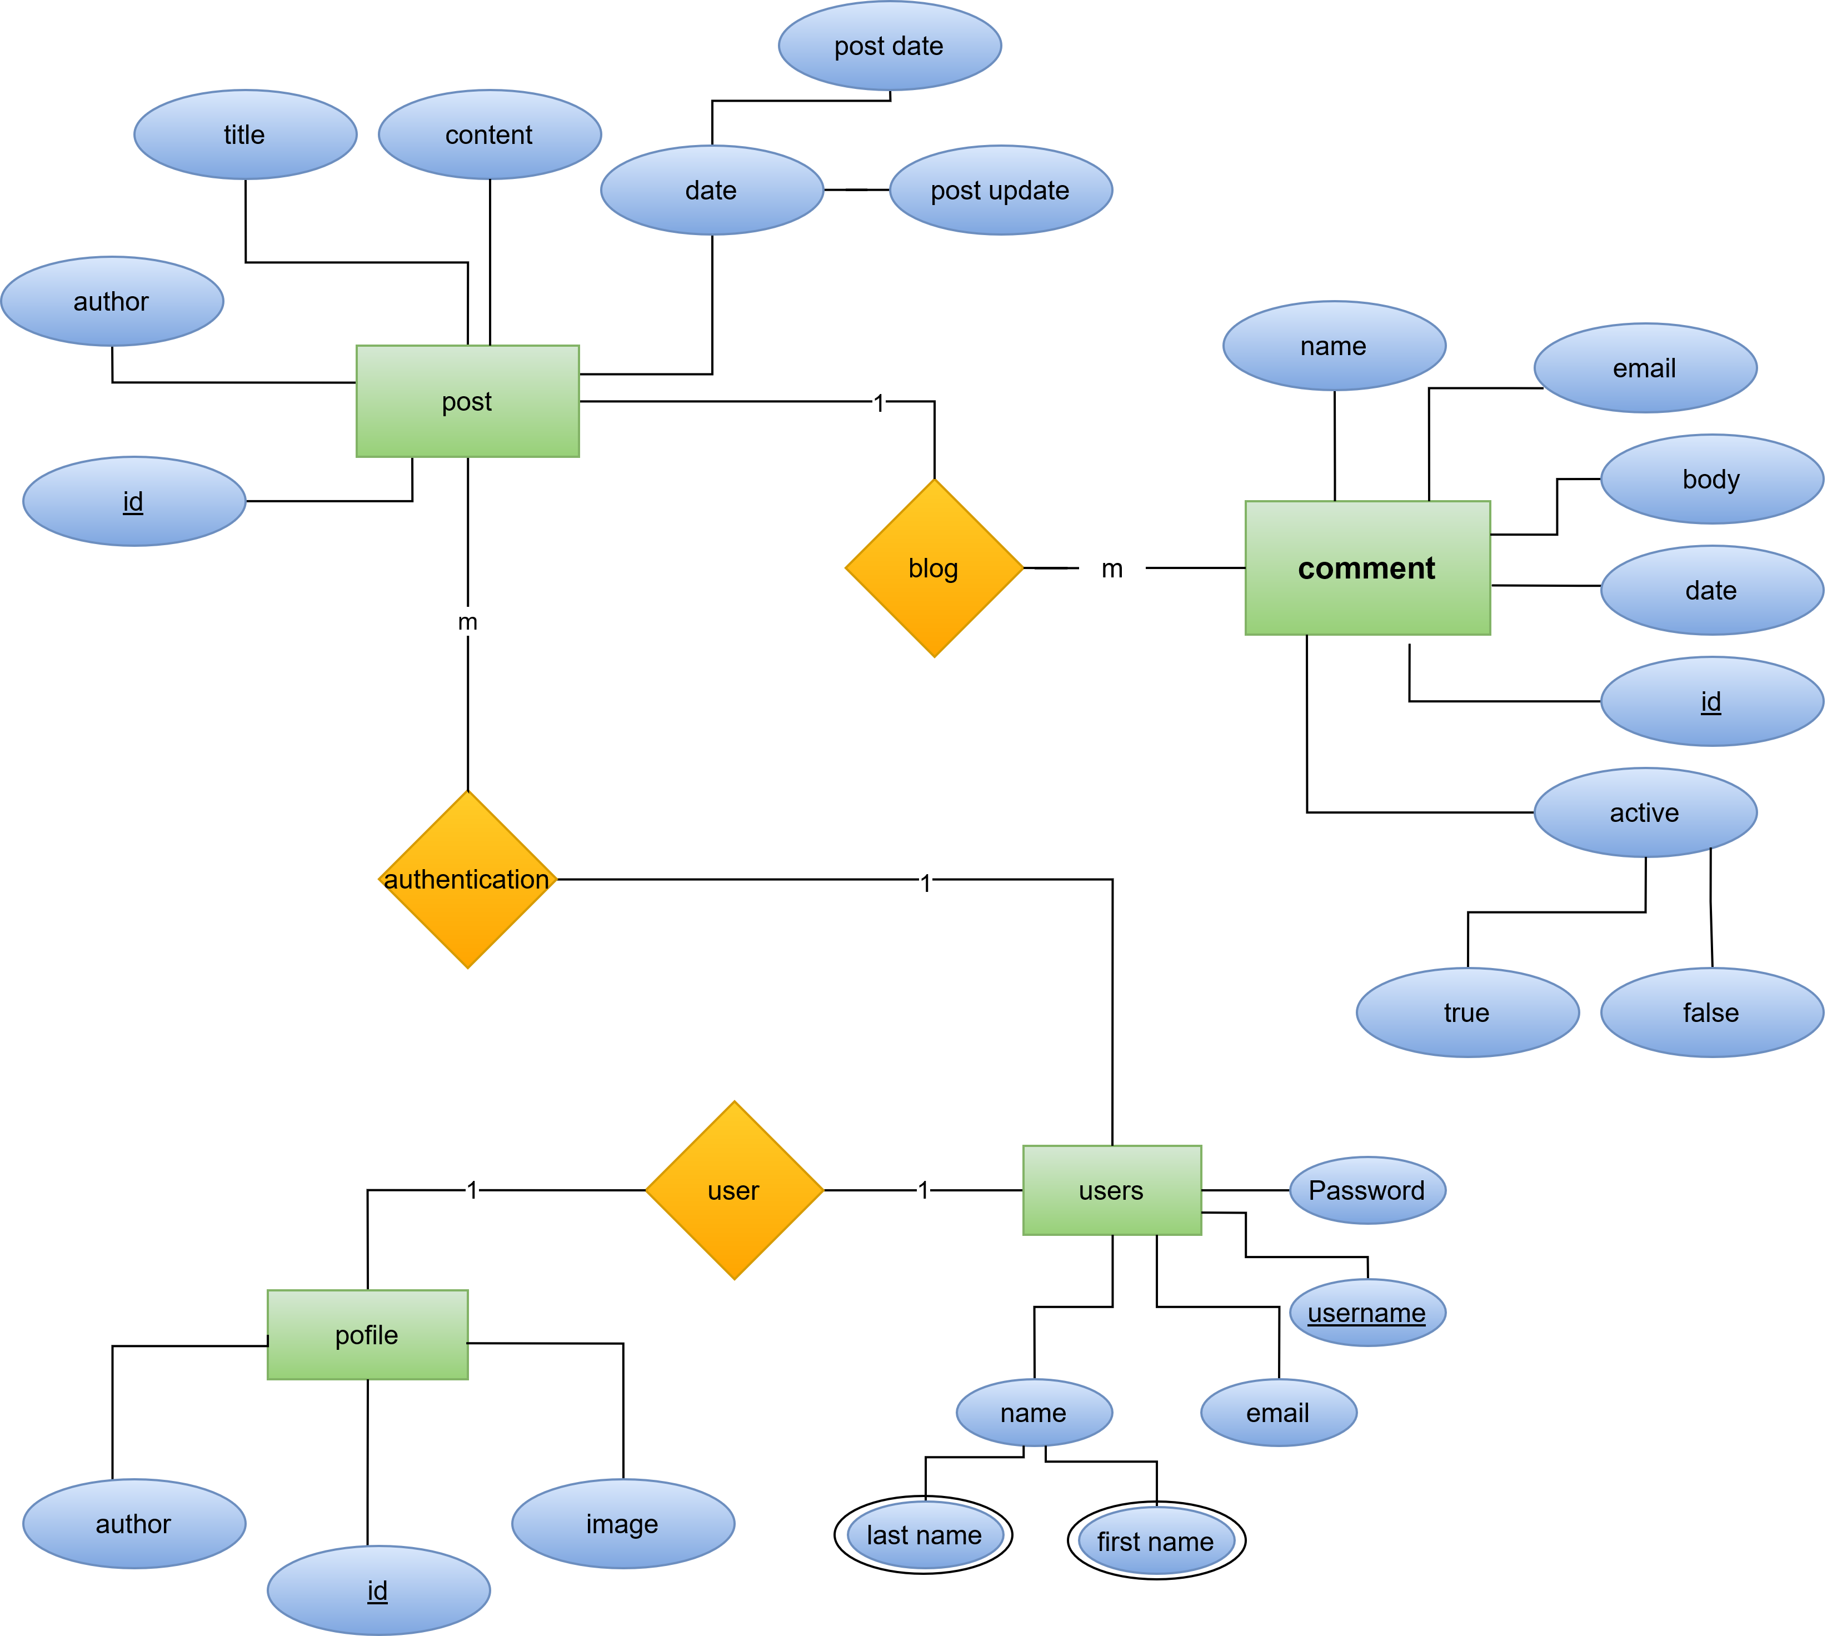
ER Model for blog site
Notes:
Pclass : A proxy for socio-economic status (SES) 1st = Upper 2nd = Middle 3rd = Lower
age: Age is fractional if less than 1. If the age is estimated, is it in the form of xx.5 sibsp: The dataset defines family relations in this way... Sibling = brother, sister, stepbrother, stepsister Spouse = husband, wife (mistresses and fiancés were ignored) parch: The dataset defines family relations in this way... Parent = mother, father Child = daughter, son, stepdaughter, stepson Some children travelled only with a nanny, therefore parch=0 for them.

Slide 9
COOP project (coursers)
in coop project I build a courses site you can register and login.
In this web you can join in the curses and all about datil the course you can know
I use Django framework for my coop project .
Django==3.0.9
sqlite3

Slide 10
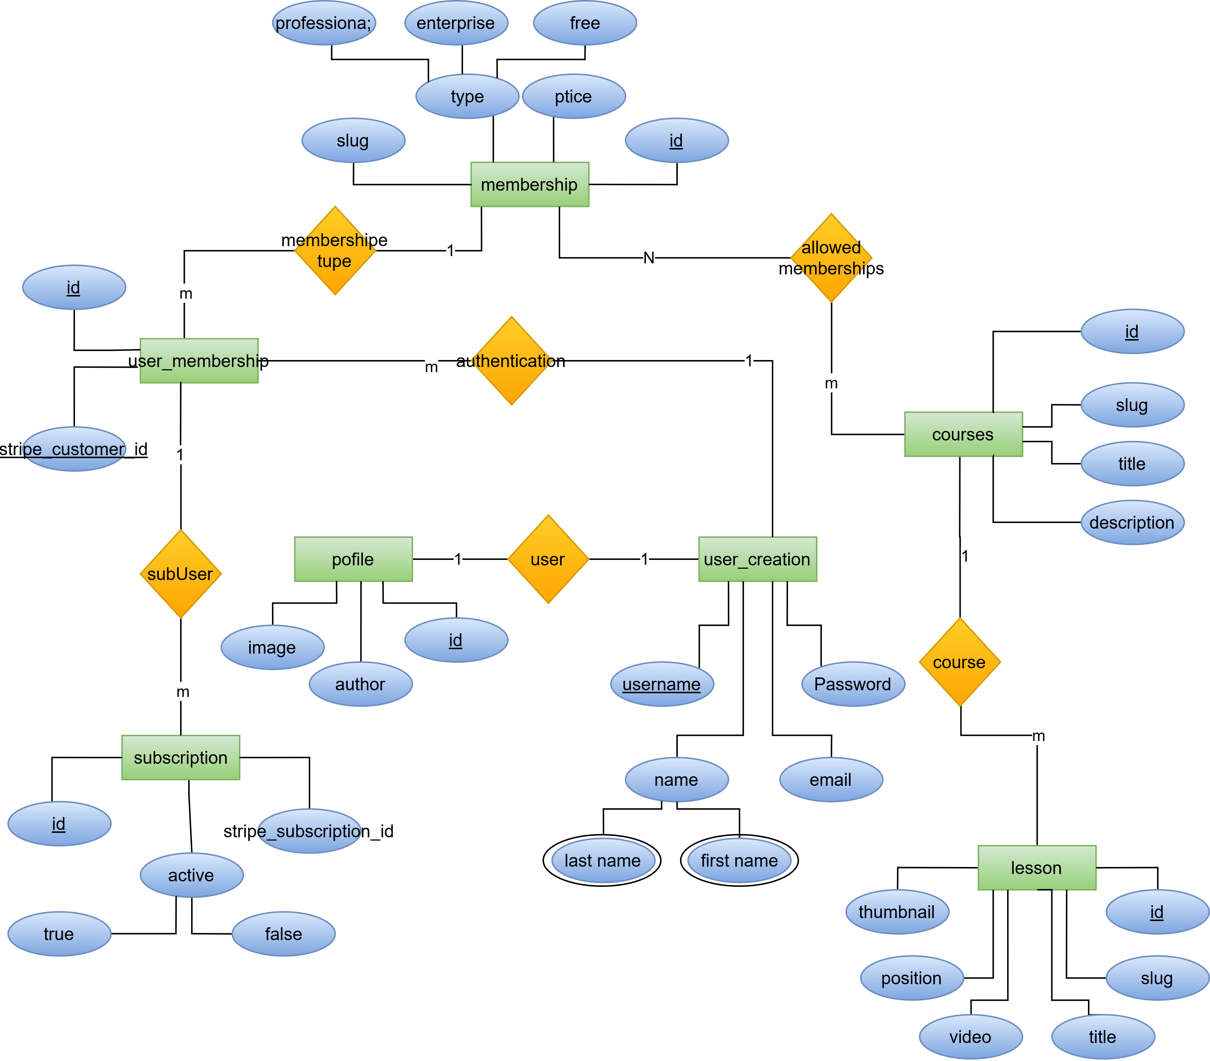
ER Model for course site

Slide 11
conclusion
In this coop I proved my skills and I learn many subject in this coop
The tracks in the summer semester help my and I into all of the tracks in Data science I learn R programming,Weka,Exel and in network I use packet tracer , in wep programming we learn PHP ,c#,java script ,html,css finally in artificial intelligence we use Python .
And to work in fab lab .

Slide 12
Any question

Slide 13
Thank you .

