Slide 1
ROAD SAFETY ANALYTICS
Analysis of Road Traffic Accident in USA
A tool-by-tool walkthrough: Excel, SQL, Python (AI Agent) & Power BI
Excel
SQL Server
Python (AI Agent)
Power BI
21,183 accidents | 11 states | Jan 2016 – Jan 2017
Data Analytics Project • Discussion Presentation

Slide 2
AGENDA
What we'll cover — tool by tool
01
Business Objective
Why this analysis matters
02
Excel — Data Cleaning
Standardizing the raw dataset
03
SQL — Server-Side Analysis
Building the analytical table
04
Python — AI Query Agent
A natural-language assistant over the data
05
Power BI — Dashboard & Findings
KPIs, severity, geography & time patterns
2

Slide 3
BUSINESS OBJECTIVE
Turning raw accident records into safety decisions
The US Accidents dataset (Kaggle) covers Feb 2016 – Mar 2023 nationwide. For this project, a Jan 2016 – Jan 2017 slice was cleaned, structured and loaded into Power BI — 21,183 accident records across 11 states — to surface patterns that support road-safety planning. The work spans four tools, each handling a different stage of the pipeline.
THE PIPELINE
Excel
clean & standardize raw columns
SQL Server
build the analytical table with T-SQL
Which states and cities carry the highest accident volume?
When do accidents peak — by time slot and day/night?
Python (AI Agent)
natural-language querying over the data
Which road and weather factors show up most often?
Power BI
How severe are these accidents, and how are severity levels distributed?
interactive 3-page dashboard
21,183 records • 11 states • Jan 2016 – Jan 2017
3

Slide 4
1
SECTION 1
Excel — Data Cleaning
4

Slide 5
EXCEL — DATA CLEANING
Standardizing the dataset before analysis
Category | Columns | Action | Reason
Date & Time | Start_Time, End_Time | Date/Time | Time analysis
Numeric | Start_Lat, Start_Lng, Distance, Temperature, Wind_Speed, Visibility | Decimal | Higher precision
Numeric | Humidity | Whole Number | Percentage
Identifier | Zipcode | Text | Identifier / contains '-'
Boolean | Road feature columns | True/False | Binary values
Removed | End_Lat, End_Lng | Deleted | Empty & redundant
Removed | Country | Deleted | All values = US
Removed | Description | Deleted | Not relevant
Removed | Airport_Code | Deleted | Out of scope
Removed | Wind_Chill, Precipitation | Deleted | Many null values
The dataset was cleaned and standardized before building the dashboard to improve data quality, consistency, and analytical accuracy.
5

Slide 6
EXCEL — DATA CLEANING
What the cleaning process delivered
Corrected inconsistent data types.
Removed redundant and irrelevant columns.
✓
✓
Handled null values by removing low-quality columns with excessive missing data.
Eliminated empty and redundant fields.
✓
✓
Improved data consistency and reduced dataset size.
Prepared the dataset for reliable analysis and interactive dashboard development.
✓
✓
6

Slide 7
2
SECTION 2
SQL Server — Analytical Workflow
7

Slide 8
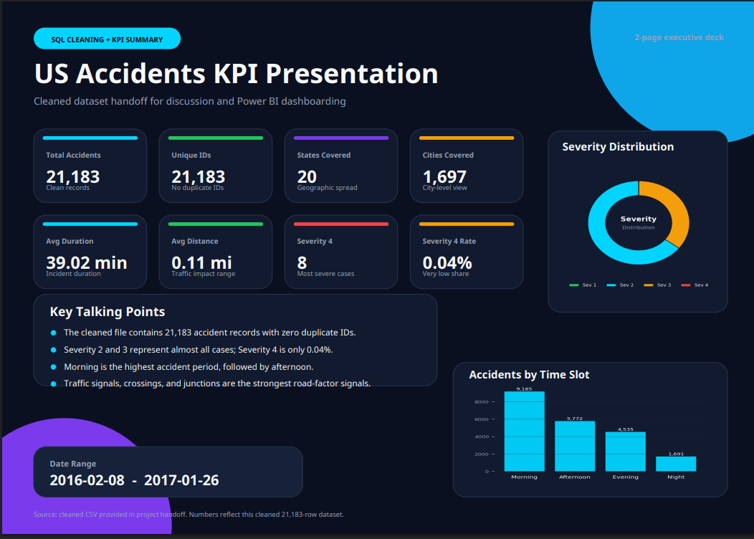

Slide 9
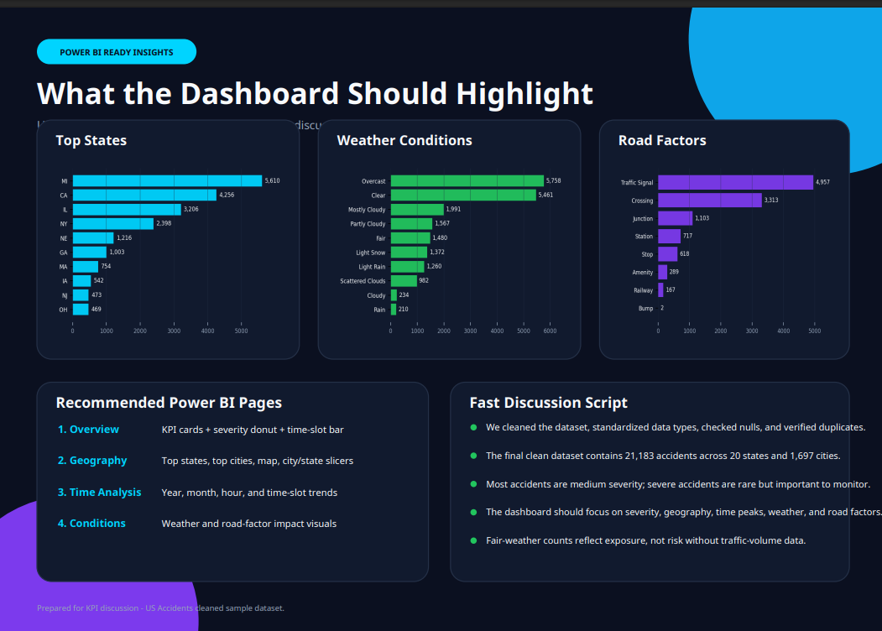
9

Slide 10
3
SECTION 3
Python — AI Query Agent
10

Slide 11
PYTHON — AI QUERY AGENT
From language models to agents that act
1
2
3
Large Language Model (LLM)
AI Agent
Tools
An AI model trained on vast text data — understands and generates human language for tasks like Q&A, summarization and translation.
An AI system that perceives, decides and acts to achieve a goal — it thinks, plans, and uses tools to interact with the outside world.
Crucial for extending an agent beyond language processing — they let it access external data (APIs), execute code, and query databases.
11

Slide 12
PYTHON — AI QUERY AGENT
Our Agent: Traffic Accident AI Assistant
A specialized AI agent for analyzing the US traffic accident data. It processes user questions in natural language, generates SQL, executes it against the database, and interprets the results into a clear answer.
Understand User Intent — determine if database access is needed
Generate SQL Query — create a valid SELECT statement
1
2
Execute Query — run it through a read-only execute_sql tool
Interpret Results — read and interpret the returned rows
3
4
Formulate Answer — produce a clear, concise final answer
Error Handling — explain SQL errors and retry if possible
5
6
Runs on a lightweight, embedded SQLite database containing a single accidents table.
12

Slide 13
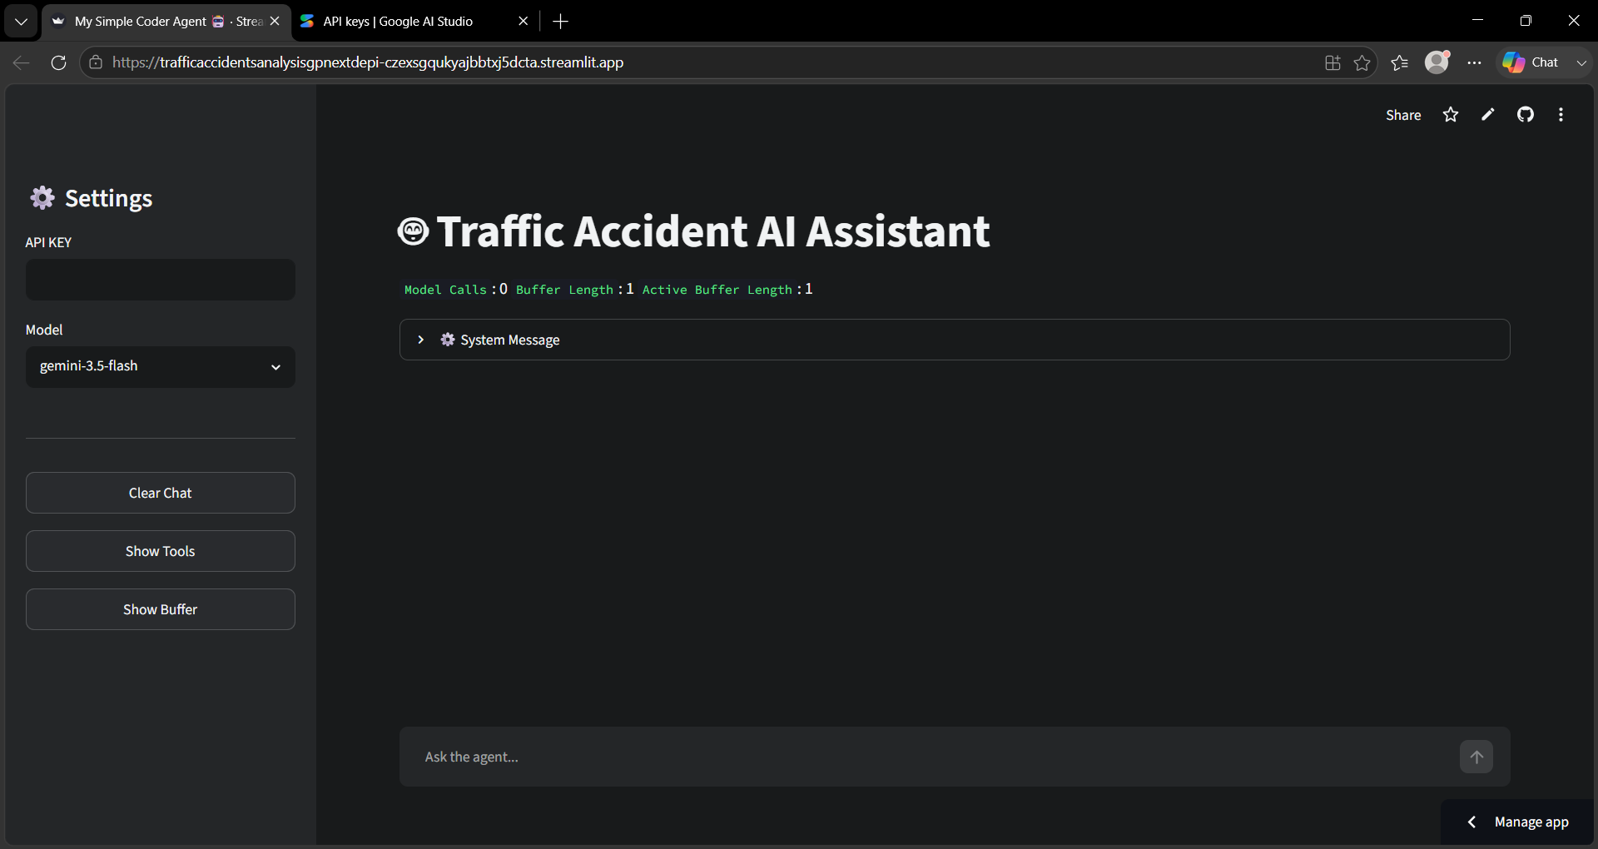
PYTHON — AI QUERY AGENT
Live example 1.1
1,697 unique cities — returned in natural language
13

Slide 14
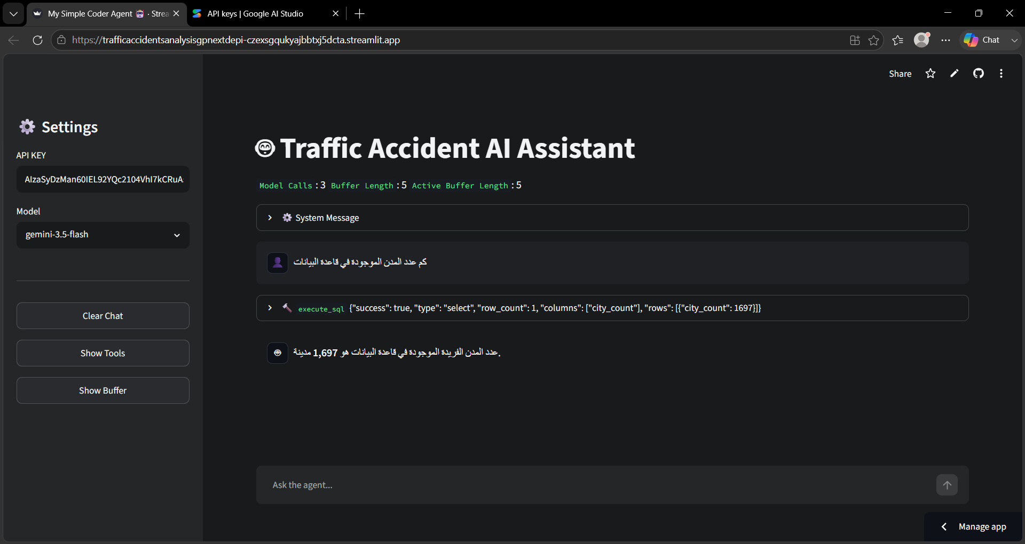
PYTHON — AI QUERY AGENT
Live example 2.1
1,697 unique cities — returned in natural language
13

Slide 15
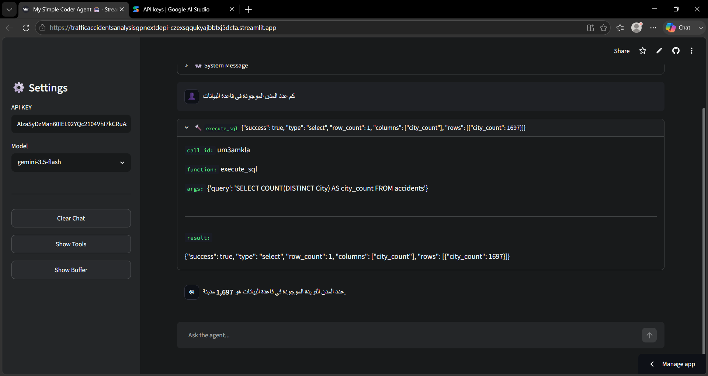
PYTHON — AI QUERY AGENT
Live example 2.2
1,697 unique cities — returned in natural language
13

Slide 16
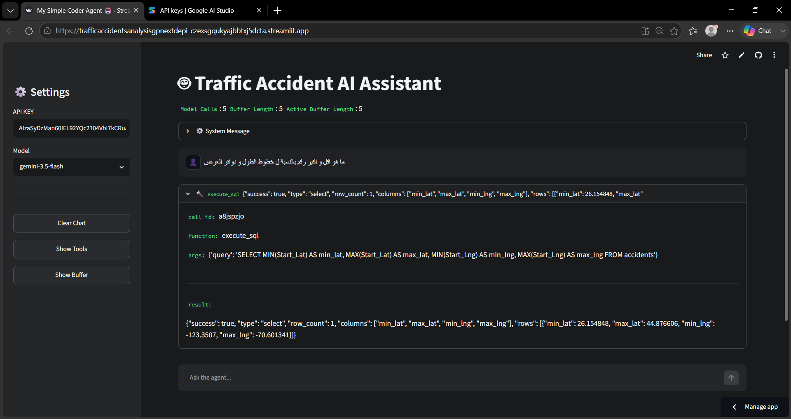
PYTHON — AI QUERY AGENT
Live example 3.1
1,697 unique cities — returned in natural language
13

Slide 17
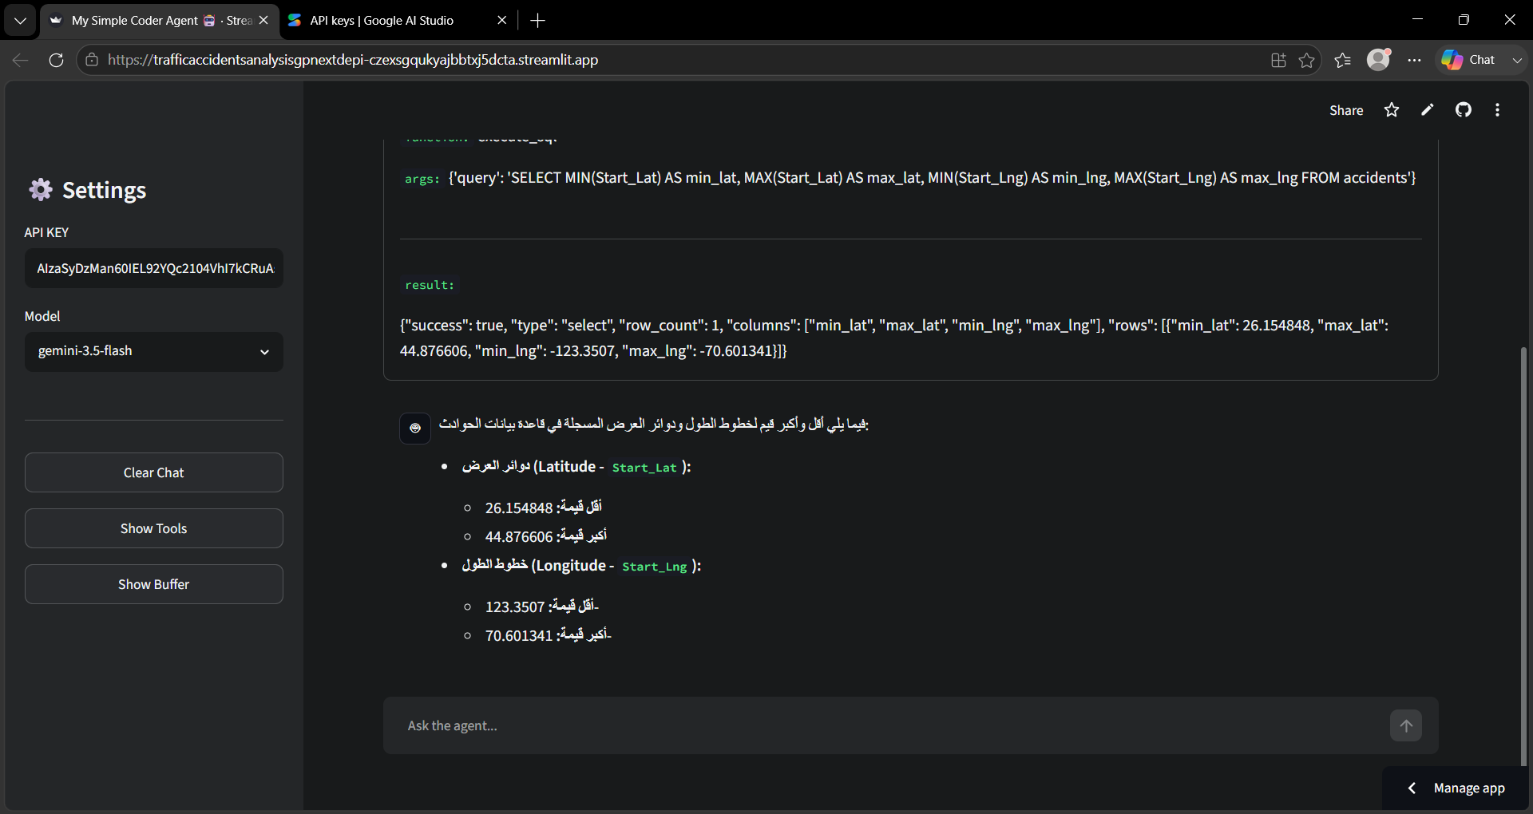
PYTHON — AI QUERY AGENT
Live example 3.2
1,697 unique cities — returned in natural language
13

Slide 18
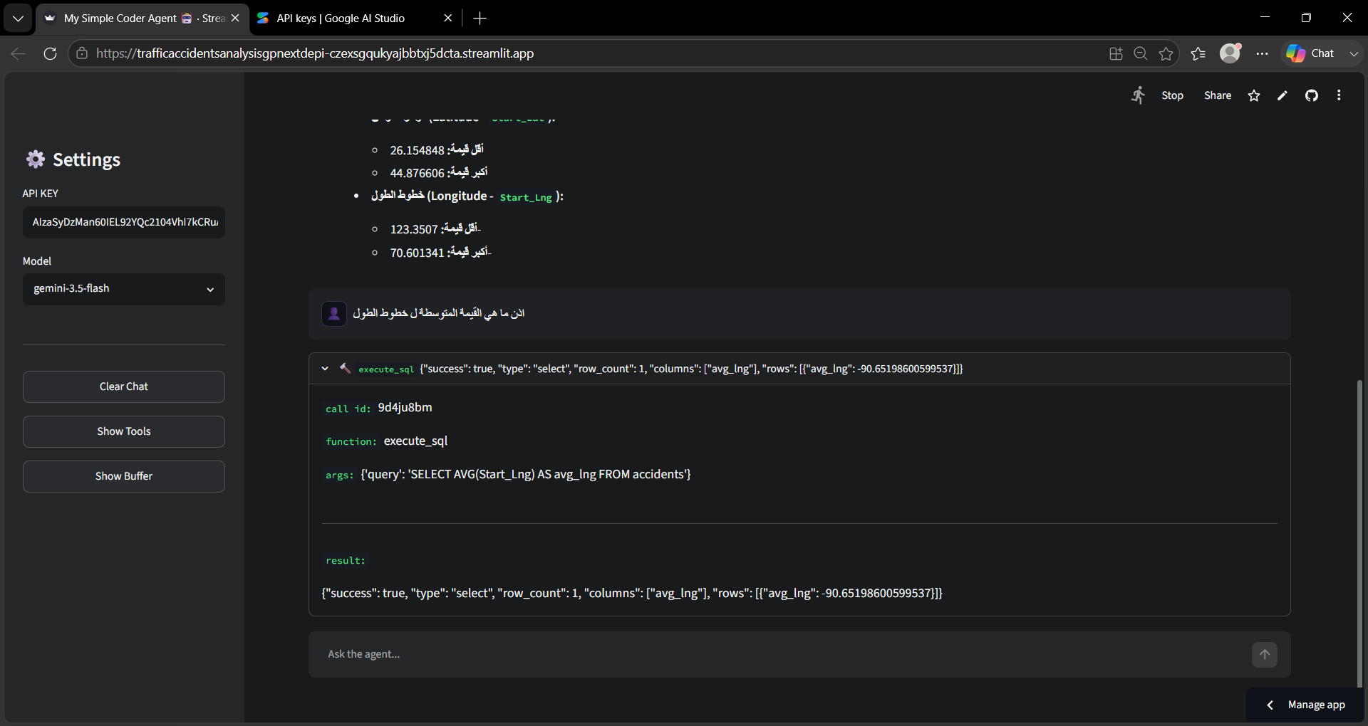
PYTHON — AI QUERY AGENT
Live example 3.3
1,697 unique cities — returned in natural language
13

Slide 19
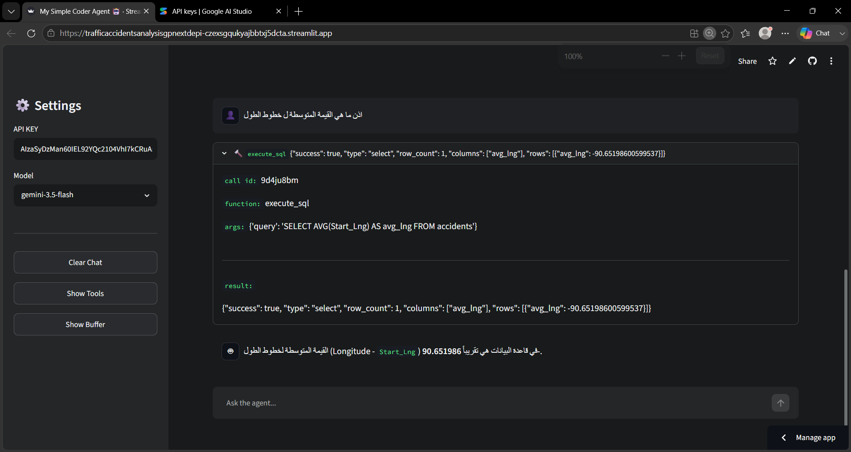
PYTHON — AI QUERY AGENT
Live example 3.4
1,697 unique cities — returned in natural language
13

Slide 20
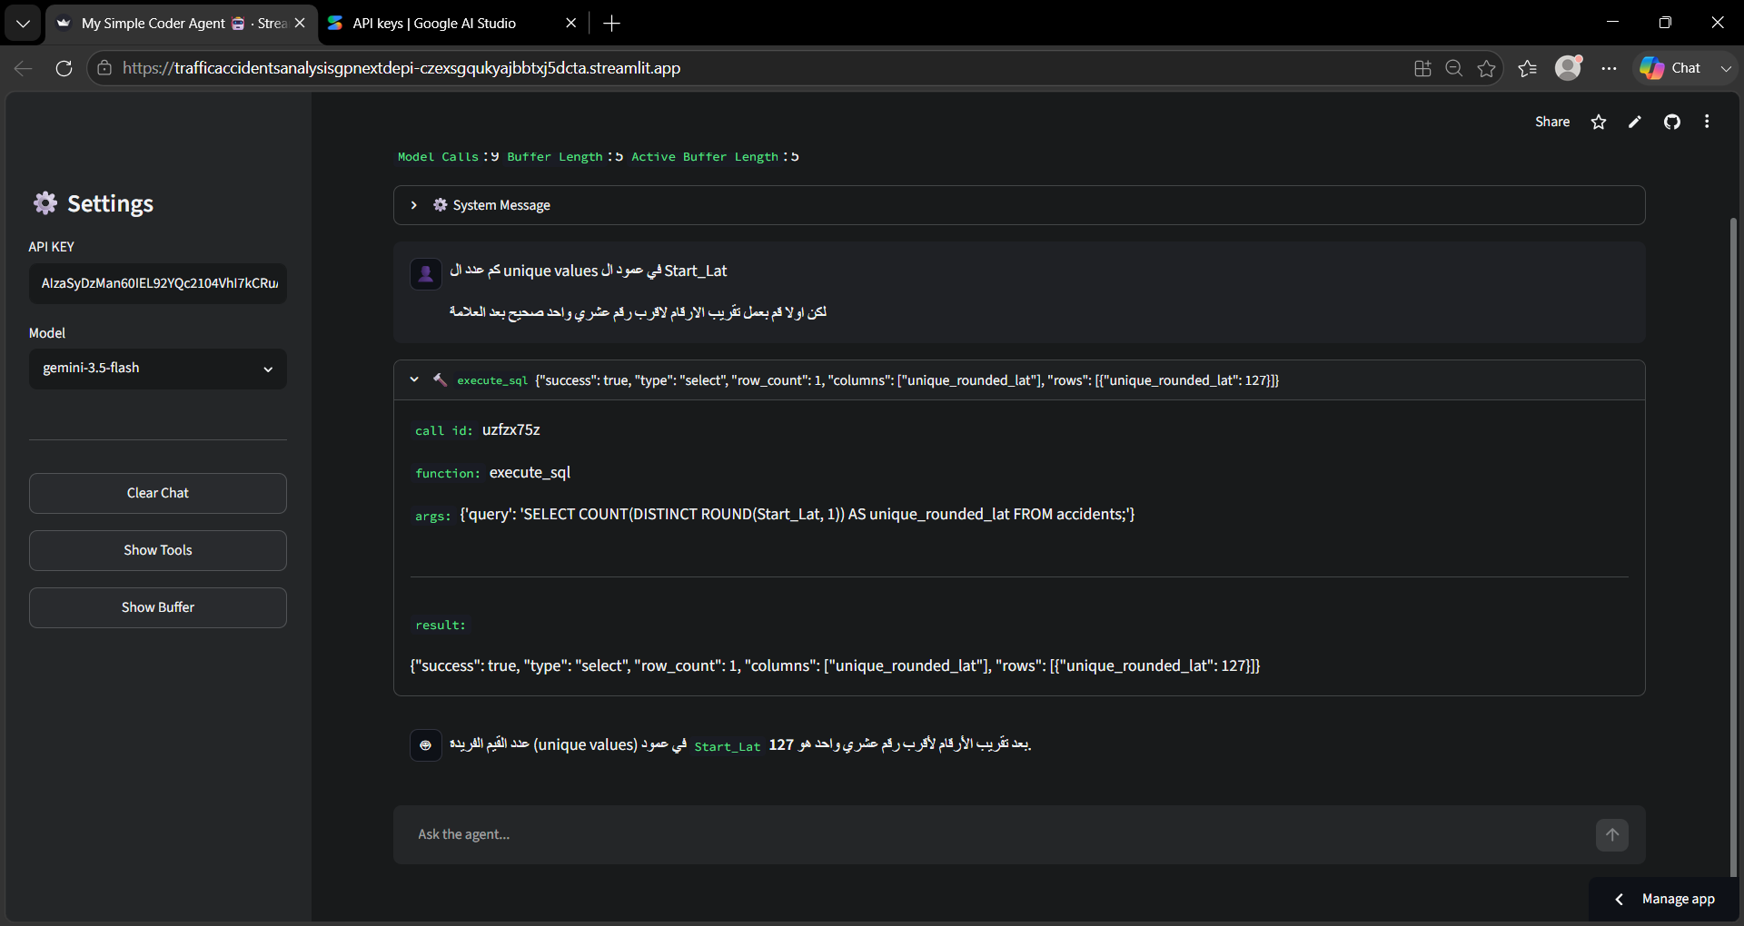
PYTHON — AI QUERY AGENT
Live example 4.1
1,697 unique cities — returned in natural language
13

Slide 21
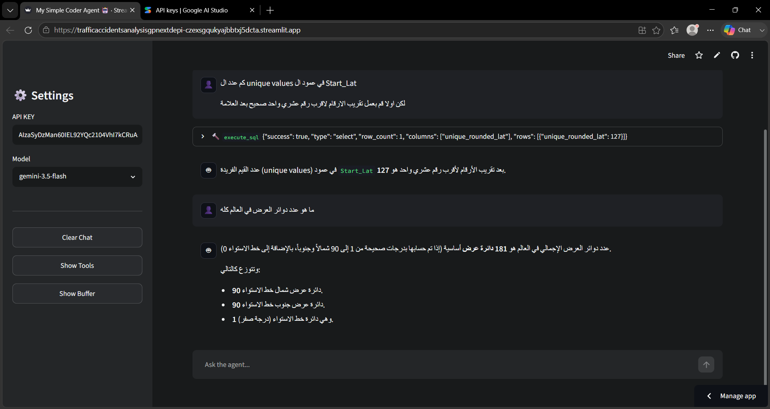
PYTHON — AI QUERY AGENT
Live example 4.2
1,697 unique cities — returned in natural language
13

Slide 22
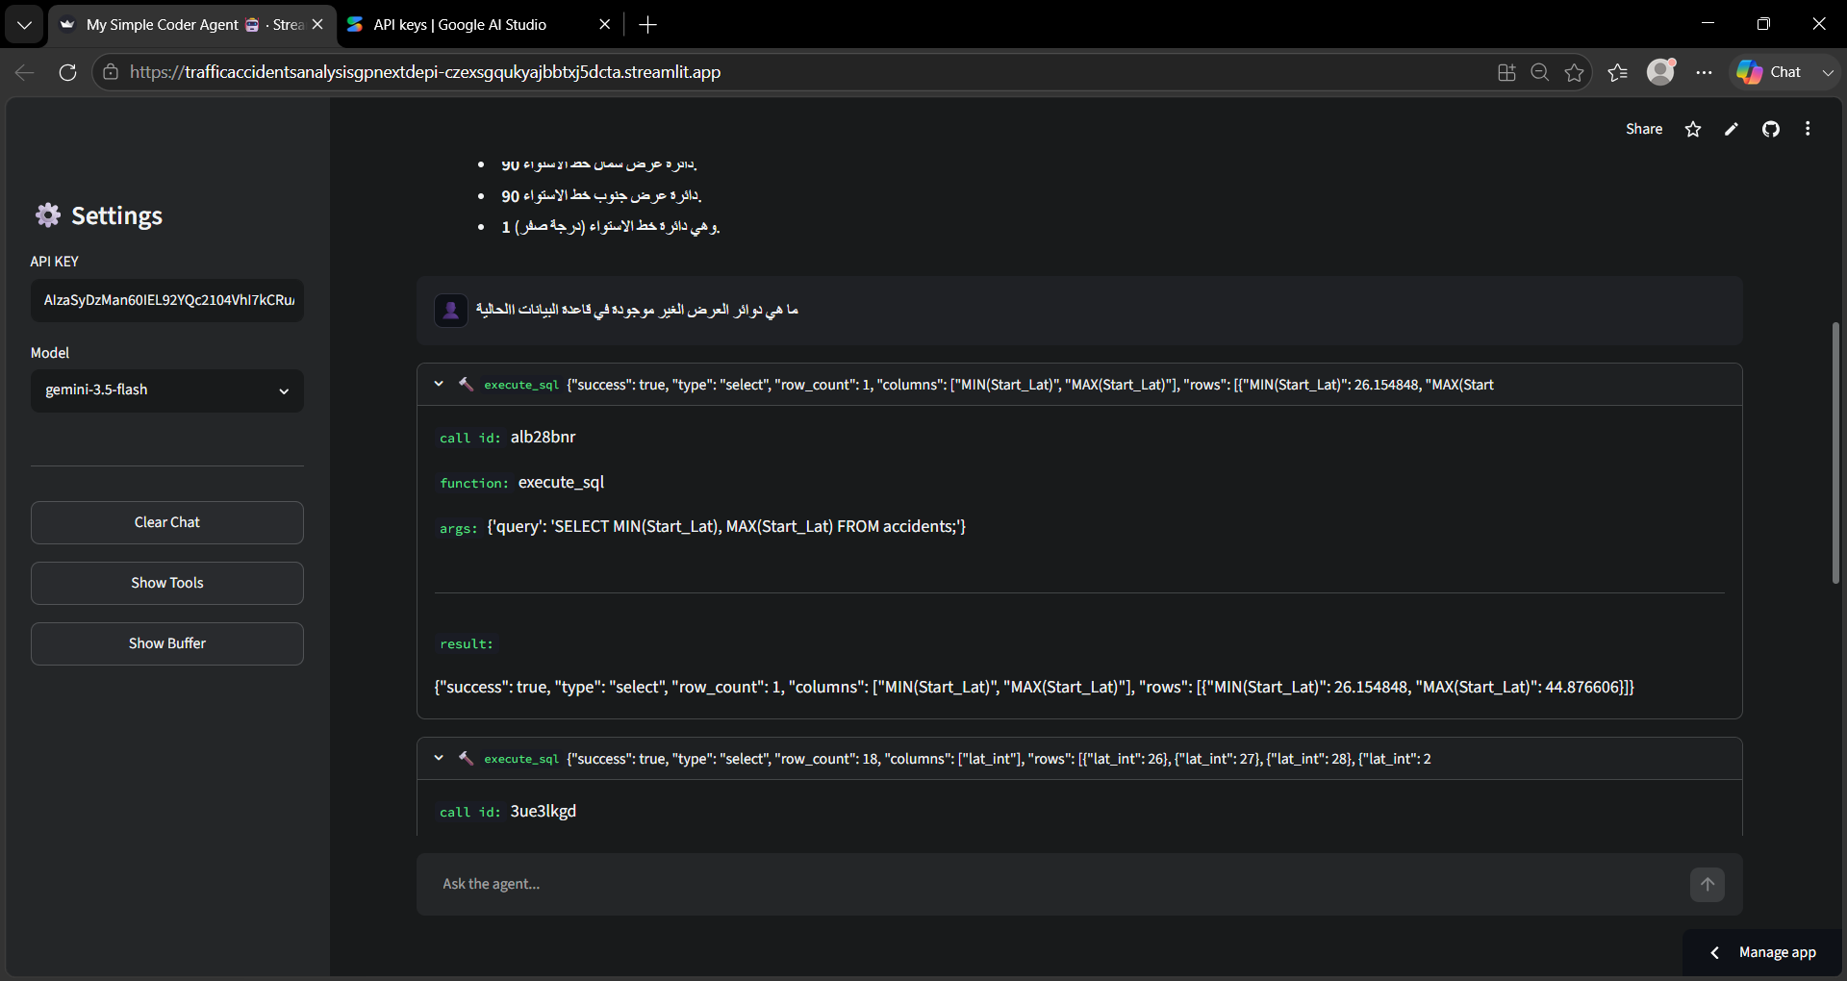
PYTHON — AI QUERY AGENT
Live example 4.3
1,697 unique cities — returned in natural language
13

Slide 23
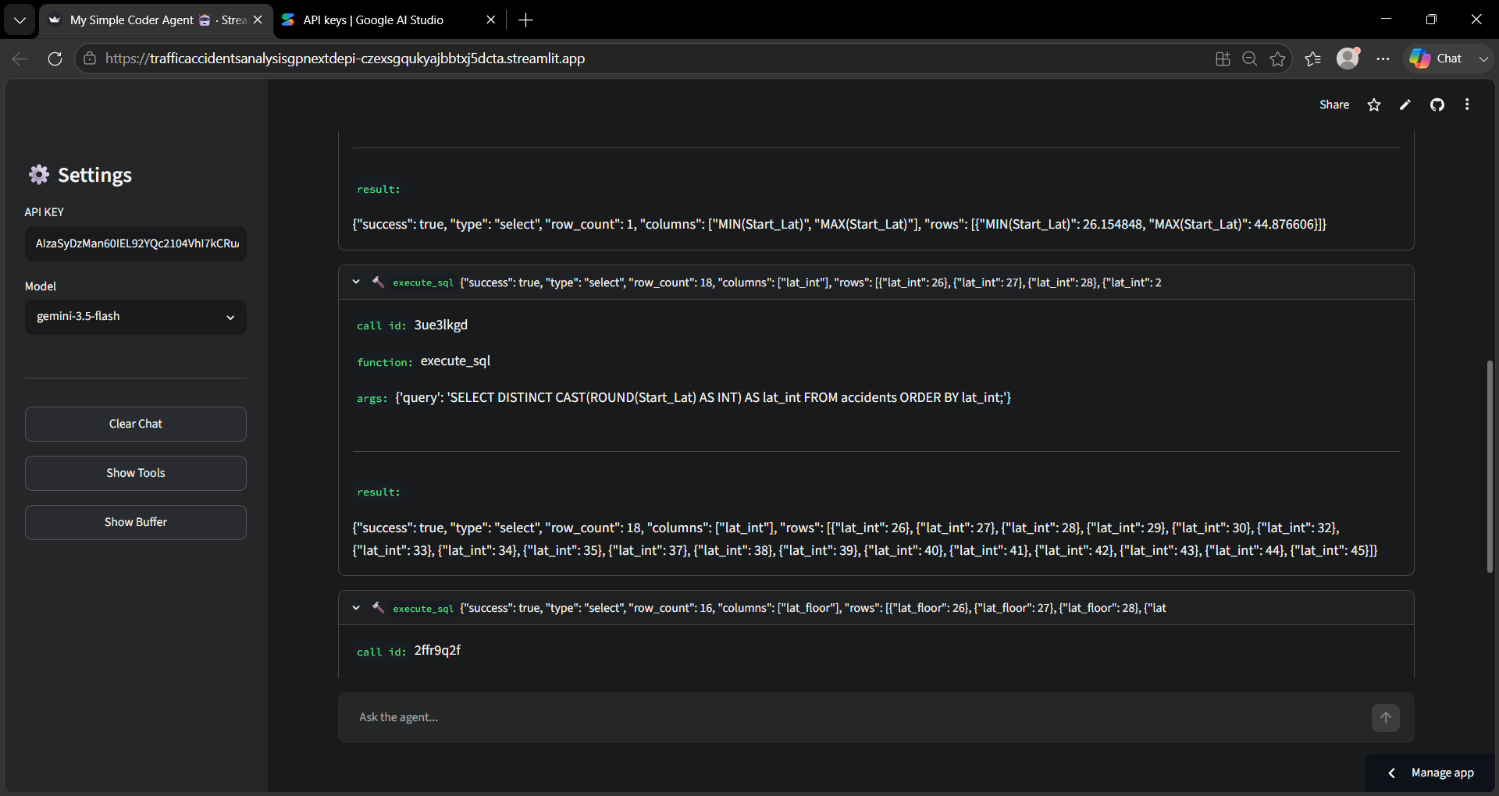
PYTHON — AI QUERY AGENT
Live example 4.4
1,697 unique cities — returned in natural language
13

Slide 24
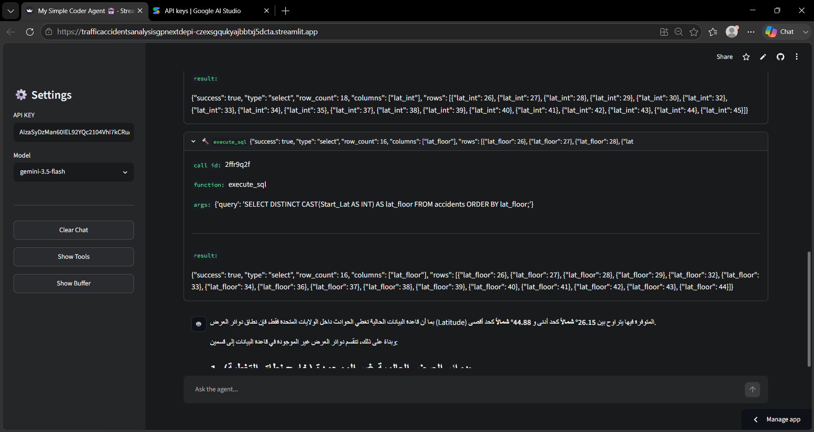
PYTHON — AI QUERY AGENT
Live example 4.5
1,697 unique cities — returned in natural language
13

Slide 25
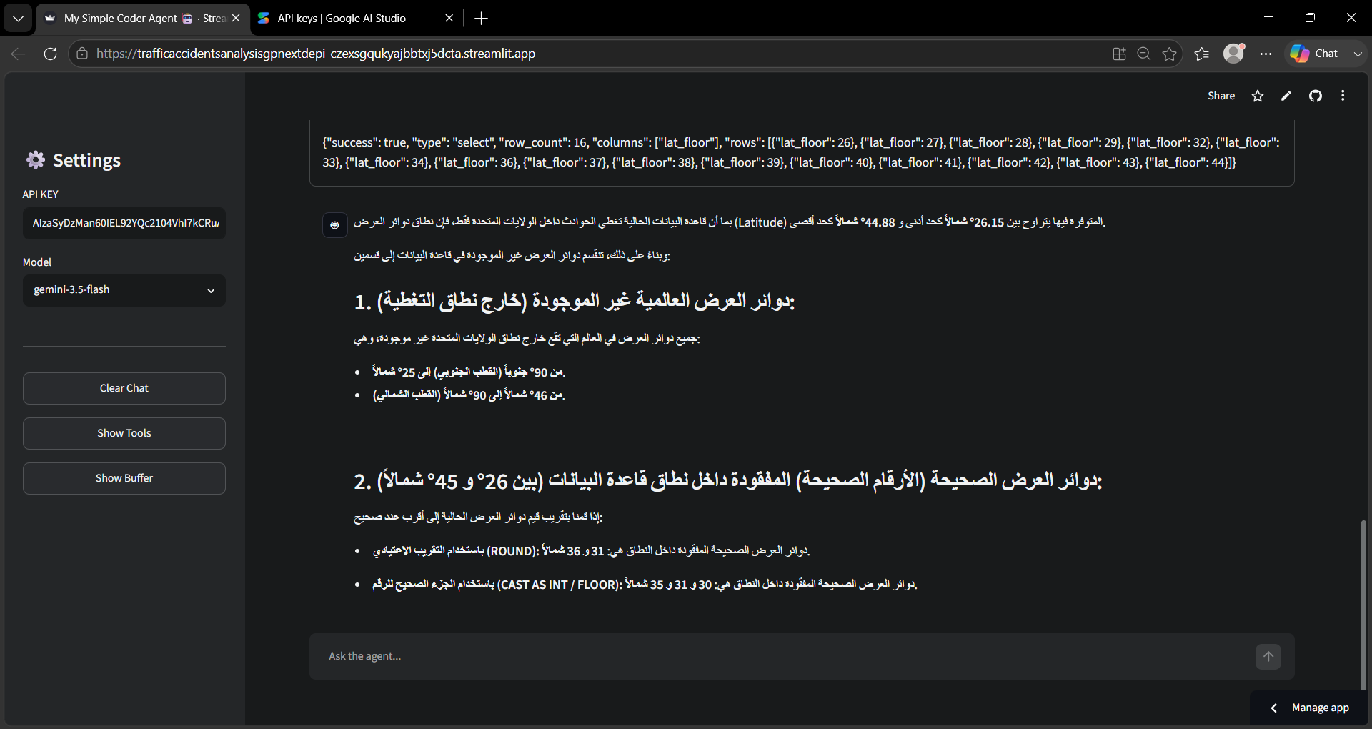
PYTHON — AI QUERY AGENT
Live example 4.6
1,697 unique cities — returned in natural language
13

Slide 26
PYTHON — AI QUERY AGENT
Why an AI agent on top of the data
Easy Data Access
Fast Analysis
Natural language queries for non-SQL users.
Quick processing of complex questions and responses.
Accurate Information
Improved Decision-Making
A dedicated SQL tool ensures data integrity.
Provides insights for road safety.
Scalability
Adaptable to other databases and analytical domains.
AI agents, LLMs and specialized tools offer a robust data-analysis solution — this agent provides direct, conversational insight into traffic accidents for informed decision-making.
14

Slide 27
4
SECTION 4
Power BI — Dashboard & Findings
15

Slide 28
POWER BI — KPI OVERVIEW
The numbers behind the dashboard
21,183
2.35
39.0 min
TOTAL ACCIDENTS
AVERAGE SEVERITY
AVERAGE DURATION
55.86%
44.14%
11
DAY SHARE
NIGHT SHARE
STATES REPRESENTED
16

Slide 29
POWER BI — SEVERITY ANALYSIS
Severity 2 dominates this sample
Severity
Count
Share
1
11
0.05%
2
13,685
64.61%
3
7,479
35.31%
4
8
0.04%
Severity 1 and 4 combined make up just 0.09% of this sample (19 of 21,183 records) — too rare here to generalize confidently.
17

Slide 30
POWER BI — GEOGRAPHIC DISTRIBUTION
Michigan, California and Illinois lead this sample
18

Slide 31
POWER BI — GEOGRAPHIC DISTRIBUTION
Michigan cities dominate the city-level view
1
Grand Rapids
MI
READING THE RANKING
2
Omaha
NE
This ranking mirrors the order shown in the dashboard's Top Cities chart. Exact per-city counts aren’t labeled on that chart — they’re available by hovering in the live Power BI report rather than being restated here as approximations.
3
Flint
MI
4
Detroit
MI
5
Atlanta
GA
6
Newhall
CA
4 of the top 7 cities are in Michigan — consistent with MI also being the top state overall.
7
Elgin
IL
19

Slide 32
POWER BI — TIME PATTERNS
Morning is the highest-risk time slot
DAY VS NIGHT
55.86%
44.14%
DAY
NIGHT
Morning alone accounts for 43% of accidents in this sample — more than afternoon and evening combined relative share, and over 5x the night share.
20

Slide 33
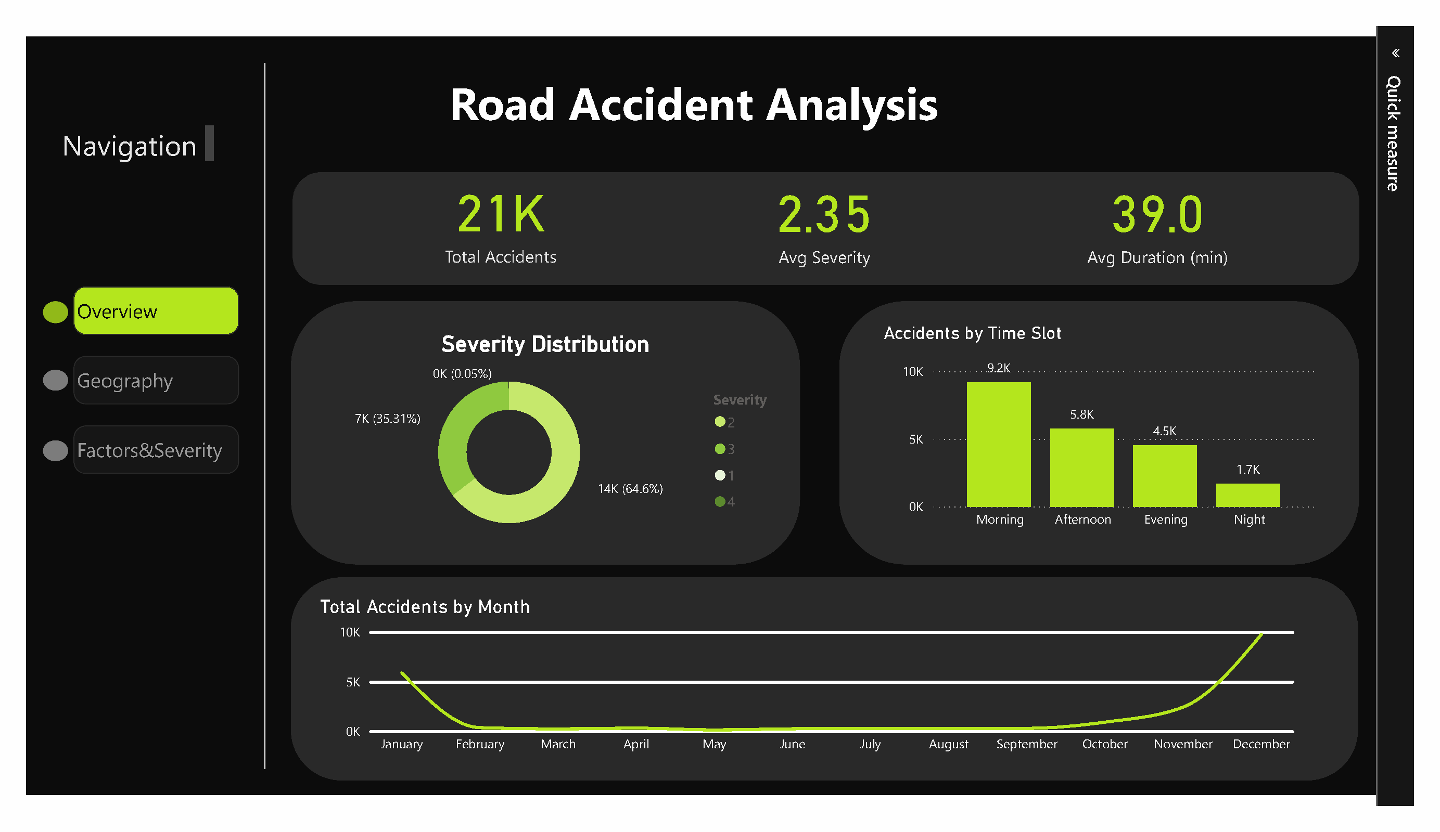
POWER BI DASHBOARD
Page 1 — Overview
21

Slide 34
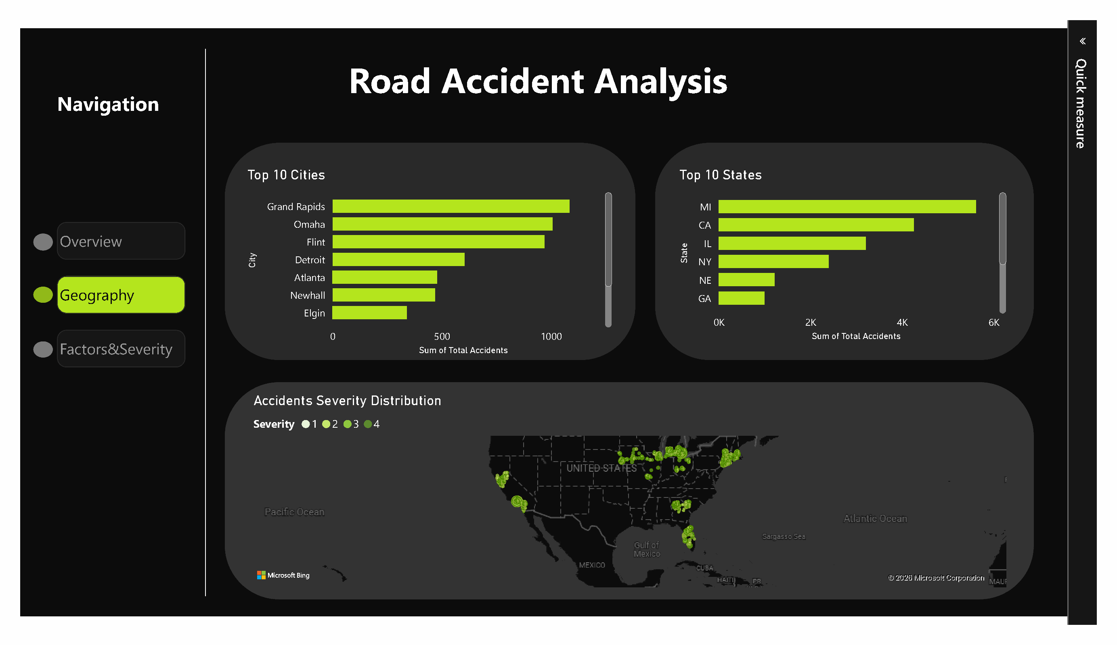
POWER BI DASHBOARD
Page 2 — Geography
22

Slide 35
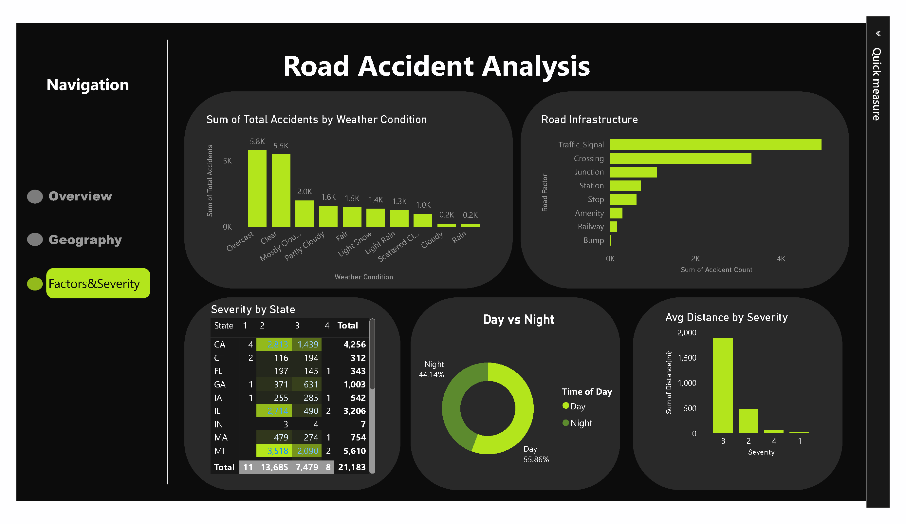
POWER BI DASHBOARD
Page 3 — Factors & Severity
23

Slide 36
TEAM
The people behind this project
ZG
AT
SA
EA
Ziad Ghallab
Abdelrahman Talaat
Salma Ahmed
Eslam Ahmed
Team Leader
RT
MM
YS
Retaj Tareq
Malak Magdy
Youssef Samy
24

Slide 37
Thank You
Questions & Discussion
US Accidents Data Analysis • Excel, SQL Server, Python & Power BI • Jan 2016 – Jan 2017 sample

