Slide 1


HR data …
Employee Churn Analysis Project!
Employee Churn Analysis Project
second project of Capstone Project Series.
Group4

Slide 2
introduction
predicting employee turnover in a company using machine learning and deep learning techniques. The dataset includes employee attributes, and the project includes steps such as exploratory data analysis, data pre-processing, cluster analysis, building classification models, implementing deep learning with Tensorflow-Keras, and deploying the models using Streamlit.
The goal is to provide actionable insights for businesses to understand and address employee churn.

Slide 3
Overview of DataFrame
01
02
satisfaction_level Employee satisfaction point (range: 0-1).
last_evaluation Performance evaluated by the employer (range: 0-1).
03
04
number_projects Number of projects assigned to an employee.
average_monthly_hours Average monthly hours worked by an employee.
05
06
time_spent_company Employee experience in years.
work_accident Whether an employee had a work accident (Yes/No).
07
08
promotion_last_5years Whether an employee had a promotion in the last 5 years (Yes/No).
Departments
Salary: (low, medium, high).
left:employee left (1) or not (0).

Slide 4
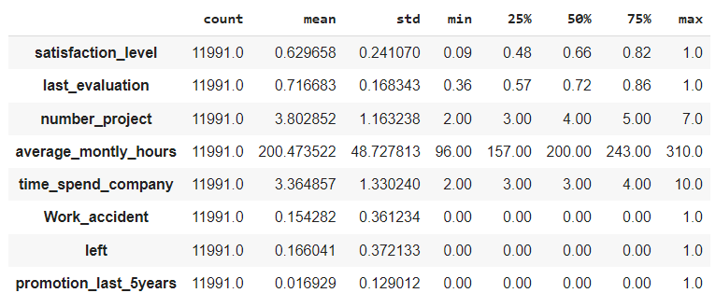
DataFrame Overview

Slide 5
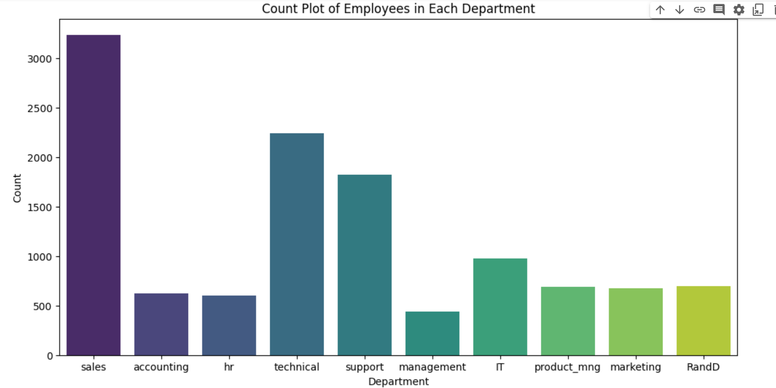
counting employees from each department

Slide 6
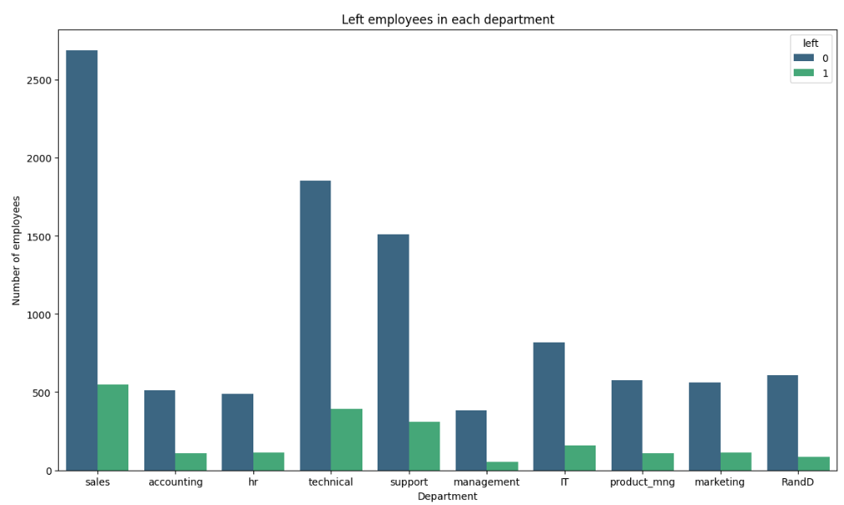
Left employees in each department

Slide 7
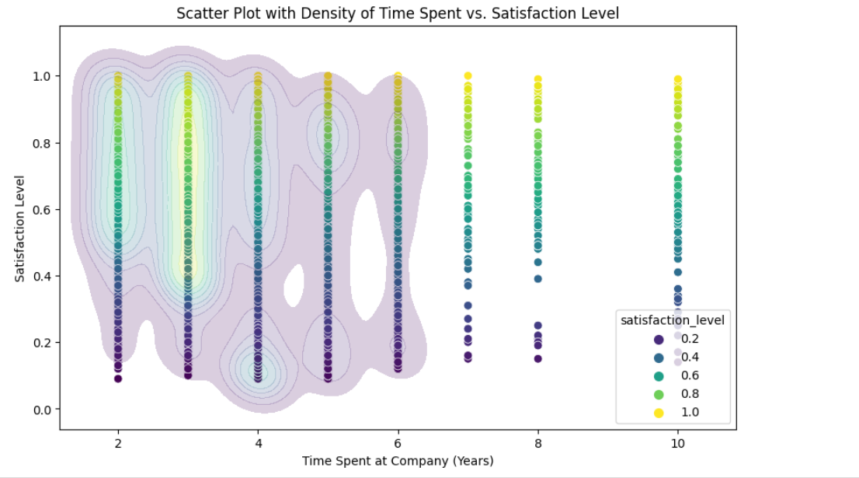
Time Spent in the company vs Satisfaction Level

Slide 8
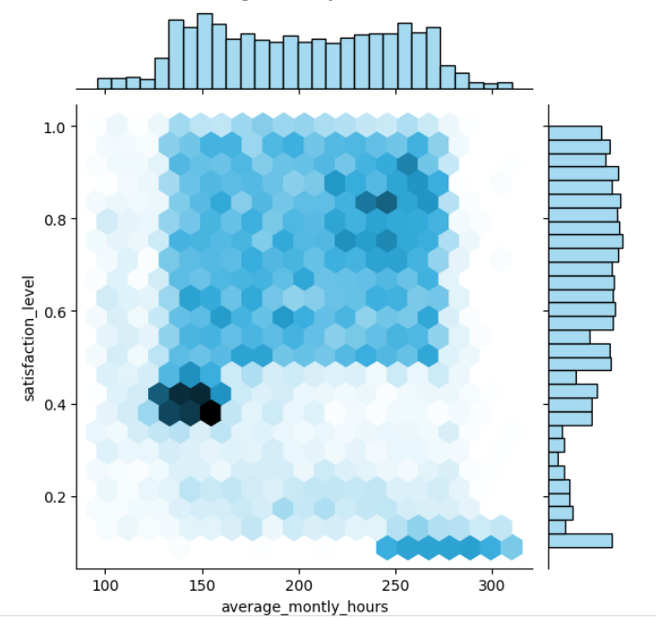
Time Spent in the company vs Satisfaction Level

Slide 9
KMeans…
Determining the right number of clusters is crucial for effective KMeans clustering Using Silhouette score and elbow method, 4 have the highest score
.

Slide 10
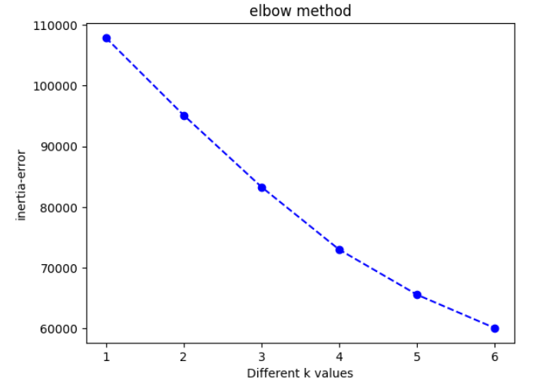
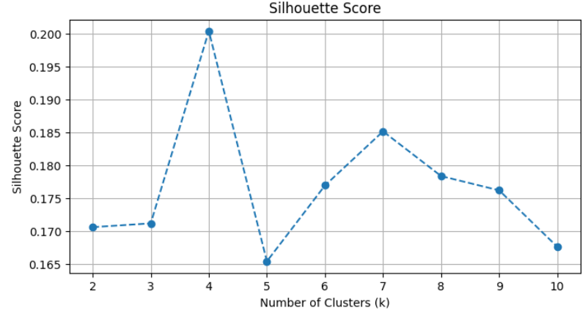
Elbow Method and Silhouette

Slide 11
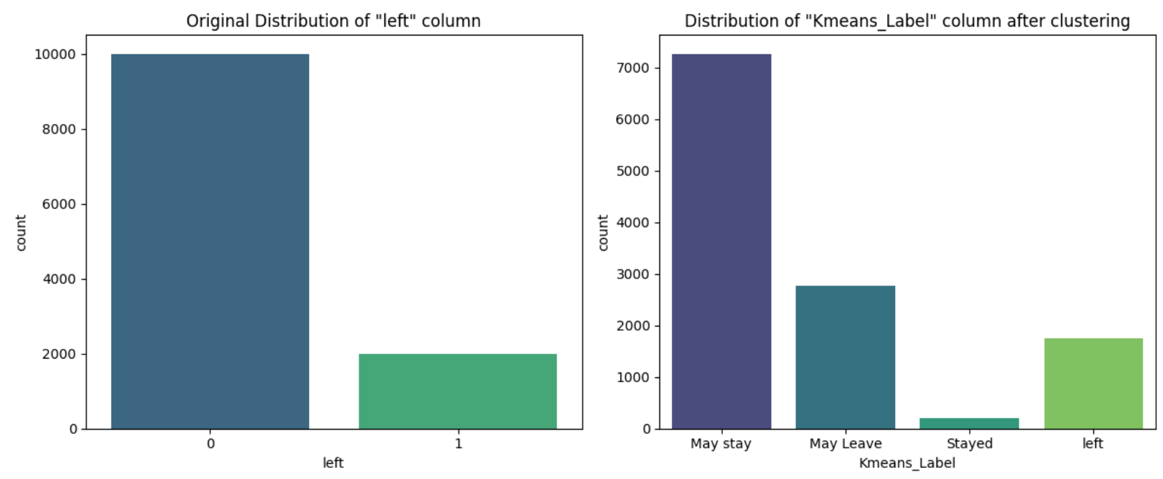
Distribution of left and K-means

Slide 12
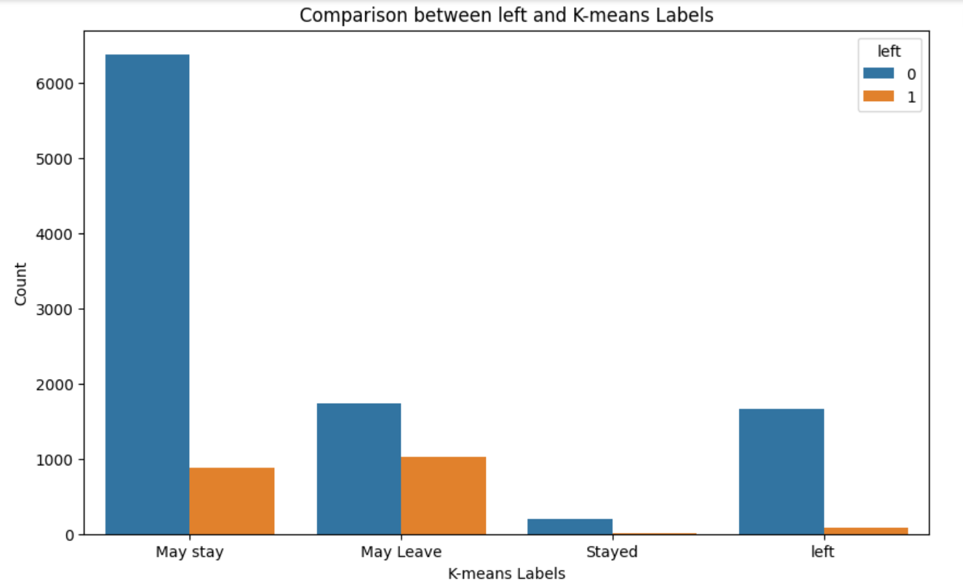
Comparison between left and K-means Labels

Slide 13
Classification Algorithms
ML/DL algorithms.
Here you can describe the topic of the section

Slide 14
Our Training and testing set
Train features shape : (9592, 9)
Train target shape : (9592,)
Test features shape : (2399, 9)
Test target shape : (2399,)

Slide 15
Models Used in our project
Logistic Regression
ANNs without class weights
ANNs with class weights
Gradient Boosting with SMOTE
XGBoost

Slide 16
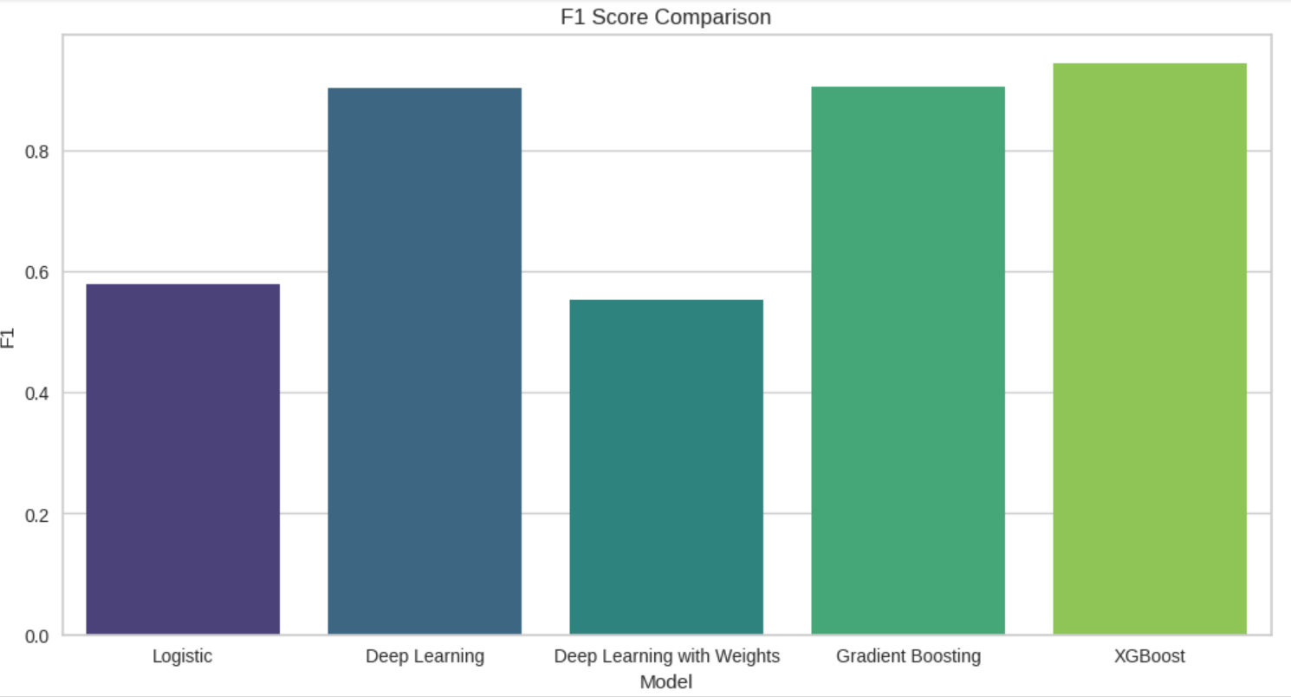
F1 Score Comparison

Slide 17
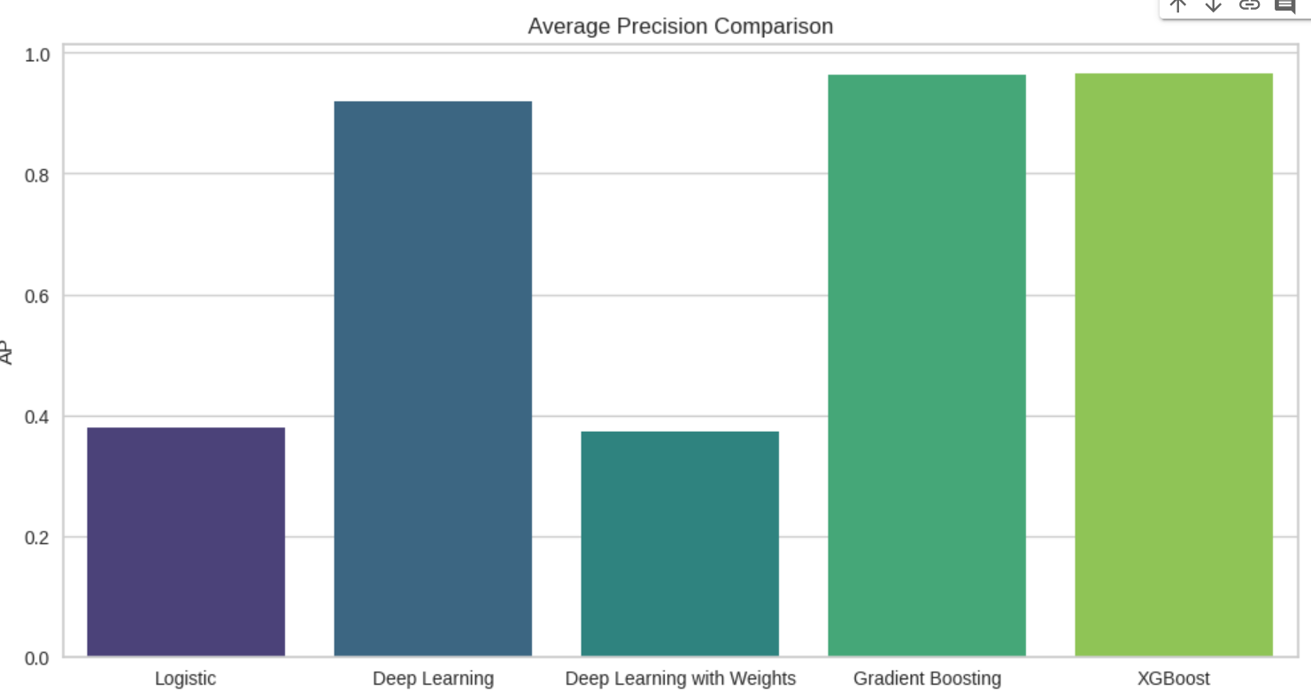
Average Precision Comparison

Slide 18
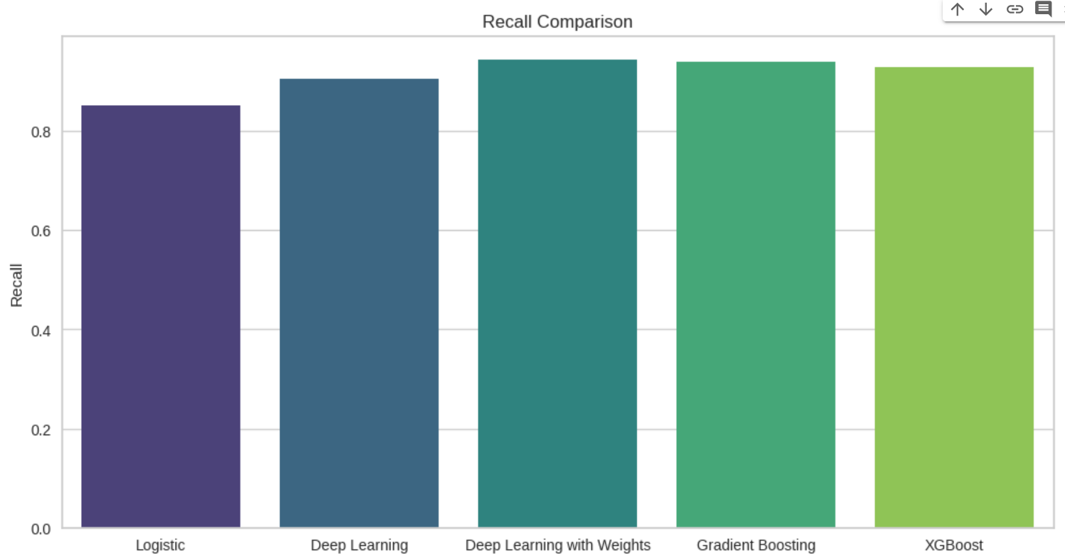
Recall Comparison

Slide 19
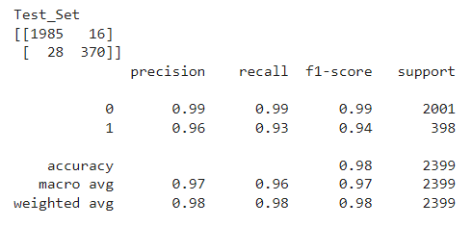
The Model We decided to go with
XGBoost

Slide 20
The Model We decided to go with
Mercury
Venus
Mars
Jupiter
Saturn
Neptune
Mercury is the closest planet to the Sun
Venus has a beautiful name, but it’s hot
Despite being red, Mars is a cold place
It’s the biggest planet in the Solar System
Saturn is the ringed one and a gas giant
It’s the farthest planet from the Sun

Slide 21
Our services
$25
$50
$75
Basic
Premium
Pro
You can explain your product or your service
You can explain your product or your service
You can explain your product or your service

Slide 22
This is a timeline
Mercury is the closest planet to the Sun
Mars is actually a very cold place
2005
2008
2011
2021
It’s the biggest planet in the Solar System
Venus has a beautiful name, but it’s hot

Slide 23
Competitors
Mars
Jupiter
Saturn
Mars is a cold place, not hot. It’s full of iron oxide dust, which gives the planet its reddish cast
It’s the biggest planet in the System and the fourth-brightest object in the sky
Saturn is the ringed planet. It’s a gas giant, composed mostly of hydrogen and helium

Slide 24
This is an infographic
Gallery
Health
Store
News
Activity resume
Activity numbers
30%
Venus
65%
65%
Venus has a beautiful name and it’s hot
75%
60%
Mars
35%
Venus
Mars
Despite being red, Mars is a cold place
Neptune
Jupiter

Slide 25
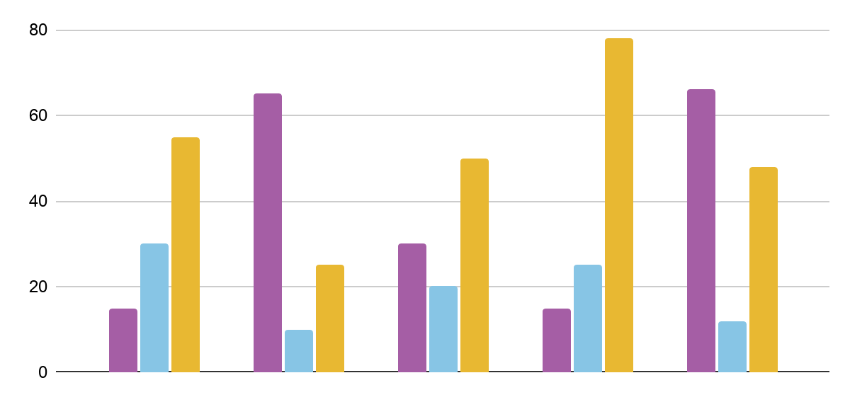
This is an infographic
Activity method
Info
25 August
It’s the closest to the Sun and the smallest one
11º | Rainy
Calendar
Venus
Mars
Neptune
1 2 3 4 5 6 7 8 9 10 11 12 13 14 15 16 17 18 19 20 21 22 23 24 25 26 27 28 29 30 31
* To modify this graph, click on it, follow the link, change the data and paste the new graph here, replacing this one *

Slide 26
This is an infographic
$450,226.000
178,055
Demography resume
Activity numbers
Demography resume
35%
20%
10%
35%
Neptune
Jupiter
Mars
Venus has a beautiful name

Slide 27
This is an infographic
1
Mars is a very cold place
Activity resource
Mars
35%
Venus has a beautiful name
Despite being red, Mars is actually a cold place
2
Neptune
50%
3
Saturn is the ringed planet
Neptune is the farthest planet from the Sun
Neptune
65%
4
Jupiter is the biggest planet
Mars
75%

Slide 28
04
Contact
Here you can describe the topic of the section
You can enter a subtitle here if you need it

Slide 29
Table of contents
01
03
About us
Reports
02
04
Services
Contact
You can describe the topic of the section here
You can describe the topic of the section here
You can describe the topic of the section here
You can describe the topic of the section here

Slide 30
Four columns
Mars
Jupiter
Mercury
Saturn
Mars is a cold place. It’s full of iron oxide dust
It’s the biggest planet in the Solar System
Mercury is the closest planet to the Sun
Saturn is the ringed planet. It’s a gas giant

Slide 31
This is a table
 | Mars | Jupiter | Neptune | Venus
Time | Write here your metrics | Write here your metrics | Write here your metrics | Write here your metrics
Sales | Write here your metrics | Write here your metrics | Write here your metrics | Write here your metrics
Taxes | Write here your metrics | Write here your metrics | Write here your metrics | Write here your metrics

Slide 32
Organizational chart
Employee name
MK Department
Employee name
CEO
Employee name
HR Department
Employee name

Slide 33
Problem vs solution
Problem
Solution
Mercury is the closest planet to the Sun and the smallest one in the Solar System—it’s only a bit larger than the Moon
Venus has a very beautiful name and is the second planet from the Sun. It’s terribly hot —even hotter than mercury

Slide 34
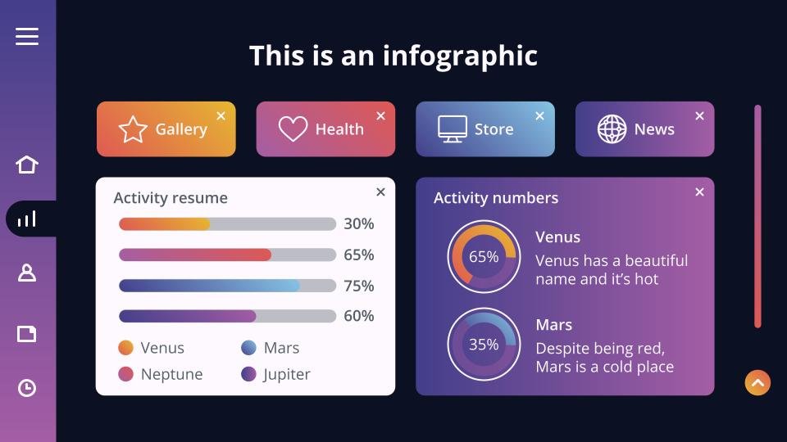
Desktop software
You can replace the image on the screen with your own work. Just delete this one, add yours and center it properly

Slide 35
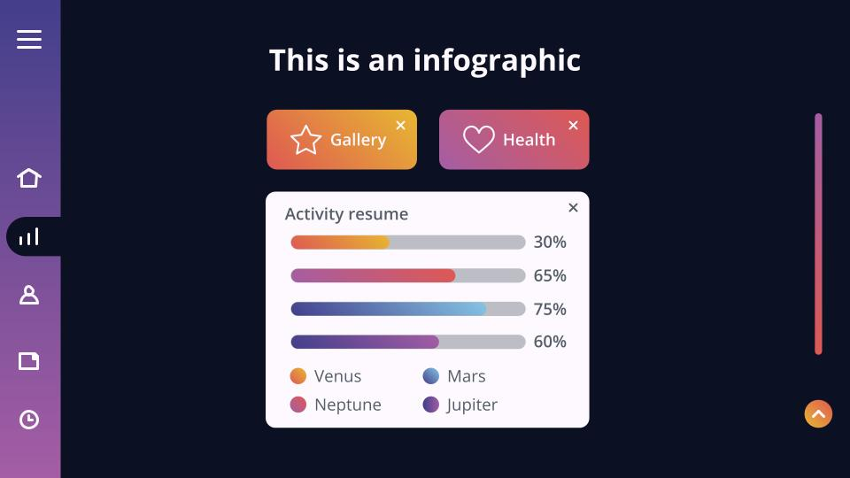
Tablet app
You can replace the image on the screen with your own work. Just delete this one, add yours and center it properly

Slide 36
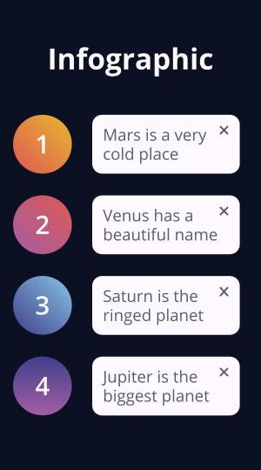
Mobile app
You can replace the image on the screen with your own work. Just delete this one, add yours and center it properly

Slide 37
Log
out
Do you have any questions?
youremail@freepik.com | +91 620 421 838 | yourcompany.com
Please keep this slide for attribution

Slide 38
Alternative resources
Photos
Woman getting interviewed by man for a job position
Side view of smiley man signing work contract
Person signing a contract or a certificate

Slide 39
Resources
Photos
Front view of woman from human resources analyzing resume
Front view of woman holding contract and another one reading papers
Front view of man holding contract for new job

