Slide 1

Predicting Dallas Fort Worth Restaurants Location

Slide 2
Predicting restaurants location is valuable for current and feature restaurant owners
Writing a restaurant business plan has many components such as menu, employees and identifying location which should be in line with the target market.
When describing potential locations in a business plan, restaurant owners should include as much information as possible about each location why it would be perfect for their business.
Data that can be easily accessed to understand where current restaurants are located, how many of them are there and what the competitions are would helpful for restaurant owner.

Slide 3
Data acquisition and cleaning
Dallas Fort Worth(DFW) cities and their zip code data from Zip-Codes.com, DFW data scraped from Zip-codes/State/tx.asp.
USA zip codes and geographical location data from public opendatasoft.com, DFW data scraped from US-zip-code-lat-log/table
DFW population data from Wikipedia, DFW data scraped from Dallas–Fort_Worth_metroplex
Total 255 rows and 5 features in the raw data.
Less populated zip codes were dropped

Slide 4
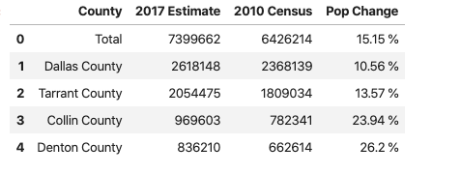
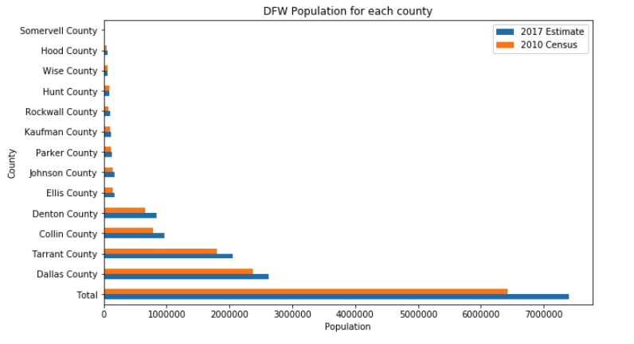
Results
Population change
Population change in the metroplex is as high as 23 % in Collin county with most of the counties showed population growth over 10 %. The over all metroplex population growth is 15.15 %, which is higher than average growth for most cities in the country.

Slide 5
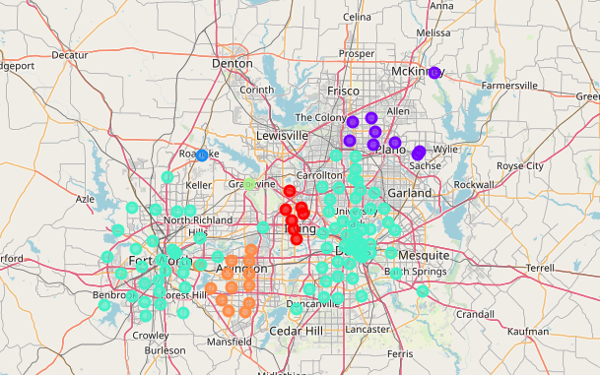
Clustering
K-means clustering used to group the cities in to 6 different clusters. Based on the top 10 most common venues in each cluster, cluster 1, 5 and 6 are ideal places to open new restaurants due to currently available restaurants and other venues which drive people to go there either to attend sporting events or other activities the likes of banking, health/beauty and doctor's office visit.

Slide 6
Conclusion and future directions
Built useful models to predict restaurant locations
Accuracy of the models has room for improvement
Capture highly populated counties
Ideas to include
Restaurant kind per zip code
Population diversity
population growth prediction

