Slide 1
Gorthrup Nrumman
Team Members: Yosel Rivera, Ari Betan Snook, Maria Bellamy, Chase Taunton

Slide 2

Organization Overview + Mission Compliance

Slide 3
Who is Gorthrup Nrumman
Why cybersecurity compliance is essential
Who are we?
Defense technology and cybersecurity contractor
Provides mission critical systems to protect the JN (Joint Nations of Vespuccica)
Specializes in advanced threat detection, secure communications, logistics systems, and R&D innovation
Operates under national security requirements and federal contract standards

Slide 4
Mission Statement
Develop innovative technologies to safeguard the J.N., focusing on the most difficult problems in defense
Supports warfighters and defense agencies
Maintain secure and resilient operations 24/7
Advance national technology superiority

Slide 5
Why Compliance Matters
Why cybersecurity compliance is essential
Compliance protects sensitive and classified defense data
Compliance Maintains federal contract eligibility
Compliance Prevents breaches that can jeopardize national security
Compliance Builds trust with government partners and stakeholders

Slide 6
Compliance frameworks we follow
Compliance with NIST standards
NIST SP 800-53
Security and privacy controls for federal systems
Builds a secure foundation across GN operations
NIST SP 800-171
Protects controlled unclassified information (CUI)
Required for federal defense-controlled eligibility

Slide 7
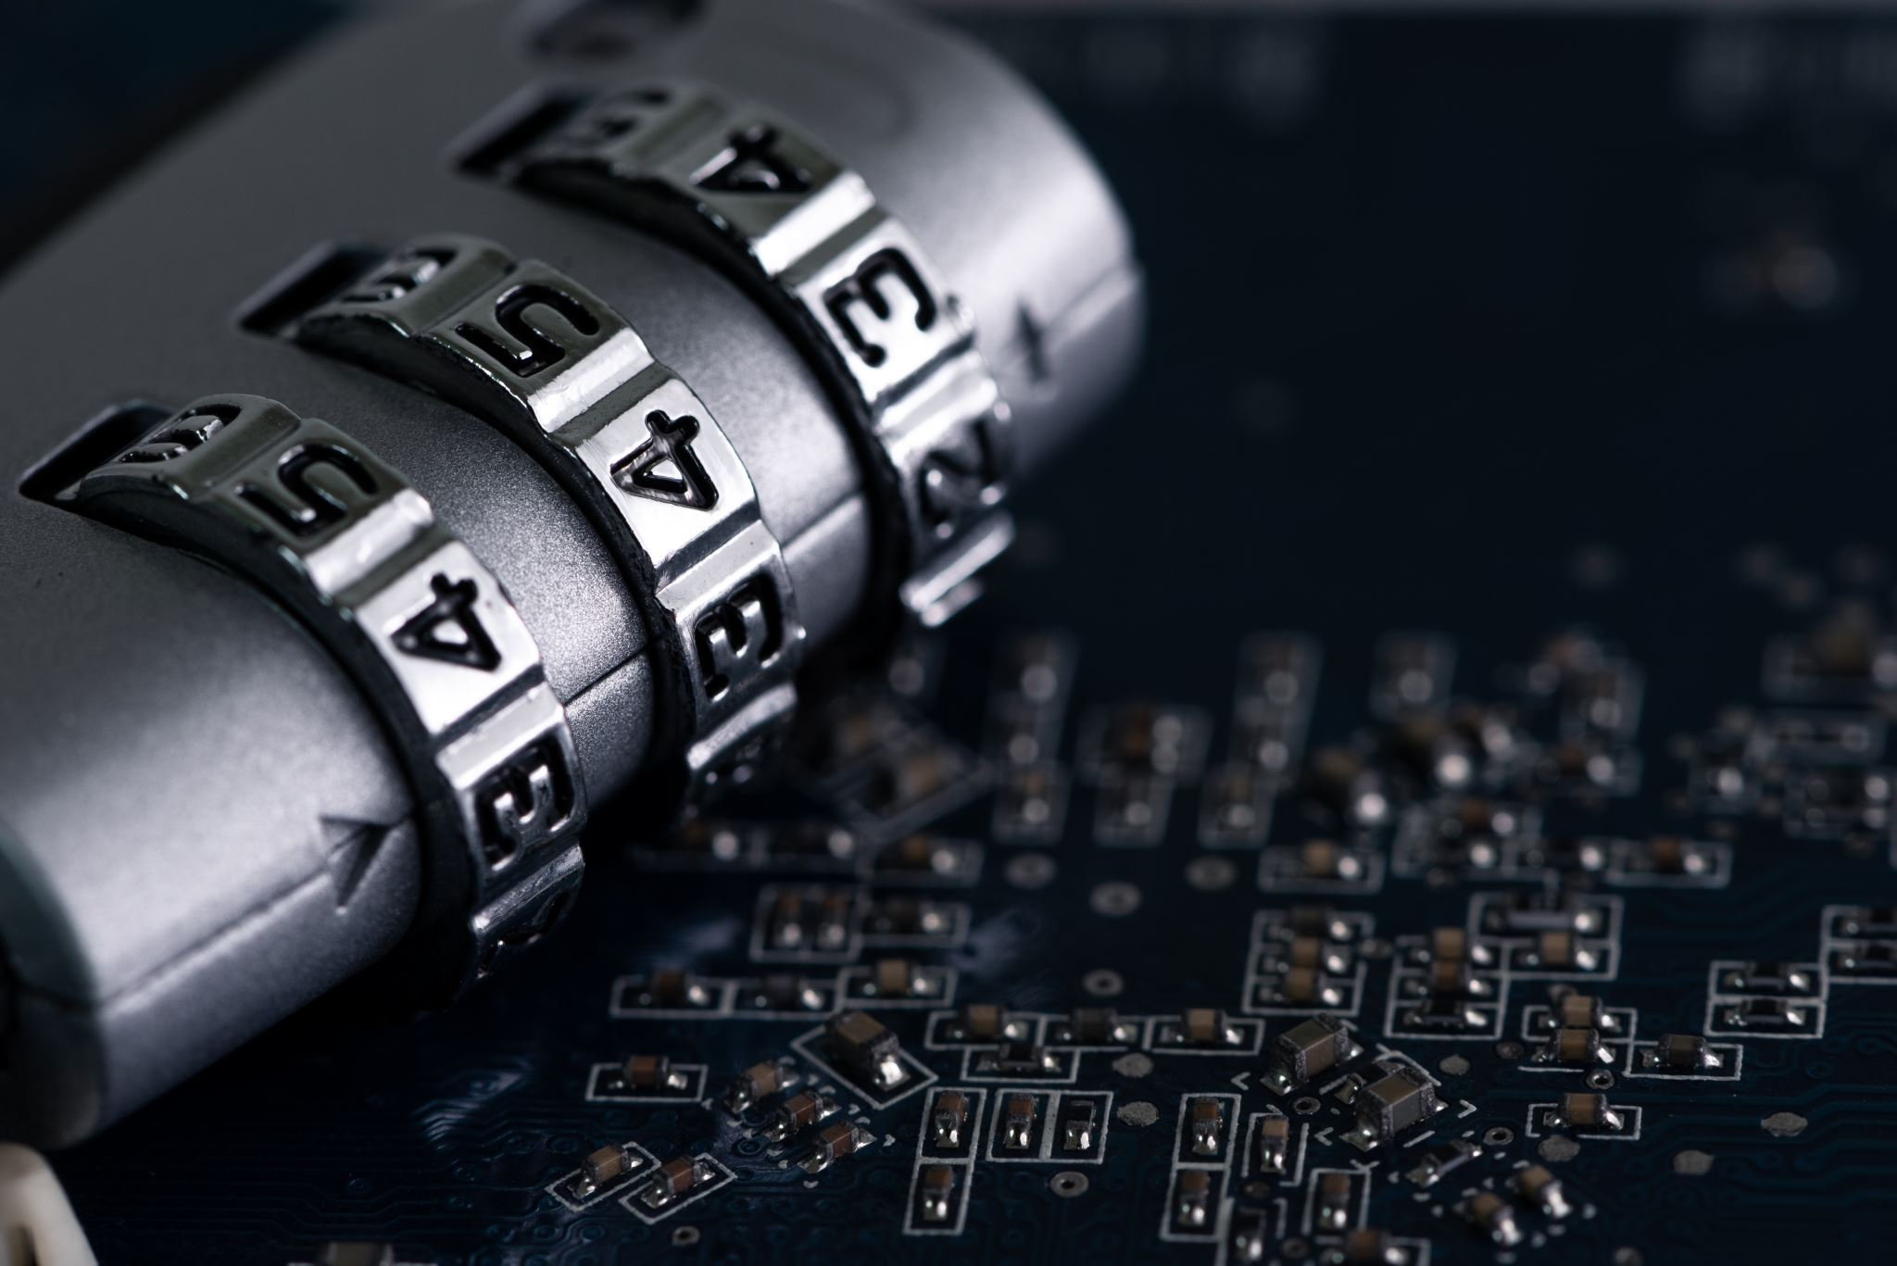
Information Systems Overview + Security Components

Slide 8
Core Information Systems
Mission Critical Cyber Systems
GN-TDS: Threat Detection System
GN-RDE: Research and Development Environment
GN-CWA: Contractor Workforce Access System
GN-LCS: Logistics and Communication Systems

Slide 9
GN-TDS: Threat Detection System
What it does:
Monitors national threat indicators
Collects real time telemetry and adversarial activity data
Supports mission critical defense decisions
Key Security Components
SIEM + IDS/IPS security tools
24/7 Availability – hot failover site
Immutable log preservation

Slide 10
GN-RDE: Research and Development Environment
What it does
Stores prototypes, classified engineering work
Develops and researches new technologies
Key Security Components
Encrypted source code repositories
Version control integrity
Zero trust access segmentation
Internal only network zone

Slide 11
GN-CWA: Contractor Workforce Access System
What it does
Controls access to GN facilities and digital systems
Tracks authentication logs and identity metadata
Key security components
Multi Factor Authentication
Privileged Access Management
Identity Lifecycle management
Continuous monitoring for unauthorized entry.

Slide 12
GN-LCS: Logistics and Secure Communication Systems​
What it does
Coordinate supply chain + secure communications
Tracks equipment movement and Timing of defense assets
Key security Components
PKI-based encrypted messaging
Inventory integrity checks
Vendor/Partner access controls

Slide 13
GN-TDS Security Demonstration
A ransomware attack scenario where GN-TDS security mechanisms detects the threat, isolates the affected systems, and restores operations using secure, immutable backups.
Detection: SOC receives alert from SIEM/IDS
Containment: Infected systems isolated from the network
Eradication: Malware removed and vulnerabilities patched.
Recovery: Immutable backups restored to ensure data integrity.
Continuity: Failover site keeps TDS operational.

Slide 14
Disaster recovery plan and business continuity plan demo

Slide 15
Risk Assessment and Business Impact Analysis (BIA)
Based on likelihood & impact model
Determines:
RTO (max acceptable downtime), RPO (maximum acceptable data loss in time)
Critical business functions
System dependencies
Financial impact per hour/day
Higher risk = more resources allowed. I.E. on call resources, overtime, external contractors (retainers/service fees), software, etc.

Slide 16
Data backups
3-2-1 Backup Rule:
3 copies of data: Primary data plus two backup copies
2 different media types: local and encrypted cloud storage
1 offsite/cloud copy: Stored in an isolated and geographically different environment
Backups encrypted while at rest, airgapped for long-term storage
Version history, immutable backups protect against corruption
Procedures reviewed quarterly

Slide 17
Incident Response
SOC detects unusual activity, investigates, and confirms
Short-term containment prevents further damage, can cause shutdowns pursuant to RTO
Immediately begin communication plan (later slide)
Long-term containment returns unaffected portions of systems to working state while keeping the affected portion apart for recovery
Eradicate threat from systems
Recovery (next slide)
After-Action Review for lessons learned

Slide 18
Recovery
Systems are restored in priority order based on disaster recovery plan
Dependencies are considered as well
Backup sites/systems can carry operations while primary is in recovery
Configurations should remain as before, unless an obvious vulnerability. Non-urgent changes can be raised in the AAR.
Function checks: integrity checks, access tests, log reviews, and functionality tests

Slide 19
Communication
Chain of command is informed immediately on incident, higher as severity rises
Disaster Recovery Coordinator → GN Cybersecurity Defense Force → Executive Leadership → System Owners → All Personnel
Personnel: Informed via GN’s secured communication channels (encrypted email, GN Emergency App)
Customers/partners: Pre-approved messages inform J.N., defense partners, contractors, and compliance authorities about system status, recovery steps, and timelines
Media/PR: Only GN’s Communications Lead or Executive Spokesperson issue statements
Regulatory: only required notifications are required, other comms opened on executive leadership's discretion

Slide 20
Continuity
Based on above; Operations switch to backup systems where possible; details worked out with individual vendors/contractors
Redundant secure communications channels
Staff may be switched to alternate tasks within their domain while the systems necessary for their primary are down
Physical systems (i.e. manufacturing) should be able to run offline, or even without data systems for 48 hours, the length of downtime permitted by the RTO

Slide 21

Conclusion

Slide 22
What we learned
Key takeaways from this project
How NIST security frameworks can be effectively applied within organizations.
The importance of compliance and the consequences of noncompliance.
The importance of risk-based security and prioritizing mission-critical systems.
Why Disaster Recovery and Business Continuity planning are essential.
How backup strategies and recovery objectives significantly influence restoration success

Slide 23
Skills Gained
Practical Skills Developed
Conducting risk assessments and business impact analyses
Creating enforceable and effective security policies
Applying NIST standards within an organizational environment
Establishing a NIST Cybersecurity Framework (CSF) profile
Prioritizing security decisions based on risk and mission impact
Identifying vulnerabilities and developing actionable mitigation plans

Slide 24
Future Career preparation
How this supports our future career
Builds real-world cyber defense skills used across modern organizations.
Supports entry into cybersecurity and compliance roles in the workforce.
Strengthens crisis communication and coordination skills which are essential in cybersecurity careers.
Provides familiarity with federal cybersecurity expectations and NIST standards.
Improves our ability to maintain secure operations before, during, and after cyber incidents.

Slide 25
Reflection
The project showed us that cybersecurity isn't only about stopping attacks; it's about ensuring that organizations can continue to operate no matter the threat they face.

