Slide 1


Remote VCS: GitHub
Josipa Milovac

Slide 2
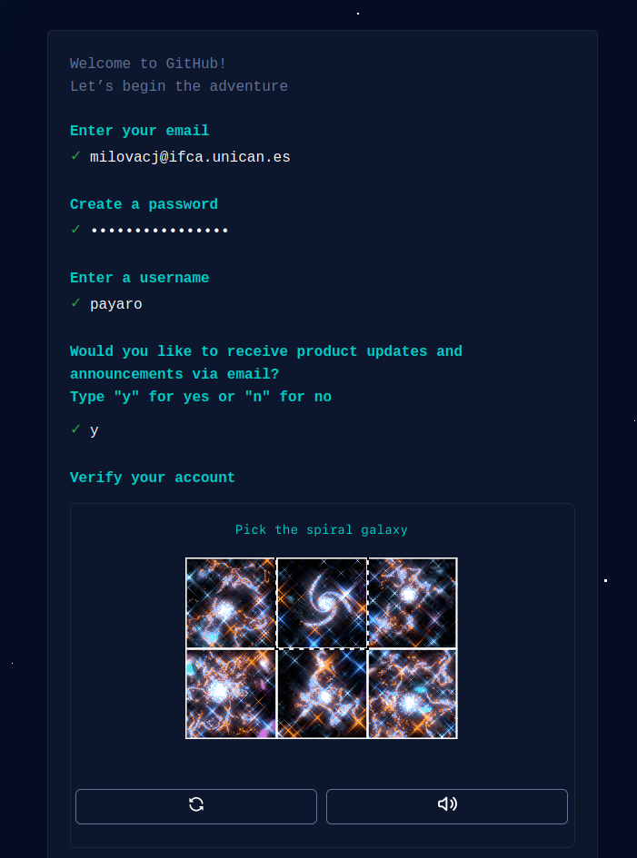
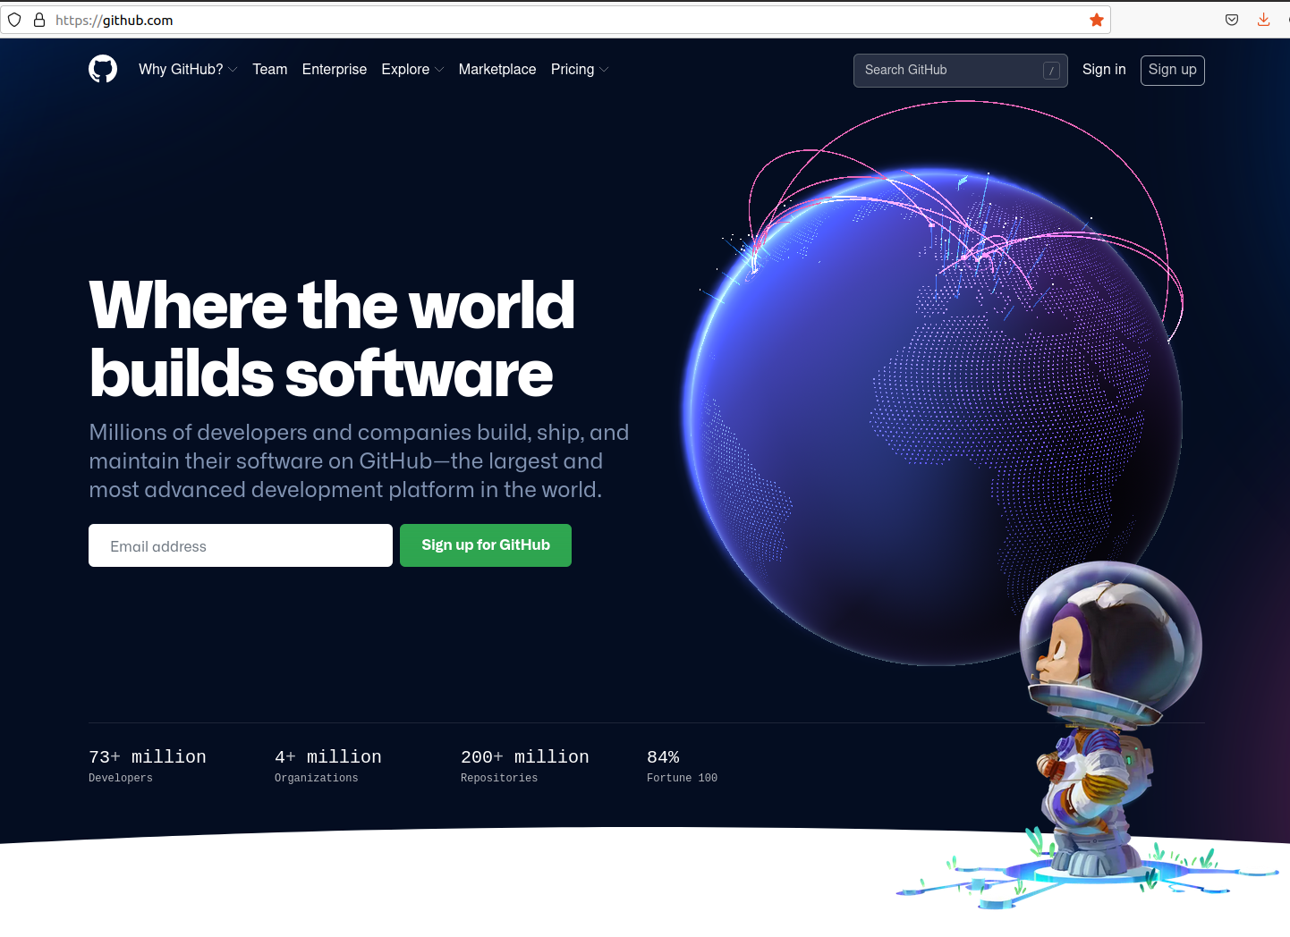
Create a new account

Slide 3
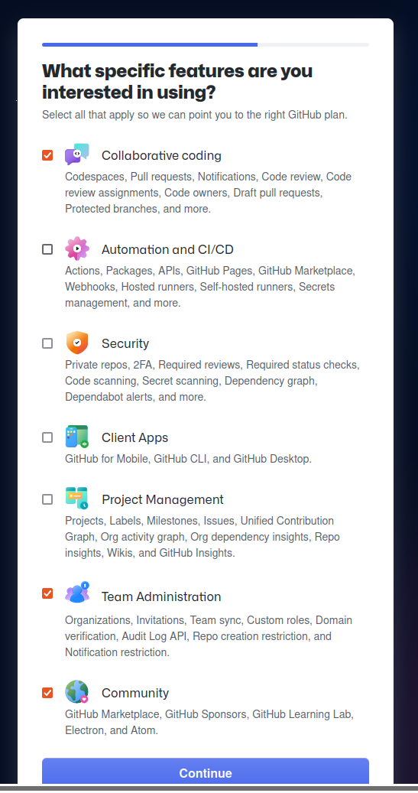
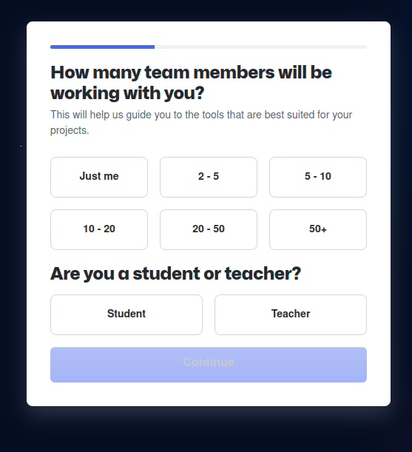
Create a new account
Enter a code sent to your email, and voila....

Slide 4
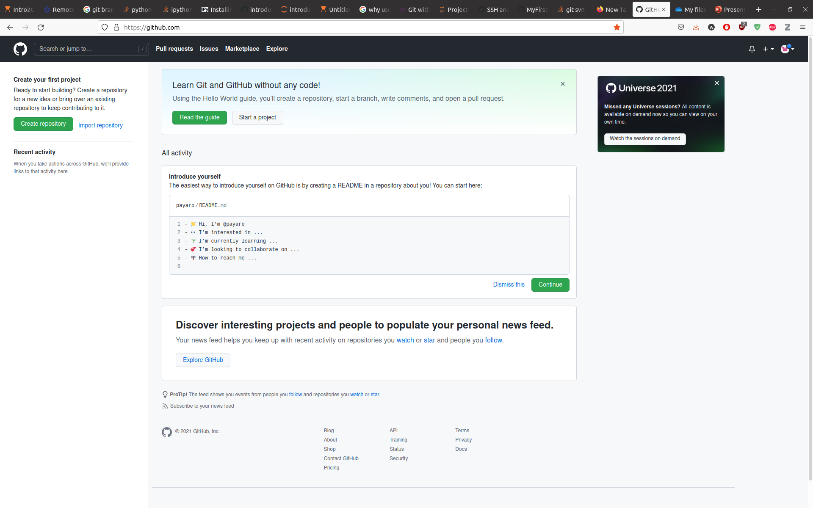
Your account is created

Slide 5
SSH Background and Setup
Check is SSH is set on your machine:
ls -al ~/.ssh
If empty:
ssh-keygen -t rsa -b 4096 -C your_email@example.com
Follow the instructions, and for each prompt press enter
Check again if SSH is set:
ls -al ~/.ssh
2 files should be listed:
id_rsa
id_rsa.pub

Slide 6
SSH Background and Setup
Edit and copy the public key (id_rsa.pub):
Now go to your GitHub account
Click on your profile icon in the top right corner to get the drop-down menu.
Click “Settings,” then on the settings page, click “SSH and GPG keys,” on the left side “Account settings” menu.
Click the “New SSH key” button on the right side.
Add some recognizable title, paste your SSH key into the field, and click the “Add SSH key” to complete the setup.
All set. Check your authentication from the command line:
$ ssh -T git@github.com
$ Hi <user>! You've successfully authenticated, but GitHub does not provide shell access.

Slide 7
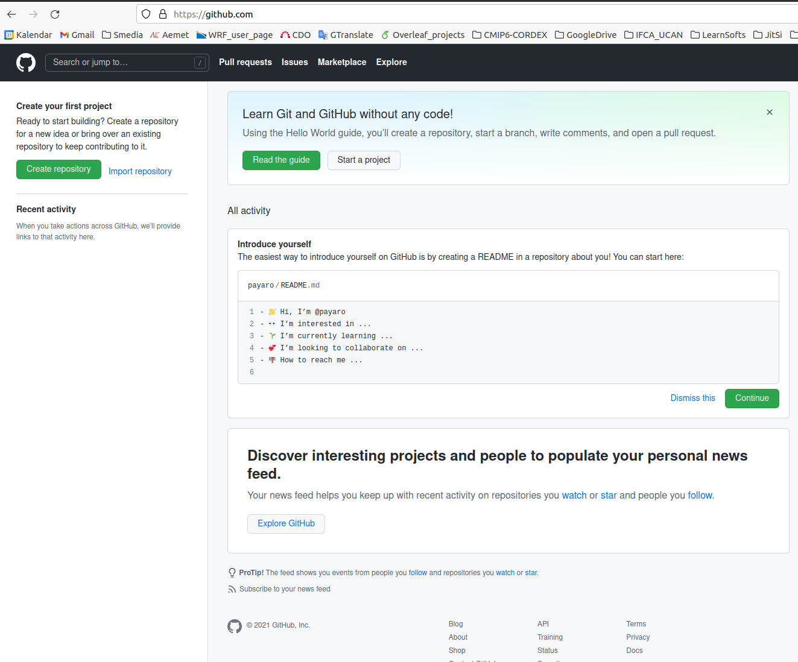
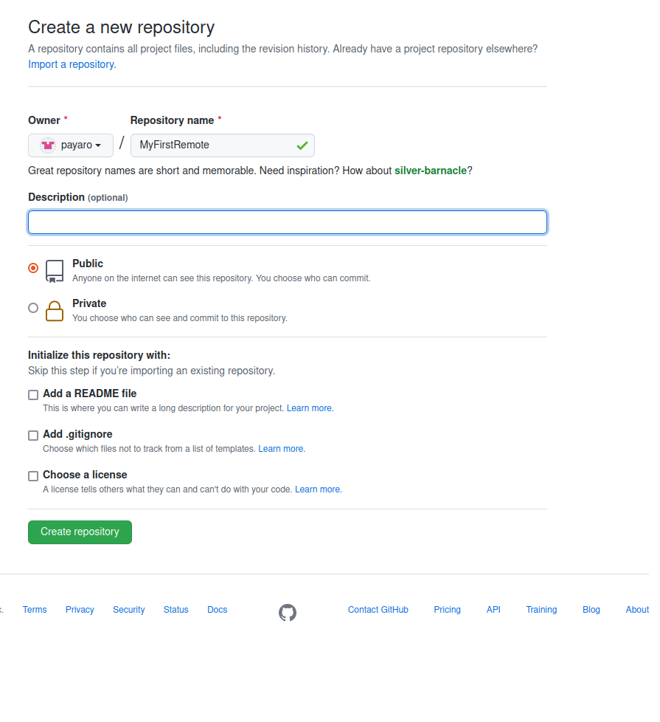
Create a repository on GitHub

Slide 8
Create a repository on GitHub
url: https://github.com/<username>/<Repositry_name>

