Slide 1
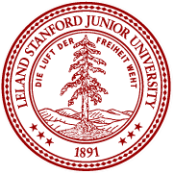

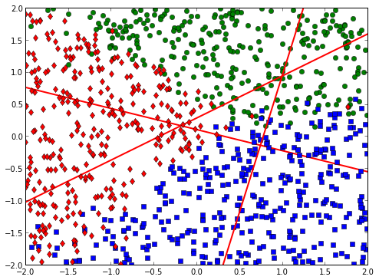
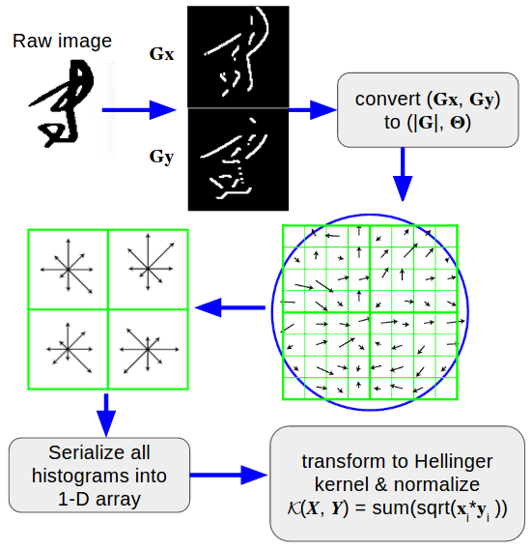
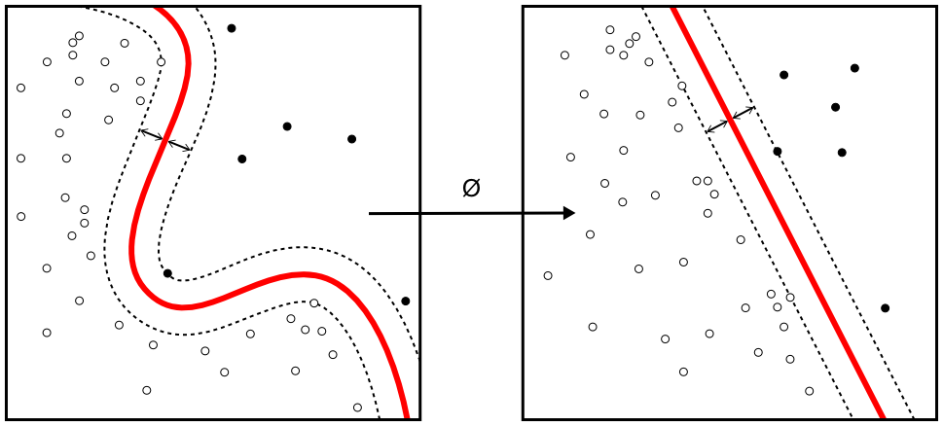
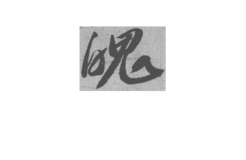
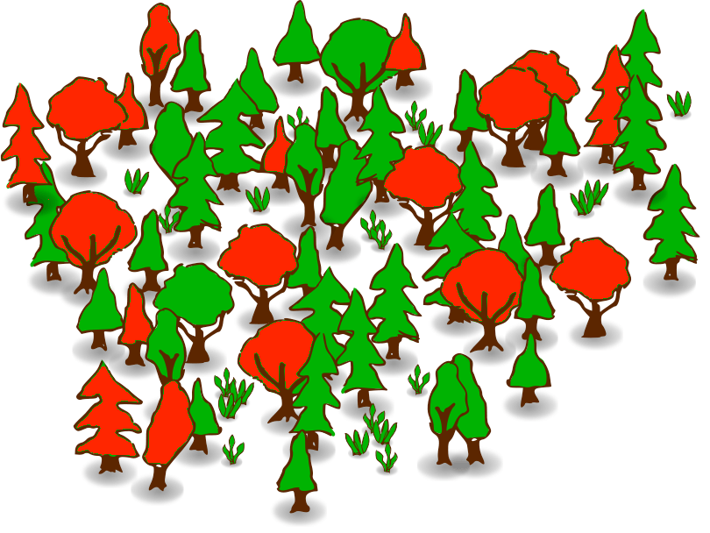
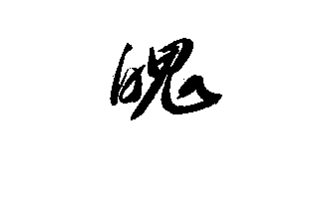
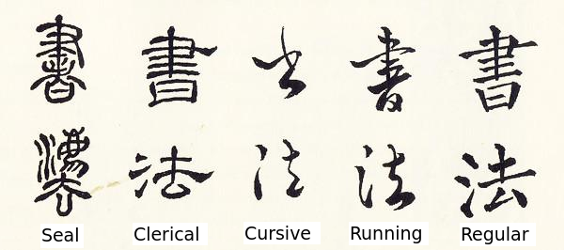
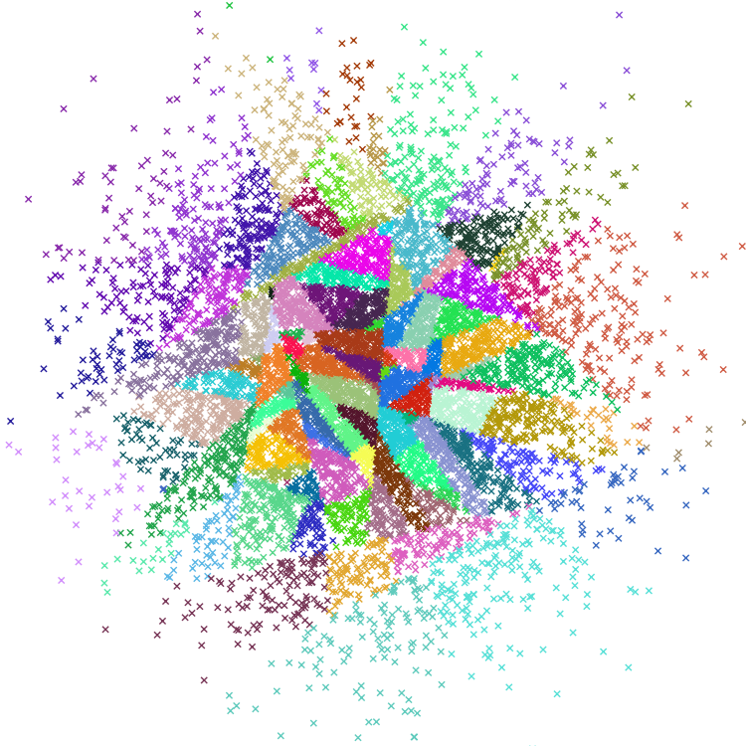
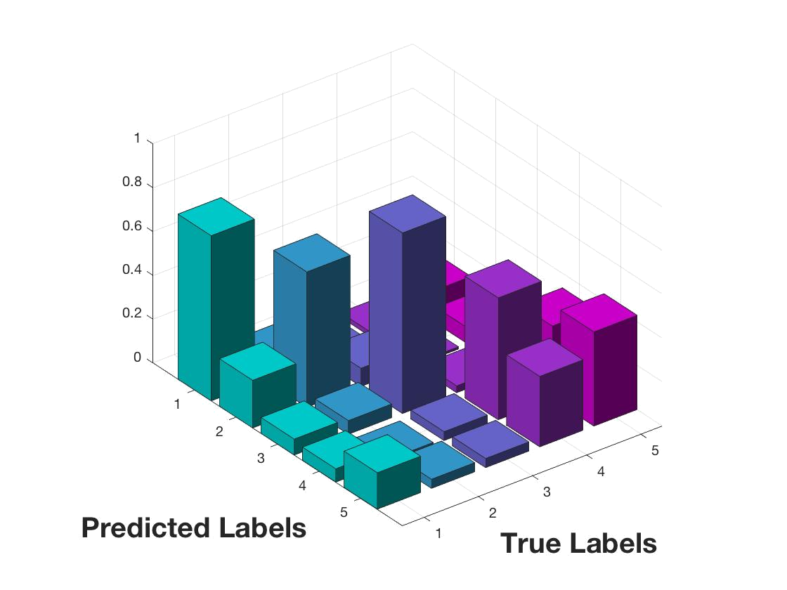
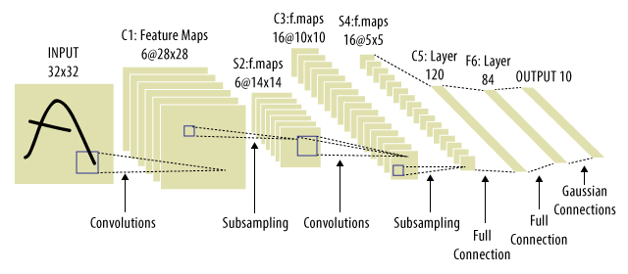
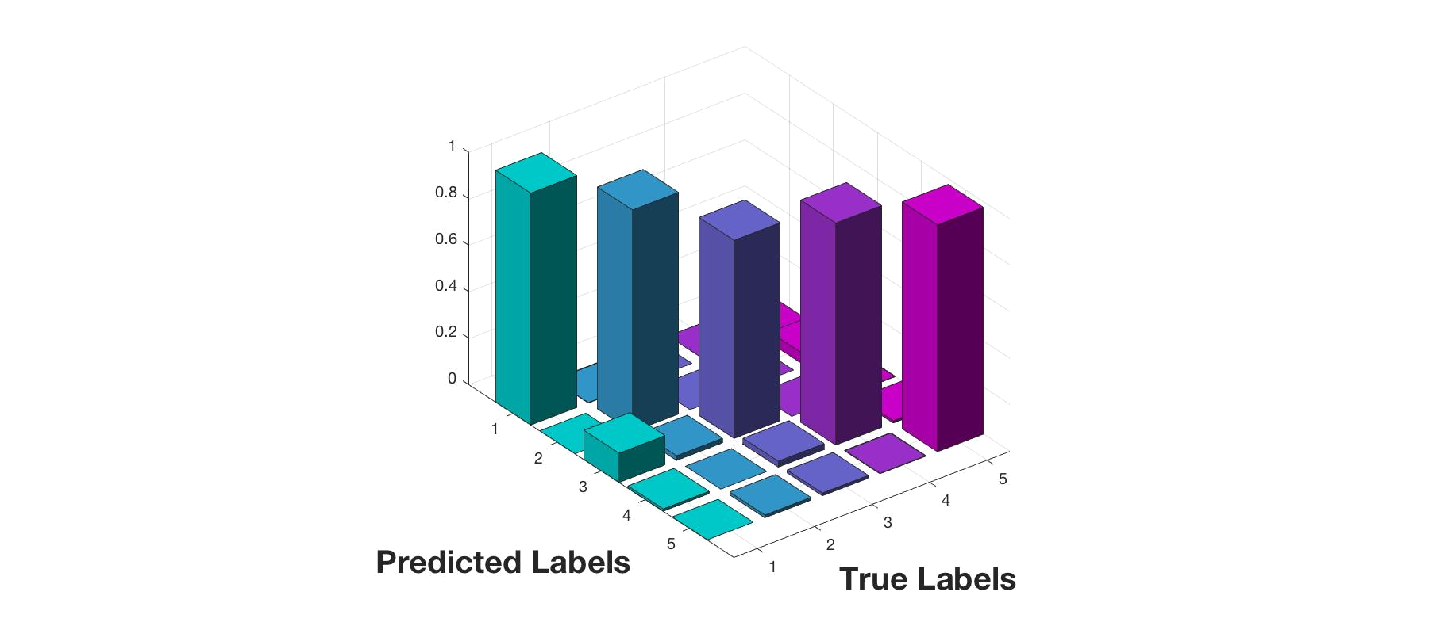
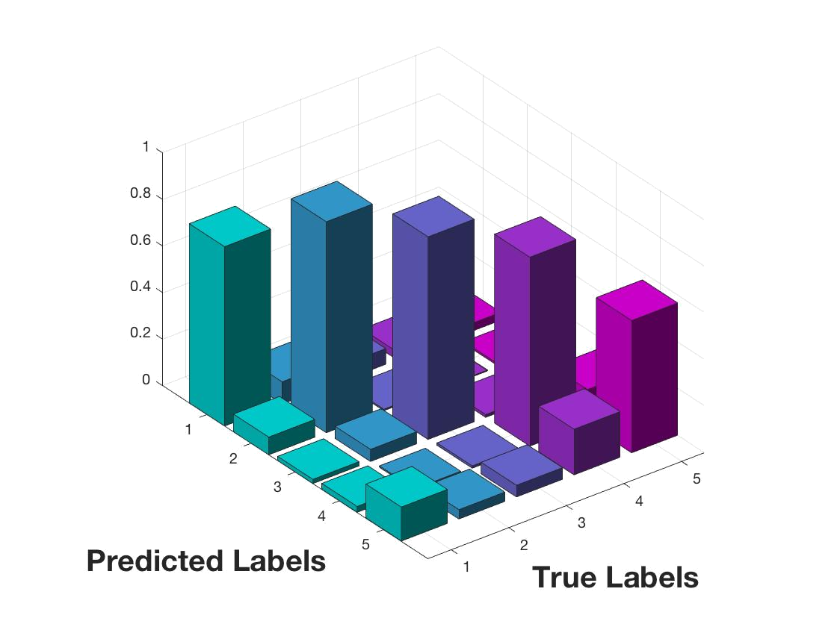
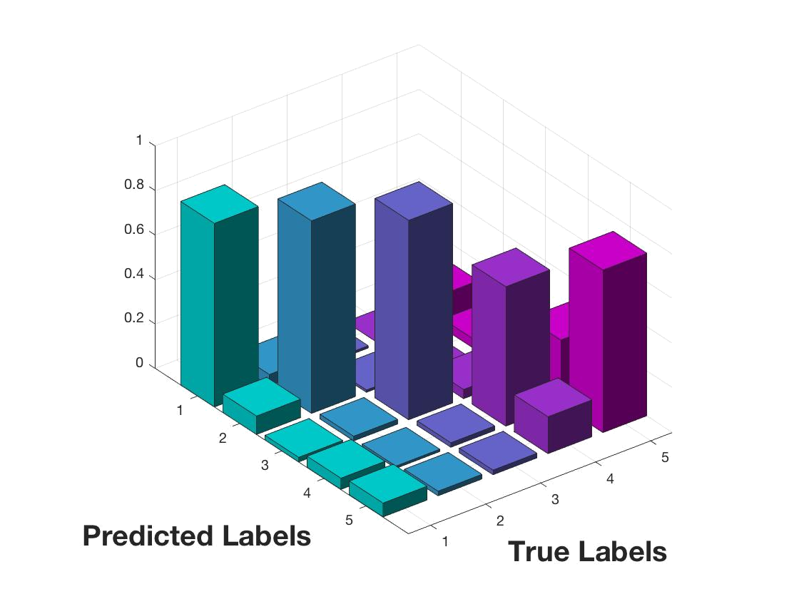
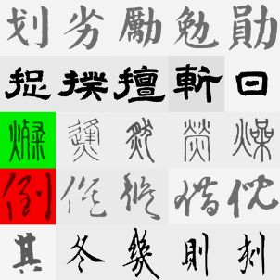
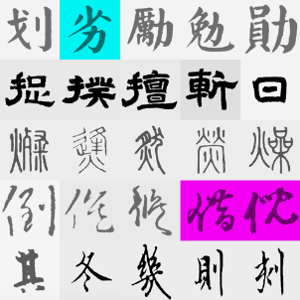
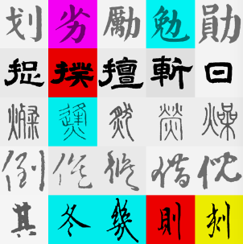
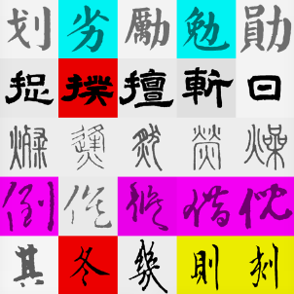
Recognizing Chinese Calligraphy Styles: A Cage Fight
Chen Yu-Sheng, Li Haihong, Su Guangjun
{gsu2, hhli, yusheng}@stanford.edu
CS229 Machine Learning, Stanford University
Introduction
Methodology
Our goal is to recognize different Chinese Calligraphy script styles using machine learning models.
Support Vector Machine (SVM), Softmax classification, k-Nearest Neighbors (kNN), Random Forests (RF), and Convolutional Neural Network (CNN) with different feature extraction techniques are compared in this classification problem.
Raw Data
Image Processing
Feature Extraction
Models
Analysis
1.Regular
2.Clerical
3.Seal
4.Running
5.Cursive
1.Raw Image
2.Grayscale Image
3.Contrast Adjusted Image
4.Padded Image
1.Raw Pixel
2.Hog
Softmax
Image Processing
Histogram of Oriented Gradients
Hold-out Validation
Raw Image
Grayscale Image
RBF-Kernel SVM
Training
Test
Data
1.Choose part of the data as training set and test set;
2.Give a single performance estimate.
Random Forest
Style | Train Set | Test Set
Regular | 1500 | 505
Clerical | 1500 | 500
Seal | 1500 | 500
Running | 1500 | 514
Cursive | 1500 | 500
Confusion Matrix
k-Nearest Neighbor
Contrast Adj. Image
Padded Image & deskew
Figure 1: Five different Chinese calligraphy styles
Table 1: Description of dataset
Figure 2: Image Processing Steps
Figure 3: HOG Explanation
Convolutional Neural Network
Experimental Results and Analysis
Conclusion
Confusion Matrix for Each Model
Rank | Algorithm | Training Accu. | Testing Accu. | Confusion Covar.
1 | Softmax Classification + HOG | 96.80% | 95.55% | 0.9415
2 | CNN (11 Layers) * | 90.11% | 88.64% | *
3 | Support Vector Machine + HOG | 86.37% | 78.76% | 0.6104
4 | Random Forest + HOG | 90.11% | 78.52% | 0.7356
5 | Softmax Classification | 85.31% | 71.89% | 0.6123
6 | K-Nearest Neighbor + HOG | 79.93% | 63.51% | 0.7681
For this classification problem, Softmax classifier with HOG descriptor outperforms all other ML algorithms, including CNN and SVM.
Softmax with HOG can even beat human judgment with respect to running and cursive styles.
Traditional ML with relevant features can be more accurate and efficient than CNN, while CNN can do excellent jobs without designing features (domain knowledge)
Feature extraction is the key factor to this problem.
Softmax + HOG
SVM + HOG
Table 2: Ranking Board: Who is fittest for the job?
RF + HOG
kNN + HOG
Softmax + HOG
SVM + HOG
RF + HOG
kNN + HOG
Future Works
Train our models to classify Calligraphers’ styles. (maybe new feature is needed).
Build a more complex CNN configuration to complete the more sophisticated tasks.
Figure 4: Confusion Matrix for 4 Different Models
the order of labels is Regular(1), Clerical(2), Seal(3), Cursive(4), Running(5)
1. CNN (11 Layers) * is the result cited from Boqi Li, ” Convolution Neural Network for Traditional Chinese Calligraphy Recognition”, CS 231N Final Project.

