Slide 1

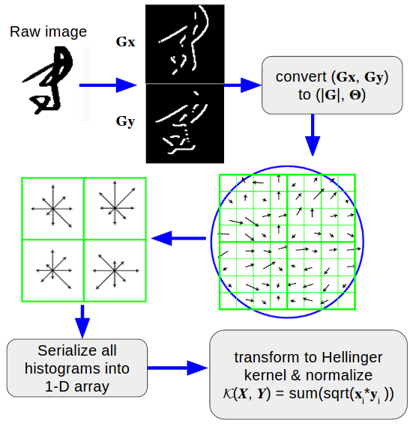
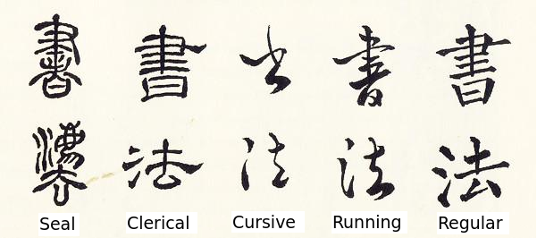
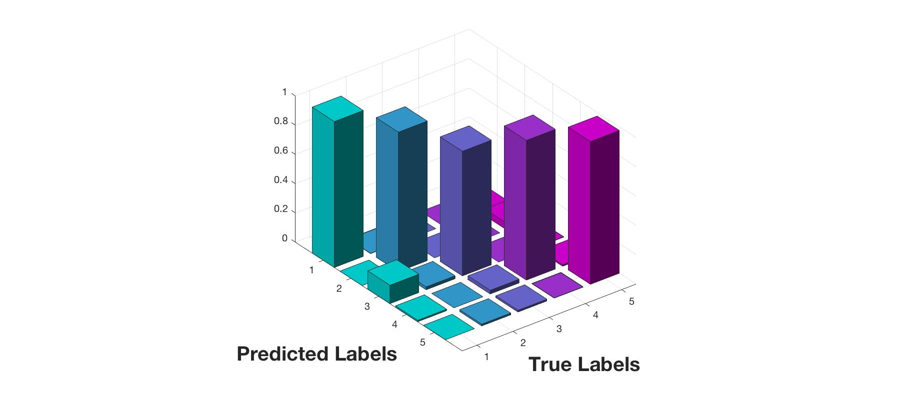
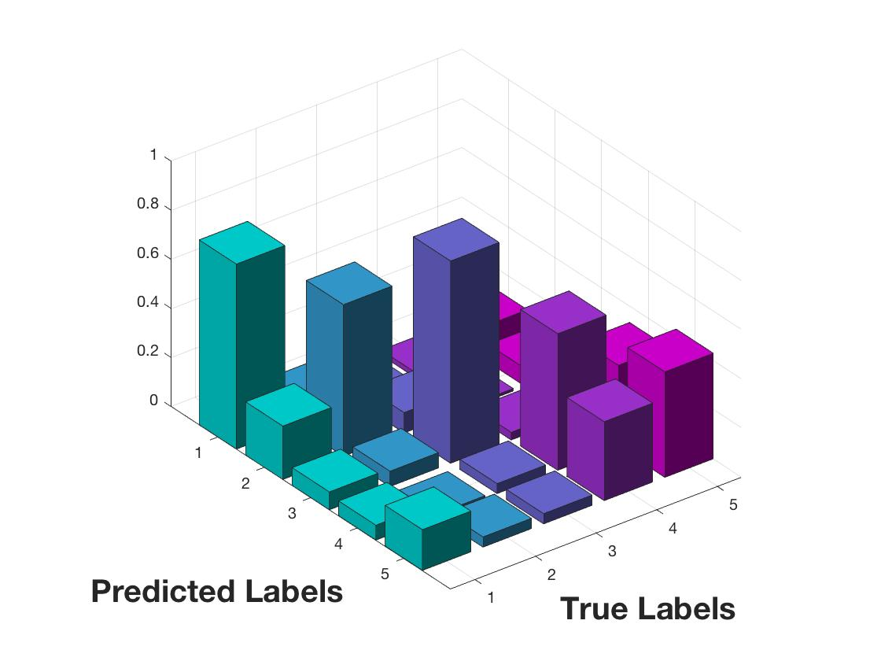
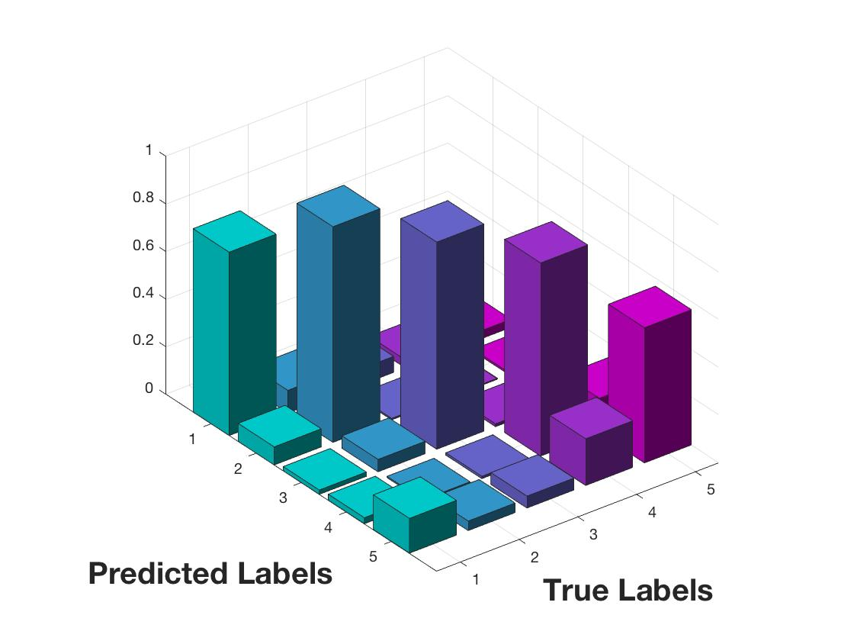
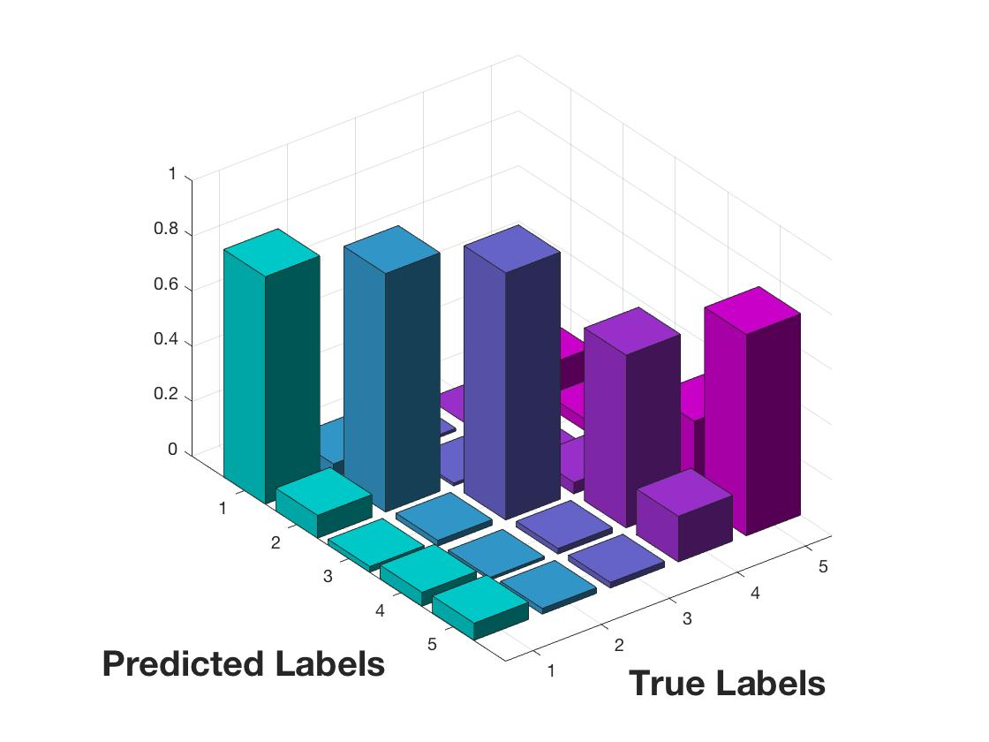
Recognizing Chinese Calligraphy Styles: A Cage Fight
Su Guangjun, Li Haihong, Chen Yu-Sheng
{gsu2, hhli, yusheng}@stanford.edu
CS229 Machine Learning, Stanford University
Introduction
Methodology
Our goal is to recognize different Chinese Calligraphy script styles using machine learning models.
SVM, Softmax classification, k-Nearest Neighbors, Random Forests, and Convolutional Neural Network with different feature extraction techniques are compared in this classification problem.
Experimental Results
Conclusion
Softmax + HOG
SVM + HOG
Rank | Algorithm | Training Accu. | Testing Accu. | Confusion Covar.
1 | Softmax Classification + HOG | 0.9680 | 0.9555 | 0.9415
2 | CNN (11 layers) | 0.9011 | 0.8864 | *
3 | Support Vector Machine + HOG | 0.8637 | 0.7876 | 0.6104
4 | Random Forests + HOG | 0.9011 | 0.7852 | 0.7356
5 | Softmax Classification | 0.8531 | 0.7189 | 0.6123
6 | K-Nearest Neighbors + HOG | 0.7993 | 0.6351 | 0.7681
For this classification problem, Softmax classifier with HOG descriptor outperforms all other ML algorithms, including CNN and SVM.
Softmax + HOG can even beat human judgment with respect to running and cursive styles.
Feature extraction is the key factor to this problem.
RF + HOG
kNN + HOG
Future Works
Train our models to classify Calligraphers’ styles. (maybe new feature is needed)
Notes:
<number>

