Slide 1
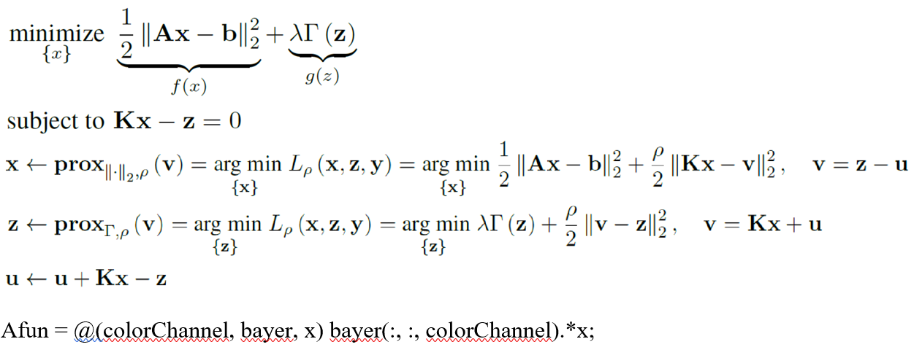
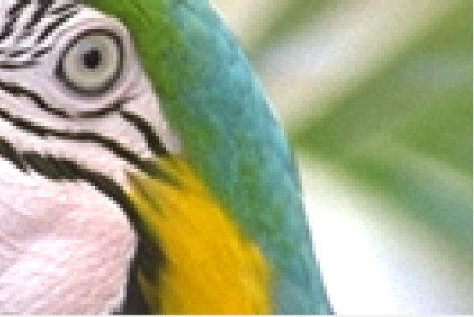
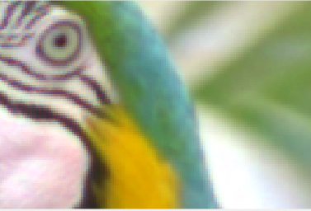
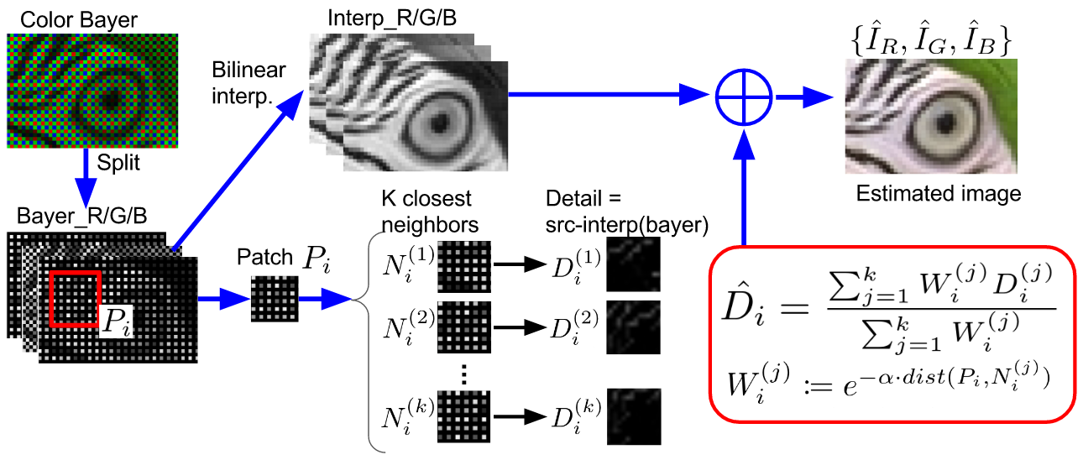
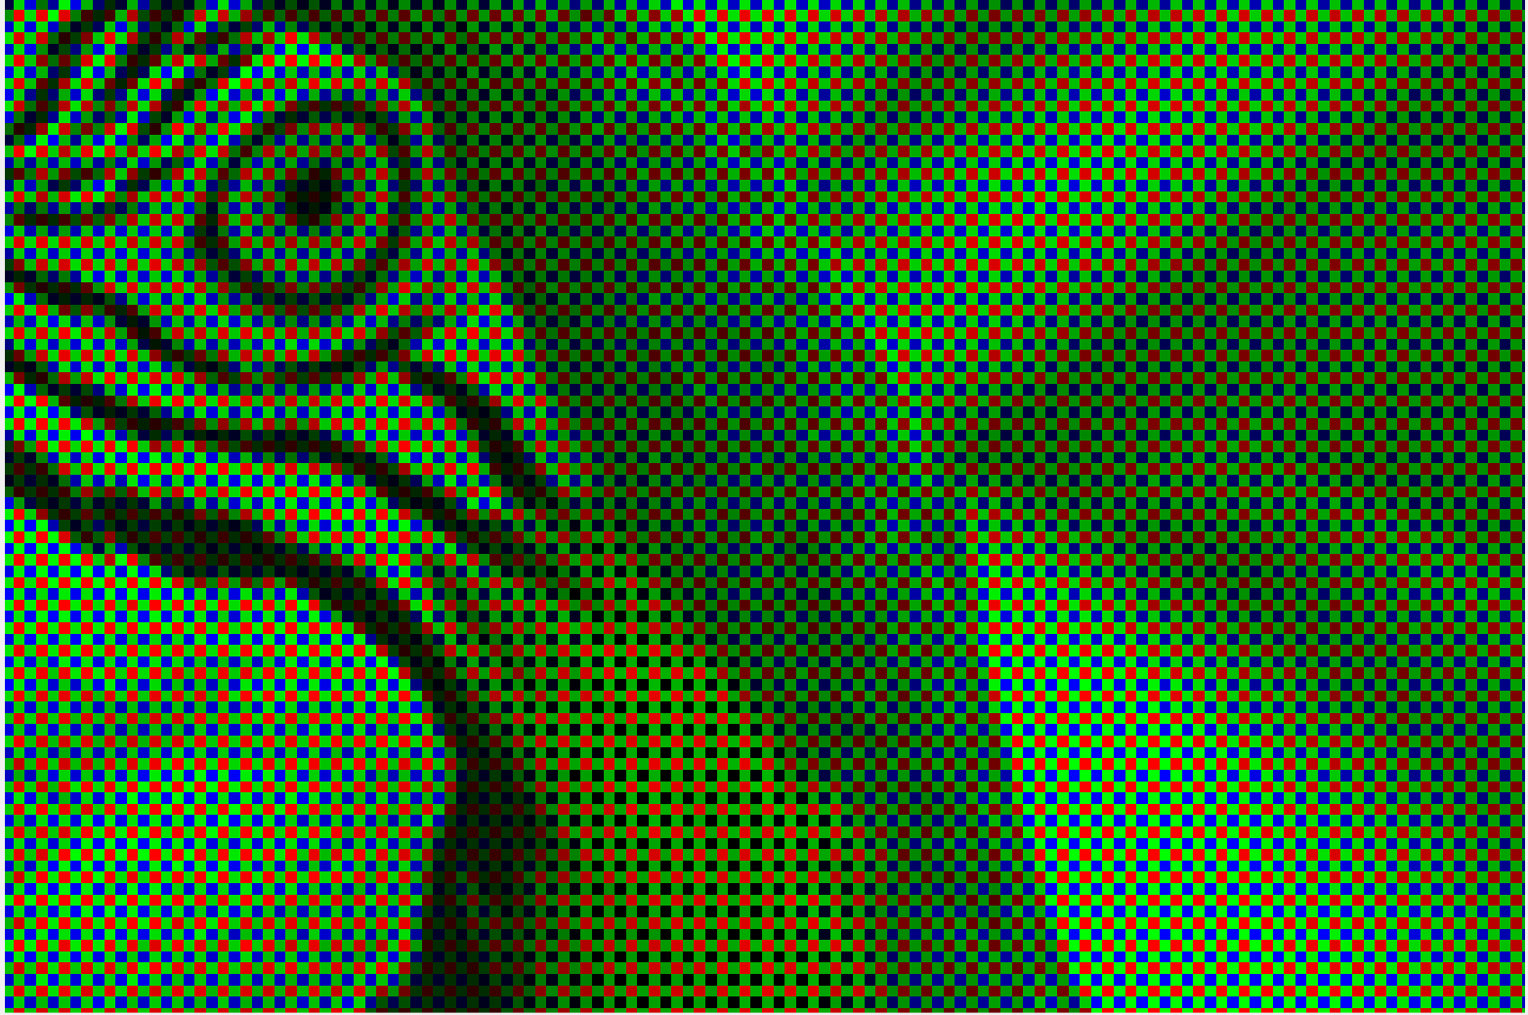
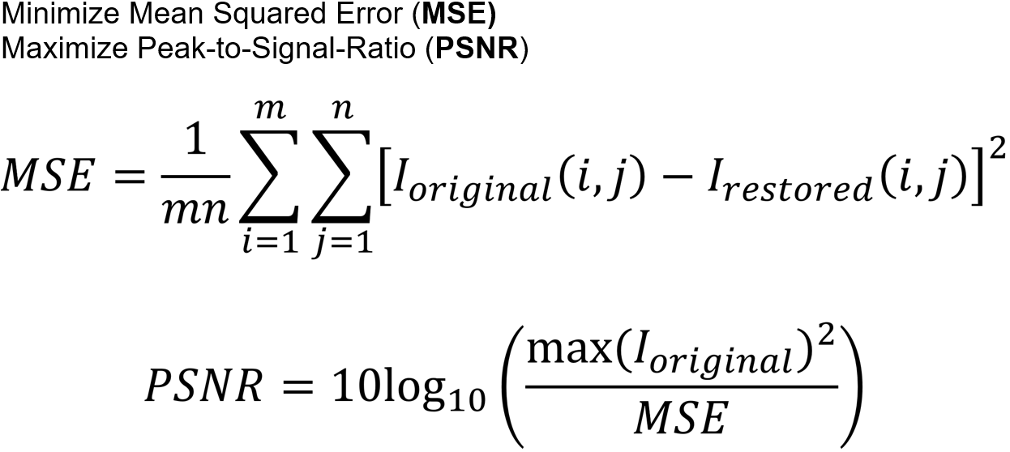
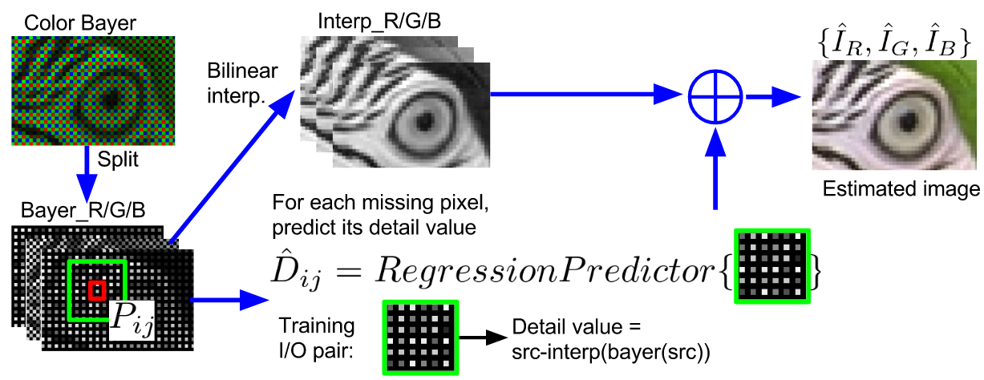
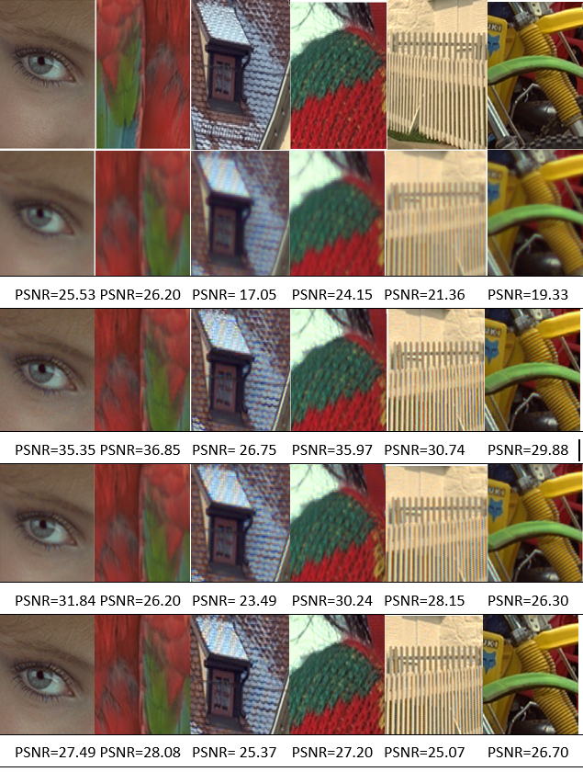
Machine Learning Methods for Demosaicing and Denoising
Yu-Sheng Chen, Stephanie Sanchez
Affiliations, Stanford University
Motivation
Method
Parameter Search
Demosaicing is a well known long-standing method. If we consider demosaicing and super-resolution together we notice that both methods utilize a technique to fill in pixel value information.
Therefore, we have implemented a method that utilizes super-resolution techniques such as machine learning methods and solving a least squares problem.
These techniques include k-nearest neighbors (KNN), regression, and alternating directing method of multipliers with a total variation prior (ADMM+TV).
We optimize parameters in each method to minimize the mean sqaured error (MSE) and maximize the peak signal-to-noise ratio (PSNR).
Input
Output
ADMM+TV
Bayer+Noise
KNN
Parameter Opt.
3
Regression
Related Work
Numerical Summary
Conclusion
Traditional demosaicing methods include bilinear and Malvar interpolation. Bilinear interpolation approximates pixel values by averaging known pixel values in different directions. Malvar uses only linear kernels to perform the demosaicing by optimizing the kernel gain parameters.
Original
Method | Sum MSE (24 images)
ADMM+TV | 0.2527
KNN
Regression
Bilinear | 0.0356
Malvar | 00584
ADMM+TV
KNN
Bilinear
Malvar

