Slide 1

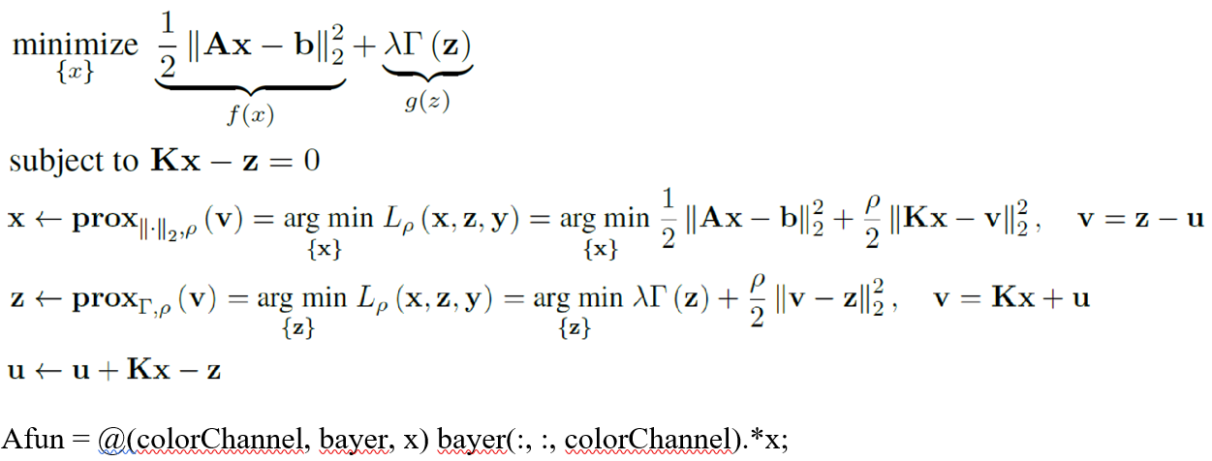
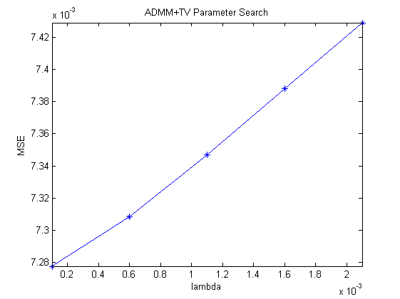
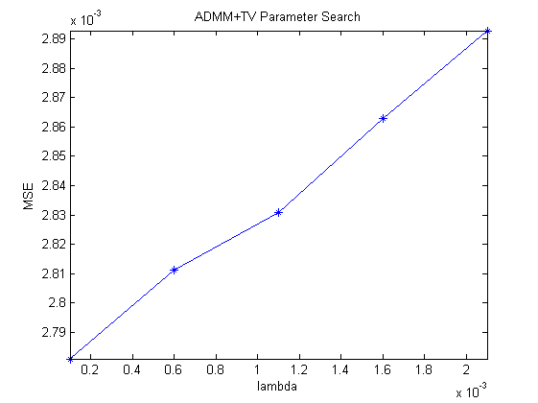
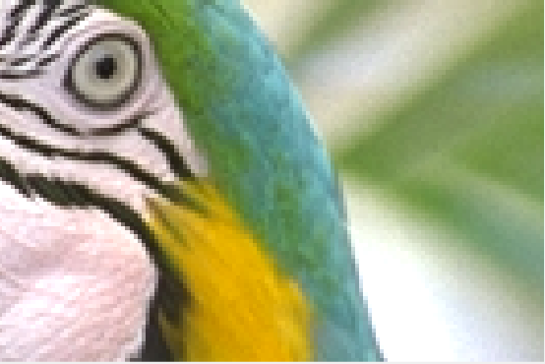
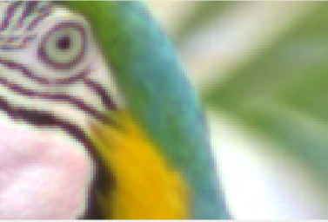
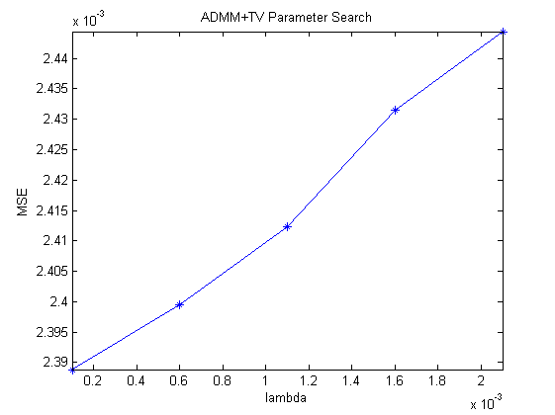
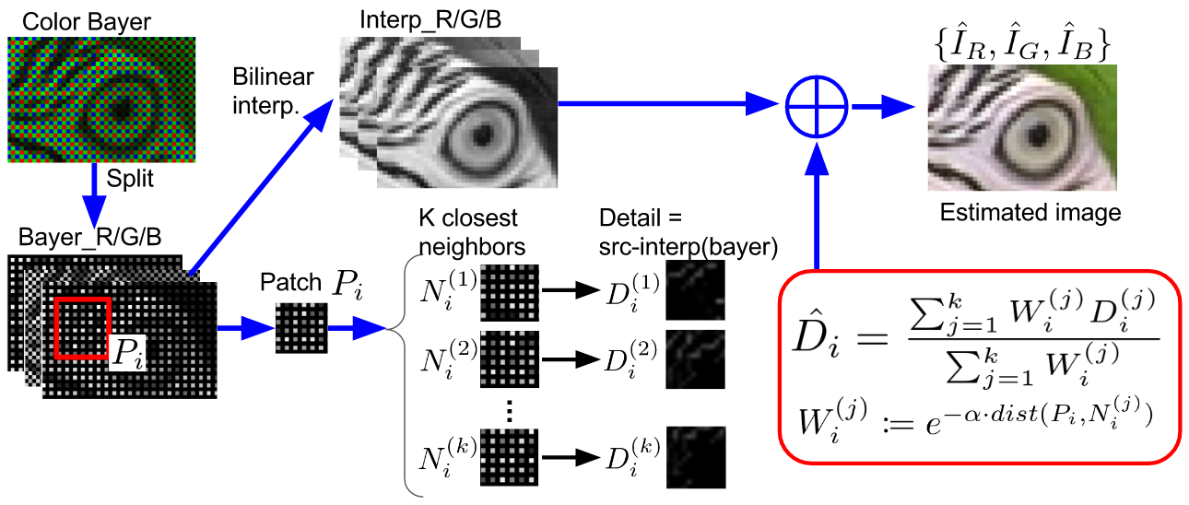
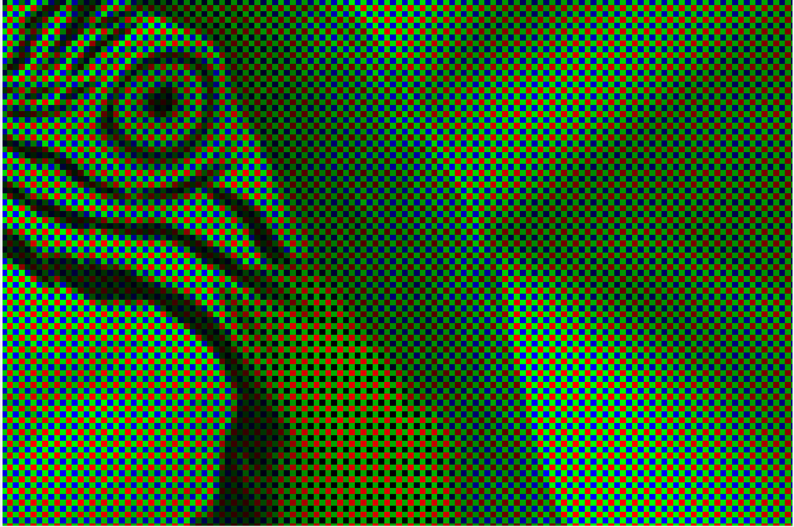
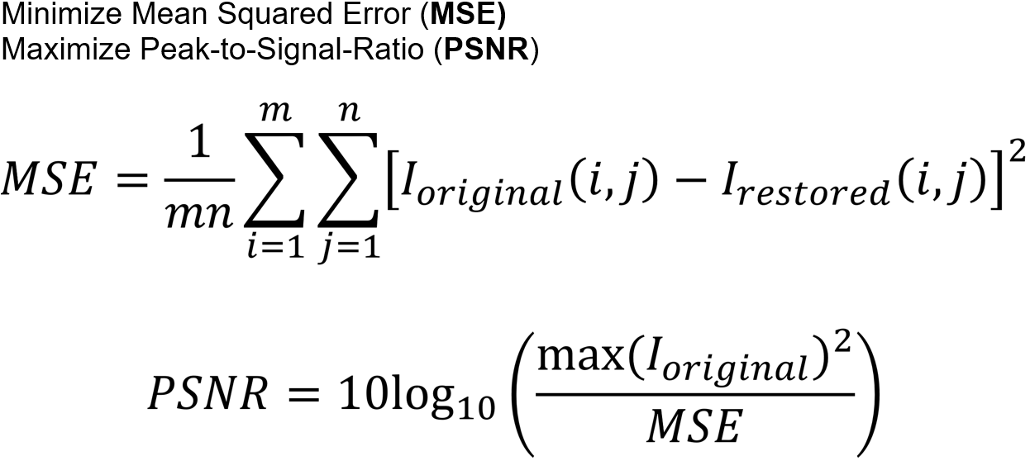
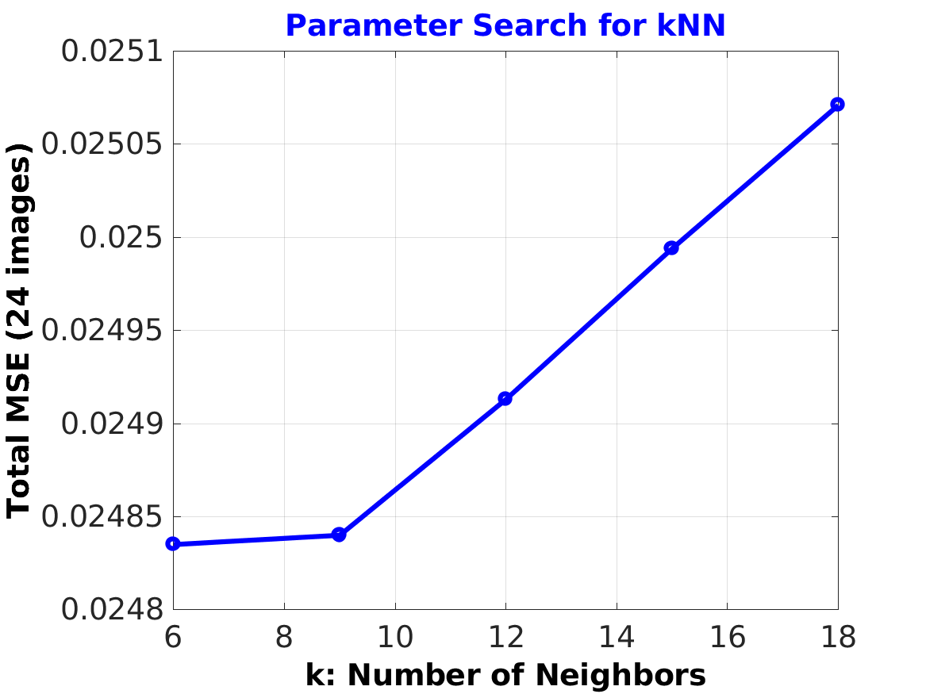
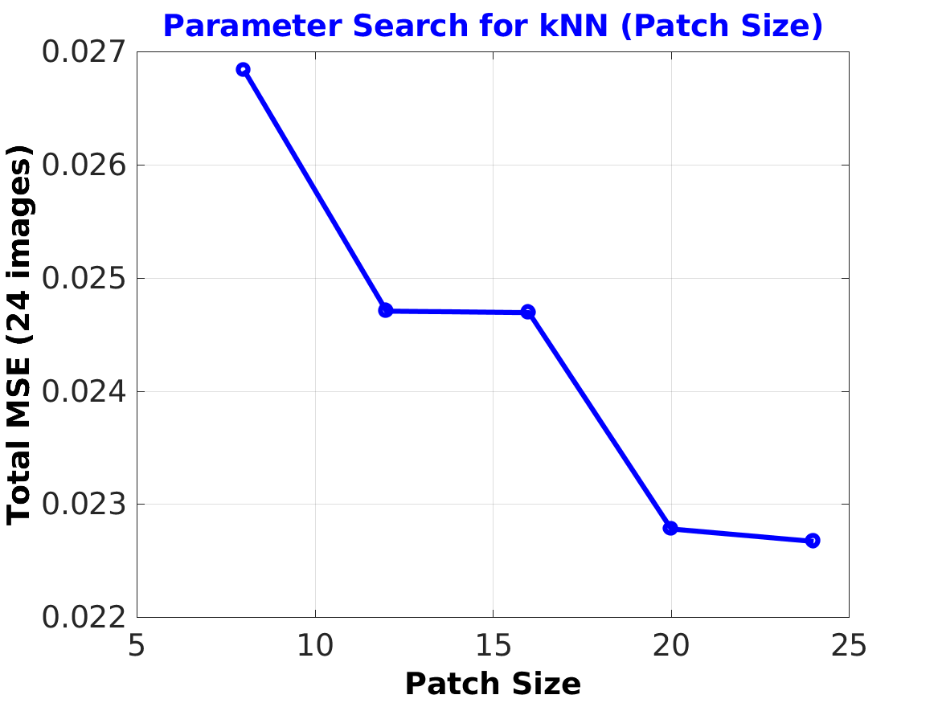
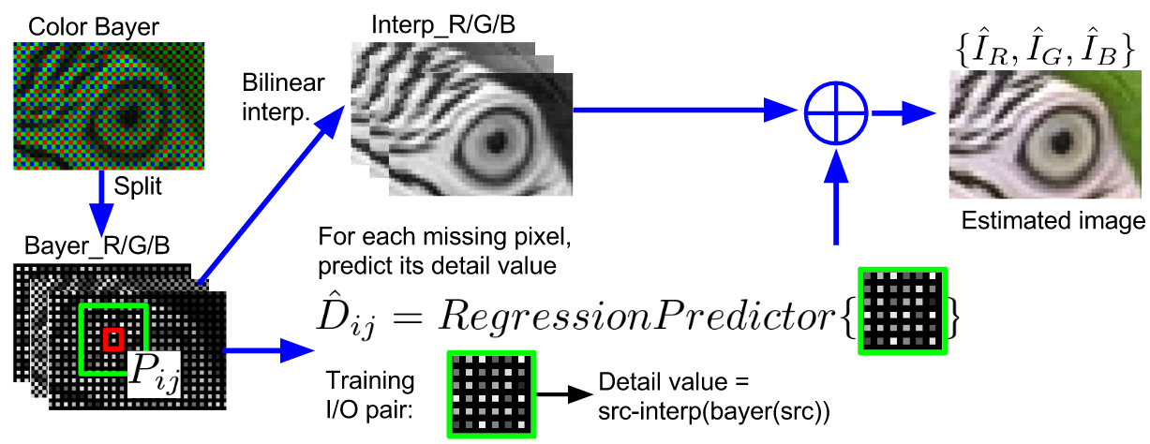
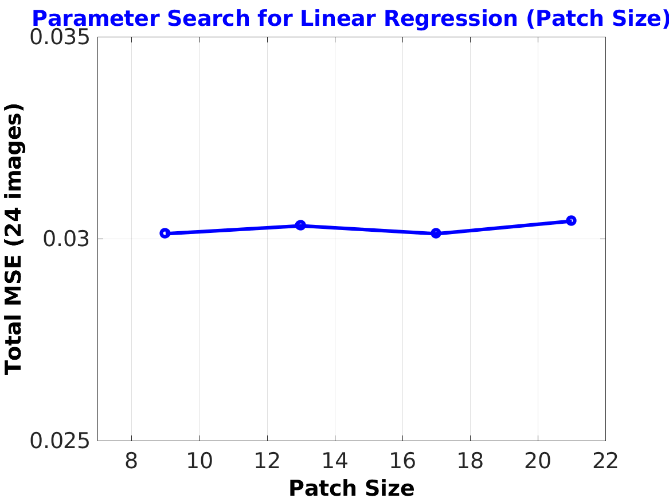
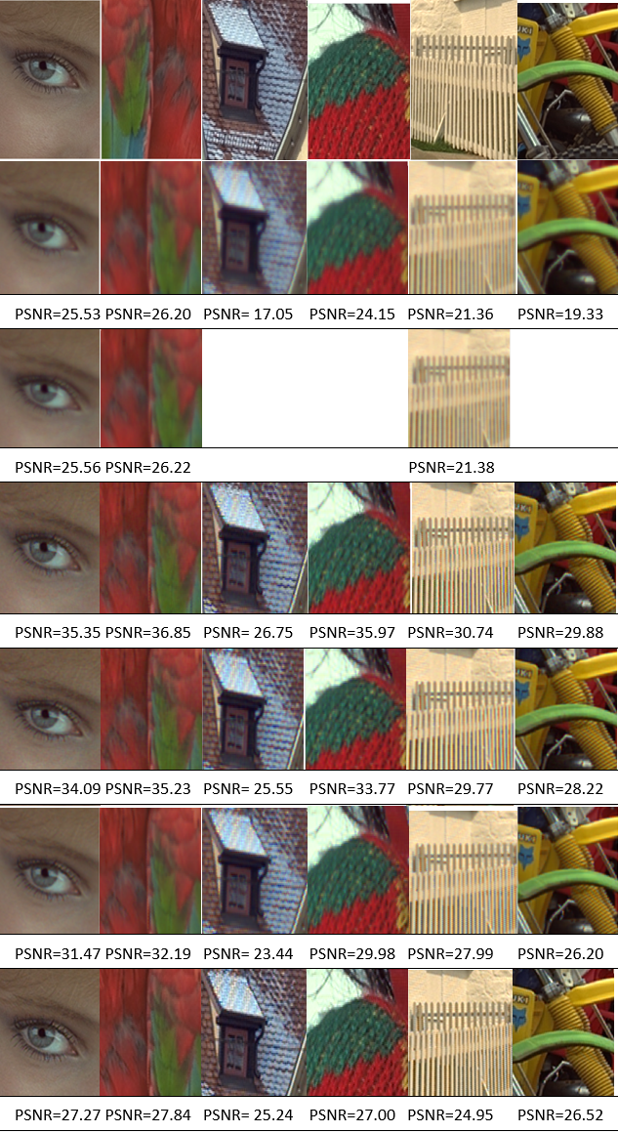
Machine Learning Methods for Demosaicing and Denoising
Yu-Sheng Chen, Stephanie Sanchez
ICME, Stanford University
Motivation
Method
Parameter Search
Demosaicing is a well known long-standing method. If we consider demosaicing and super-resolution together we notice that both methods utilize a technique to fill in pixel value information.
Therefore, we have implemented a method that utilizes super-resolution techniques such as machine learning methods and solving a least squares problem.
These techniques include k-nearest neighbors (NN), regression(SVR), and alternating directing method of multipliers with a total variation prior (ADMM+TV).
We optimize parameters in each method to minimize the mean sqaured error (MSE) and maximize the peak signal-to-noise ratio (PSNR).
Input
Output
ADMM+TV
Bayer+Noise
KNN
Parameter Opt.
3
Regression
Related Work
Numerical Summary
Conclusion
Traditional demosaicing methods include bilinear and Malvar interpolation. Bilinear interpolation approximates pixel values by averaging known pixel values in different directions. Malvar uses only linear kernels to perform the demosaicing by optimizing the kernel gain parameters.
For super-resolution problem, machine learning methods (kNN,SVR, and SRCNN) are used to predict the missing pixels. Theoretically, the super-resolution problem is very similar to the demosaicing problem.
Original
Method | Sum MSE (24 images)
ADMM+TV | 0.2527
kNN | 0.0248
Regression | 0.0303
Bilinear | 0.0356
Malvar | 0.0584
1. Bilinear and Malvar methods gives good results with lowest time complexity.
2. ADMM + TV can be used for demosaicking, but the parameter lambda is quite sensitive to the image content.
2. kNN method (example-based) can predict the image details well, while regression method also can improve image quality based on Bilinear’s result.
3. ML methods can be combined with any interpolation techniques
ADMM+TV
λ=0.0005
Optimize
λ=0.0001
KNN
Regression
Bilinear
We sum all the MSE over the 24 image Kodak data set. We see that kNN has the best minimized MSE followed by regression and bilinear.
Future Work
Malvar
1. Deep learning (CNN) approach
2. Test noise robustness for all methods
Notes:
1

