Slide 1

Online Banking System
Design Document
Overview, Objectives, and Guidelines
The design specifications for the Online Banking System
Date: 0 2 - 1 1 - 2 0 2 4

Slide 2
PREAPRED BY:
HAWO MOHAMMED
YISHAK ALEMU
YOHANNES AYENEW
YOSEF DAGNE
YUSUF KEDIR
ZEKARIAS TAMIRU

Slide 3
1.INTRODUCTION
Design specifications for the Online Banking System.
key areas
Transition from traditional banking to e-banking.
System interfaces and data stores.
Structural design and class descriptions.
Dynamic models and user scenarios.
Supplementary documentation and security considerations.

Slide 4
Functionality Coverage
Core Functionalities:
- Account Management
- Fund Transfers
- Bill Payments
- Account Inquiries
- Transaction History

Slide 5
Scope and Context
Focus Areas:
- Core functionalities for online banking services.
- Emphasis on customer convenience and security.
- Exclusions:
- Advanced trading features and complex financial products.

Slide 6
2.Design Overview
Overview:
- Object-oriented design methodology.
- Emphasis on modularity and reusability.
- Client-server architecture for efficient communication.

Slide 7
Environment Overview
Secure Web Environment:
- Components:
- Web Server:
Hosts application,
processes user requests.
- Database Server:
Stores user data, account info,
transaction histories.
- Client Devices:
Accessible via desktops,
laptops, mobile devices.

Slide 8
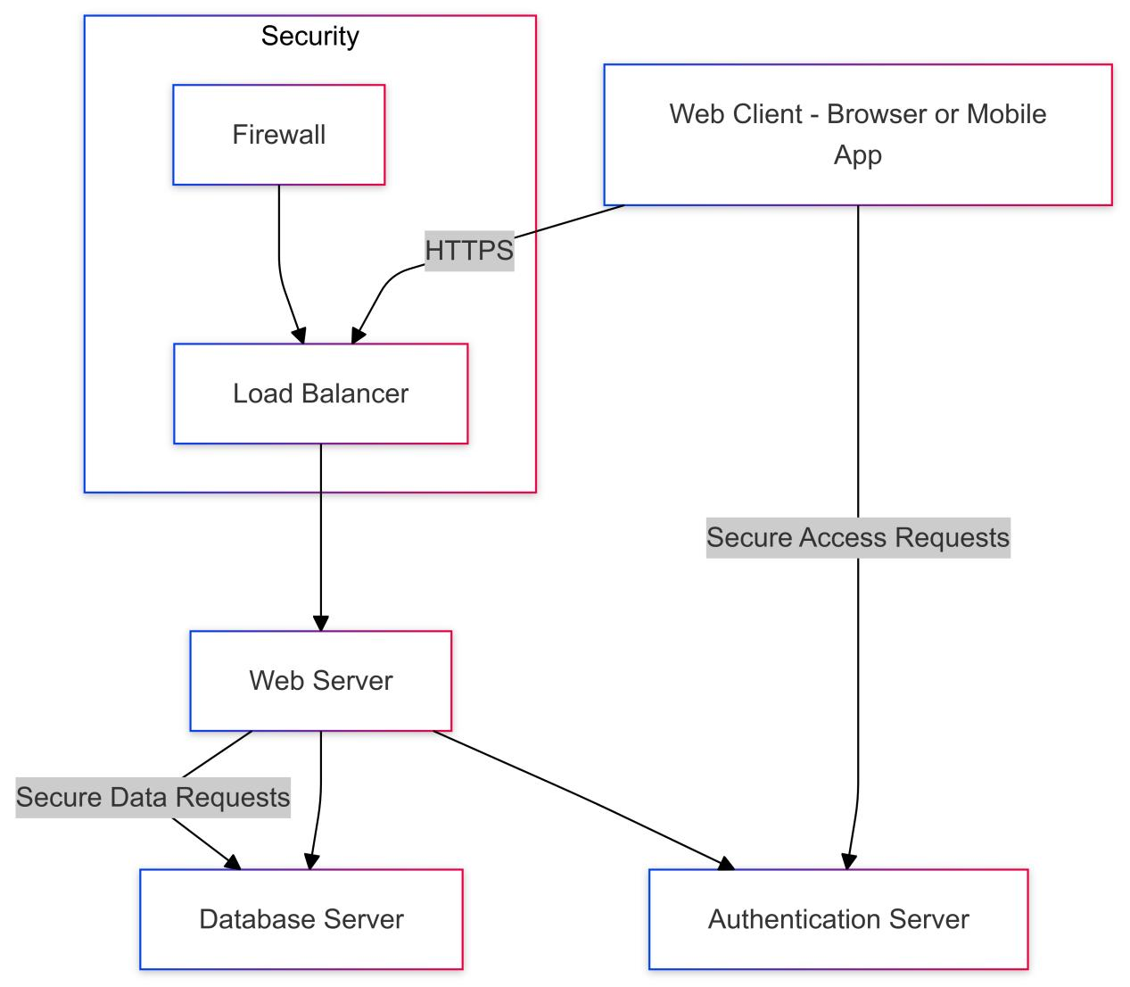
Network Diagram
Shows interactions between
Client, Web Server, and
Database Server.
fig network diagram

Slide 9
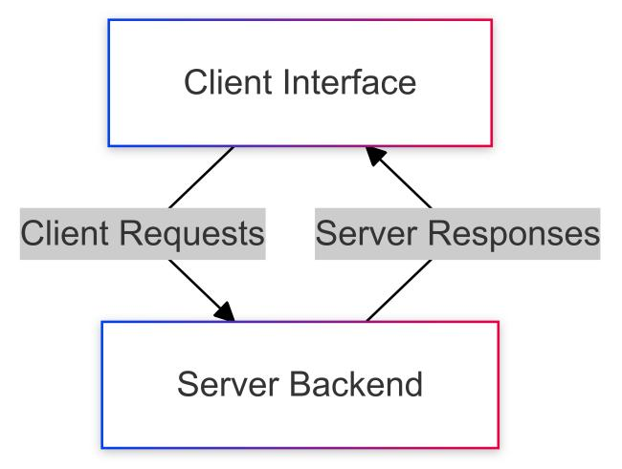
System Architecture
- Top-Level Structure:
- Client-Server Architecture
- Components:
- Client Interface
- Server Back-end
fig network diagram

Slide 10
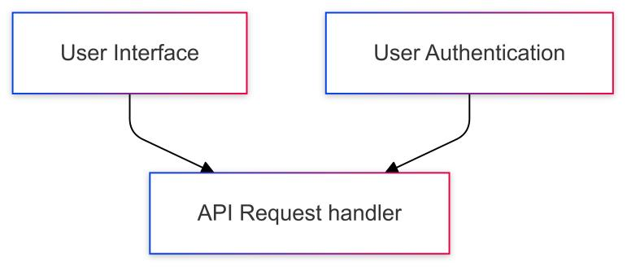
Client Interface
Responsibilities:
- User Interface: Responsive design for various screen sizes.
- User Authentication: Secure login mechanisms.

Slide 11
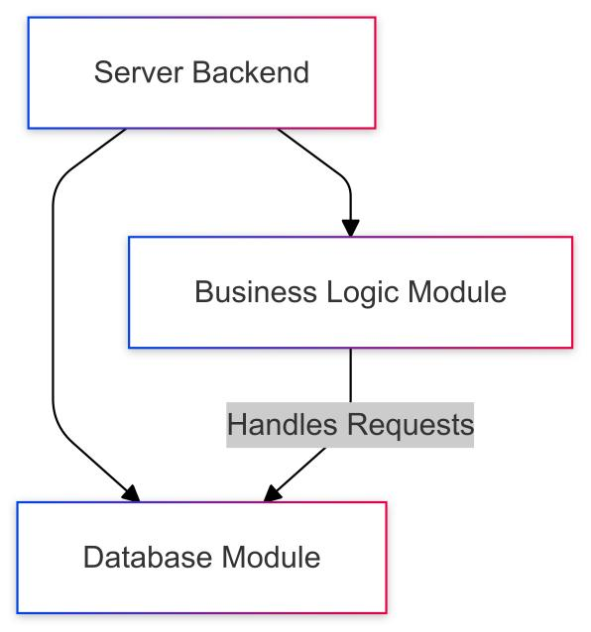
Server Back-end
- Core Operations:
- Business Logic Module:Transaction processing, account management.
- Database Module:Data storage, retrieval, integrity, and security.

Slide 12
3.Interfaces
Components of User Interface:
- Login/Registration Interface
- Account Management Dashboard
- Fund Transfer Interface
- Bill Payment Interface
- Customer Support Interface
- Settings and Security Interface
As the program is web application React frame work is suitable and node js as a back end language

Slide 13
Database
For:-
User Accounts
Transaction
Session
Management

Slide 14
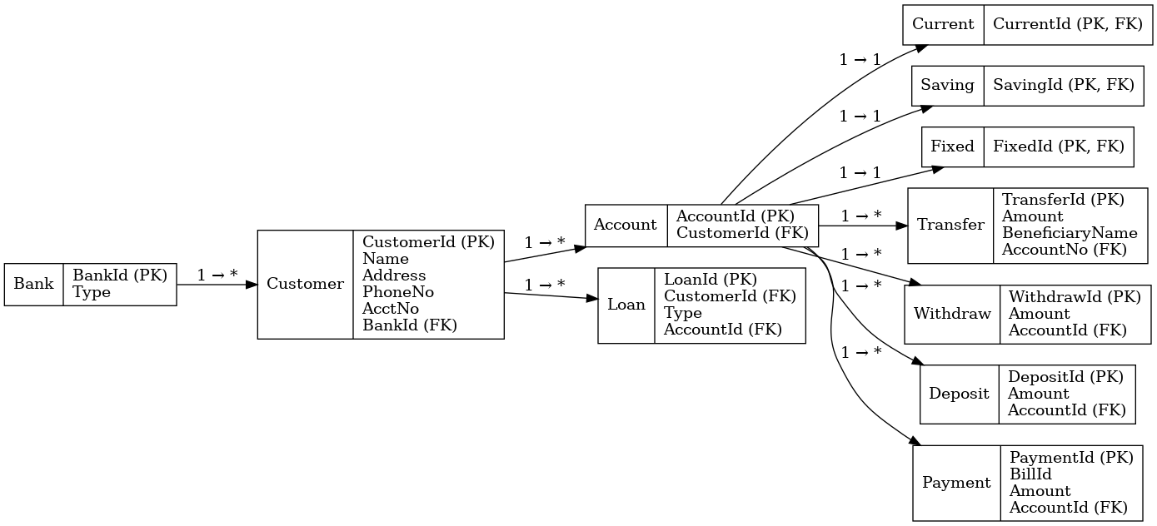

Slide 15
4. Structural Design
- Built on an object-oriented approach.
- Supports modularity, scalability, and maintainability.

Slide 16
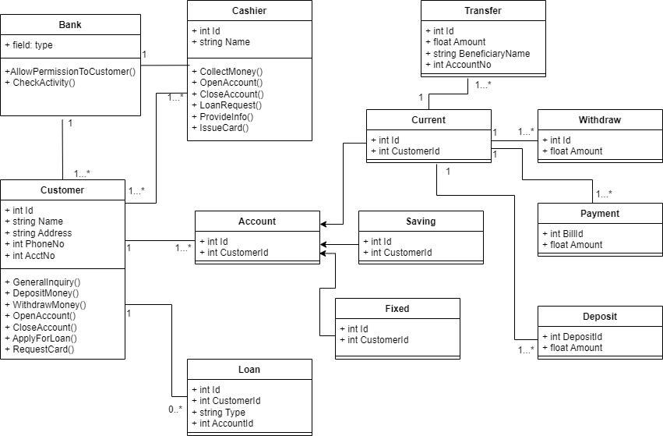
Class Diagram

Slide 17
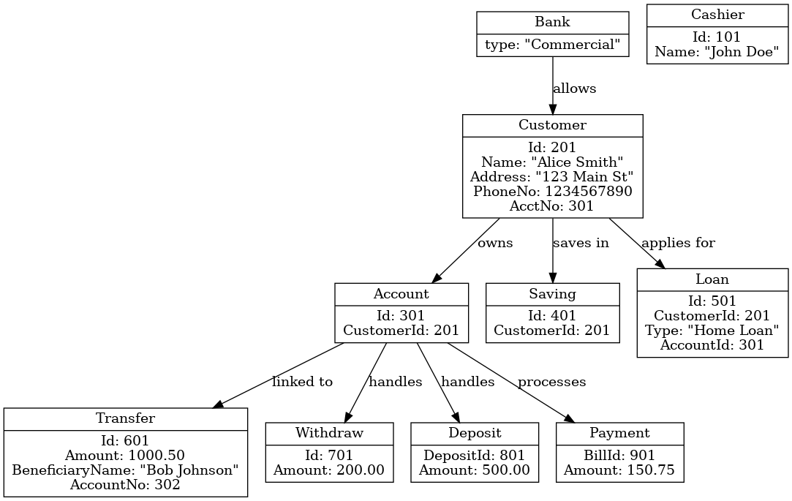
Object diagram
.

Slide 18
5.Dynamic Model
User Scenarios and Sequence Diagrams
The dynamic model illustrates how users interact with the Online Banking System through various scenarios.
Each scenario includes a sequence diagram to visualize the interactions.

Slide 19
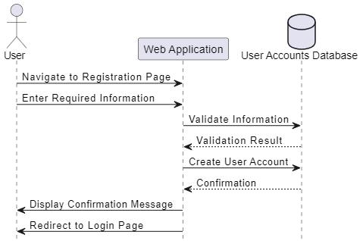
Scenario 1 - User Registration
New user creates an account by navigating to the registration page and entering required information.

Slide 20
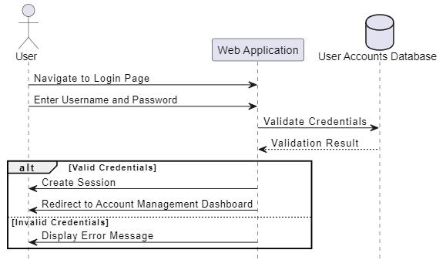
Scenario 2 - User Login
- Existing user logs in by entering credentials, which are verified against stored user data.
fig Sequence Diagram for user login

Slide 21
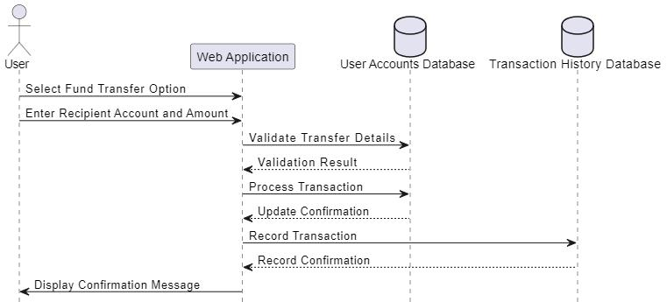
Scenario 3 - Fund Transfer
- Logged-in user transfers funds between accounts. The system validates details and updates accounts.
Sequence Diagram for Fund Transfer

Slide 22
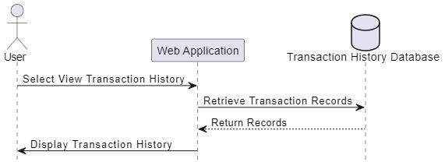
Scenario 4 - View Transaction History
- Logged-in user views transaction history. The system retrieves and displays records from the database.
Sequence Diagram for View Transaction History

Slide 23
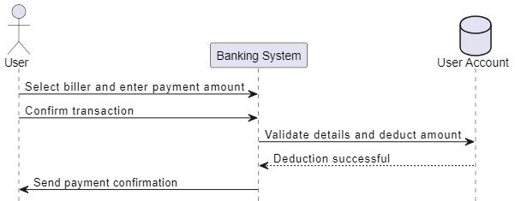
Scenario 5 - Bill Payment
- User pays a bill by selecting the biller, entering the amount, and confirming the transaction.
Sequence Diagram for user login

Slide 24
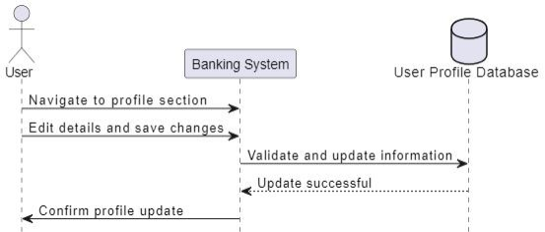
Scenario 6 - Profile Update
- User updates profile information. The system validates and updates the database with new details.
Sequence Diagram for Profile Update

Slide 25
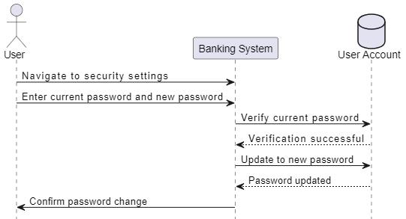
Scenario 7 - Change Password
- User changes their password by entering the current password and setting a new one.
Sequence Diagram for Change Password

Slide 26
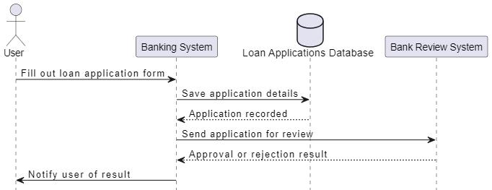
Scenario 8 - Loan Application
- User submits a loan application. The application is processed and reviewed by the bank.
Sequence Diagram for Loan Application

Slide 27
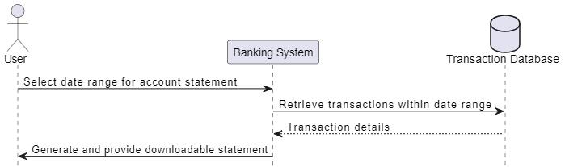
Scenario 9 - Download Account Statement
- User selects a date range to download their account statement in a preferred format.
Sequence Diagram for Download Account Statement

Slide 28
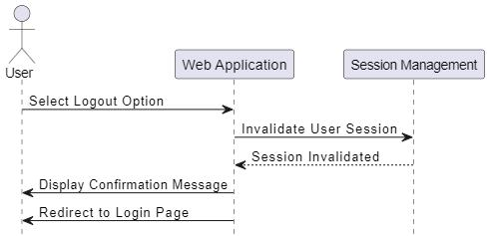
Scenario 10 - User Logout
Logged-in user logs out of the system securely.
Sequence Diagram for User Logout

Slide 29
6.Supplementary Documentation
Ensures effective utilization and management of the Online Banking System.
User Manuals:Empower end-users
Technical Documentation:Provides in-depth technical information
Security Guidelines:Framework for protecting user data
Compliance Documentation:Outlines adherence to legal and regulatory requirements
Change Management Document:Manages updates and modifications
Training Materials:Assists in onboarding new users and staff

Slide 30
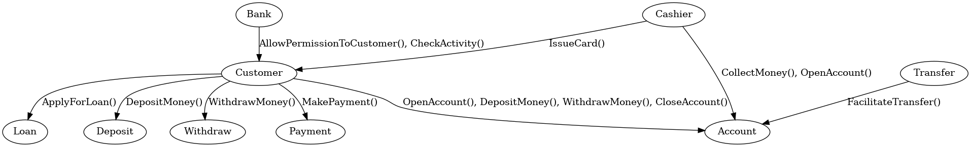
Collaboration diagram
Focuses on the relationships and interactions between objects in a scenario

Slide 31
Thanks for listening to us, now you can ask your questions

