Slide 1
Computational Chemistry
Considered CHARMMful Josh Mitchell

Slide 2
Why am I here

Slide 3
Computational methods can be…
Complementary to experiment
Faster/cheaper than experiment
More detailed than experiment
Though usually not at the same time

Slide 4
Lets think statistically

Slide 5
Protein structure forms according to a probability distribution

Slide 6
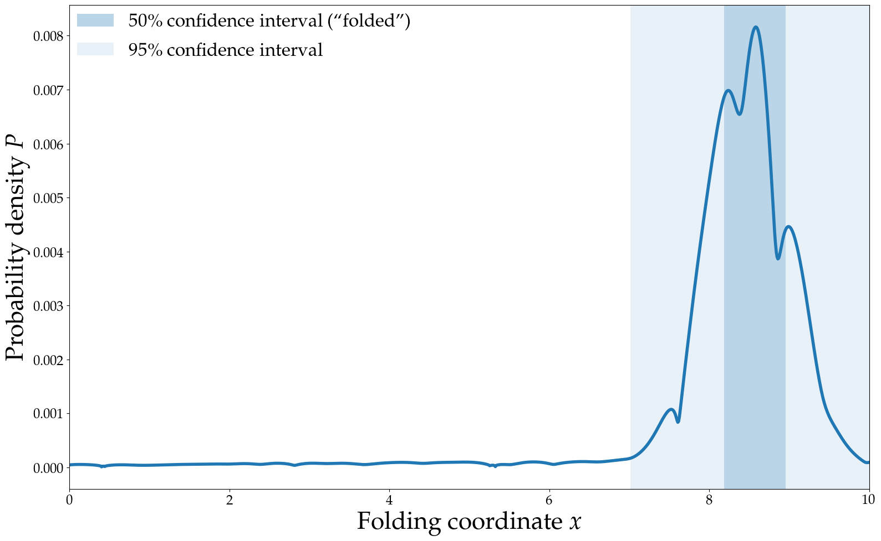
Folded proteins have a funnel-shaped probability distribution

Slide 7
Ready for some maths?

Slide 8
The Boltzmann Distribution
$$P_{i}=\frac{\text{exp}(−βϵ_{i})}{Z}$$
$P_{i}$ is the probability of state $i$ at equilibrium
$\text{exp}(x)$ is the exponential function $e^{x}$
$β=\frac{1}{K_{B}T}$ incorporates the temperature
$ϵ_{i}$ is the energy of state $i$ . . .
Z=j​exp(−βϵj)
Notes:
What kind of energy $ϵ_{i}$ is depends on how state $i$ is represented:
Free energy for coarse grained representations
Hamiltonian for canonical ensemble in phase space
Potential energy for canonical ensemble in configuration space

Slide 9
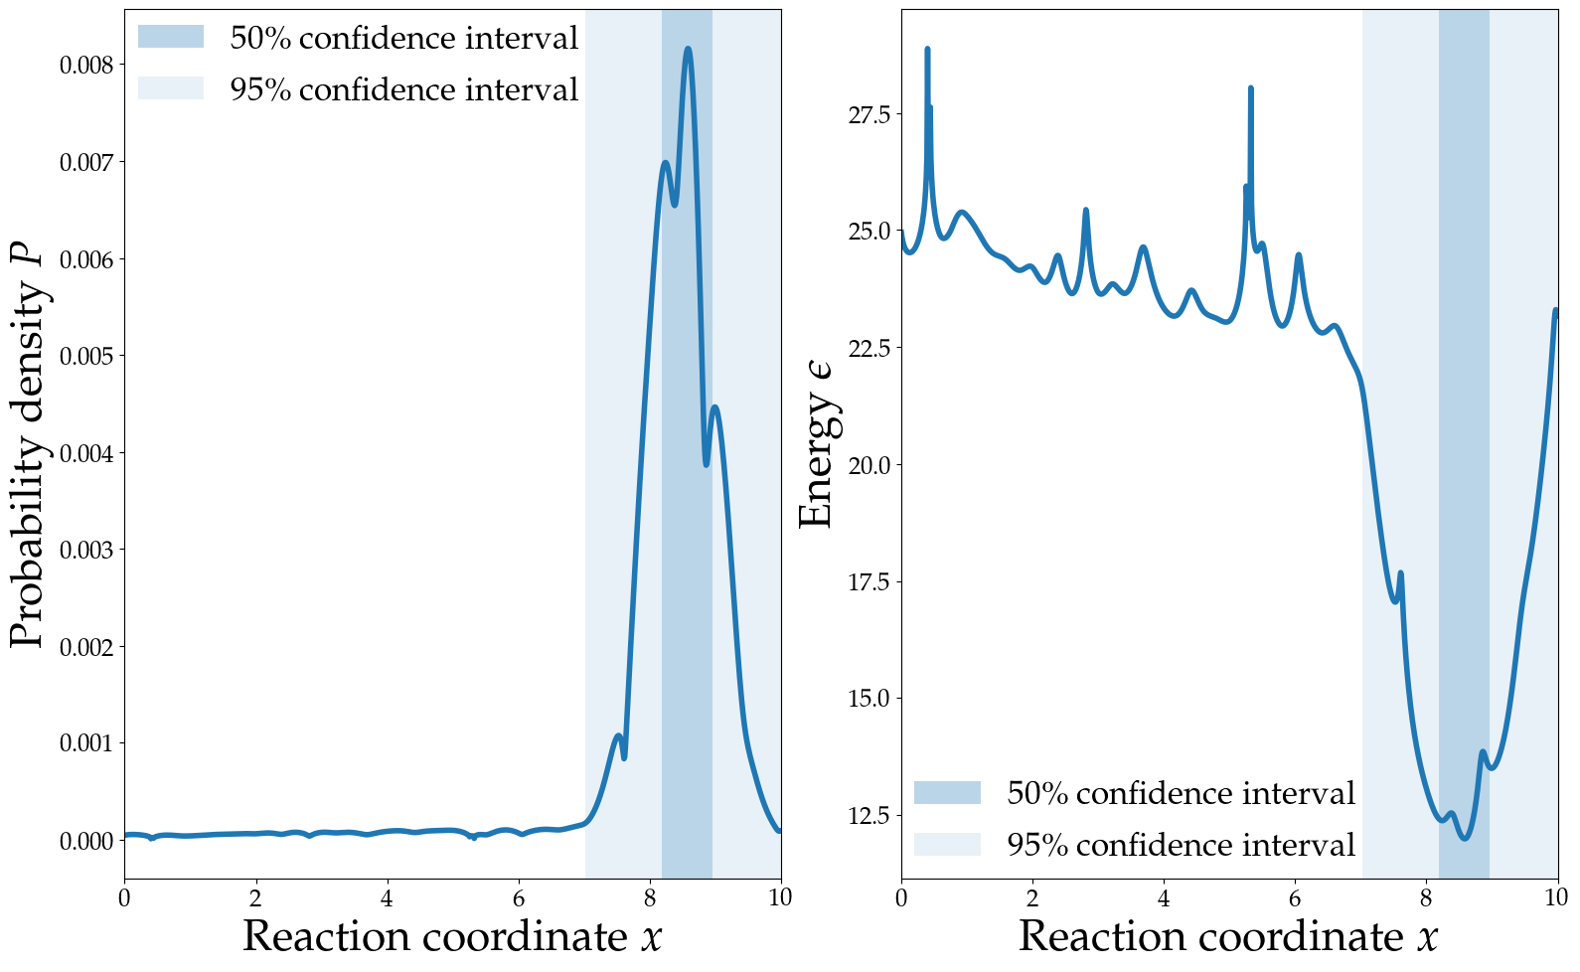
The Boltzmann distribution

Slide 10
There are two problems
$$P_{i}=\frac{\text{exp}(−βϵ_{i})}{Z}$$
Which states are most important
How important are those states

Slide 11
Fast methods assume there is only one important state
So we just find the minimum energy state $i$
$$P_{min}=\frac{\text{exp}(−βϵ_{min})}{\text{exp}(−βϵ_{min})}=1$$
. . .
Entropic effects must be part of the energy $ϵ$
Energy function doesn’t need much detail

Slide 12
What happens if we don’t make that assumption?

Slide 13
$$P_{i}=\frac{\text{exp}(−βϵ_{i})}{Z}$$
We need to sample from the entire Boltzmann distribution with a detailed energy function

Slide 14
Sampling is hard
The curse of dimensionality

Slide 15
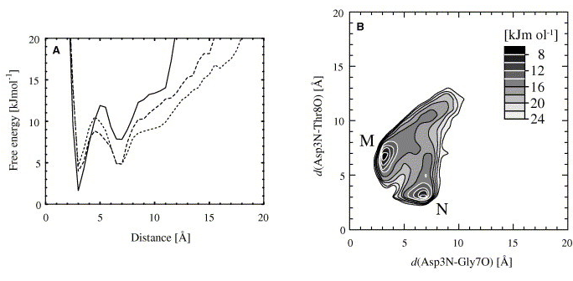

Slide 16
(Satoh et al. 2006)

Slide 17
Levinthal’s paradox
~50 KDa, 500 residue protein
Assume each residue is either α-helix or β-sheet
500 binary dimensions
Looking for 1 folded state in 2⁵⁰⁰ (~10¹⁵⁰) possible states
Yet, nature can do it

Slide 18
Molecular dynamics
Calculate forces from the energy function (“force field”)
Step the system through time with classical mechanics
Let the shape of the probability distribution guide your sampling

Slide 19
Simulation is the method, not the goal
Kinetics are unreliable
Produces lots of noisy data
Humans are good at finding patterns

Slide 20
Know what you’re looking for
Just like experiments

Slide 21
I’m looking for a non-crystallographic, highly populated state
I’m looking for the important states in solution near the crystal structure
I’m looking for the folded state from an extended model or homology model
I wanna measure the free energy of this process

Slide 22
Make sure it’s computationally feasible

Slide 23
Check you’ve found it
Check everything seems reasonable
The good, the bad and the user in soft matter simulations (Wong-ekkabut and Karttunen 2016)
Make sure it’s not just a statistical fluke
Best practices for quantification of uncertainty and sampling quality in molecular simulations (Grossfield et al. 2018)
Run replicas
Avoiding False Positive Conclusions in Molecular Simulation: The Importance of Replicas (Knapp, Ospina, and Deane 2018)

Slide 24
So
We sample from the Boltzmann distribution
Simulation is the method, not the goal
Know what you’re looking for
Check you’ve found it
Questions about sampling?

Slide 25
Anyone want more maths?

Slide 26
A really nice way to think about entropy is only a few algebraic manipulations away!

Slide 27
What is energy
$$P_{i}=\frac{\text{exp}(−βϵ_{i})}{Z}$$
. . .
$$\text{exp}(−\frac{1}{K_{B}T}ϵ_{i})=P_{i}Z$$
. . .
$$−\frac{1}{K_{B}T}ϵ_{i}=\text{log}(P_{i}Z)$$
. . .
$$ϵ_{i}=−K_{B}T\text{log}(P_{i})−K_{B}T\text{log}(Z)$$

Slide 28
What is energy
$$ϵ_{i}=−K_{B}T\text{log}(P_{i})−K_{B}T\text{log}(Z)$$
. . .
$$ϵ_{irel}=−K_{B}T\text{log}(P_{i})$$

Slide 29
What is entropy?
Suppose we have a state $i$ that comprises $Ω_{i}$ microstates, each of probability $p_{i}$
$$P_{i}=Ω_{i}p_{i}$$
. . .
$$ϵ_{i}=−K_{B}T\text{log}(Ω_{i}p_{i})−K_{B}T\text{log}(Z)$$
. . .
$$ϵ_{i}=−K_{B}T\text{log}(Ω_{i})−K_{B}T\text{log}(p_{i})−K_{B}T\text{log}(Z)$$

Slide 30
What is entropy?
Suppose we have a state $i$ that comprises $Ω_{i}$ microstates, each of probability $p_{i}$
$$ϵ_{i}=−K_{B}T\text{log}(Ω_{i})−K_{B}T\text{log}(p_{i})−K_{B}T\text{log}(Z)$$
. . .
$$S_{i}=K_{B}\text{log}(Ω_{i})$$
. . .
$$ϵ_{i}=−TS_{i}−K_{B}T\text{log}(p_{i})−K_{B}T\text{log}(Z)$$
. . .
In reality, not all the microstates have the same energy, but this is the gist.

Slide 31
What’s the difference?
$$ϵ_{i}=−K_{B}T\text{log}(Ω_{i}p_{i})−K_{B}T\text{log}(Z)$$$$ϵ_{j}=−K_{B}T\text{log}(Ω_{j}p_{j})−K_{B}T\text{log}(Z)$$
. . .
$$ϵ_{i}−ϵ_{j}=−K_{B}T\text{log}(Ω_{i}p_{i})+K_{B}T\text{log}(Ω_{j}p_{j})$$
. . .
$$ϵ_{i}−ϵ_{j}=−K_{B}T\text{log}(p_{i})+K_{B}T\text{log}(p_{j})$$$$−K_{B}T\text{log}(Ω_{i})+K_{B}T\text{log}(Ω_{j})$$
. . .
$$Δϵ=Δ[−K_{B}T\text{log}(p)]−TΔ[K_{B}\text{log}(Ω)]$$

Slide 32
Anyone recognise this?
$$Δϵ=Δ[−K_{B}T\text{log}(p)]−TΔ[K_{B}\text{log}(Ω)]$$
. . .
$$G=ϵ$$$$H=−K_{B}T\text{log}(p)$$$$S=K_{B}\text{log}(Ω)$$
. . .
$$ΔG=ΔH−TΔS$$

Slide 33
If you want more, check out stat mech!

Slide 34
No more maths

Slide 35
I promise

Slide 36
A quick run down of force fields

Slide 37
What to look for in a force field
Can it model all the parts of my system?
Does it accurately produce the kind of data I’m looking for?
Has it been validated by people other than the authors?
Can I trust the parameters I have in the format I use?

Slide 38
WARNINGS
Don’t confuse force field and software!
Don’t mix parameters from different force fields!
Most force fields are not parameterised for kinetics!
Most force fields are only parameterised at one temperature!

Slide 39
CHARMM
CHARMM22*
Extremely well validated force field for vanilla proteins. Reasonable accuracy even for IDPs and loop regions, despite not being parametrised for this. CHARMM22 modified by Shaw group.
CHARMM36m
CHARMM36 modified for better performance with IDPs and loop regions. Distributed in many formats by the authors.

Slide 40
AMBER
Great supplementary DNA and metallic ion parameters
AMBER99SB-disp
AMBER99SB-ILDN with torsion and protein-water VDW optimisations by Shaw group. 4-point water model (slow). State-of-the-art IDP/loop accuracy (according to authors).
AMBER99SB*-ildn
AMBER99SB with optimised torsions. Solid, widely used AMBER force field. Predates the IDP revolution. Several daughter force fields with improved performance.

Slide 41
MARTINI
Coarse grained!
1000-fold faster than atomic MD
Converged MARTINI probably more accurate than unconverged atomic force fields

Slide 42
Other stuff
GROMOS 54a7
Great for arbitrary chemicals (ATB). Outdated for proteins.
OPLS 3e
Schrödinger’s proprietary force field. Claims experimental accuracy for binding free energies of arbitrary drug molecules to proteins. Expensive to license. Proteins under-validated.

Slide 43
Questions about force fields?

Slide 44
A few traps

Slide 45
Use the same parameters as your force field authors
Read the paper!
Use same VDW cutoff range and method.
PME is usually OK if force field uses other long-range electrostatic treatment.
Use same water model.
Use same constraints (everyone breaks this rule and it might be OK)

Slide 46
Thermostats and barostats
Don’t ever use Berendsen thermostats or barostats in production!

Slide 47
Thermostat
Just use Bussi’s stochastic velocity rescaling thermostat for everything (v-rescale in GROMACS). Use a Nosé–Hoover chain if that’s unavailable.

Slide 48
Barostat
Use a Monte Carlo barostat if available (unless you really care about how the box changes shape). Coming soon to GROMACS.
If not, or if you care about box dynamics:
Use Berendsen or Monte Carlo for equilibration
Use Parrinello-Rahman or MTTK for production

Slide 49
Step size
It’s OK to make it as big as possible, as long as your simulation doesn’t crash.
If your simulation crashes, try reducing the step size.
Atomic production simulations should never need to be below 1 fs, or 2 fs with constraints.
Adjacent frames are very similar - don’t be afraid to drop them!

Slide 50
Non-monovalent metal cations
Shape of orbitals is important IRL, but force fields are spherically symmetric!
Some work has been done on introducing virtual particles to correct this

Slide 51
Box size
Smaller box lets you have less water and faster simulation
Too small box introduces finite size artifacts
Keep your periodic image distance larger than VdW cutoff
Rhombic Dodecahedral boxes have about 0.707 times the volume of a cubic box
Orientation of protein can change PI distance!

Slide 52
Protonation state
Set at start of simulation.
If you’re doing experiments near the PK_{a} of something, be careful!

Slide 53
Enhanced sampling
Enhanced sampling is good.
Replica exchange is good.
Biased sampling methods are good if you have a good reaction coordinate.
Ensemble sampling methods will probably be good very soon.
Be careful with accelerated MD.
Make sure you should know what you’re doing!

Slide 54
Further reading and references

Slide 55
Braun, Efrem, Justin Gilmer, Heather B. Mayes, David L. Mobley, Jacob I. Monroe, Samarjeet Prasad, and Daniel M. Zuckerman. 2018. “Best Practices for Foundations in Molecular Simulations [Article V1.0].” Living Journal of Computational Molecular Science 1 (1): 5957. https://doi.org/10.33011/livecoms.1.1.5957.
Eastman, Peter. 2015. “Introduction to Statistical Mechanics.” 2015. https://peastman.github.io/statmech/.
Grossfield, Alan, Paul N. Patrone, Daniel R. Roe, Andrew J. Schultz, Daniel Siderius, and Daniel M. Zuckerman. 2018. “Best Practices for Quantification of Uncertainty and Sampling Quality in Molecular Simulations [Article V1.0].” Living Journal of Computational Molecular Science 1 (1): 5067. https://doi.org/10.33011/livecoms.1.1.5067.
Knapp, Bernhard, Luis Ospina, and Charlotte M. Deane. 2018. “Avoiding False Positive Conclusions in Molecular Simulation: The Importance of Replicas.” Journal of Chemical Theory and Computation 14 (12): 6127–38. https://doi.org/10.1021/acs.jctc.8b00391.
Satoh, Daisuke, Kentaro Shimizu, Shugo Nakamura, and Tohru Terada. 2006. “Folding Free-Energy Landscape of a 10-Residue Mini-Protein, Chignolin.” FEBS Letters 580 (14): 3422–6. https://doi.org/10.1016/j.febslet.2006.05.015.
Wong-ekkabut, Jirasak, and Mikko Karttunen. 2016. “The Good, the Bad and the User in Soft Matter Simulations.” Biochimica et Biophysica Acta (BBA) - Biomembranes 1858 (10): 2529–38. https://doi.org/10.1016/j.bbamem.2016.02.004.

