Slide 1

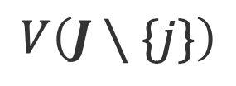

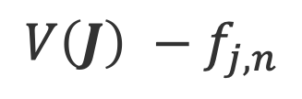
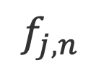

$$V\left(J∖\{j\}\right)$$
$${pay}_{j}$$
$$t_{j,n}$$
$$f_{j,n}$$
$${V\left(J\right) −f}_{j,n}$$
$$V\left(J\right)$$
amount

Slide 2

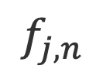
$$V\left(J∖\{j\}\right)$$
$${pay}_{j}$$
$$t_{j,n}$$
$$f_{j,n}$$
$${V\left(J\right) −f}_{j,n}$$
$$V\left(J\right)$$
amount

Slide 3

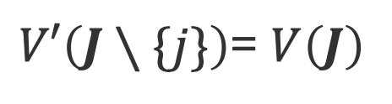

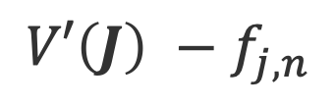
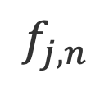

$V′\left(J∖\{j\}\right)$= $V\left(J\right)$
$${pay}_{j}$$
$$t_{j,n}$$
$$f_{j,n}$$
$${V′\left(J\right) −f}_{j,n}$$
$$V′\left(J\right)$$
amount

Slide 4
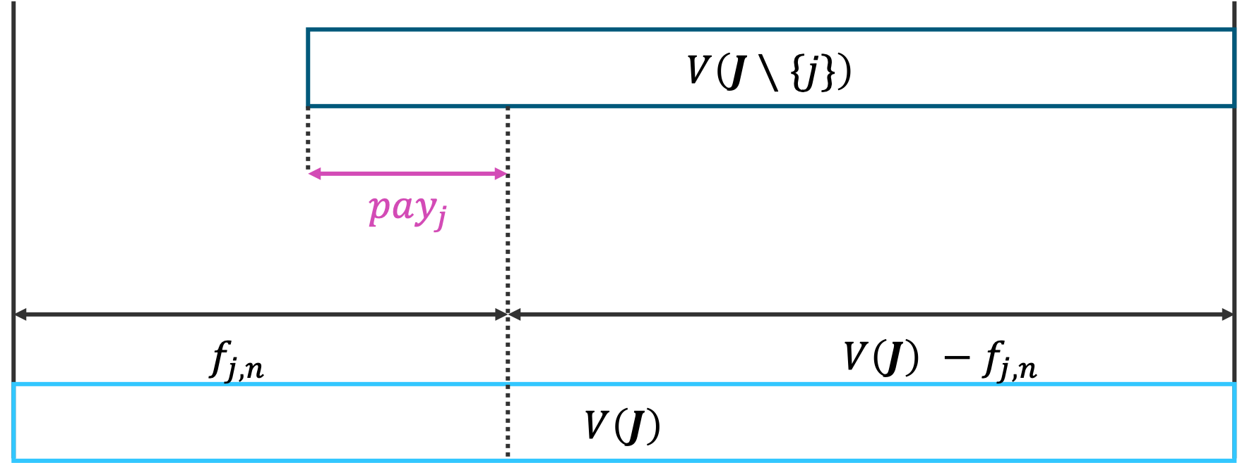
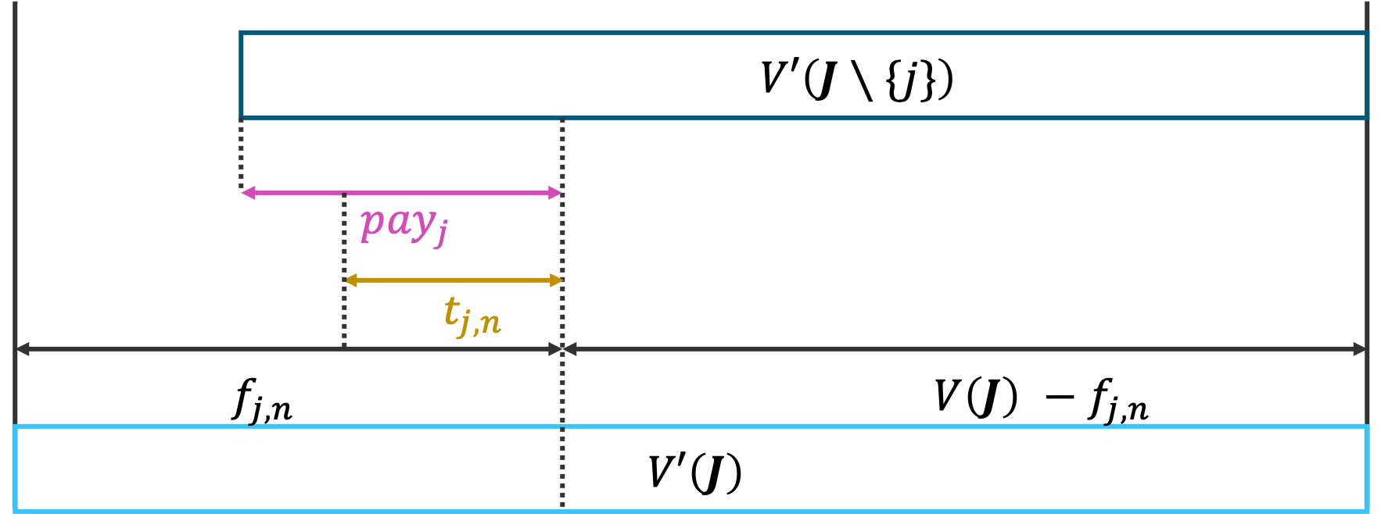
(a)
(b)

Slide 5
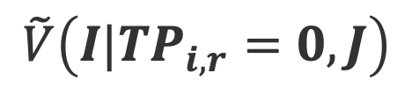


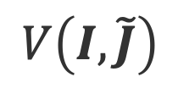
$$\tilde{V}\left(I|TP_{i,r}=0,J\right)$$
$${rewaed′}_{i,r}$$
$$V\left(I,\tilde{J}\right)$$
$$c_{i,r}×x_{i,r}$$

