Slide 1

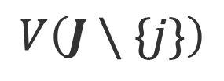

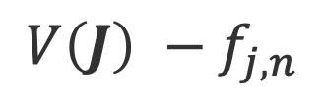
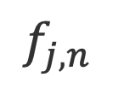
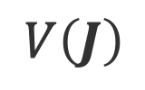
$$V\left(J∖\{j\}\right)$$
$${pay}_{j}$$
$$t_{j,n}$$
$$f_{j,n}$$
$${V\left(J\right) −f}_{j,n}$$
$$V\left(J\right)$$

Slide 2
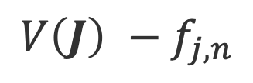
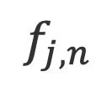

$$V\left(J∖\{j\}\right)$$
$${pay}_{j}$$
$$t_{j,n}$$
$$f_{j,n}$$
$${V\left(J\right) −f}_{j,n}$$
$$V\left(J\right)$$

Slide 3

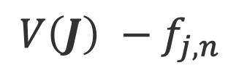
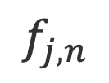

$$V\left(J∖\{j\}\right)$$
$${pay}_{j}$$
$$t_{j,n}$$
$$f_{j,n}$$
$${V\left(J\right) −f}_{j,n}$$
$$V\left(J\right)$$

Slide 4

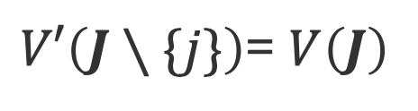

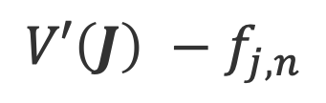


$V′\left(J∖\{j\}\right)$= $V\left(J\right)$
$${pay}_{j}$$
$$t_{j,n}$$
$$f_{j,n}$$
$${V′\left(J\right) −f}_{j,n}$$
$$V′\left(J\right)$$

Slide 5
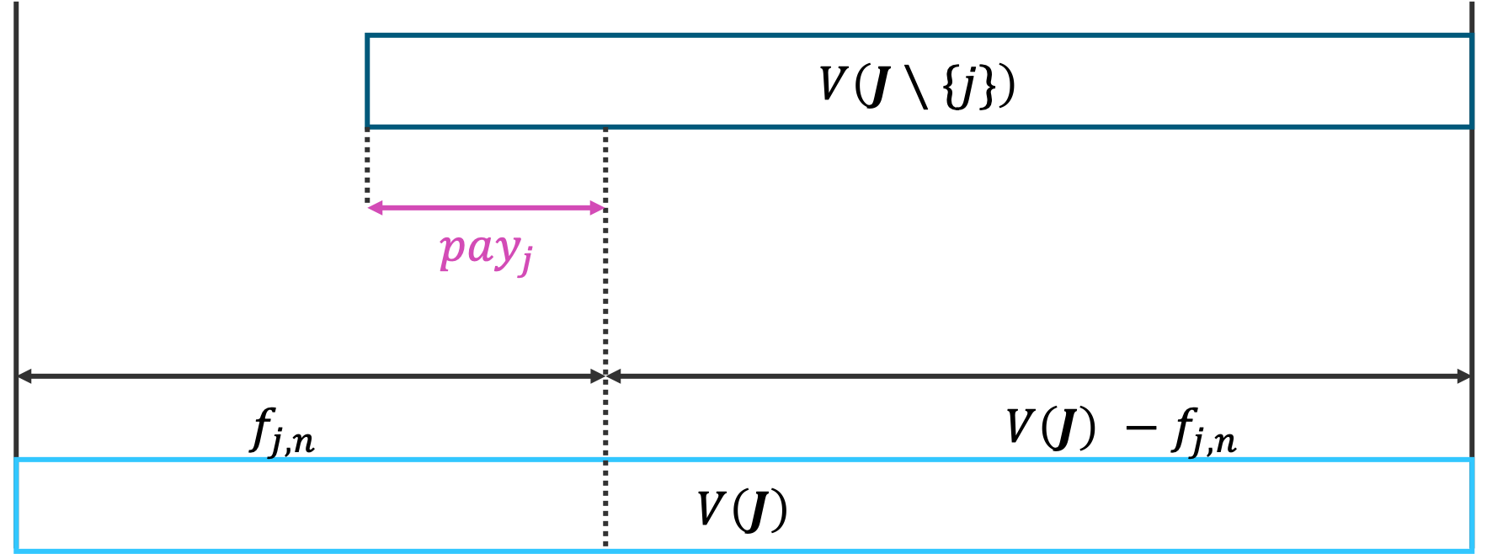
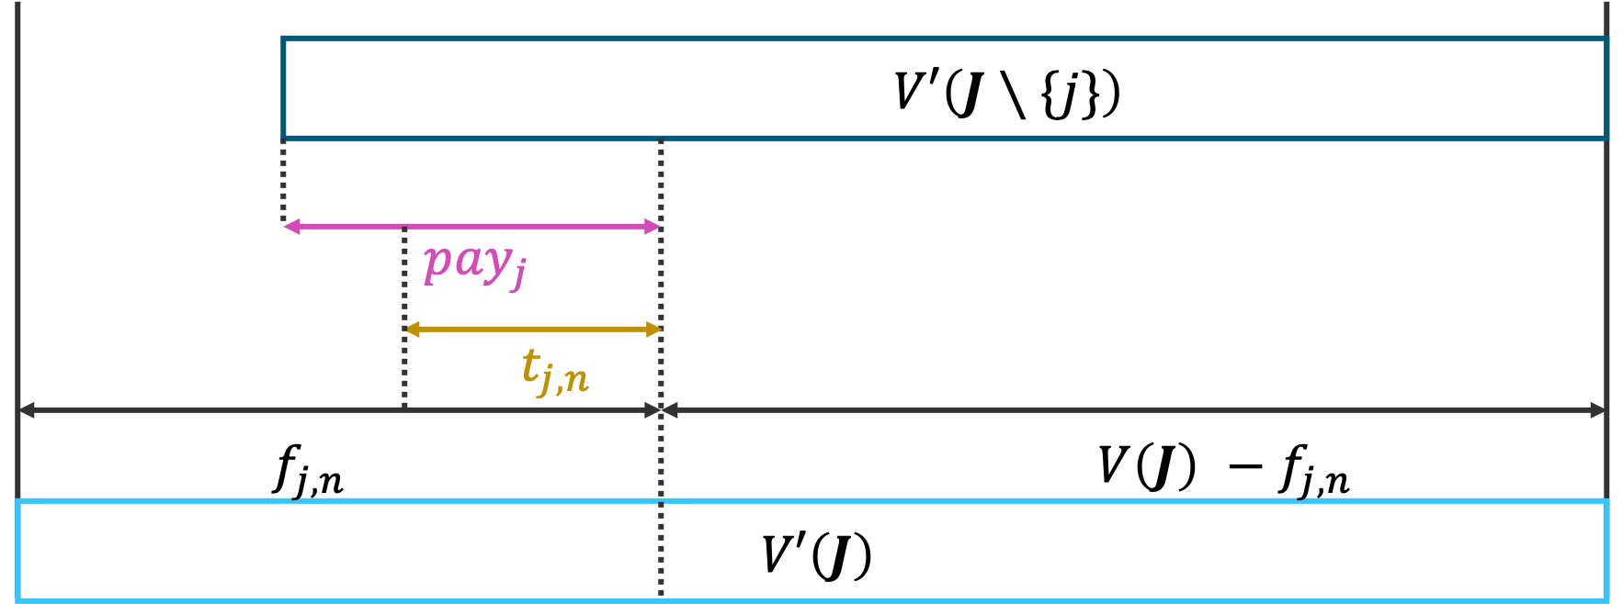
(a)
(b)

Slide 6
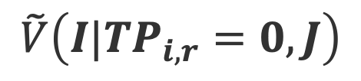


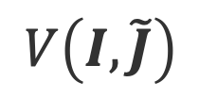
$$\tilde{V}\left(I|TP_{i,r}=0,J\right)$$
$${revenue′}_{i,r}$$
$$c_{i,r}×x_{i,r}$$
$$V\left(I,\tilde{J}\right)$$

Slide 8

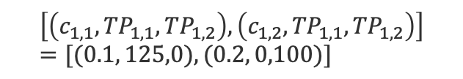
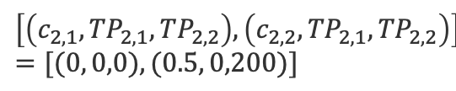
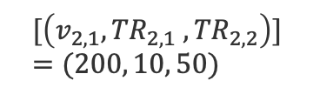
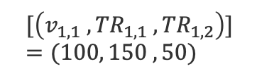
Provider1
Provider2
$$\left[\left({c_{1,1}, TP}_{1,1},TP_{1,2}\right), \left(c_{1,2}, {TP}_{1,1},{TP}_{1,2}\right)\right]=[(0.1, 125,0),(0.2, 0,100)]$$
$$\left[\left({c_{2,1}, TP}_{2,1},TP_{2,2}\right), \left(c_{2,2},{TP}_{2,1},{TP}_{2,2}\right)\right]=[(0, 0,0),(0.5, 0,200)]$$
Auctioneer
$$[\left({v_{1,1} ,TR}_{1,1} , {TR}_{1,2}\right)]=(100, 150 , 50)$$
$$[\left({v_{2,1},TR}_{2,1} , {TR}_{2,2}\right)]=(200, 10, 50)$$
Requester1
Requester2

