Slide 1

Attention Network

Slide 2
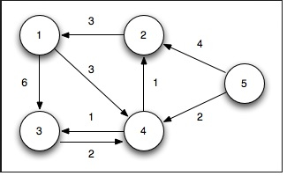
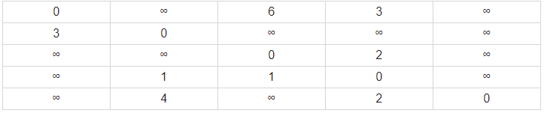
Weighted graphs
It is a type of graph in which each edge is given a numerical weight. It can be a distance, time or amount etc.
Adjacency matrix (A)
The information about connections in a graph can e represented in an adjacency matrix. [n x n]
1 2 3 4 5
1
2
3
4
5

Slide 3
Attention Network
On which part of input, you need to put more attention.
Hello, I am Yoshi Bansal. I am a 2nd-year BTech student. I was born on 25 Dec 2000, in MP, and I am currently living in New Delhi.
The basic idea of attention in graph neural network (GNN) is to additionally learn how important node j features are for node i.
हैलो, मैं योशी बंसल हूं। मैं 2-वर्षीय बीटेक छात्र हूं। मेरा जन्म २५ दिसंबर २००० को मप्र में हुआ था और मैं इस समय नई दिल्ली में रह रहा हूं।

Slide 4
END

