Slide 1

COVID-19 Data Analysis
Data analytics boot camp - Monash University
Yoshie Hara

Slide 2
Agenda
Introduction
Covid Cases in Australia (2022/01/01 ~ 2022/01/07)
Covid Cases in Worldwide (2022/01/01)
Conclusion

Slide 3
Introduction
The primary goal of this project is to unravel the stories within the data, stories that reveal the impact of COVID-19 on both a global and national scale within Australia.

Slide 4
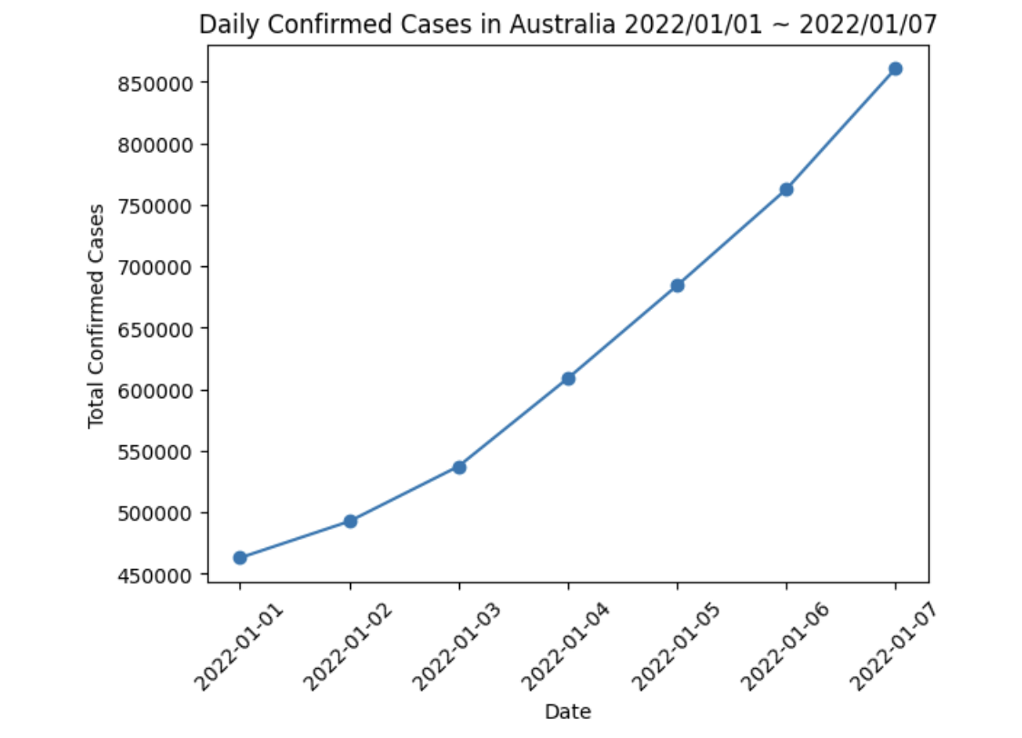
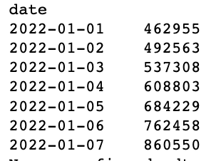
Analysis of Australia: Daily Confirmed Cases
Period: January 1, 2022, to January 7, 2022
The number of COVID-19 cases shows a consistent upward trend, indicating a substantial increase in infections during this period.

Slide 5
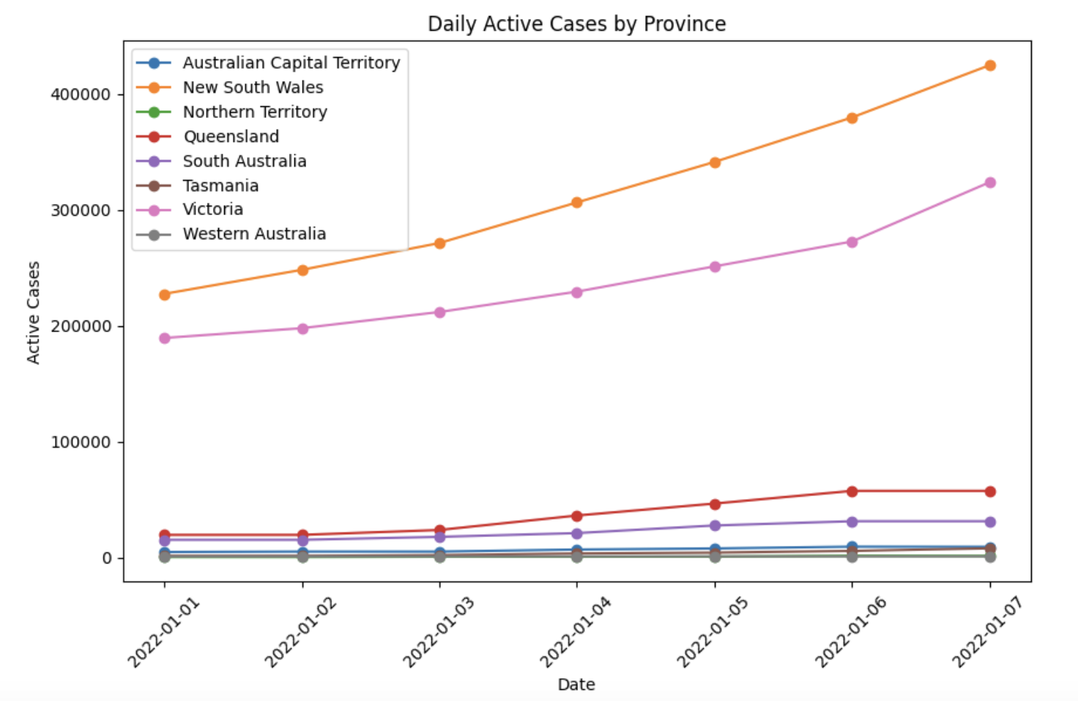
Analysis of Australia: Daily Active Cases (Province)
Period: January 1, 2022, to January 7, 2022
New South Wales and Victoria exhibit a consistent and substantial increase,
Northern Territory and Western Australia maintain relatively lower and stable case counts throughout the observed period.

Slide 6
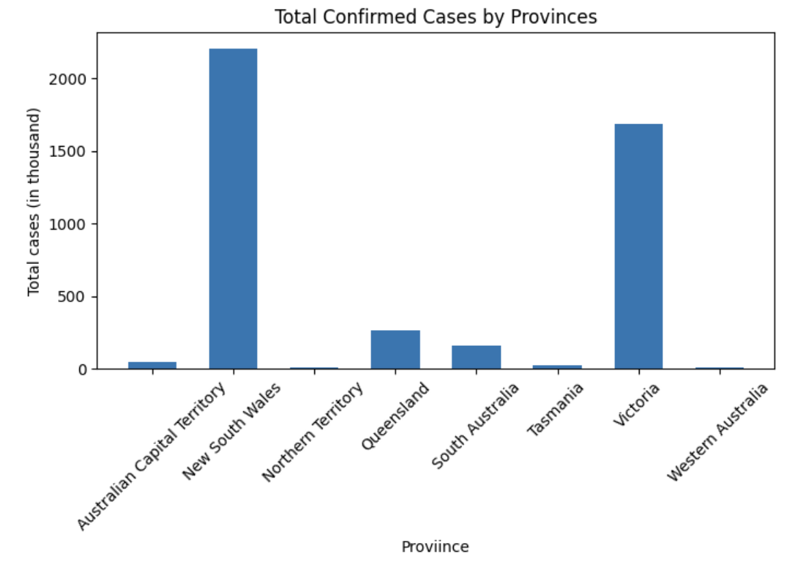
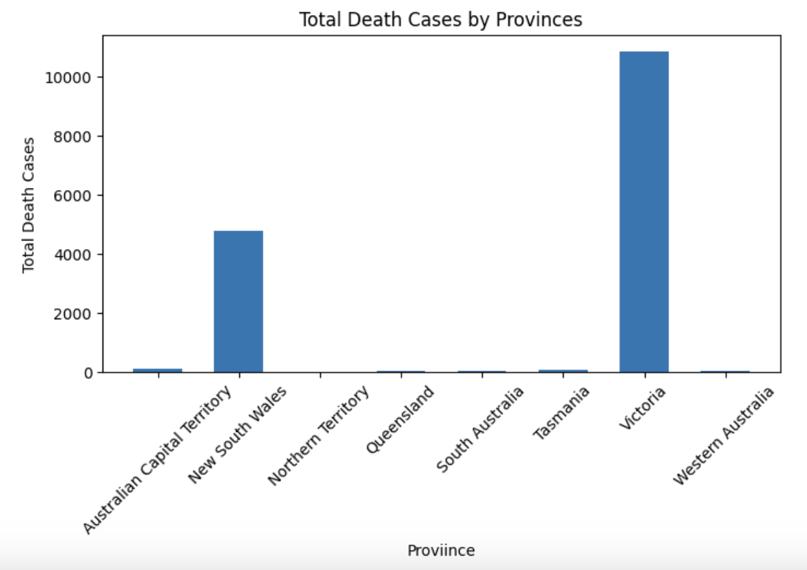
Analysis of Australia: Daily Confirmed Cases (Province)
Period: January 1, 2022, to January 7, 2022
New South Wales exhibits the highest confirmed cases, contributing significantly to the overall caseload.
Victoria stands out with the highest death toll, emphasizing the severity of the outbreak in that region.

Slide 7
Insights and findings
The first graph indicates a consistent rise in confirmed cases for the first week of January 2022 across Australian states, with New South Wales reporting the highest confirmed cases.
In contrast, Victoria leads in the number of death cases during the same period among Australian states.

Slide 8
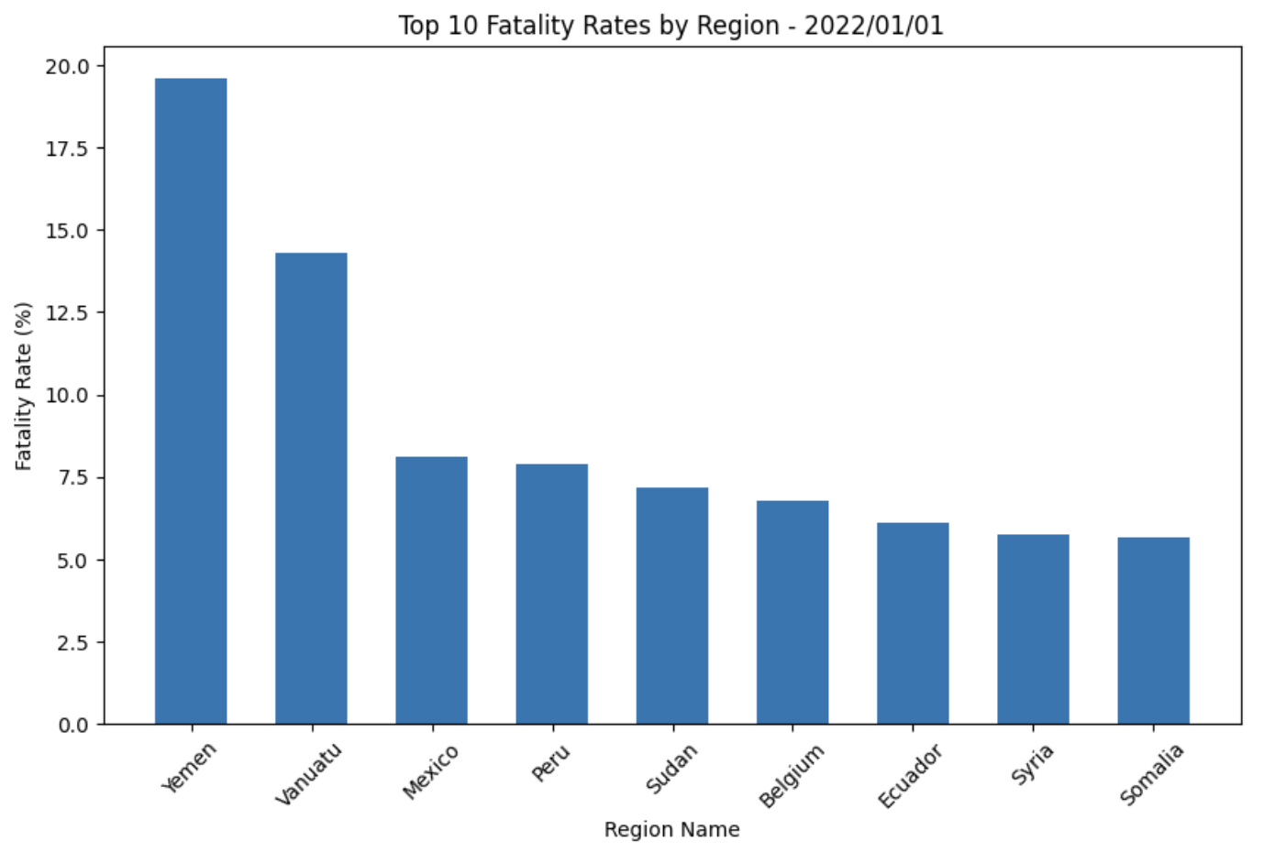
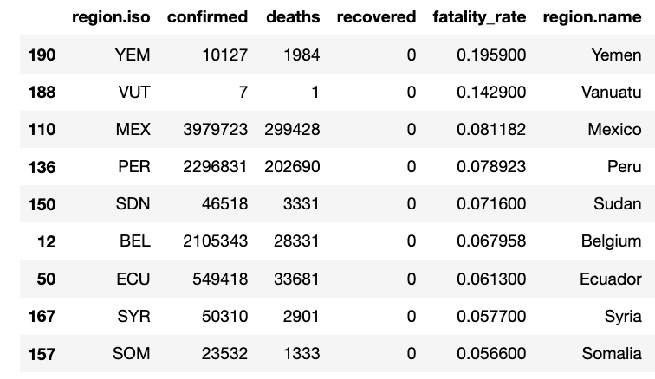
Analysis of Worldwide: Top 10 Fatality Rates by Region
Date: January 1, 2022
The countries with the highest fatality rates are geographically diverse, representing regions from the Middle East (Yemen), Oceania (Vanuatu), North America (Mexico), South America (Peru), Africa (Sudan, Somalia), Europe (Belgium), and the Middle East (Syria).
While Yemen has the highest fatality rate among the top 10, there is a range of fatality rates among these countries, indicating variations in the impact of the COVID-19 pandemic on different regions.

Slide 9
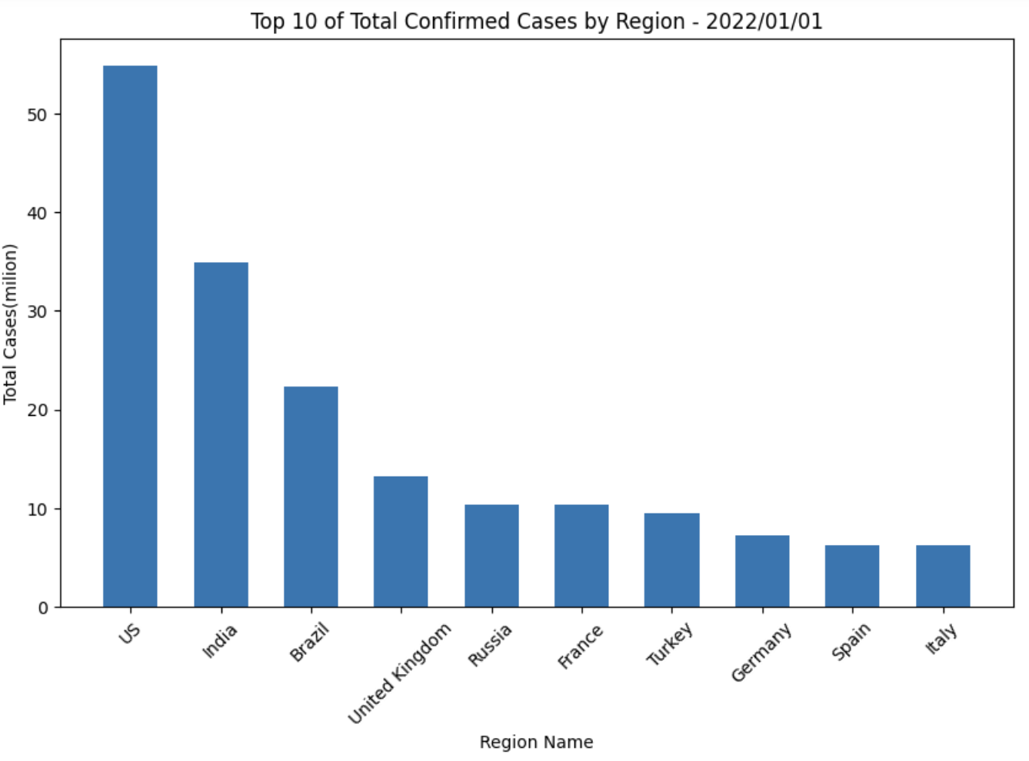
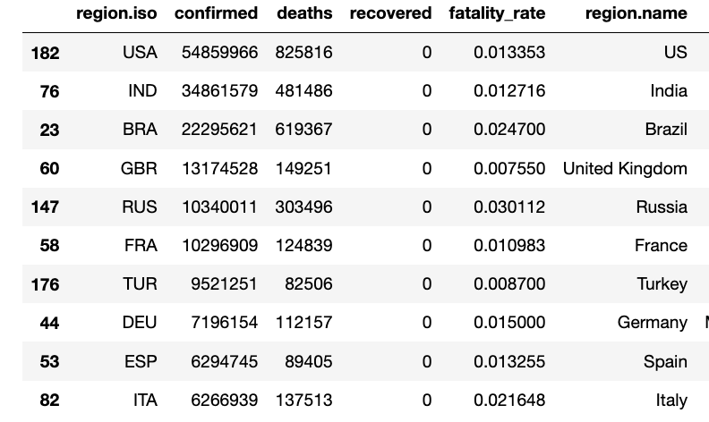
Analysis of Worldwide: Top 10 Confirmed Cases by Region
Date: January 1, 2022
The countries with the highest confirmed cases include nations from different continents.
Despite having high confirmed cases, the fatality rates vary among these countries.

Slide 10
Insights and findings
The analysis reveals that countries with the highest fatality rates are widely distributed geographically, encompassing regions such as the Middle East (Yemen), Oceania (Vanuatu), North America (Mexico), South America (Peru), Africa (Sudan, Somalia), and Europe (Belgium and Syria).
Similarly, the countries with the highest confirmed cases exhibit a global representation across continents. However, despite the high number of confirmed cases, there is considerable variation in fatality rates among these nations.

Slide 11
Conclusion
The COVID-19 impact is diverse globally, with the top 10 countries in fatality rates representing various regions. Yemen has the highest rate, underlining regional differences.
Similarly, top 10 confirmed cases span continents, with variable fatality rates. Notable variations, like lower rates in India and the UK, highlight the need for context-specific responses.
Recognizing this diversity is crucial for effective global pandemic management.

