Slide 1

Victoria Safety Analysis
Project 3 - Group 1
Hussam Goda
Kashif Bashir
Nairui Guo
Yoshie Hara

Slide 2
Introduction and Scope
Analysis of Crimes Data in Victoria.
Data available for the period from 2014, ending 2023.
The objective is to compile an overview of the criminal activities, trends and patterns across the period indicated above.
Data Source: CRIME STATISTIC AGENCY
https://www.crimestatistics.vic.gov.au/crime-statistics/latest-victorian-crime-data/download-data

Slide 3
Approach
Prepare data (Python in Jupyter notebook)
Develop a Database to store data tables (SQLITE)
Create Flask API(s) (Python in Visual Studio)
Create a Dashboard to visualize analysis using chart.js library (Html, Java script)
Analysis and Conclusions

Slide 4
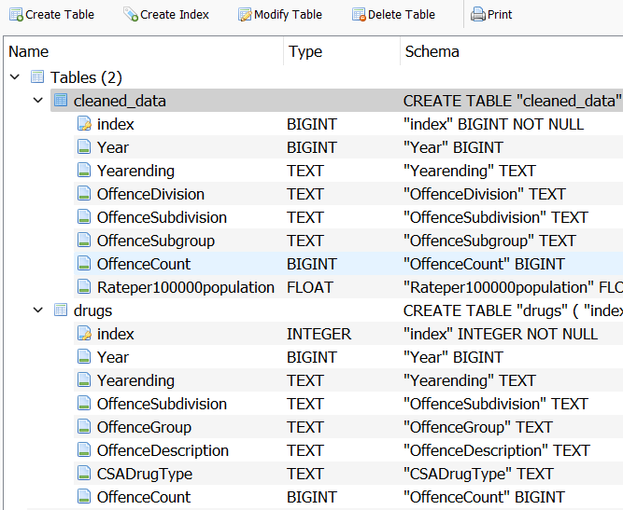
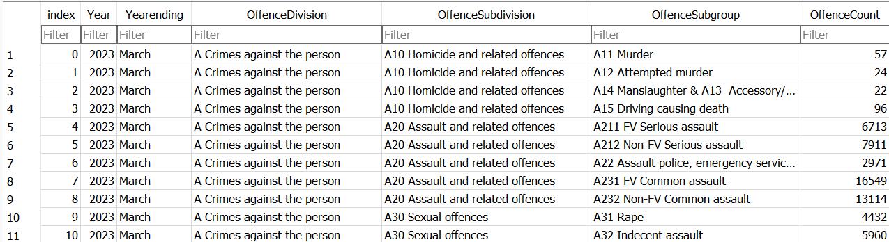
Data Analysis – Database and Flask API (1)
Data preparation: import data, check and confirm data types, check empty rows, convert to csv files.
SQLITE Database: crime.sqlite
Two tables:
Table “cleaned_data”: summary of all crimes
Table “drugs”: detailed summary of crimes related to drugs

Slide 5
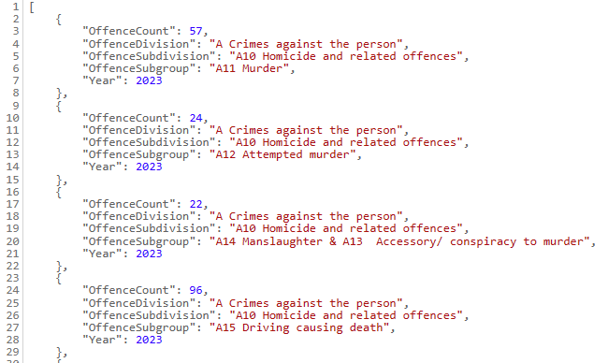
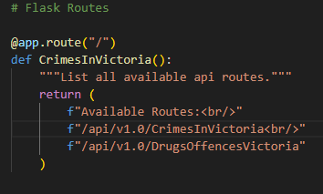
Data Analysis – Database and Flask API (2)
API Flash: “AllCrimes.py”
Two routes defined for tables
http://localhost:5000/api/v1.0/CrimesInVictoria
http://localhost:5000/api/v1.0/DrugsOffencesVictoria

Slide 6
Data Analysis – Dashboard

Slide 7
Analysis/Conclusion

Slide 8
Thank you.

