Slide 1

Victoria Safety Analysis
Project 3 - Group 1
Kashif Bashir
Hussam Goda
Yoshie Hara
Nairui Guo

Slide 2
Introduction and Scope
Understand the level of safety in Victoria by analysing recorded crimes.
Data available for the period from 2014, ending 2023
Project covers:
Part 1: Assessing all crime types
Part 2: Assessing drug crimes
The objective is to compile an overview of the criminal activities, trends and patterns over the period indicated above.
Track: A dashboard page with multiple charts that update from the same data
Parameters: Crime Categories, Drugs Crime Groups, Years and Offence Counts
Data Source: CRIME STATISTIC AGENCY
https://www.crimestatistics.vic.gov.au/crime-statistics/latest-victorian-crime-data/download-data

Slide 3
Approach and Workflow
Prepare data (Python in Jupyter Notebook)
Develop a database to store data tables (SQLITE)
Create flask API(s) (Python in Visual Studio)
Create a dashboard to visualize analysis using chart.js library (HTML, CSS, Java Script)
Analysis and Conclusions

Slide 4
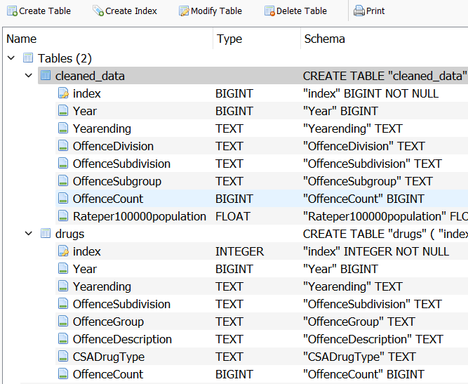
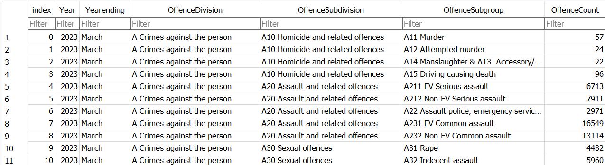
Data Analysis – Database and Flask API (1)
Data preparation: import data, check and confirm data types, check empty rows, convert to csv files (DataCleaningAndConversion.ipynb).
SQLITE Database: crime.sqlite
Two tables:
Table “cleaned_data”: summary of all crimes (1123 records)
Table “drugs”: detailed summary of crimes related to drugs (2073 records)

Slide 5
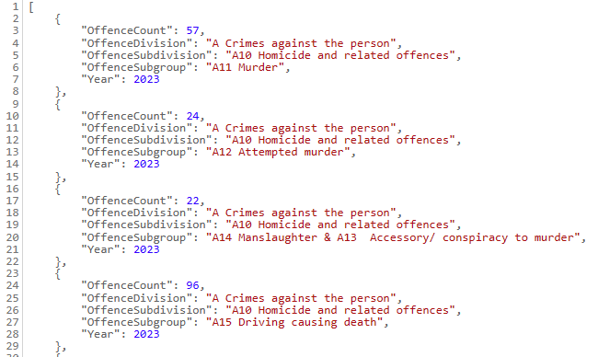
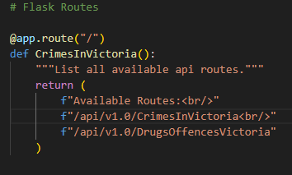
Data Analysis – Database and Flask API (2)
Flask API: “AllCrimes.py”
Two routes defined for tables
http://localhost:5000/api/v1.0/CrimesInVictoria
http://localhost:5000/api/v1.0/DrugsOffencesVictoria

Slide 6
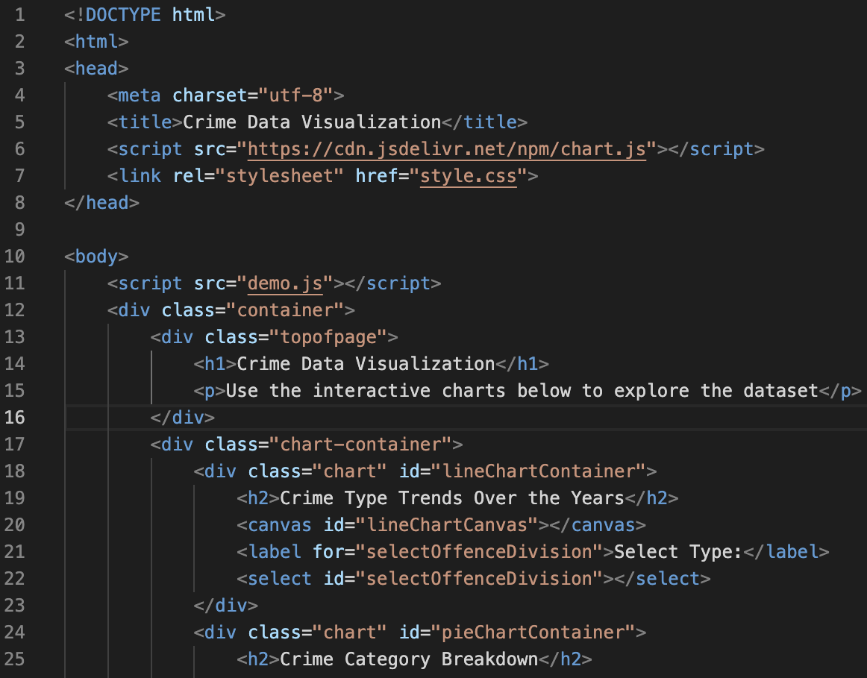
Data Analysis – HTML
Chart.js library
CSS/Java Script file

Slide 7
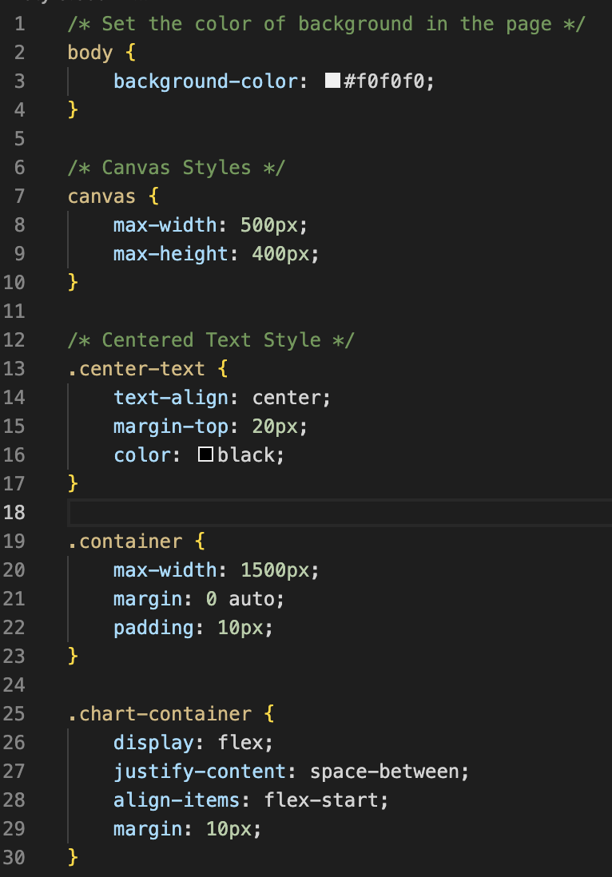
Data Analysis – CSS
Html page
Charts (canvas)

Slide 8
Data Analysis – JavaScript (1)
Set API URLs and Variables, HTML Form Element References
Define two API URLs that point to different data sources, several HTML form elements using variables.
CreateChart Function
Using Chart.js library
Creating and updating charts based on the selected offense division, group, and year(s).
Filter Rand process data based on the selected division/group and updates the chart accordingly.
Fetching Data and Populating Dropdowns
Fetch data from the API URL using the fetch API and populates dropdowns based on the fetched data.
It extracts unique offense divisions, unique years for the pie chart, and using event listeners to update charts based on user selections.
Chart Initialization
Iinitialize the charts with default values, such as "Total (all divisions)" and the first available year, respectively.

Slide 9
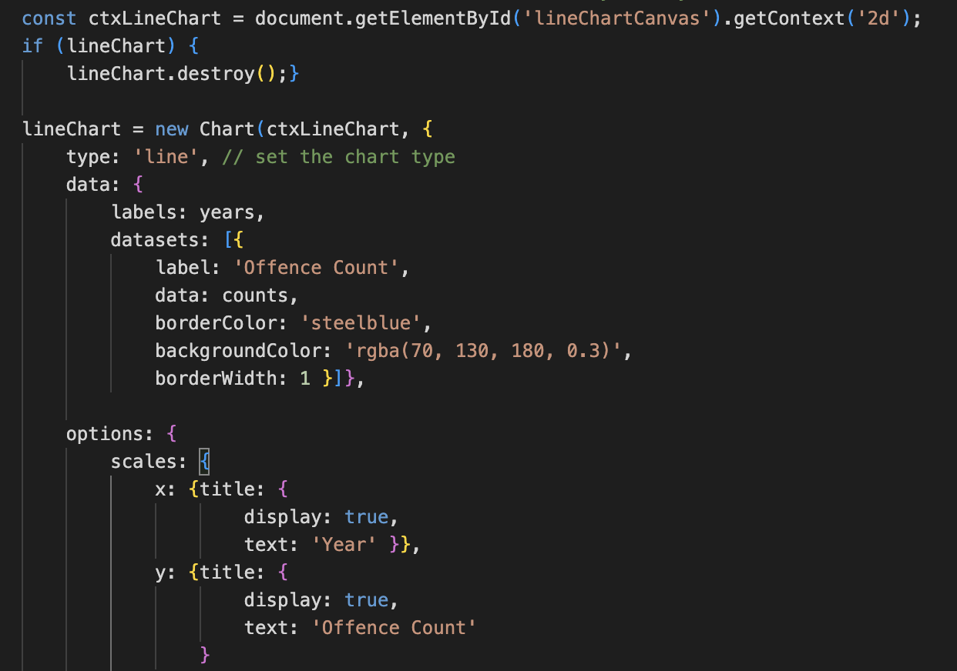
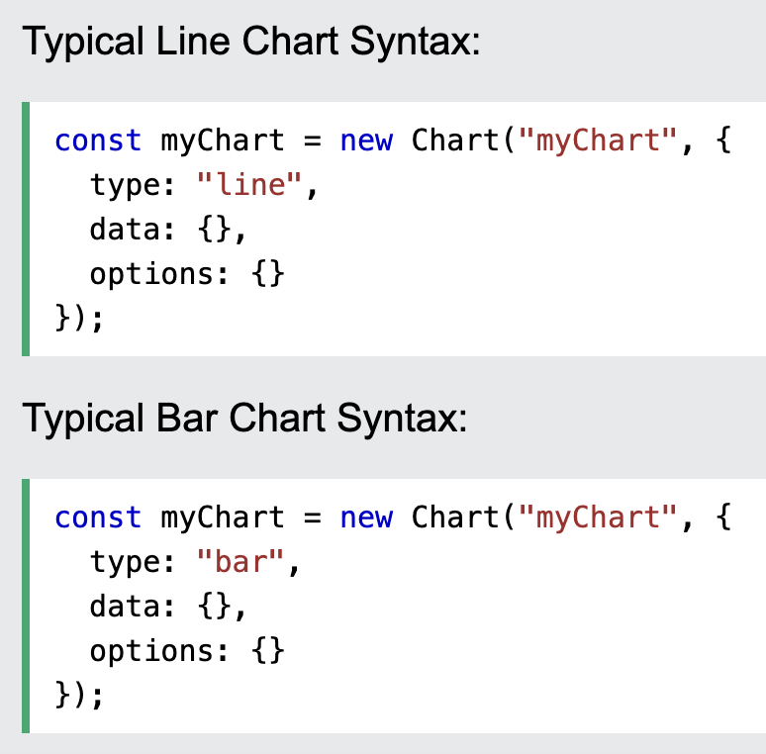
Data Analysis – JavaScript (2)
Chart.js library to create and update various types of charts based on the fetched data.

Slide 10
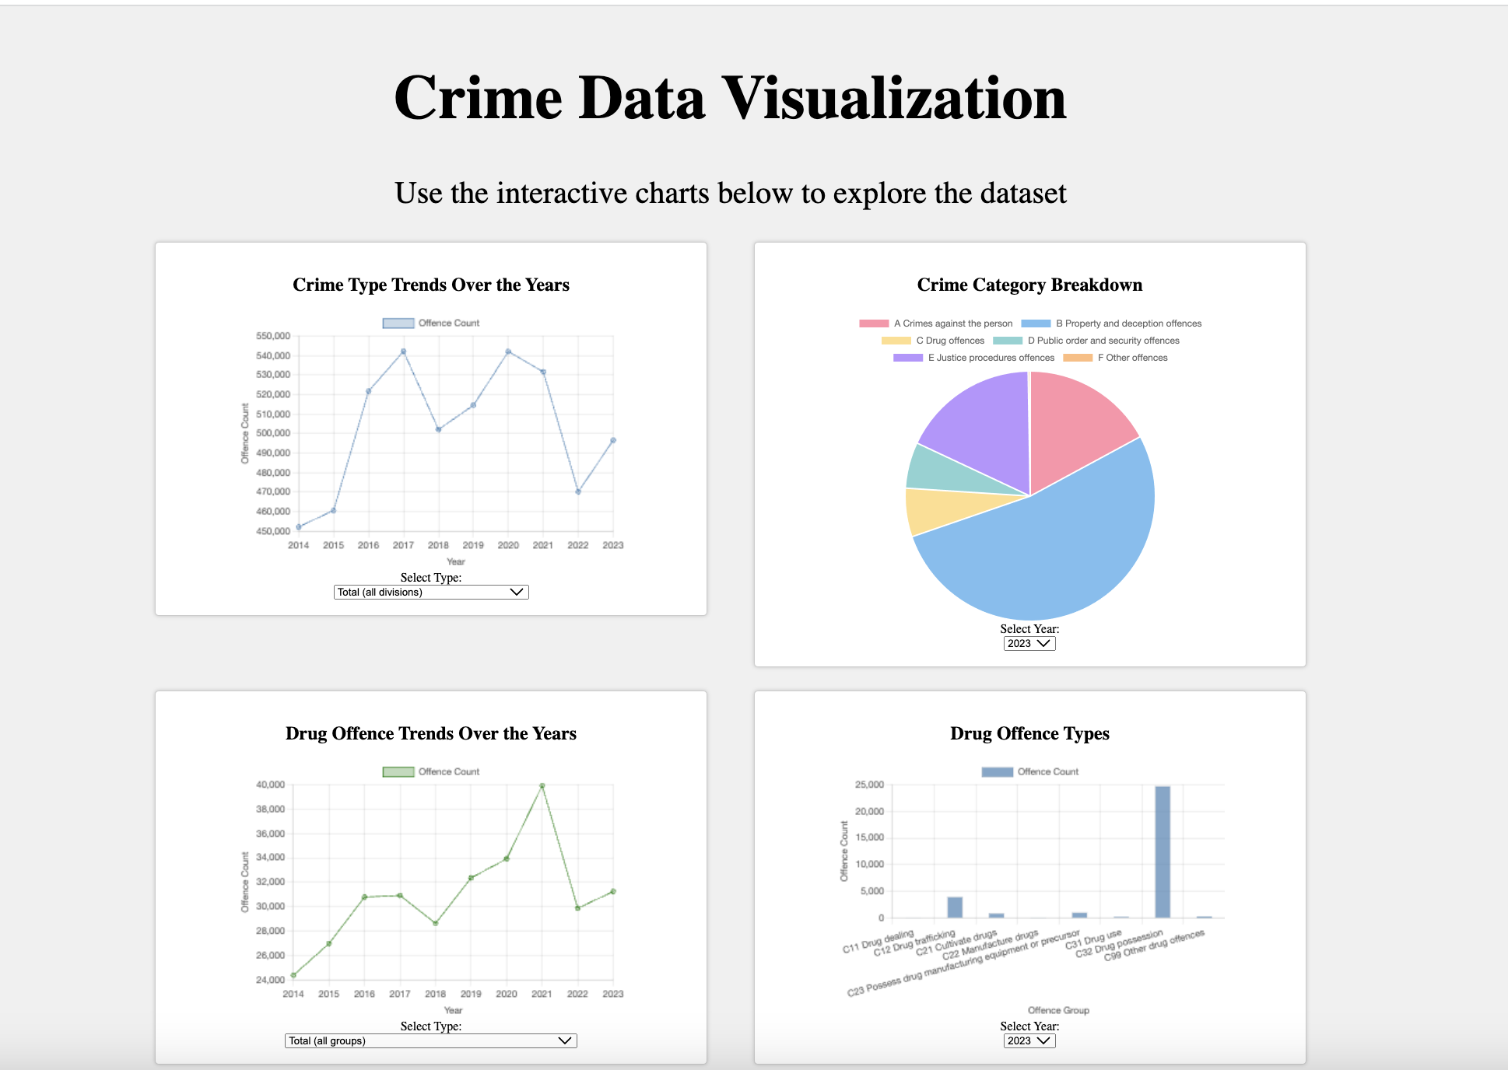
End Product - Dashboard
Pie Chart – Crime Category Breakdown
Dropdown List: Years
Line Chart - Crime Type Trends over the Years
Offence Count vs. Years
Dropdown List: Crime Type (Category)
Bar Chart - Drug Offence Types
Offence Count vs. Offence Group
Dropdown List: Years
Line Chart – Drug Offence Trends Over the Years
Offence Count vs. Years
Dropdown List: Offence Type (Group)

Slide 11
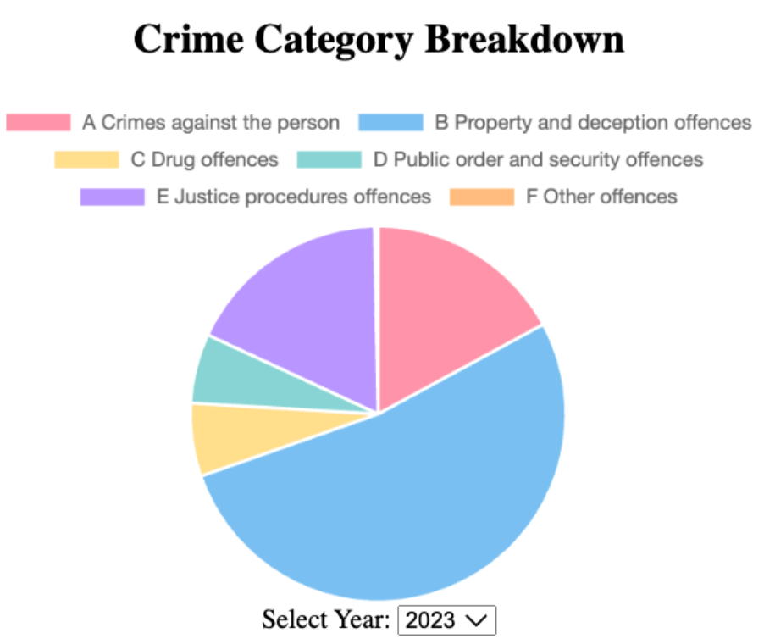
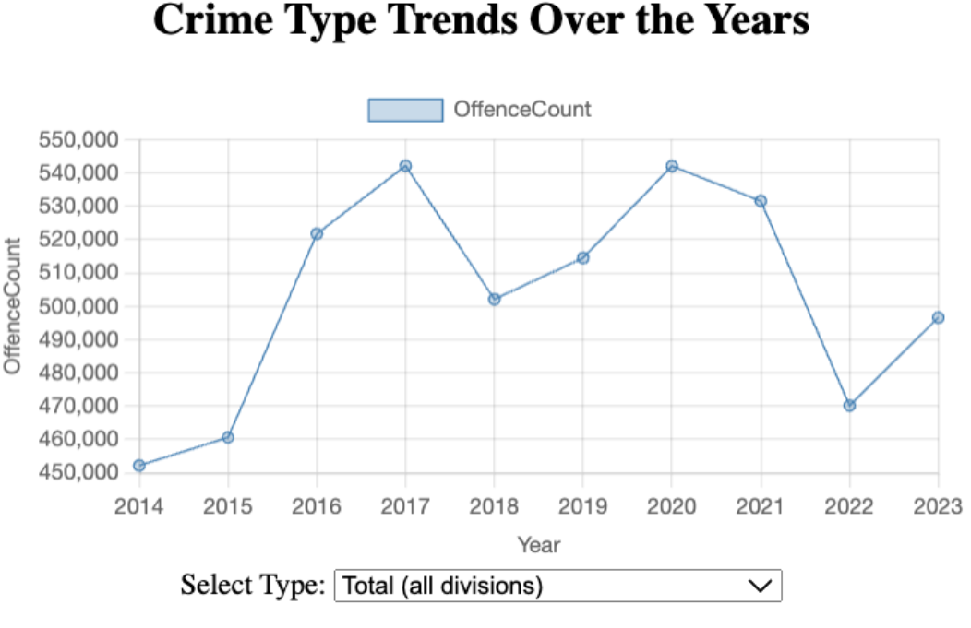
Data Analysis – Crime Types Visualization
Crime type: Property and Deception Offences is the most prominent through out all the years.
"In 2017, crime rates peaked at 540,000, dropped to 500,000 in 2018, spiked in 2020 to almost 540,000, sharply fell in 2022 to 470,000 it is likely due to COVID-19 lockdowns, and are now slowly approaching 500,000 in 2023."

Slide 12
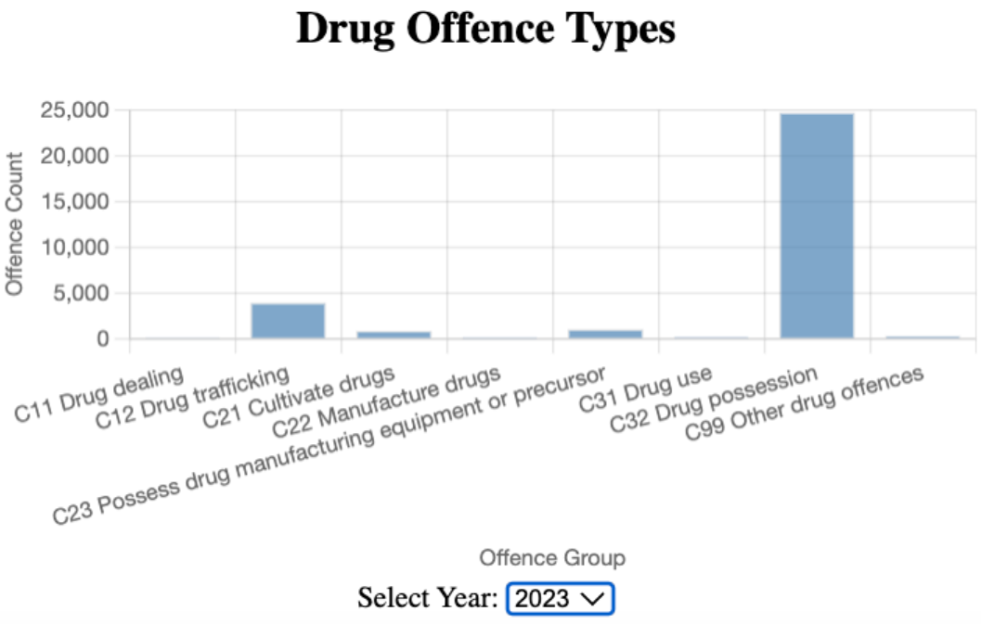
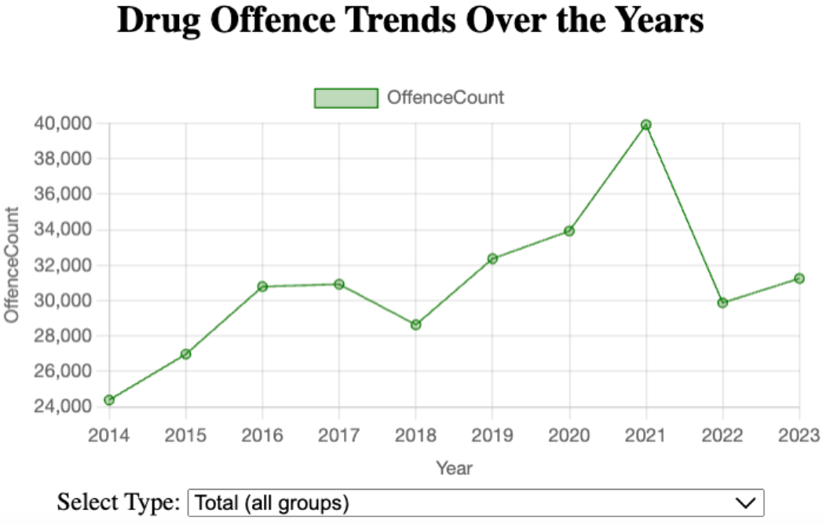
Data Analysis – Drug Crimes Visualization
Drug trafficking and Drug possession stands out the most being the most prominent. This means that most of the drug possessions are imported from other countries.
Drug offences over the years have been steadily increasing, but on 2021 there was a spike in records. This increase can be linked to factors such as post-COVID international travel reopening and enhanced baggage checks.

Slide 13
Analysis/Conclusion
Property and deception offences are consistently the most common crimes.
Crime rates fluctuated over the years, influenced by external factors.
Drug possession is a significant concern.
A notable spike in drug offences in 2021 was linked to international travel resuming.

Slide 14
Thank you.

