Slide 1

Metrics Assessment Plugin Platform for Software Unit
Yoshiki Higo
Akira Saitoh
Goro Yamada
Yuko Mutoh

Slide 2
What is MASU?
A tool that support metrics measurement from source code
User don’t have to implement a tool for analyzing source code
User can measure any code metrics from the source code if (s)he implements plugins of the metrics
MASU can be used as source code analysis library with your own tool

Slide 3
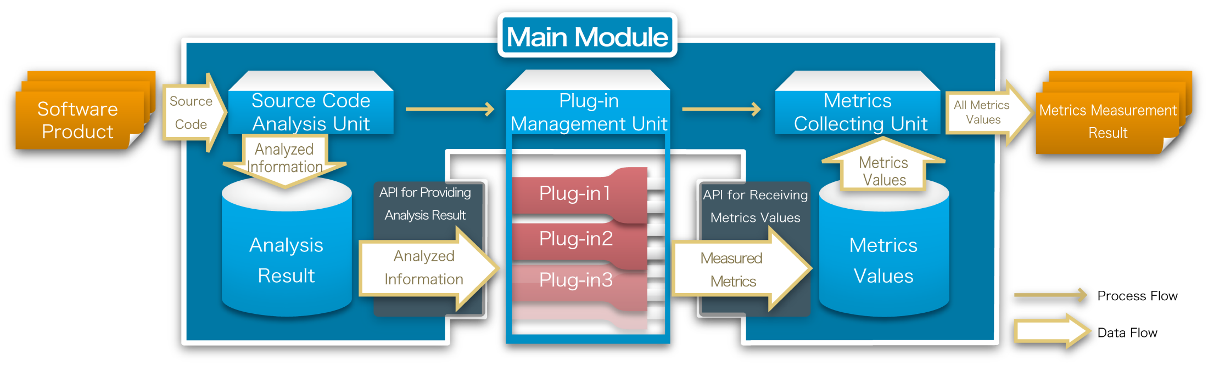
MASU Architecture

Slide 4
How to Implement Plugins

Slide 5
Modules related to Plugins
Main module
AbstractPlugin
・・・・・・・
APIs for cooperating with main module
AbstractClassMetricPlugin
AbstractMethodMetricPlugin
・・・・・・・
・・・・・・・
abstract “measureClassMetric”
abstract “measureMethodMetric”
Plugin
CBOPlugin
CyclomaticPlugin
・・・・・・・
・・・・・・・
・・・・・
Method “measureClassMetric”
（implementation of the logic）
Method “measureMethodMetric”
（implementation of the logic）
Register
(put on the specified directory)
AOASIA3
Directory “plugins”
CBOPlugin.jar
CyclomaticPlugin.jar
・・・・・

Slide 6
Steps for Plugin Implementation
Implement the measurement logic
Plugin class has to be a derived class of “AbstractXXXMetricPlugin”
XXX:Class,Method,Field,or File
Some methods have to be overrided in the class
You can easily know the methods if you work on Eclipse
Compile the plugin
Archive the plugin as a Jar file
Put the Jar file on the specified directory “plugins”
Step 2.3.4. are very easy if you reuse “build.xml” of existing plugins, which can be downloaded from SourceForge
Depending on which unit is the measurement target

Slide 7
An Example: RFC Metric
What is RFC metric …
A member of CK metrics suite
Represent the responsibility of the specified class
The metric value is the sum of the number of local methods and the number of remote methods
Local method: method defined in the specified class
Remote method: method invoked in local method

Slide 8
Source code of RFC Plugin
This is open to the public in SourceForge
RFC Plugin(117 LOC）
Extends “AbstractClassMetricsPlugin”
/**
* RFCを計測するプラグインクラス.
*
* @author rniitani
*/
public class RfcPlugin extends AbstractClassMetricPlugin {
/**
* 詳細説明文字列定数
*/
private final static String DETAIL_DESCRIPTION;
/**
* メトリクスの計測.
*
* @param targetClass 対象のクラス
*/
@Override
protected Number measureClassMetric(TargetClassInfo targetClass) {
// この数が RFC
final Set<MethodInfo> rfcMethods = new HashSet<MethodInfo>();
// 現在のクラスで定義されているメソッド
final Set<TargetMethodInfo> localMethods = targetClass.getDefinedMethods();
rfcMethods.addAll(localMethods);
// localMethods で呼ばれているメソッド
for (final TargetMethodInfo m : localMethods) {
rfcMethods.addAll(m.getCallees());
}
return new Integer(rfcMethods.size());
}
/**
* このプラグインの簡易説明を1行で返す
* @return 簡易説明文字列
*/
@Override
protected String getDescription() {
return "Measuring the RFC metric.";
}
/**
* このプラグインの詳細説明を返す
* @return 詳細説明文字列
*/
@Override
protected String getDetailDescription() {
return DETAIL_DESCRIPTION;
}
/**
* メトリクス名を返す．
*
* @return メトリクス名
*/
@Override
protected String getMetricName() {
return "RFC";
}
/**
* このプラグインがメソッドに関する情報を利用するかどうかを返すメソッド．
* trueを返す．
*
* @return true．
*/
@Override
protected boolean useMethodInfo() {
return true;
}
/**
* このプラグインがメソッド内部に関する情報を利用するかどうかを返すメソッド.
* trueを返す．
*
* @return true．
*/
@Override
protected boolean useMethodLocalInfo() {
return true;
}
static {
// DETAIL_DESCRIPTION 生成
{
StringWriter buffer = new StringWriter();
PrintWriter writer = new PrintWriter(buffer);
writer.println("This plugin measures the RFC (Response for a Class) metric.");
writer.println();
writer.println("RFC = number of local methods in a class");
writer.println(" + number of remote methods called by local methods");
writer.println();
writer.println("A given remote method is counted by once.");
writer.println();
writer.flush();
DETAIL_DESCRIPTION = buffer.toString();
}
}
}
public class RFCPlugin extends AbstractClassMetricPlugin {
Implements measurement logic(13 LOC)
@Override
protected Number measureClassMetric (TargetClassInfo t) {
・・・
}
Override other methods
@Override protected String getDescription() {・・・}
@Override protected String getDetailDescription() {・・・}
@Override protected String getMetricName() {・・・}
@Override protected boolean useMethodInfo() {・・・}
@Override protected boolean useMethodLocalInfo() {・・・}

Slide 9
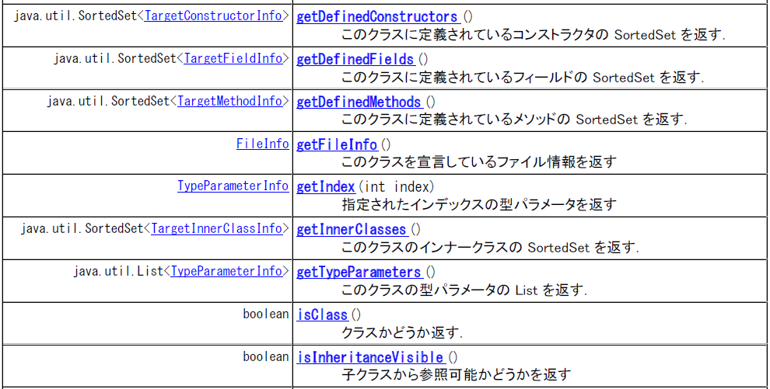
Class API examples jp.ac.osaka_u.ist.sel.metricstool.main.data.target.TargetClassInfo
I’m very sorry that comments are written in Japanese

Slide 10
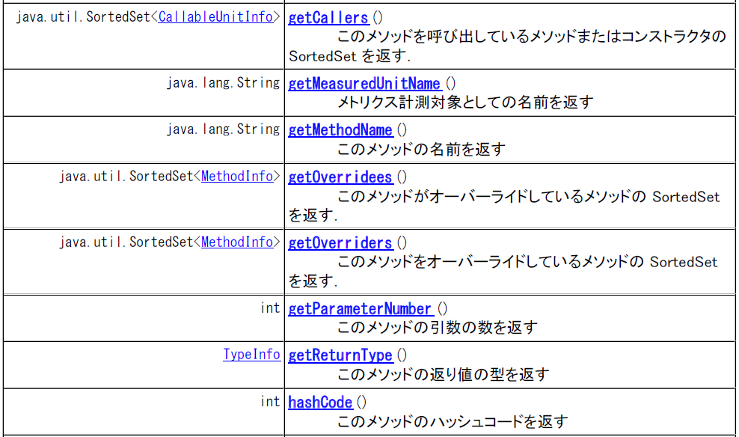
Method API examples jp.ac.osaka_u.ist.sel.metricstool.main.data.target.MethodInfo
I’m very sorry that comments are written in Japanese

Slide 11
How to execute MASU

Slide 12
Checklist for execution (1)
Check that the following files are located at the same directory where “masu.jar” exists
antlr.jar
asm-all-3.2.jar
commons-cli-1.1.jar
(If you execute MASU on Eclipse, all you have to do is adding the above files to the build path)

Slide 13
Checklist for execution (2)
Check that there is a “plugins” directory at the same directory where “masu.jar” exists
In “plugins” directory, every plugin has its own directory
In their own directories, you have to put the following files on
JAR file (plugin’s binary)
XML file (configuration file)
(you may be helped by the existing plugins that are open to the public in SourceForge)

Slide 14
Checklist for execution (3)
Check that there is “resource” directory at the same directory where “masu.jar” exists, and the following files are located at the “resource” directory
jdk142.jar
jdk142java.lang.jar
jdk150.jar
jdk150java.lang.jar
jdk160.jar
jdk160java.lang.jar

Slide 15
Exuecute MASU
Example: measure RFC metric from Java source code located in “sample” directory, and the measurement result is output to “result.csv” file
java –jar masu.jar –d sample –l java –m rfc –C result.cvs
The following pages explain every command line argument

Slide 16
Command Line Argument (1)
-h: Execution on help mode. All the other arguments are ignored, and MASU outputs the list of command line arguments with brief description
-v: Verbose output. Output detailed information on processing. Analysis speed may become a little slower than non-verbose mode.
-l: Specify programming language. Currently, you can choose from “java13”, “java14”, “java15”, and “csharp”.
“java” is also available, it is an alias of “java15”.

Slide 17
Command Line Argument (2)
-i: specify the list file, which contains a list of target source files.
Every line contains only a single source file
-d: specify the target directory, where the target source files exist
You can use both of “-i” and “-d” at the same time

Slide 18
Command Line Argument (3)
-m: specify measured metrics. If you specify multiple metrics, please them with comma “,”. Note that white space around the comma is not permitted.
In the case of RFC and LCOM measurement, please write “-m rfc,lcom”

Slide 19
Command Lint Argument (4)
-F: specify output file for file metrics. If you specify 1 or more file metrics by using “-m”, you have to use this option.
-C: specify output file for class metrics
-M: specify output file for method metrics
-A: specify output file for field (attribute) metrics

Slide 20
Command Line Argument (5)
-b: specify libraries (binaries) for improving analysis result. For example, if your target is java15 source files, please specify “-b resource/java150.jar”. With the specification, MASU completely performs name resolving of JDK libraries.
-t: specify the number of threads for analysis. Ideally, we would like to specify the number of logical CPUs that the OS recognizes. If this option is not used, the number of used thread is “1”

Slide 21
Use MASU as a source code analyzer

Slide 22
Required steps
Define a main class as a drived class of “MetricsTool” class
解析に必要な情報をSettingsクラスに与える
対象言語，対象ソースファイル，スレッド数など
MetricsToolクラスに定義されているanalyzeTargetFilesメソッドを呼び出し，対象ソースファイルを解析
解析結果を利用
DataManagerから，ClassInfoManager, MethodInfoManager, FieldInfoManager, FileInfoManagerを取得
各マネージャからさまざまな情報を取ってくることができる

Slide 23
For obtaining more enhanced analysis result
If your target is Java source code, you can obtain more enhanced analysis result by giving libraries (bytecode) that the target uses.
Specifis libraries by <Setting.getInstance().addLibrary(“path\to\library”);>
Don’t forget to invoke method “analyzeLibraries” after the specification
You can find a simple example on the next page

Slide 24
Example: outputs element names
public class Simple01 extends MetricsTool {
public static void main(String[] args) {
// 解析用設定
Settings.getInstance().setLanguage("java");
Settings.getInstance().setTargetDirectory(
"H:\\eclipse\\eclipse-3.5\\workspace\\masu");
Settings.getInstance().setVerbose(true);
Settings.getInstance().addLibrary(“resource\jdk160.jar”);
Settings.getInstance().setThreadNumber(2);
// 対象ファイルの解析
final Simple01 simple = new Simple01();
Simple.analyzeLibraries();
simple.readTargetFiles();
simple.analyzeTargetFiles();
// 対象クラス一覧を取得
final Set<TargetClassInfo> classes = DataManager.getInstance()
.getClassInfoManager().getTargetClassInfos();
for (final TargetClassInfo classInfo : classes) {
System.out.println(classInfo.getFullQualifiedName("."));
}
// 対象メソッド一覧を取得
final Set<TargetMethodInfo> methods = DataManager.getInstance()
.getMethodInfoManager().getTargetMethodInfos();
for (final TargetMethodInfo method : methods) {
System.out.println(method.getMethodName());
}
// 対象フィールド一覧を取得
final Set<TargetFieldInfo> fields = DataManager.getInstance()
.getFieldInfoManager().getTargetFieldInfos();
for (final TargetFieldInfo field : fields) {
System.out.println(field.getName());
}
// 対象ファイル一覧を取得
final Set<FileInfo> files = DataManager.getInstance()
.getFileInfoManager().getFileInfos();
for (final FileInfo file : files) {
System.out.println(file.getName());
}}}
1. Extends “MetricsTool” class
public class Simple01 extends MetricsTool {
2. Specifies required information
Settings.getInstance().setLanguage("java");
Settings.getInstance().setTargetDirectory(
"H:\\eclipse\\eclipse-3.5\\workspace\\masu");
Settings.getInstance().setVerbose(true);
Settings.getInstance().addLibrary(“resource\jdk160.jar”);
Settings.getInstance().setThreadNumber(2);
3. Analyzes target source files
final Simple01 simple = new Simple01();
simple.analyzeLibraries();
simple.readTargetFiles();
simple.analyzeTargetFiles();

Slide 25
Example: outputs element names
public class Simple01 extends MetricsTool {
public static void main(String[] args) {
// 解析用設定
Settings.getInstance().setLanguage("java");
Settings.getInstance().setTargetDirectory(
"H:\\eclipse\\eclipse-3.5\\workspace\\masu");
Settings.getInstance().setVerbose(true);
Settings.getInstance().addLibrary(“resource\jdk160.jar”);
Settings.getInstance().setThreadNumber(2);
// 対象ファイルの解析
final Simple01 simple = new Simple01();
Simple.analyzeLibraries();
simple.readTargetFiles();
simple.analyzeTargetFiles();
// 対象クラス一覧を取得
final Set<TargetClassInfo> classes = DataManager.getInstance()
.getClassInfoManager().getTargetClassInfos();
for (final TargetClassInfo classInfo : classes) {
System.out.println(classInfo.getFullQualifiedName("."));
}
// 対象メソッド一覧を取得
final Set<TargetMethodInfo> methods = DataManager.getInstance()
.getMethodInfoManager().getTargetMethodInfos();
for (final TargetMethodInfo method : methods) {
System.out.println(method.getMethodName());
}
// 対象フィールド一覧を取得
final Set<TargetFieldInfo> fields = DataManager.getInstance()
.getFieldInfoManager().getTargetFieldInfos();
for (final TargetFieldInfo field : fields) {
System.out.println(field.getName());
}
// 対象ファイル一覧を取得
final Set<FileInfo> files = DataManager.getInstance()
.getFileInfoManager().getFileInfos();
for (final FileInfo file : files) {
System.out.println(file.getName());
}}}
4. Outputs full qualified names of target classes
final Set<TargetClassInfo> classes = DataManager.getInstance().getClassInfoManager().getTargetClassInfos();
for (final TargetClassInfo classInfo : classes){
System.out.println(classInfo.getFullQualifiedName("."));
}
5. Obtains target methods
final Set<TargetMethodInfo> methods = DataManager.getInstance().getMethodInfoManager() .getTargetMethodInfos();
6.Obtains target fields (attributes)
final Set<TargetFieldInfo> fields =
DataManager.getInstance().getFieldInfoManager().getTargetFieldInfos();
7. Obtains target source files
final Set<FileInfo> files = DataManager.getInstance().getFileInfoManager().getFileInfos();

Slide 26
How to obtain the progress of MASU (1)
You can obtain the analysis progres of MASU by treating its output handler
Write the code of the next 2 pages in your main method
The code has to be written at the above of the MASU analysis API invocations

Slide 27
How to obtain the progress of MASU (2)
Firstly, output printer is set to the out field of MetricsTool class
XXX should be the name of your tool
final Class<?> metricstool = MetricsTool.class;
final Field out = metricstool.getDeclaredField("out");
out.setAccessible(true);
out.set(null, new DefaultMessagePrinter(new MessageSource() {
public String getMessageSourceName() {
return “XXX";
}
}, MESSAGE_TYPE.OUT));

Slide 28
How to obtain the profess of MASU (3)
Finally, write the code what is done when an event occurs in the out field
Herein, the event was output into the standard output
The error field of MetricsTool can be treated as the same way
MessagePool.getInstance(MESSAGE_TYPE.OUT).addMessageListener(
new MessageListener() {
public void messageReceived(MessageEvent event) {
System.out.print(event.getSource().getMessageSourceName()
+ " > " + event.getMessage());
}
}
);

Slide 29
Miscellaneous

Slide 30
MASU is open to the public in SoureForge
URL on SourceForge
http://sourceforge.net/projects/masu/
You can download the package and browse historical information
Checkout the source code with subversion
svn co https://masu.svn.sourceforge.net/svnroot/masu/svnroot/main masu
License: EPL （Eclipse Public License）

Slide 31
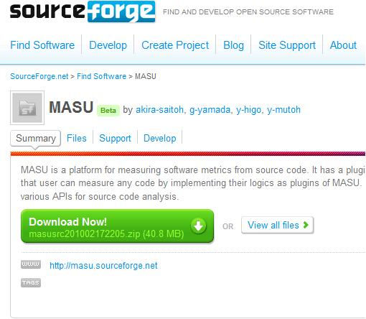
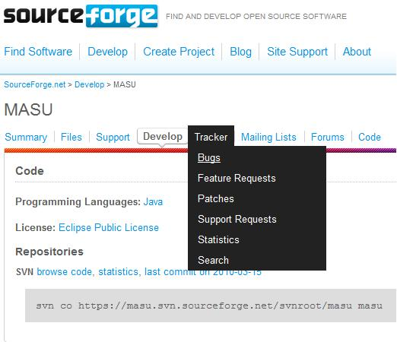
Bug report
SourceForgeでのバグ登録がめんどくさい人は，
Ｍasu-developers@fenrir.ics.es.osaka-u.ac.jp
にバグの内容を書いたメールを送ってください
If you find strange behavior, we’d like you to report it
We’ll also welcome requires for new features
Click “Develop”
Click “Bugs”

Slide 32
A special note of thanks to
Tatsuya Miyake
Koji Taniguchi
Ryusuke Niitani
Norihiro Yoshida
Choy Kho Yee
Yii Yong Lee
Yui Watanabe

