Slide 1
Subject experiment
vessel trade simulation

Slide 2
Necessity
terminal or command prompt
python3
modules
matplotlib
seaborn
numpy
tablate
colorama

Slide 3
Your Objective
Through your decisions regarding ship trade, maximize your cash.

Slide 4
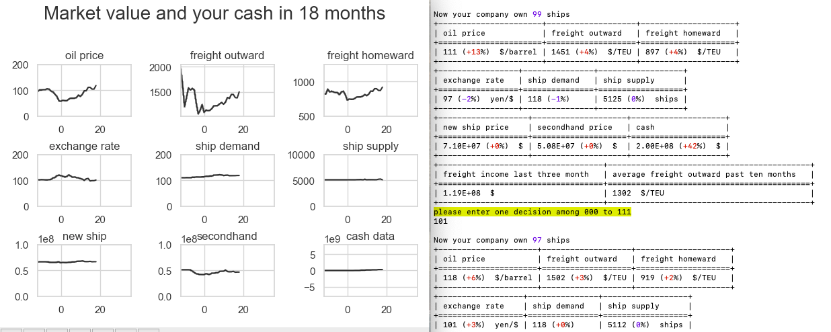
UI of the simulator
compare with data three month ago
Transition
data
current month
current market value
Your objective is to maximize this variable
decision area

Slide 5
Experimental procedure
enter python game.py
repeat step3 to step5 until the end of the simulation
3. repeat step4 every three month
4. enter one decision among 000,001,010,011,100,101,110,111.
000 means that order 0 new ship and buy 0 secondhand ship and sell 0 ship
111 means that order 1 new ship and buy 1 secondhand ship and sell 1 ship
xyz means that order x new ship and buy y secondhand ship and sell z ship
5 Enter yes if you are ready to start next simulation
enter is needed to be conducted in terminal or command prompt

Slide 6
How does each variable affect your cash?
oil price: oil is needed for shipping, so if oil price increases and other variables stay, it has bad effects on your cash.
freight: sale is equal to product of freight and the number of shipping
Exchange rate: every year, you change your cash in dollar to yen.
ship demand and supply: the balance of this two variables affect the freight. Oversupply causes freight decrease, overdemand causes freight increase.
new ship and secondhand ship: price you need to buy one ship

Slide 7
Settings
You have 100 ships.
All ship are same size, 6000TEU.
You can use new ship for 15 years, secondhand for 10 years.
You will make decision every three months until 180 months
Decision is related to new ship, secondhand ship, and sale of your ship.
if you order new ship, you can use it after two years
if you buy secondhand ship, you can use it soon
if you sell a ship, an oldest ship will be sold.

