Slide 1
AIR QUALITY DATA PREDICTION PHASE-3
YOSHITA NARNE
Master of professional studies in Data Science
Spring 2021
Instructor: Dr. Murat Gurner

Slide 2
OBJECTIVE
The main objective is to create a model based on the given data and is to predict the PM 2.5 levels in the air to determine the quality of the air using ARIMA MODEL.

Slide 3
DATASET
Air quality dataset contains the air quality data of the 35 air quality monitoring stations in Beijing from 2017 to 2018.
Each data item of the dataset contains the id, timestamp, pm2.5 concentration, pm10 concentration, NO2 concentration, CO, O3, SO2 concentration respectively measured at the air quality monitoring stations.
The Data is in CSV format
The characteristics of the data is multivariate and time-series.
The dataset contains 420768 instances, 18 attributes and all there are missing values filled with nan.
Source : https://archive.ics.uci.edu/ml/datasets/beijing+multi-site+air-quality+data

Slide 4
METHODOLOGY
ARIMA model which stands for "auto-regressive integrated moving averages".
Autoregressive integrated moving model is the generalised moving average model for time series predictions. A non season arima has three components p, d, q.
p - specifies the order of time lag.
d - specifies the degree of differencing
q - specifies order of moving average.
Arima is implemented python stats library which will be used for training and predictions. This project uses a non seasonal variant of ARIMA.
Based on the p-value and the threshold value, we can reject null-hypothesis which states that the data is not stationary.
In case if the data is stationary only AR and MA will be considered.
Then AIC will be calculated and then I will find values of p and q having lowest AIC where the p represents the number of auto-regressive (AR) terms and q represents the number of moving averages (MA) terms.
After that, the results will be predicted.

Slide 5
Important characteristics to consider in Time series analysis
Is there a trend or Pattern ? Which means that is there a constant increase or decrease.
Is there Seasonality ? Which means that there is a pattern of highs and lows related to seasons, quarterly, monthly etc.
Is the Variance constant or continuously varying.
Is there any periodic cycles in the data.

Slide 6

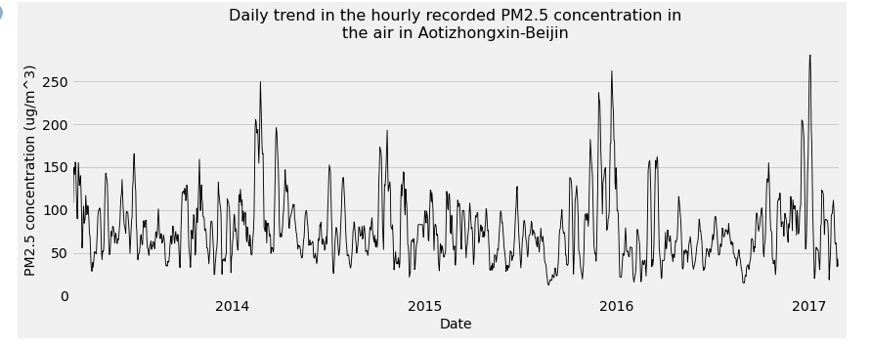
Time series plots and observations
From the above time series plot we can observe that there is no constant increase or decrease over the period. The series appears lo slowly wander upwards and downwards.

Slide 7
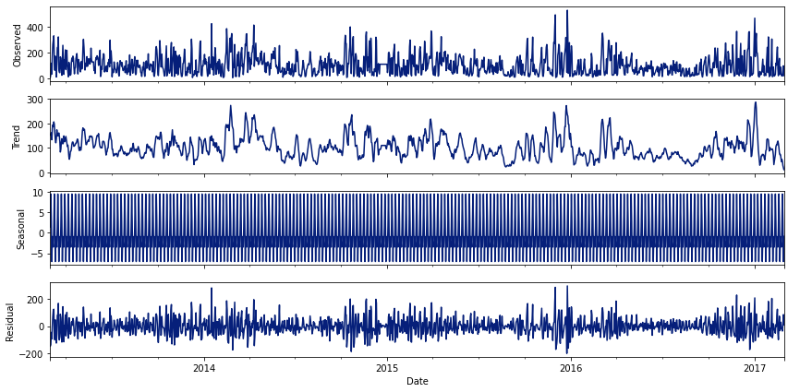
From the above plots we can say that there is no seasonality followed by the data

Slide 8
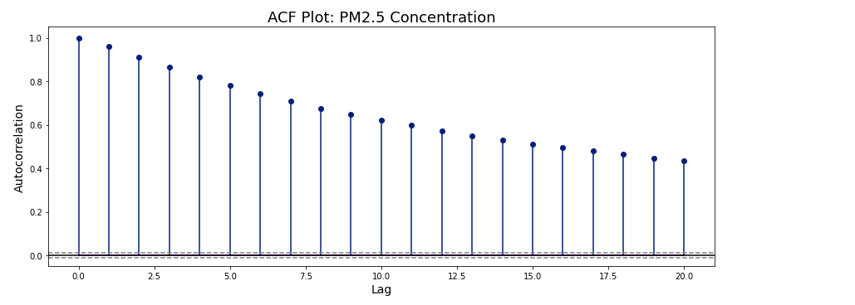
Pattern of PACF
The ACF properties defines a distinct pattern of autocorrelations for a positive slope, the ACF exponentially decreases to 0 as the lag increases, for the negative slope the ACF exponentially decreases as the lag increases.
The ACF of residuals doesn’t show any significant auto-correlations – a good result.

Slide 9
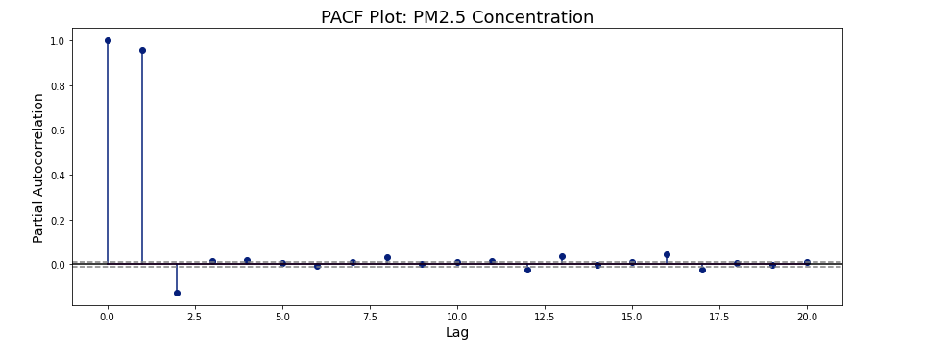
Pattern of PACF
The PACF shows a single spike at the first lag and the ACF shows a constant tapering(decreasing) Pattern so the AR(1) model is identified.
We can fit the ARIMA model with these observations.

Slide 10
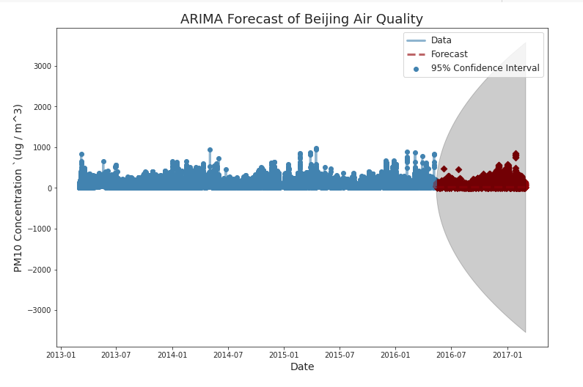
Predicting the pm2.5 values yearly
We can observe that the trend plot indicates the same pattern as the actual values.

Slide 11
Limitations and Future work
The model is overfitted as the Training RMSE values is small compared to the Test RMSE.
Overfitting happens when a model learns the detail and noise in the training data to the extent that it negatively impacts the performance of the model on the new data.
There are some additional steps that can be followed to improve the results are by trying the BOX COX TRANSFORMATION on the original data and use that as the input for the model, also apply grid search on the transformed dataset to find the optimal parameters.

Slide 12
References :
https://online.stat.psu.edu/stat510/lesson/3/3.1
https://sites.google.com/site/econometricsacademy/econometrics-models/time-series-arima-models
https://towardsdatascience.com/time-series-analysis-modeling-validation-386378cd3369
Thank You
For quires and feedback
Email: tr11891@umbc.edu

