Slide 1
Screenshots

Slide 2
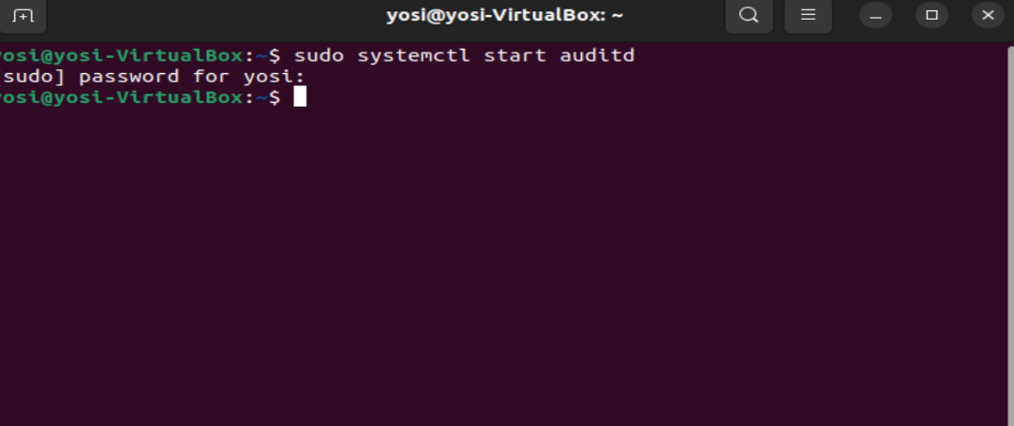
Start Auditd

Slide 3

Adding rules according to the list in audit_rules.txt

Slide 4
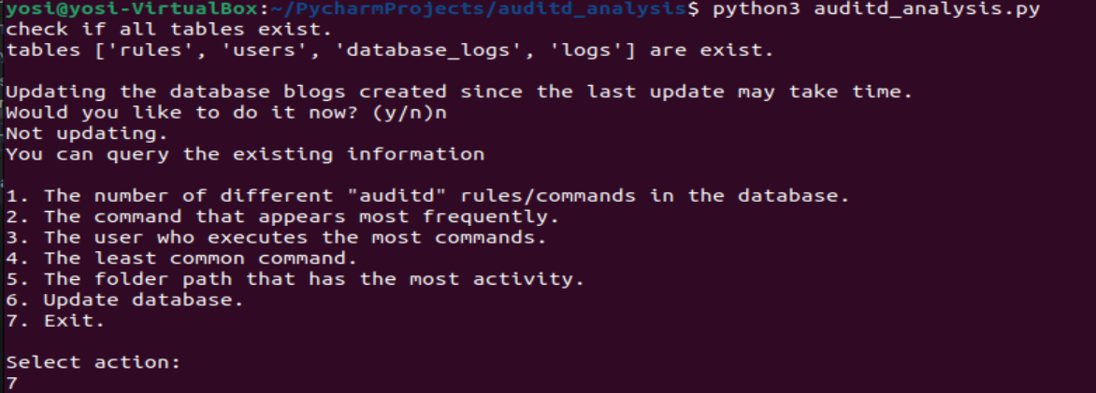
Operation without updating the logs

Slide 5
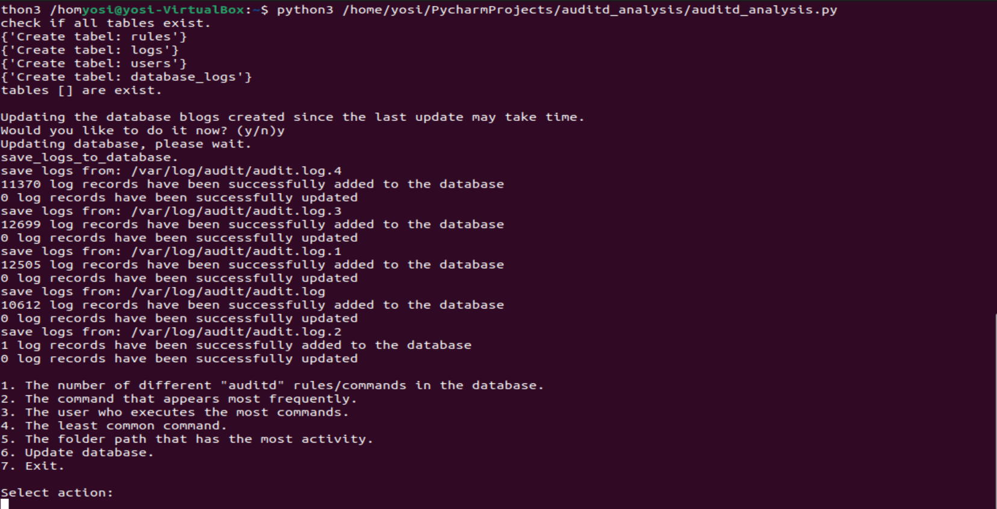
Activation with the log update

Slide 6

Action 1

Slide 7

Action 2

Slide 8

Action 3

Slide 9

Action 4

Slide 10

Action 5

Slide 11
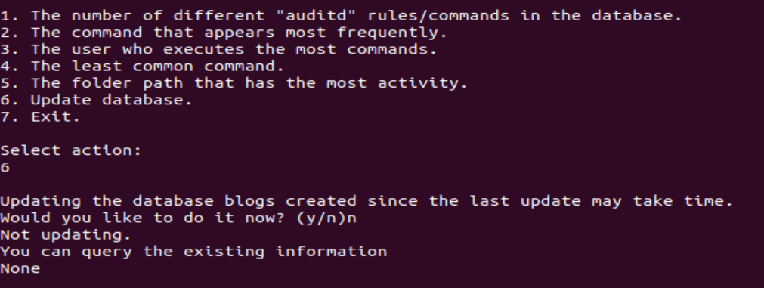
Action 6.a

Slide 12
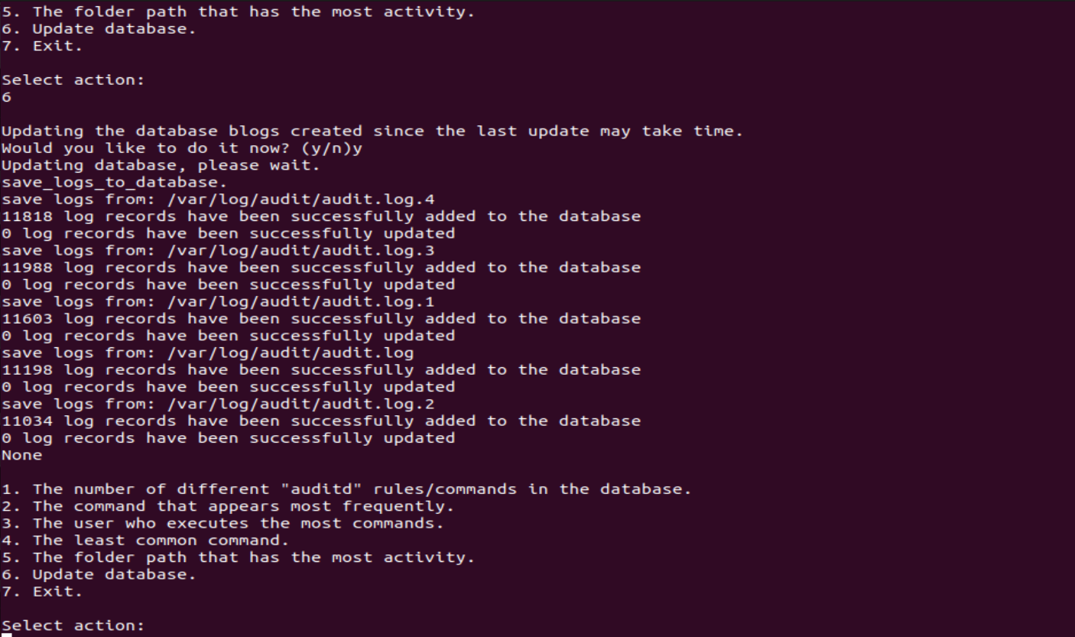
Action 6.b

Slide 13

Action 7

