Slide 1
Bitcoins
Open Source P2P Money

Slide 2
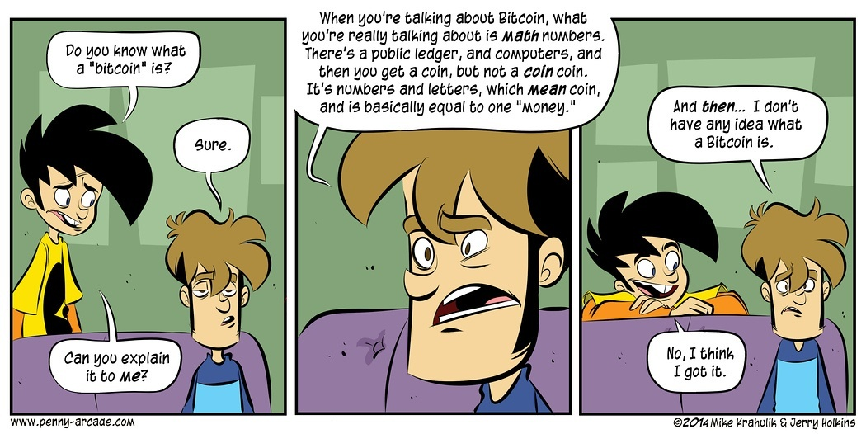

Slide 3


Slide 4
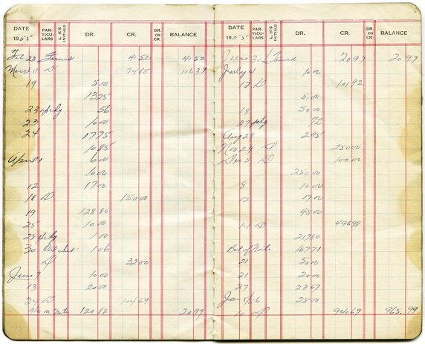

Slide 5

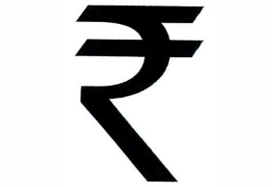




Bitcoin is another currency

Slide 6
It’s money with an API!

Slide 7
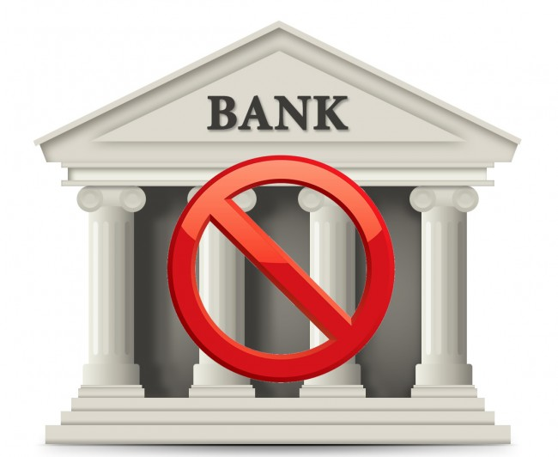

Get Rid of Transaction Cost

Slide 8
Take currency power away from banks and government.

Slide 9
Bitcoin has no notion of identity.

Slide 10
What’s preventing other person from transferring money from my wallet to their own?

Slide 11
Process?

Slide 12
Block has must be below the target difficulty
Version
Previous Block Hash
Merkle Root
Time Stamp
Bits
Nonce
Create header.
Make nonce random.
Calculate block hash.
Is it below the target?
We are done.
If not, go to 2.

Slide 13
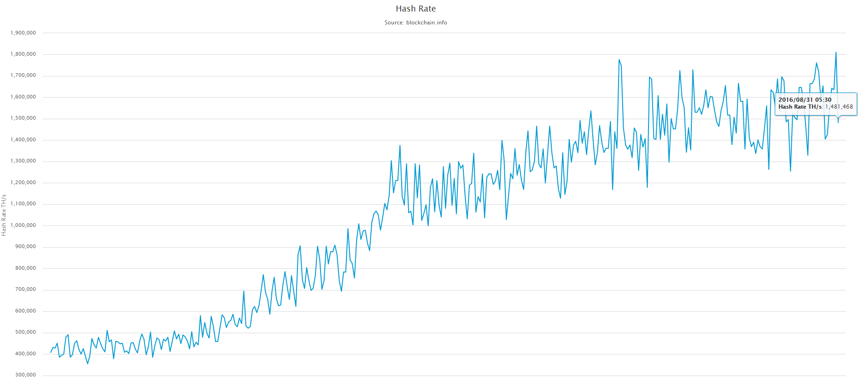
Network’s Hash Rate on 31st Aug, 2016 : 1,481,468 TH/s

Slide 14
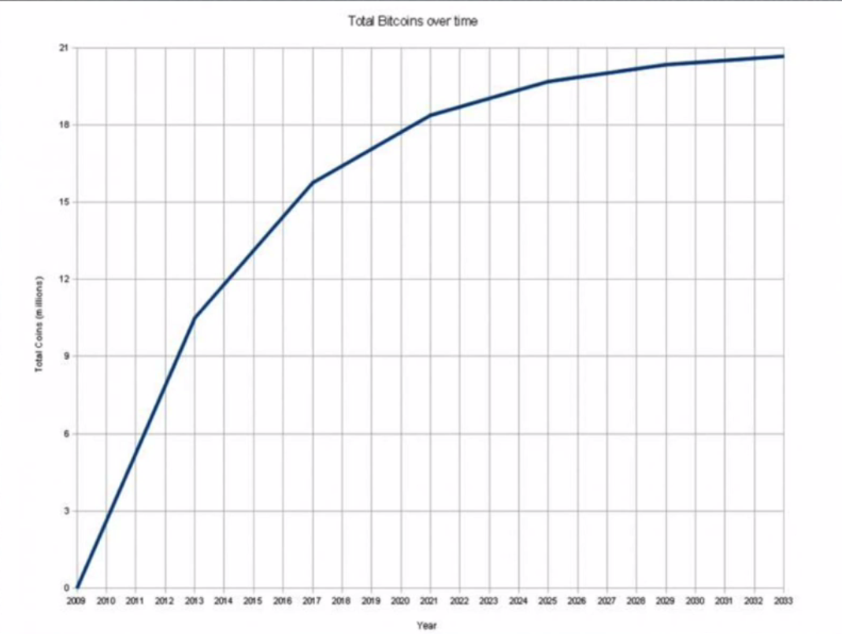

Slide 15
A normal computer with 4 cores can do 2GH/s.
GPU can hash 50x - 100x faster than a CPU.

Slide 16
Some Wikipedia Stuff
Invented by Satoshi Nakamoto.
0.000000001 = Satoshi.
First Cryptocurrency.

Slide 17


Slide 18
Why not everyone is using it?
The cryptocurrency did not have much momentum in retail transactions.
Digital theft or hacking of bitcoins.
Private key is lost, your coins are lost, they are unusable.
Malwares.
Ransomware.

Slide 19
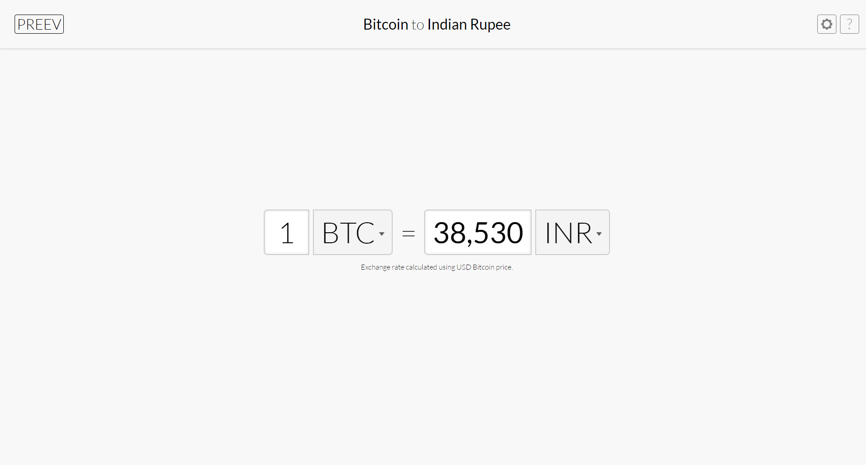
preev.com/btc/inr

Slide 20
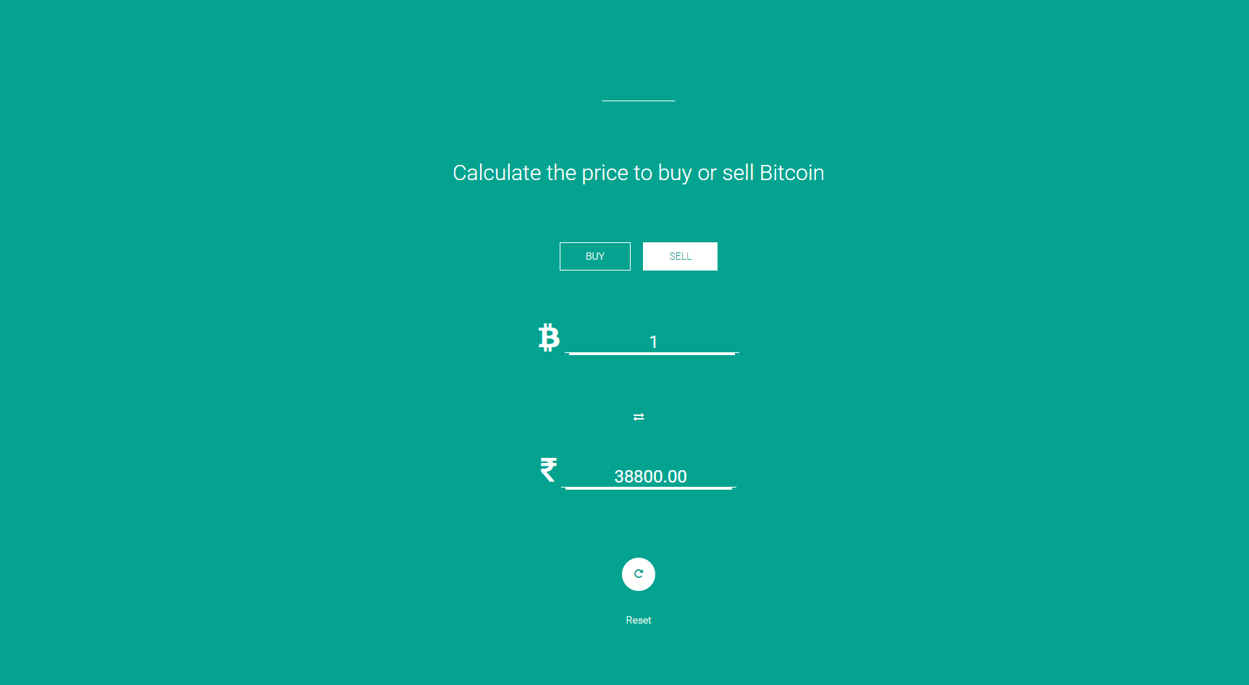
coinsecure.in

Slide 21
Questions?

Slide 22
Thank you.

