Slide 1
facial emotion recognition on an election video with CNN: Python & Keras

Slide 2
PLAN
Database construction
Database analysis
Deep Learning Tools

Slide 3
Database construction
1/How can we cut the video Debates for the 2019 presidential election which lasts 2 hours and how can we extract a portion of a video?
2/How can we extract all the images from a video?

Slide 4
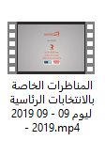
1/How to extract a portion of a video?
➔ with VLC

Slide 5

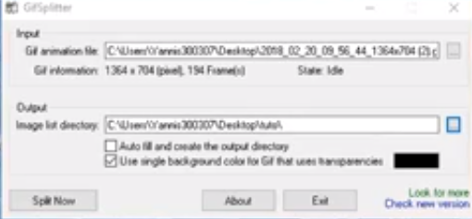
2/How can we extract all the images from a video?
➔ With GifSplitter

Slide 6

How to transform images in jpg ?

Slide 7
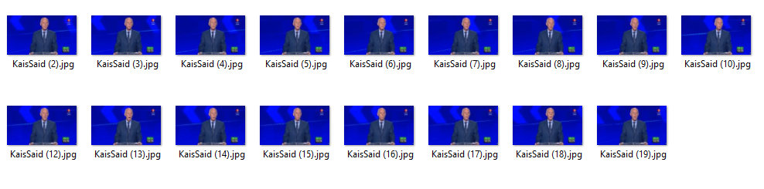
we obtain several images and we select the images according to the name of each participant

Slide 8
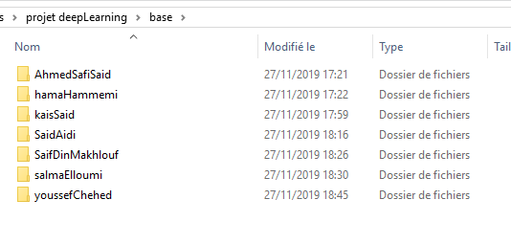

Slide 9
Database analysis

Slide 10
We implemented deep learning in our project to accurately predict imminent outcomes simply by using extracted data.
Prediction of future results for our project is achieved by applying deep learning which uses complex algorithms and predictive modeling.

Slide 11
We analyse our Database , we find :
126 picture are predicted True
30 picture are predicted wrong
Our DataBase contains 156 pictures
Accuracy=(126/156)*100 = 80,76%

Slide 12
Deep Learning Tools
What is Deep Learning ?
Our application Architecture
Deep Learning Tools Used

Slide 13
Deep learning
Deep learning is a category of machine learning based on definitive algorithms, which are influenced by the general structure and role of the neural network in the human brain.

Slide 14
Neural networks use self-learning to learn to decipher and understand the human domain.
Thanks to algorithmic processing, these networks can decode data, such as human speech, into digital images.

Slide 15
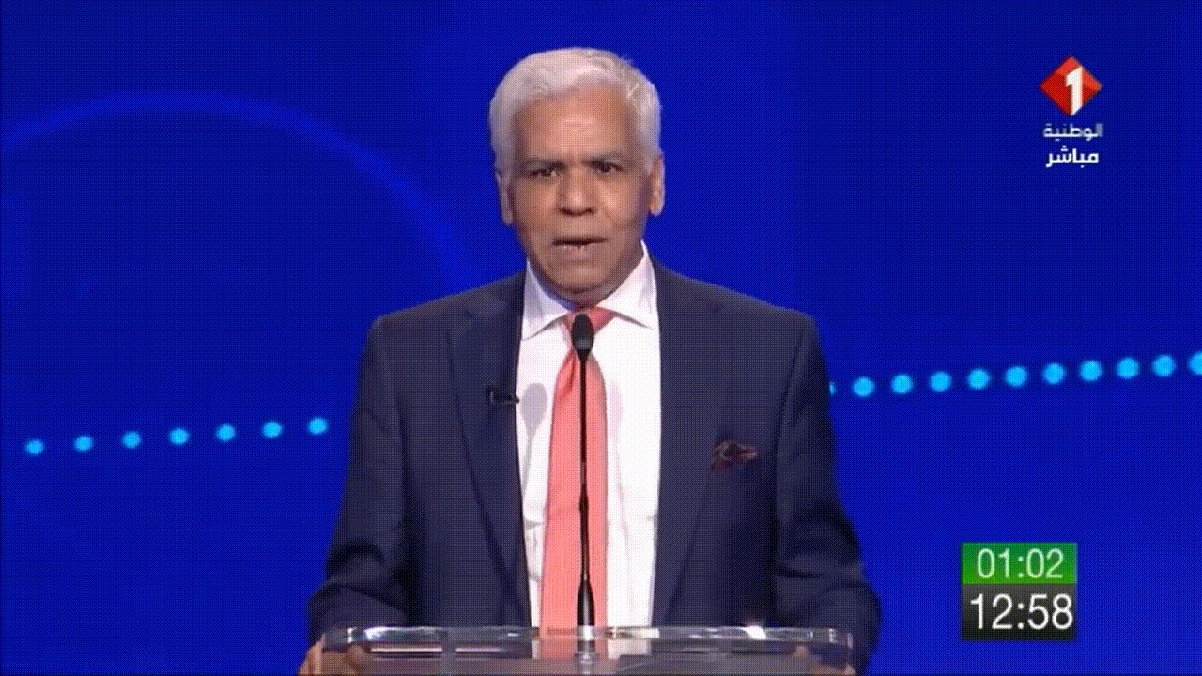

Slide 16
Architecture Détaillée du Système Emotion@Electorale
Phase d’Apprentissage
2
1
44
1
1
46
64*64
64*64
64*64*64*64
Image de visage
48
64
softmax
CL
+
RL
CL
+
RL
PL
Max
Pooling
PL
Max
Pooling
Flatten
46
44
11
2
48
11
7
1024
Output classes
CL : convolutional Layer
RL : Relu Layer
PL : Pooling Layer
Fc : Fully connected Layer
1024
Fc2
Fc1

Slide 17
Convolutional Neural Networks have several types of layers:
Convolutional layer━a “filter” passes over the image, scanning a few pixels at a time and creating a feature map that predicts the class to which each feature belongs.
Pooling layer (downsampling)━reduces the amount of information in each feature obtained in the convolutional layer while maintaining the most important information (there are usually several rounds of convolution and pooling).
Fully connected input layer (flatten)━takes the output of the previous layers, “flattens” them and turns them into a single vector that can be an input for the next stage.
The first fully connected layer━takes the inputs from the feature analysis and applies weights to predict the correct label.
Fully connected output layer━gives the final probabilities for each label.

Slide 18
While deep neural networks are all the rage, the complexity of the major frameworks has been a barrier to their use for developers new to machine learning. There have been several proposals for improved and simplified high-level APIs for building neural network models, all of which tend to look similar from a distance but show differences on closer examination.

Slide 19
Keras is one of the leading high-level neural networks APIs. It is written in Python and supports multiple back-end neural network computation engines.
TensorFlow : It’s about a symbolic math library which is used for learning applications

Slide 20
Keras principles
Neural layers, cost functions, optimizers, initialization schemes, activation functions, and regularization schemes are all standalone modules that you can combine to create new models. New modules are simple to add, as new classes and functions. Models are defined in Python code, not separate model configuration files.

Slide 21
THANKS FOR YOUR ATTENTION

