Slide 1

Session 5

Slide 2
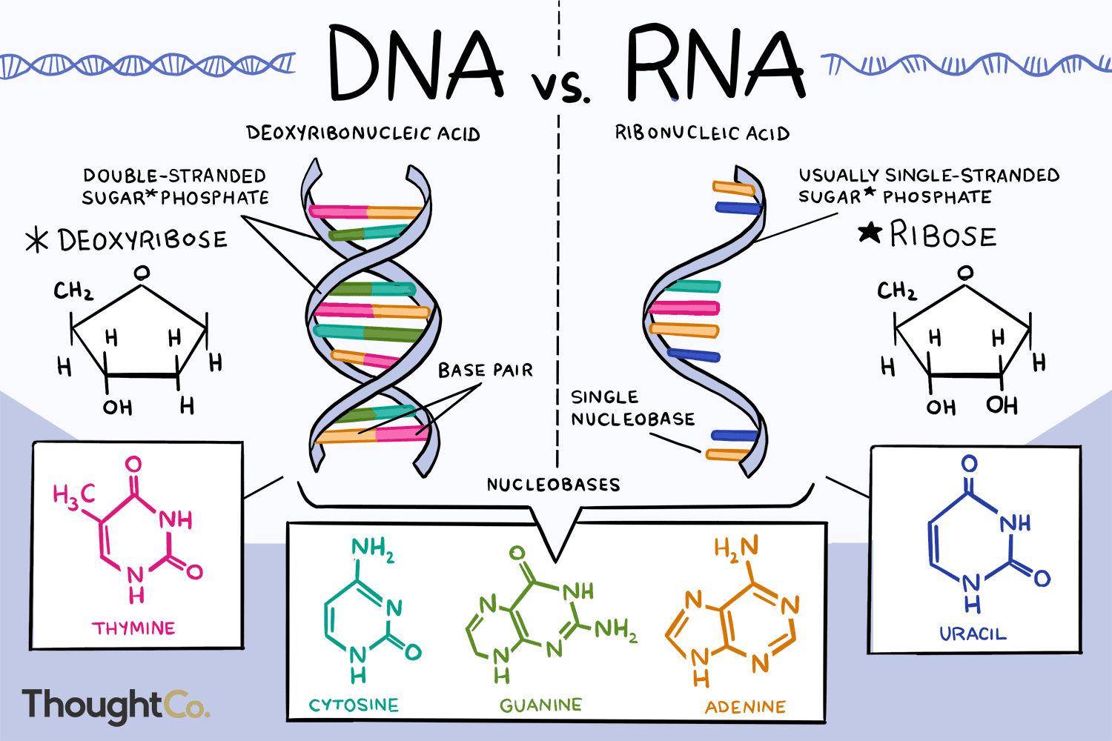
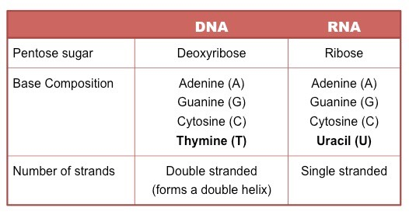

Slide 3
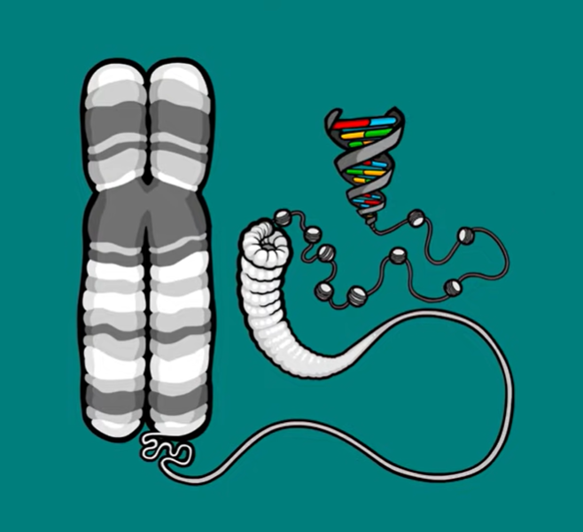
We have so much DNA (2 meters) in each cell) and our nuclei are so small, DNA has to be packaged incredibly neatly. So Strands of DNA are looped, coiled and wrapped around proteins called histones. In this coiled state, it is called chromatin, It is further condensed, through a process called supercoiling, and it is then packaged into structures called chromosomes.

Slide 4
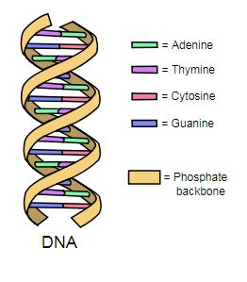
DNA stability
Phoshodiester bonds:
Link between sugar and phosphate
(base staking)
Hydrogen bonds :
Link between the complementary bases
Of the two bases or strands

Slide 5
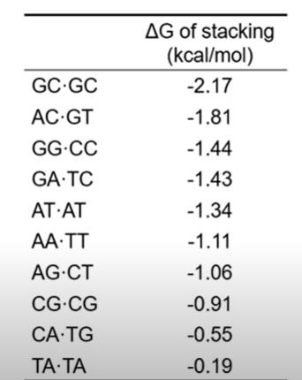
Base stacking
Hydrophodic staking interactions in which two of more bases are positioned with the planes of their rings parallel
Help to minimize contact with water and are very important in stabilizing 3D structure of DNA

Slide 6
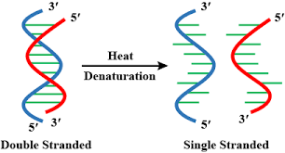
DNA Instability Factors
DNA mutations
Thermal denaturation od double-stranded DNA

Slide 7

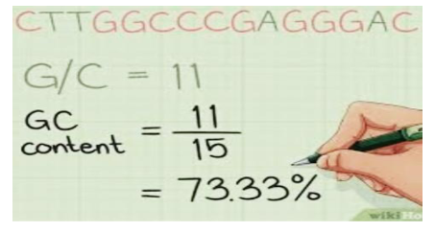
GC Content
GC-content (or guanine-cytosine content) is the percentage of nitrogenous bases in a DNA or RNA molecule that are either guanine (G) or cytosine .

Slide 8
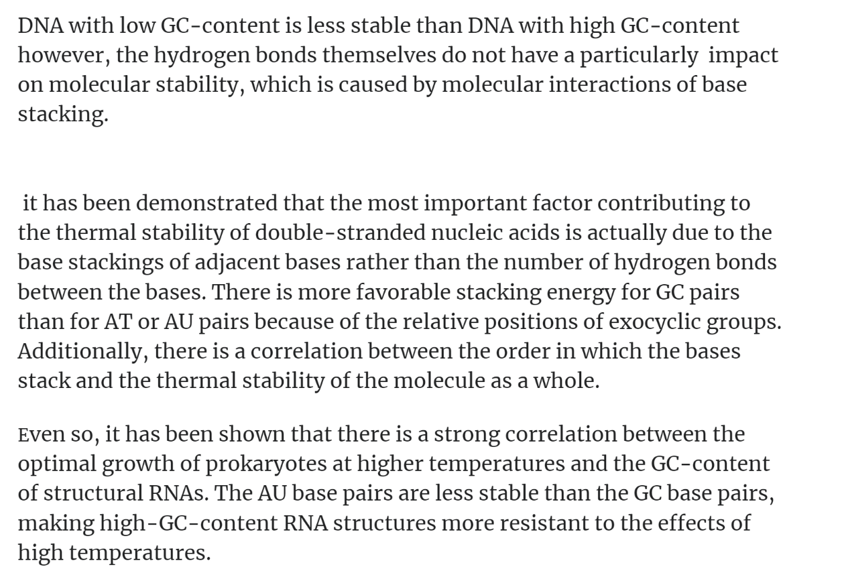
GC content & DNA Stability

Slide 9
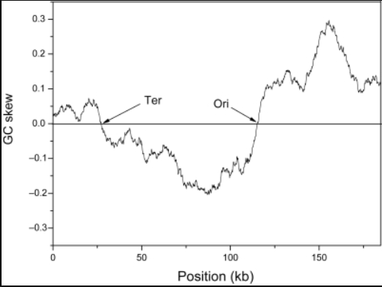
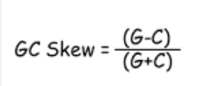
GC Skew
is when the nucleotides guanine and cytosine are over- or under-abundant in a particular region of DNA or RNA.

