Slide 1
COMPUTER VISION — FINAL PROJECT
Face Morphing Generation & Detection
A two-part study: building a landmark-based face-morphing pipeline, then training a model to detect the morphs it produces.
PREPARED BY
Yousef Yousef
Atheer Azaiza
Notes:
Introduce the project: generating face morphs and detecting them, two linked assignments.

Slide 2
AGENDA
What this presentation covers
PART 1
PART 2
Generating Face Morphs
Detecting Face Morphs — DMorphNet
Landmark detection, Delaunay triangulation, piecewise-affine warping, cross-dissolve blending, and results across 58 pairs from LFW.
Reproducing a published detection method: EfficientNet-B6 features feeding an SVM classifier, and how our results compare to the paper.
01
Detect landmarks (MediaPipe, 478 pts)
01
Resize 528×528 + CLAHE preprocessing
02
Delaunay triangulation on target shape
02
Frozen EfficientNet-B6 → 2304-d features
03
Piecewise-affine warp, triangle by triangle
03
SVM (RBF) classifies real vs. morph
Notes:
Walk through the two parts and what each covers.

Slide 3
PART 1
Generating Face Morphs
A classical, landmark-based morphing pipeline — the same family of methods used to study morphing attacks in the biometrics literature.
Notes:
Transition into Part 1.

Slide 4
METHOD
Four steps turn two photos into one morph
Delaunay-triangulation morphing (Beier–Neely family), as used in face-morphing-attack research such as Ferrara et al., 2014.
01
02
03
04
Detect landmarks
Triangulate
Warp
Cross-dissolve
MediaPipe finds 478 facial points per face.
Points form a Delaunay mesh on the target shape.
Each triangle is affine-warped into place.
Warped pixels are alpha-blended together.
landmarks.py
morph.py
_warp_triangle()
morph_images()
Notes:
Four-stage pipeline: detect landmarks, triangulate, warp, cross-dissolve.

Slide 5
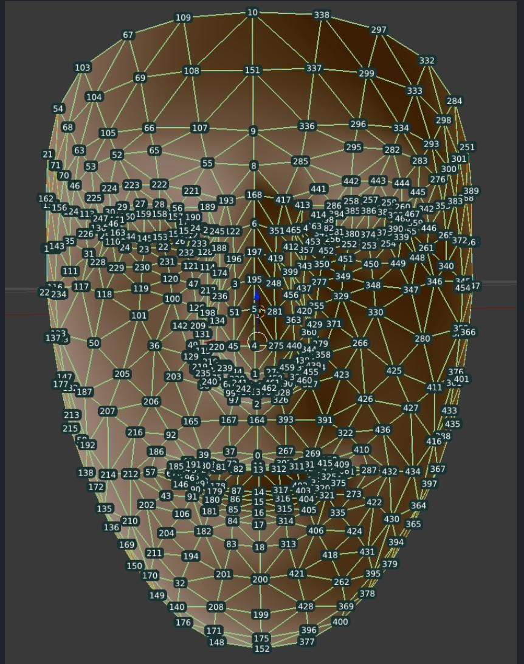
Step 01
Landmark detection & alignment
Each face is passed through MediaPipe FaceLandmarker , which returns 478 dense facial landmarks — after a 3× bicubic upscale of the small LFW crops for more reliable tracking.
Since MediaPipe tracks only the face mesh, we append 8 fixed boundary points — the frame's corners and edge midpoints — to both landmark sets, so the background warps continuously with the face instead of tearing at its edges.
Correspondence is purely index-based: point i on Subject A always maps to point i on Subject B.
478
+ 8
landmarks
boundary points
Notes:
Explain MediaPipe FaceLandmarker and the 8 boundary points.

Slide 6
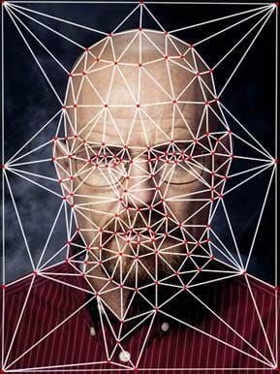
Step 02
Delaunay triangulation
The two landmark sets are averaged into a single target shape: pts_morph = (1−α)·ptsA + α·ptsB.
That target shape is triangulated once (OpenCV's Subdiv2D ), producing a mesh of non-overlapping triangles that covers the whole frame.
Because both faces share the same point indices, this single triangulation is valid for warping both Subject A and Subject B into the target geometry.
morph.py pts_morph = (1 - alpha) * pts1 + alpha * pts2 triangles = delaunay_triangulation(pts_morph, (w, h))
Notes:
Explain Delaunay triangulation on the averaged shape.

Slide 7
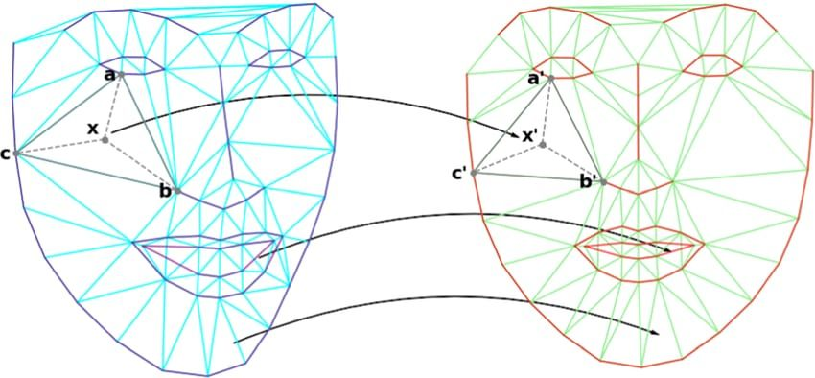
Step 03
Piecewise-affine warping
For every triangle, we compute the affine transform that maps its source vertices (in Subject A or B) to its target vertices (in the averaged shape) — via cv2.getAffineTransform.
That transform warps the triangular patch with cv2.warpAffine , and a filled-polygon mask composites it cleanly into the output canvas, one triangle at a time.
Run separately for Subject A and Subject B, this produces two fully warped images that already share the same target geometry.
Notes:
Explain piecewise-affine warp of each triangle.

Slide 8
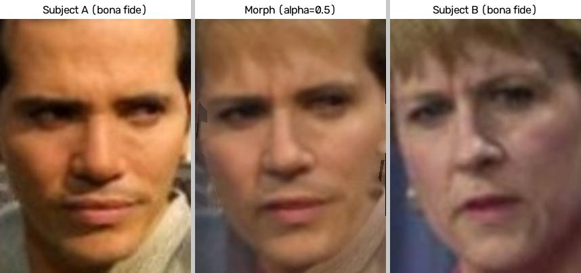
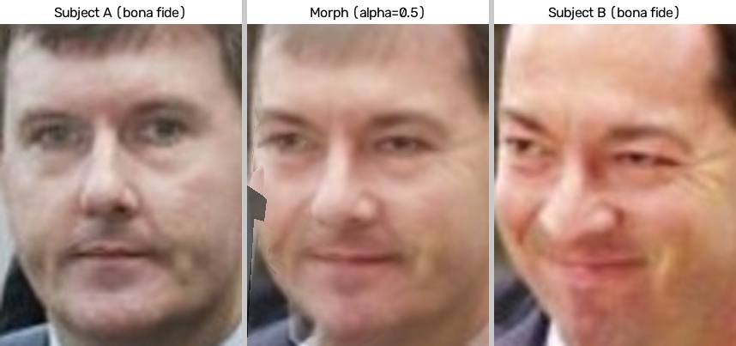
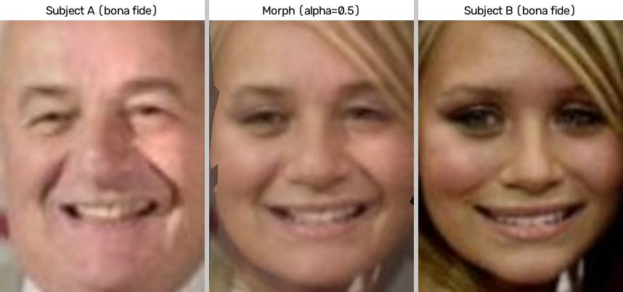
RESULTS
58 morph pairs generated from LFW faces
Three of the five featured triptychs — Subject A · morph (α=0.5) · Subject B.
Notes:
Show sample triptychs: Subject A, morph, Subject B.

Slide 9
OBSERVATIONS & LIMITATIONS
What works, and where the pipeline shows its seams
At α=0.5, morphs convincingly blend both identities into one face — demonstrating real vulnerability to morphing attacks.
Mismatched pose or expression (e.g. open mouth vs. closed lips) creates visible ghosting and double lips.
Accessories unique to one subject — glasses, hair bangs — fade in semi-transparently rather than keeping solid structure.
Linear cross-dissolve (not Poisson/gradient-domain cloning) means lighting and skin-tone differences aren't color-corrected.
Notes:
Cover the report's observations and limitations section.

Slide 10
PART 2
Detecting Face Morphs — DMorphNet
Reproducing a published morph-detection method to see whether the morphs we can generate can also be caught.
Notes:
Transition into Part 2, detection.

Slide 11
METHOD
A deep-feature + SVM detector
We implement DMorphNet (Gawade et al., COMPUTATIA 2026): classify a face as real or morphed using frozen EfficientNet-B6 features and an SVM classifier — no network training required.
Face image
EfficientNet-B6
SVM (RBF)
Resize to 528×528 + CLAHE contrast enhancement.
Frozen, pretrained; classifier head removed. Global Average Pooling → 2304-d feature vector.
Trained on the 2304-d vectors, with threshold optimized on a validation set.
Real / Morph
cv2.resize(img, (528,528)) clahe.apply(L channel)
EfficientNetB6(weights='imagenet', include_top=False, pooling='avg')
SVC(kernel="rbf", C=10.0, gamma="scale")
Notes:
Explain the paper being reproduced and the detection pipeline.

Slide 12
DATASET & ADAPTATIONS
Staying faithful to the paper, where we could
ADAPTED
KEPT FROM THE PAPER
Real faces: FFHQ instead of the paper's non-redistributable set. Morphs: our own landmark morphing (Delaunay + affine warp + seamless clone) instead of the paper's FaceSwap tool, so the dataset regenerates entirely from code.
528×528 + CLAHE preprocessing; frozen EfficientNet-B6 as a pure feature extractor (GAP → 2304-d); SVM (RBF) classifier; threshold optimization on a validation set.
Notes:
Explain what we adapted from the paper and why.

Slide 13
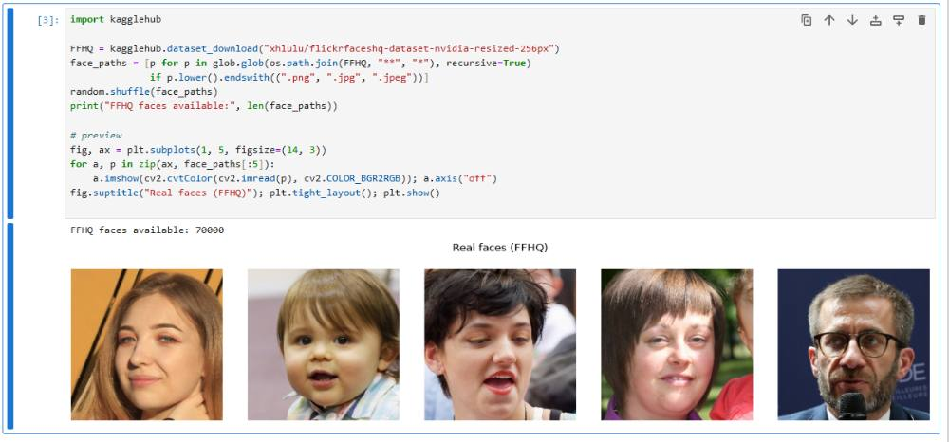
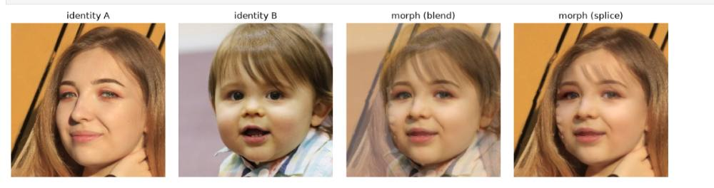
NOTEBOOK OUTPUT — BUILDING THE DATASET
70,000 real faces, morphed two ways
Cell output: FFHQ faces available: 70000 . Each morph pairs two random FFHQ identities and blends them with our Part-1 landmark pipeline — plus a seamless-clone "splice" variant for extra diversity.
Notes:
Show the actual FFHQ sample and morph-generation output cells from the notebook.

Slide 14
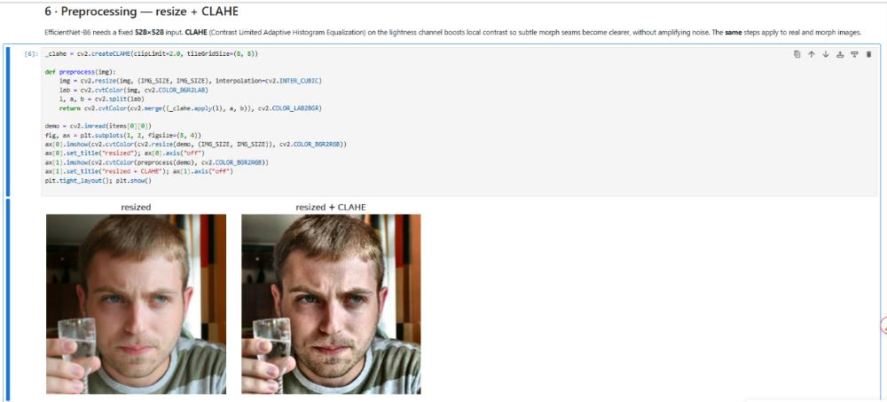
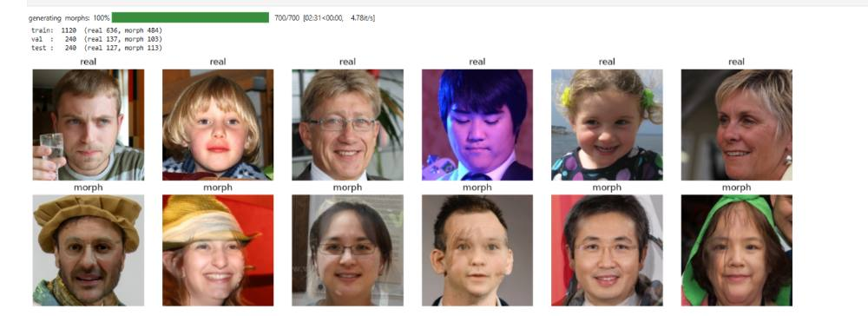
NOTEBOOK OUTPUT — PREPROCESSING & SPLITS
CLAHE sharpens contrast before the split
Cell output: train: 1120 (real 636, morph 484) · val: 240 (real 137, morph 103) · test: 240 (real 127, morph 113) — a 70/15/15 split, stratified by class.
Notes:
Show the CLAHE preprocessing output and the train/val/test split grid and counts.

Slide 15
NOTEBOOK OUTPUT — TRAINING THE CLASSIFIER
Training the classifier on deep features
Each 528×528 face becomes a 2304-d EfficientNet-B6 feature vector. An SVM with an RBF kernel is trained on these vectors to separate real faces from morphs.
The perfect train score is expected for an RBF-SVM on high-dimensional features — it isn't overfitting in a harmful sense here, since validation and test accuracy both stay strong.
svm = SVC(kernel="rbf", gamma="scale") svm.fit(Xtr, ytr)
Notes:
Explain the SVM training cell and its train/val accuracy output.

Slide 16
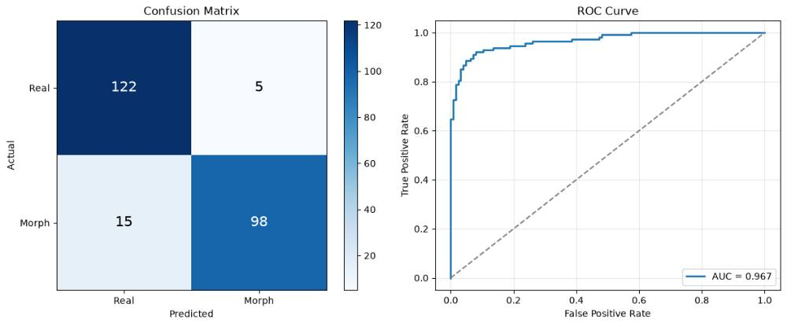
NOTEBOOK OUTPUT — HELD-OUT TEST RESULTS
98 of 113 morphs caught, 5 real faces misflagged
On the 240-image test set (127 real, 113 morph): 91.7% accuracy , 0.951 precision, 0.867 recall, 0.907 F1, 0.967 AUC.
TP=98 TN=122 FP=5 FN=15 — most errors are missed morphs (false negatives), not false alarms on real faces.
Notes:
Show the confusion matrix and ROC curve from the held-out test set.

Slide 17
NOTEBOOK OUTPUT — SIX IMPROVEMENT EXPERIMENTS
Trying to beat the SVM baseline
EXPERIMENT
ACC
PREC
REC
F1
AUC
0 · SVM (baseline)
0.917
0.943
0.876
0.908
0.967
1 · MLP (softmax + cross-entropy)
0.904
0.925
0.867
0.895
0.968
2 · + dropout 0.5
0.904
0.950
0.841
0.892
0.965
3 · + cosine LR decay
0.904
0.917
0.876
0.896
0.973
4 · + Swish activation
0.912
0.934
0.876
0.904
0.972
5 · + class weights (2.5×)
0.912
0.911
0.903
0.907
0.972
6 · deeper + BatchNorm
0.908
0.917
0.885
0.901
0.970
7 · best + tuned threshold (0.56)
0.912
0.926
0.885
0.905
0.970
Each row swaps in one change at a time — a neural head, then dropout, LR decay, Swish, class weights, more capacity, and finally a re-tuned decision threshold. None of the neural variants clearly beats the plain SVM baseline's F1 of 0.908 — deeper capacity (row 6) and threshold tuning (row 7) recover some ground but don't surpass it, suggesting the bottleneck is the fixed EfficientNet-B6 features, not the classifier head.
Notes:
Walk through the six improvement experiments run after the SVM baseline.

Slide 18
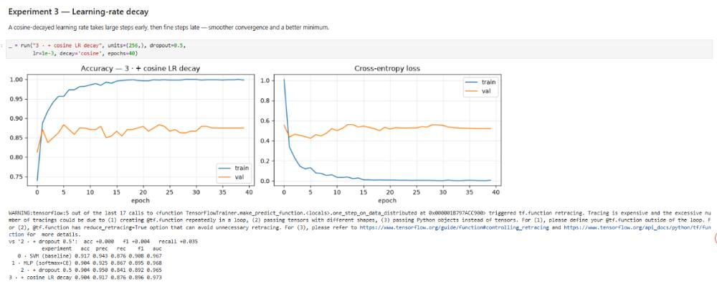
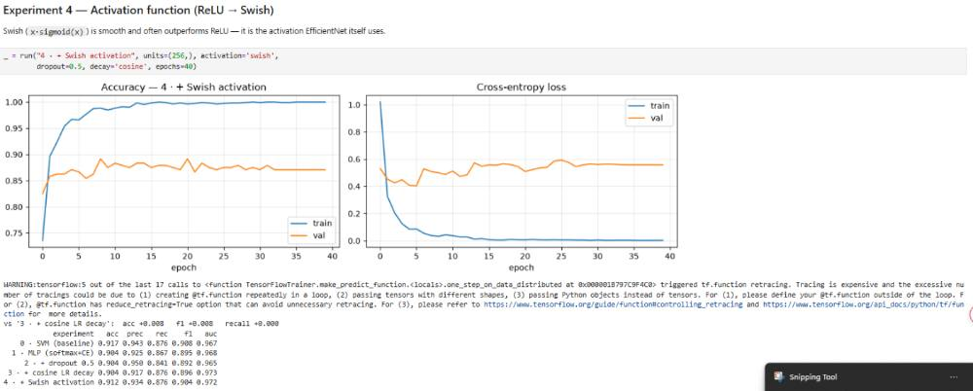
NOTEBOOK OUTPUT — EXPERIMENTS 3 & 4
Smoother training curves, same plateau
Cosine LR decay and Swish activation both tighten the accuracy/loss curves — val loss stops climbing as sharply — but F1 stays within a point of the baseline (0.896 and 0.904).
Notes:
Show the actual cell output for cosine LR decay and Swish activation experiments.

Slide 19
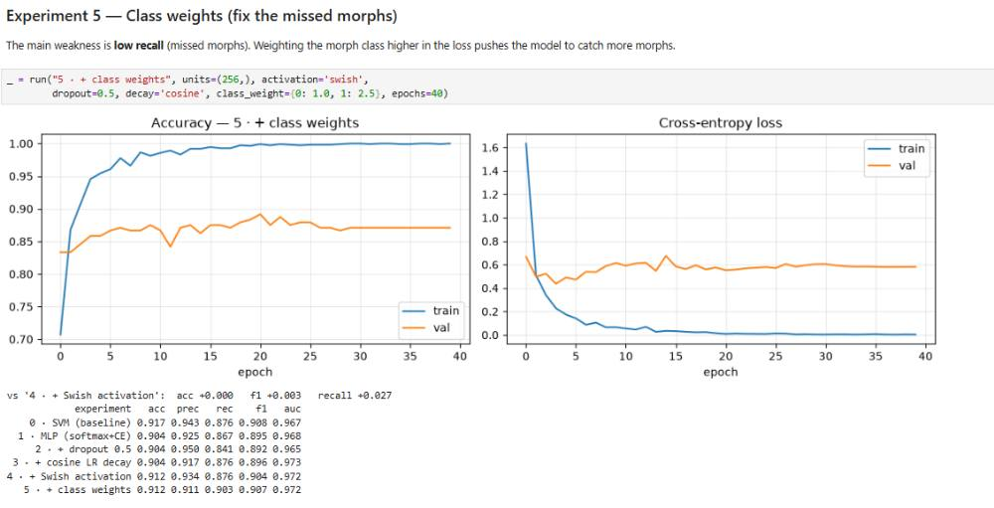
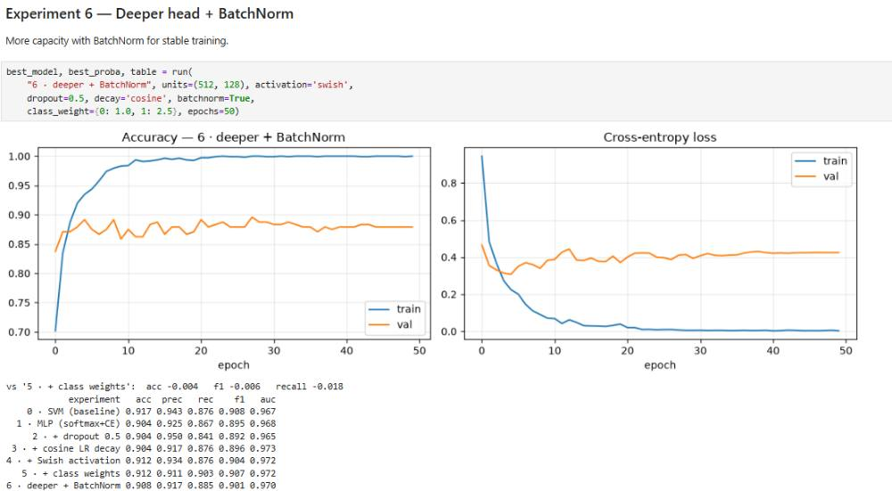
NOTEBOOK OUTPUT — EXPERIMENTS 5 & 6
Chasing recall with weights and capacity
Weighting the morph class 2.5× lifts recall to 0.903, its best value yet. Adding a deeper BatchNorm head (512→128 units) doesn't push further — accuracy and F1 both dip slightly, a sign the extra capacity isn't the bottleneck.
Notes:
Show the actual cell output for class weights and deeper+BatchNorm experiments.

Slide 20
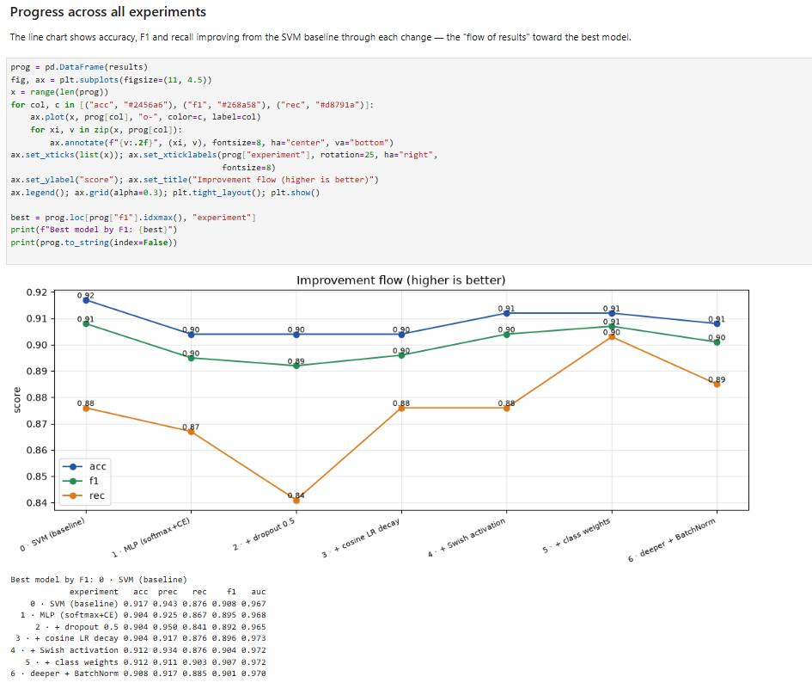
NOTEBOOK OUTPUT — PROGRESS ACROSS ALL EXPERIMENTS
The SVM baseline is hard to beat
Tracking accuracy, F1 and recall across all seven variants, the line chart shows recall dipping hardest under plain dropout, then climbing back once class weights and extra capacity are added.
By F1, the notebook's own comparison still ranks experiment 0 — the original SVM baseline — as the best model overall.
Notes:
Show the line chart tracking accuracy, F1 and recall across all seven experiments.

Slide 21
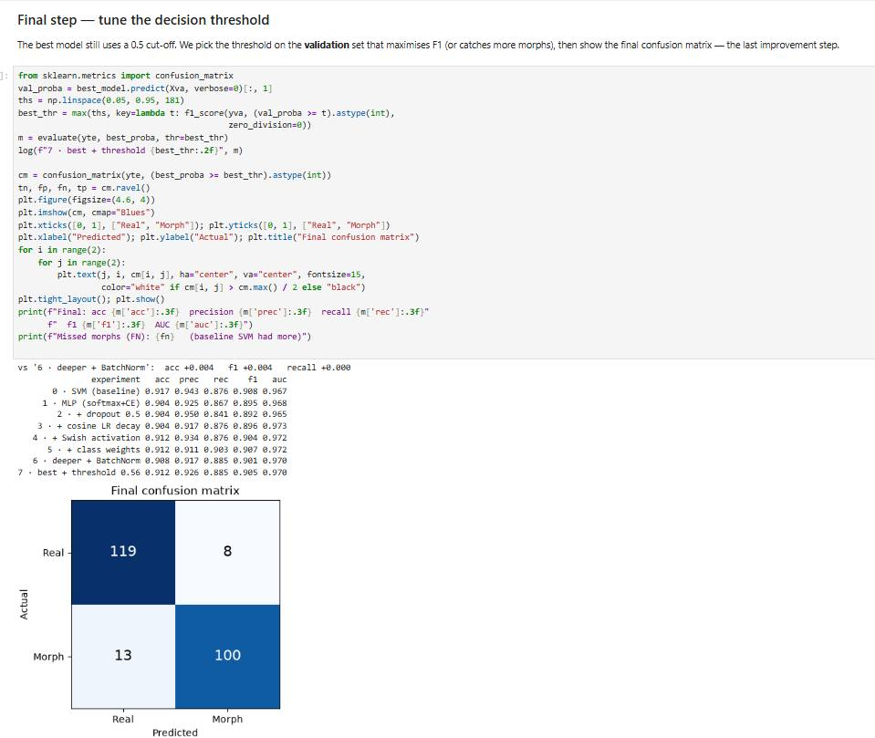
NOTEBOOK OUTPUT — FINAL STEP: THRESHOLD TUNING
Moving the cutoff from 0.50 to 0.56
The best neural model still used a plain 0.5 cutoff. Sweeping thresholds on the validation set and picking the one that maximizes F1 lands on 0.56.
Final test confusion matrix: 119 real correctly kept, 8 real misflagged, 13 morphs missed, 100 morphs caught — acc 0.912, precision 0.926, recall 0.885, F1 0.905, AUC 0.970.
Notes:
Explain the final threshold-tuning step and its confusion matrix.

Slide 22
RESULTS
Our reproduction matches — and edges past — the paper
MODEL
ACCURACY
PRECISION
RECALL
F1
ROC-AUC
Paper (Gawade et al., Table 2)
89.9%
0.90
0.90
0.90
0.965
This implementation
91.7%
0.951
0.867
0.907
0.967
Measured on our FFHQ + landmark-morph test set, with the same DEMO-scale pipeline (900 real / 700 morph) described in the notebook.
Notes:
Walk through the metrics table comparing paper vs our implementation.

Slide 23
SUMMARY
We built the attack, then the defense
A landmark-based morphing pipeline that generates convincing identity blends, and a reproduced detector that catches them slightly better than the original paper.
Yousef Yousef
Atheer Azaiza
Notes:
Close with a summary and thanks.

