Slide 1
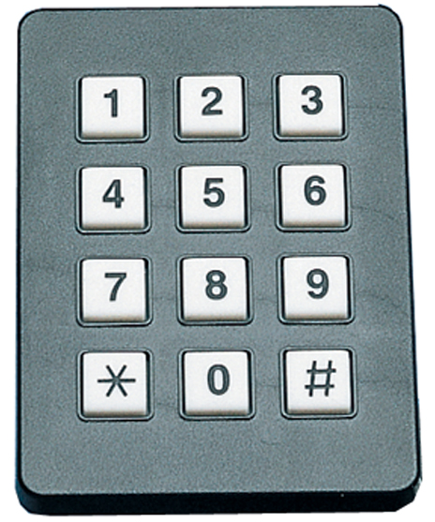
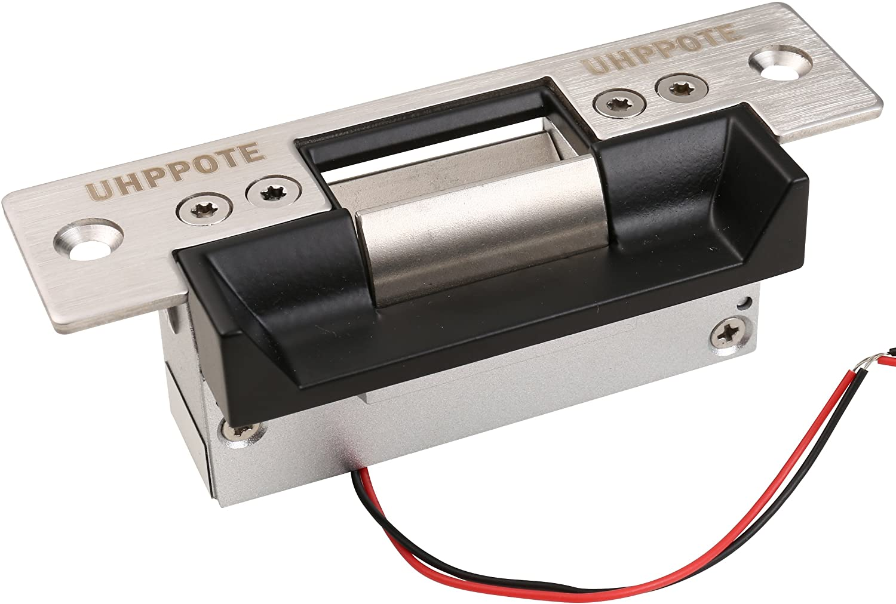

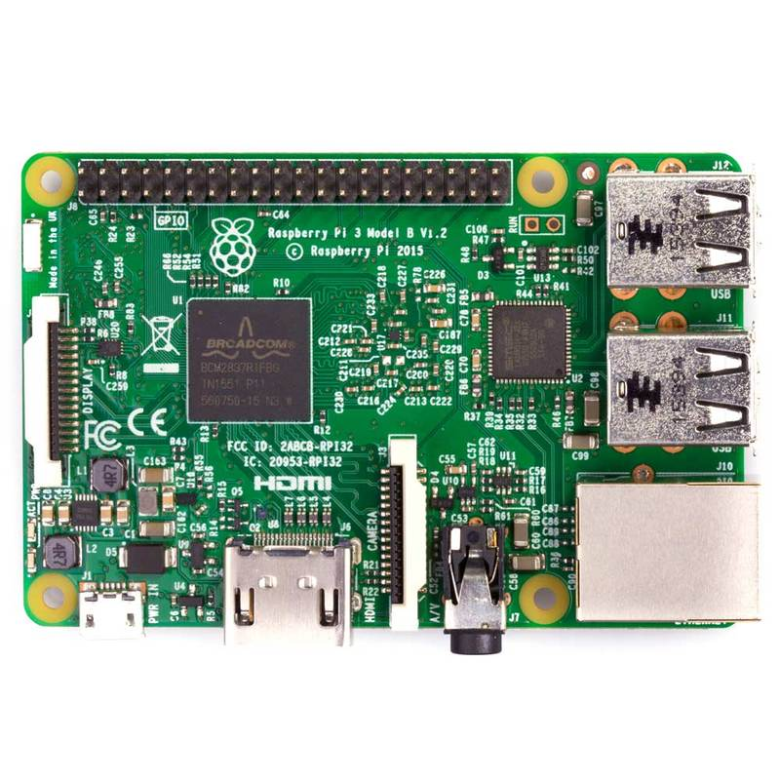


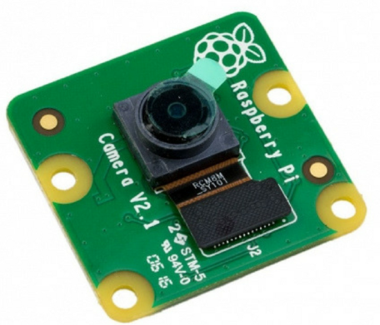

Bouncer Locking System
John Chrosniak, AJ Given, Derek Martin, Jamison Stevens
ECE 4440/4991 Fall 2021
Background
Package deliveries increased in response to COVID-19
Increased package theft followed
Objectives
Facilitate communication between users and package delivery services to effectively eliminate porch piracy
Deliverables
A locking system with multi-level user access, integrated camera, and web application
Learning Opportunities
New product development, prototyping, and secure data transfer and storage
Design of Deliverables
Keypad
Lock Mechanism
Secure Package
Camera
Raspberry Pi
Cloud Storage
User Interface

