Slide 1
Question 1 — Do the three contraceptive methods differ in community composition?
Study B — 93 participants, one vaginal sample each
• Quality-checked both count tables (depth, zeros, batch)
• Filtered: nothing deleted — 9 low-depth samples (< 15,000 reads) were flagged and retested without, as a sensitivity check
• Main test: PCoA map + PERMANOVA on Bray-Curtis distance of relative abundances (999 permutations, seed 202)
• Pairwise arm comparisons with Holm correction for three tests
Notes:
The 15,000-read rule was picked from the depth histogram alone, never from the test result. Relative abundances so shallow samples are not punished for being shallow.

Slide 2
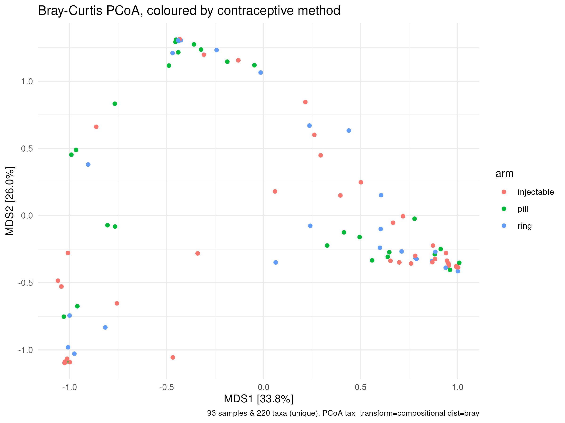
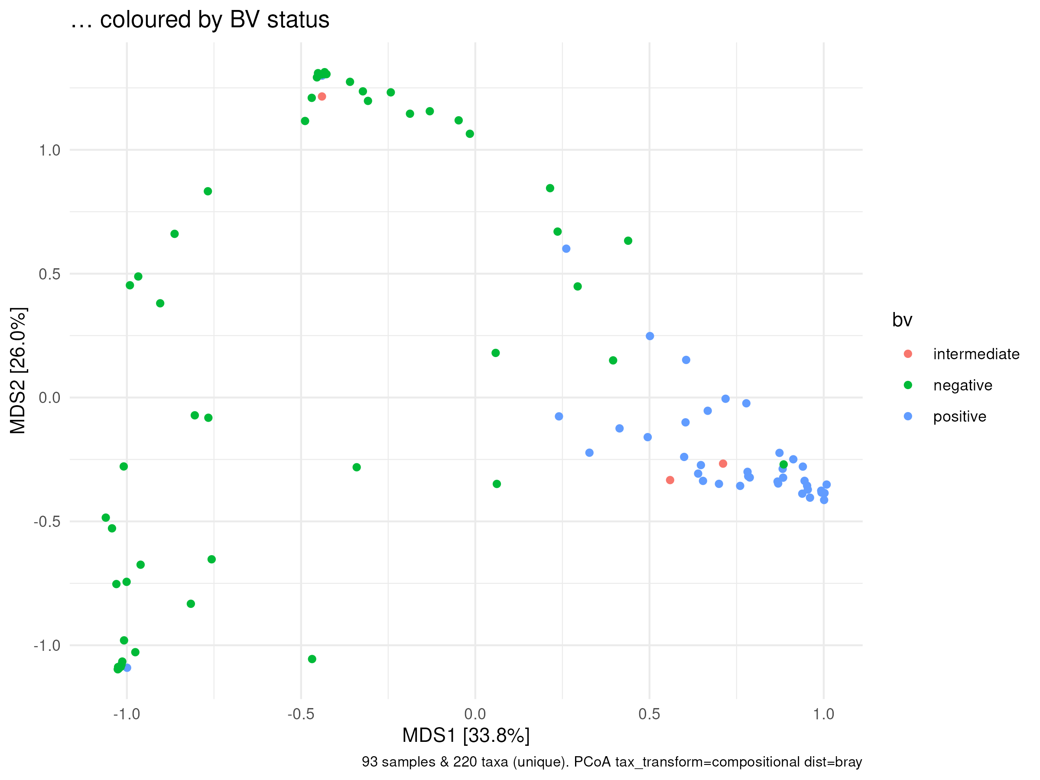
Q1 — the map, and what actually separates the samples
“Three overlapping crowds, not three islands.”
“What separates them is BV — not the method.”
Arm alone: R² = 3.3%, p = 0.147. After BV, pH, STI and batch: R² = 2.7%, p = 0.108.
BV: R² = 14.3%, p = 0.001. Pill vs injectable alone: R² = 3.9%, p = 0.033 (→ 0.099 Holm-corrected).
Notes:
Left: each point is one participant's community; close points have similar communities. If the methods differed, colours would form three islands. Right: the same map coloured by BV — BV-negative top left, BV-positive bottom right.

Slide 3
Q1 — choices we made, and the answer
Choice | Route A | Route B | Kept
Distance | Bray-Curtis on relative abundances | on raw counts (draft 1) | A — raw counts punish the 9 shallow samples
Pairwise tests | Holm-corrected | raw p-values | A — three tests, three chances to be fooled
Source we opened: Anderson (2001), the PERMANOVA paper — doi.org/10.1111/j.1442-9993.2001.01070.pp.x
Answer to Question 1: No. Method explains 3.3% (p = 0.147); every alternative distance agrees. The one hint — pill vs injectable, p = 0.033 — falls to 0.099 after correction. Sanity check agrees: median Lactobacillus share 84.8% pill vs 45.3% injectable / 44.7% ring.
Notes:
Robustness table (02 §4): raw-count Bray, Aitchison and Jaccard all leave arm at ~3%, non-significant.

Slide 4
Question 2 — Is bacterial vaginosis more common in one arm?
Tuesday's anatomy module: look at the table before testing it
• Validated the bv column first: label vs Nugent score agreed in 93/93 samples — safe to use
• Kept all 93 samples — BV status comes from the Nugent score, not sequencing depth, so shallow samples are still valid rows here
• Tested: Fisher's exact test (two cells held < 5 samples, so chi-square was unreliable), three BV categories AND collapsed to any-BV-vs-none
• Sanity check from biology: BV-positive samples should carry more Gardnerella
Choice | Route A | Route B | Kept
Test | Fisher's exact test | chi-square (unreliable with cells < 5) | A
BV definition | three categories | collapsed to any-BV | both — p = 0.45 and p = 0.90, same verdict twice
Source we opened: the R documentation for fisher.test (?fisher.test)
Notes:
Both BV definitions were run so the verdict does not hinge on where 'BV' is drawn.

Slide 5
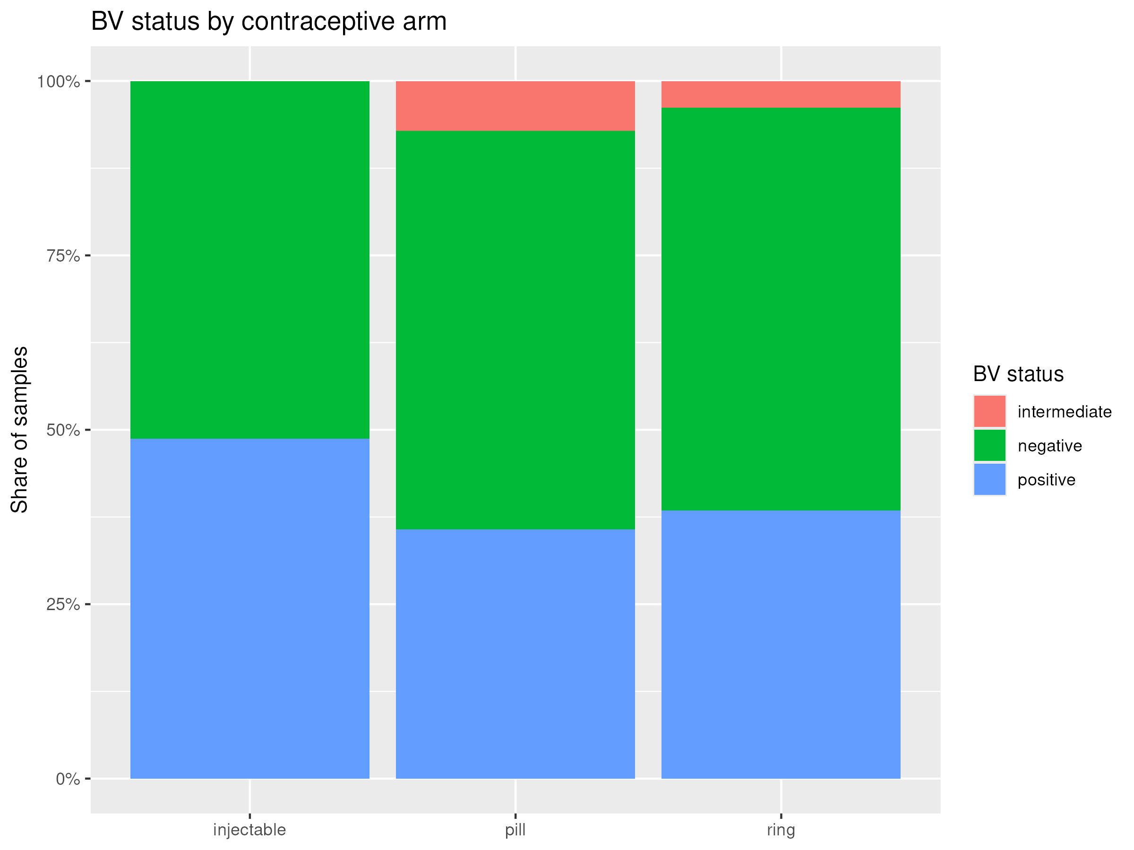
Q2 — the figure, the numbers, and the answer
Arm | any BV | positive only
injectable | 48.7% | 48.7%
pill | 42.9% | 35.7%
ring | 42.3% | 38.5%
Fisher's exact test: p = 0.454 (3 categories), p = 0.897 (any BV vs none).
Sanity check: median Gardnerella share — 24.6% in BV-positive vs 1.1% in BV-negative. The labels mean something.
The share of each arm that is BV-negative, intermediate or positive.
Answer to Question 2: No. BV is common (~42–49%) everywhere; no arm is protected or penalised. BV dominates the communities (Q1: R² = 14.3%) but is a rival explanation, not a confounder.
Notes:
With 26–39 per arm, even the largest gap (13 points) is within chance.

Slide 6
What we do not believe — and the questions we ask next
We do not believe: “no difference” means no difference exists (26–39 per arm can miss a modest effect); the pill-vs-injectable hint (it does not survive correction); that our distance sees everything (arm effects could hide under the BV signal); or that the arms were comparable at baseline (observational, not randomised).
Question | Answer
Do the gene differences match the pill-vs-injectable hint? | Not tested yet — we expect mostly no, since the hint fell to p ≈ 0.10
Does BV leave a mark on the immune data (cytokines)? | We expect yes — BV-positive samples already carry 24.6% Gardnerella vs 1.1%
Do cytokines differ by arm? | Open — the immune readout is where an arm effect could still hide
Which Lactobacillus dominates, crispatus or iners? | Checked now: iners peaks in the pill arm (17.3% vs 9.0% ring, 1.8% injectable); crispatus tracks BV (28.2% vs 0.1%), not arm
Does composition shift gradually with Nugent 0–10? | Expected yes — three categories may hide a dose–response
Is pH the middleman? | Checked now: pill's median pH is 4.55 vs 5.0 in the other arms, and pH tracks BV (4.4 negative → 5.0 positive) — a look, not a test
Notes:
The two 'checked now' answers are looks at the data, not tests — they still need formal analysis. Cross-table habit applies throughout: define the group from one table, test the other.

