Slide 1

DL-based Image Denoising Survey
Xiangsheng Shi
2021-9-23 ver1.5

Slide 2
Menu
A Brief Intro to Low-Level Vision
Advanced DL-based Image Denoising Tech.
Assessment: Datasets & Indice
Summary

Slide 3
A Brief Intro to Low-Level Vision
What is LLCV?
low-level vision concerns the extraction of image properties from the retinal image.¹
The low level image processing techniques involve extracting fundamental image primitives and performing filtering and morphology, etc.²
Low-Level: without semantic information; image pre/post-processing
What are typical tasks of LLCV?
图像恢复 (Image Restoration)
超分辨率(Super-Resolution)
图像去雨(Image Deraining)
图像去雾(Image Dehazing)
图像去模糊(Image Deblurring)
图像去噪(Image Denoising)
图像去摩尔纹(Image Demoireing)
图像修复(Image Inpainting)
图像增强(Image Enhancement)
图像质量评价
(Image Quality Assessment)
插帧(Frame Interpolation)
视频/图像压缩
(Video/Image Compression)
其他多任务
1. By a famous scholar Peter A. van der Helm @ Leuven
2. From Coursera

Slide 4
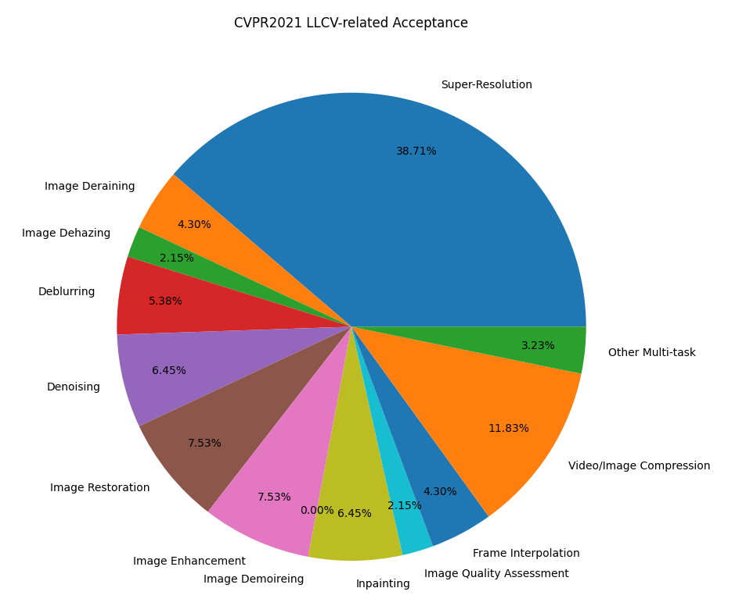
A Brief Intro to Low-Level Vision
Publications of LLCV?
CVPR2021 接收LLCV文章数/文章总数* 93/1663
CVPR2021 细分领域接收文章数/LLCV文章总数
1. (36/93)超分辨率(Super-Resolution)
2. ( 4/93)图像去雨(Image Deraining)
3. ( 2/93)图像去雾(Image Dehazing)
4. ( 5/93)去模糊(Deblurring)
5. ( 6/93)去噪(Denoising)
6. ( 7/93)图像恢复(Image Restoration)
7. ( 7/93)图像增强(Image Enhancement)
8. ( 0/93)图像去摩尔纹(Image Demoireing)
9. ( 6/93)图像修复(Inpainting)
10. ( 2/93)图像质量评价(Image Quality Assessment)
11. ( 4/93)插帧(Frame Interpolation)
12. (11/93)视频/图像压缩(Video/Image Compression)
13. ( 3/93)其他多任务
根据github repo Awesome-CVPR2021-Low-Level-Vision统计

Slide 5

A Brief Intro to Low-Level Vision
Publications of LLCV?
CVPR2020 接收LLCV文章数/文章总数* 85/1470
CVPR2020 细分领域接收文章数/LLCV文章总数
1. (30/85)超分辨率(Super-Resolution)
2. ( 5/85)图像去雨(Image Deraining)
3. ( 4/93)图像去雾(Image Dehazing)
4. ( 7/85)去模糊(Deblurring)
5. ( 2/85)去噪(Denoising)
6. ( 6/85)图像恢复(Image Restoration)
7. ( 6/85)图像增强(Image Enhancement)
8. ( 1/85)图像去摩尔纹(Image Demoireing)
9. ( 5/85)图像修复(Inpainting)
10. ( 5/85)图像质量评价(Image Quality Assessment)
11. ( 5/85)插帧(Frame Interpolation)
12. ( 7/85)视频/图像压缩(Video/Image Compression)
13. ( 2/85)其他多任务
根据github repo Awesome-CVPR2020-Low-Level-Vision统计

Slide 6
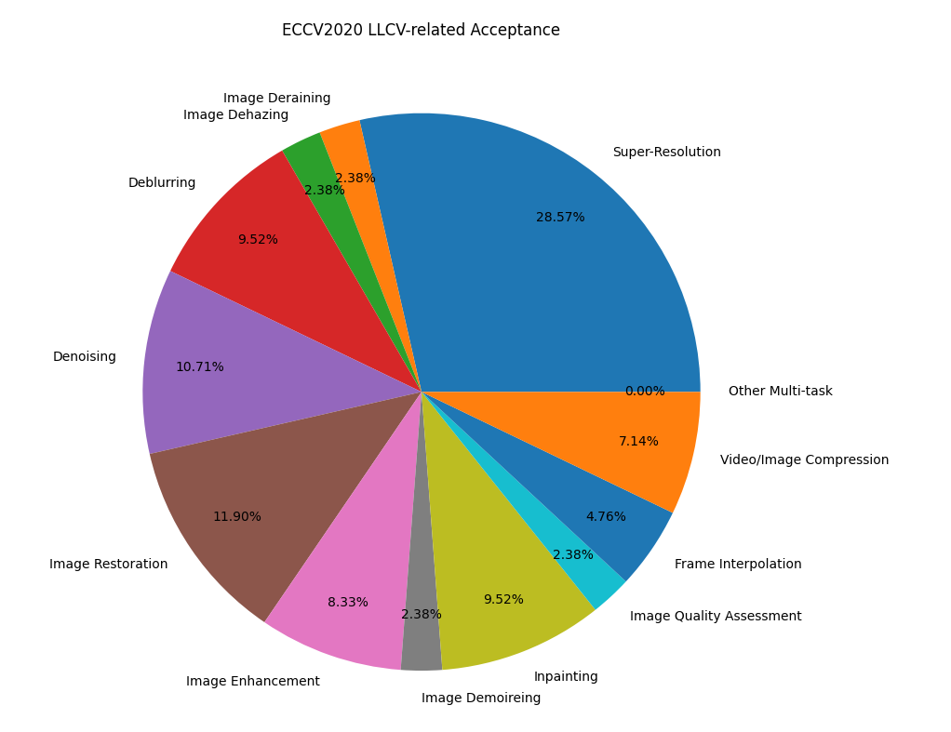
A Brief Intro to Low-Level Vision
Publications of LLCV?
ECCV2020 接收LLCV文章数/文章总数* 85/1361
ECCV2020 细分领域接收文章数/LLCV文章总数
1. (24/85)超分辨率(Super-Resolution)
2. ( 2/85)图像去雨(Image Deraining)
3. ( 2/85)图像去雾(Image Dehazing)
4. ( 8/85)去模糊(Deblurring)
5. ( 9/85)去噪(Denoising)
6. (10/85)图像恢复(Image Restoration)
7. ( 7/85)图像增强(Image Enhancement)
8. ( 2/85)图像去摩尔纹(Image Demoireing)
9. ( 8/85)图像修复(Inpainting)
10. ( 2/85)图像质量评价(Image Quality Assessment)
11. ( 4/85)插帧(Frame Interpolation)
12. ( 6/85)视频/图像压缩(Video/Image Compression)
13. ( 0/85)其他多任务
根据github repo Awesome-ECCV2020-Low-Level-Vision统计

Slide 7



A Brief Intro to Low-Level Vision
Restoration tasks / inter-relationship between LLCVs
Notation for Restoration task:
y for a degraded image observation, x for the latent clean image, H for degradation matrix, v for additive noise
What is an inverse problem? What is an ill-posed problem?
What’s the relationship between different restoration tasks?
image denoising – H is an identity matrix
image deblurring – H is a blurring operator
image super-resolution – H is a composite operator of blurring and
downsampling
From a Bayesian perspective¹: different image prior
$$y=Hx+v$$
1 – (CVPR17) Learning Deep CNN Denoiser Prior for Image Restoration

Slide 8


A Brief Intro to Low-Level Vision
What does Image Denoising do?
Notation for image denoise task:
Where does noise come from?
$$y=x+v$$
$$arg\min_{θ}{L(f_{θ}\left(y\right),x)}$$
Categories¹:
additive white noisy-image denoising
blind noisy image denoising
hybrid noisy image denoising
real noisy image denoising
Categories:
non-blind / blind image denoising
synthesis-noise image denoising /
real nosiy image denoising
1.Deep Learning on Image Denoising: An overview

Slide 9
A Brief Intro to Low-Level Vision
What does Image Denoising do?
Where does noise come from?
Synthetic Noise
Gaussian, Poisson, Salt, Pepper and multiplicative, etc.
Real Image Noise
shot noise - stochastic arrival process of photons hitting the sensor
Possion distribution, not stationary(pixel level)
electronics within the sensor chip
discretization / readout noise
noise distortion – in-camera pipeline(demosaicing, gamma correction, in-camera denoiser, white balancing, color correction, etc)
Corresponding noise model: Gaussian-Poisson, heteroscedastic Gaussian, Gaussian Mixture Model (GMM), deep leaning based methods, etc.

Slide 10
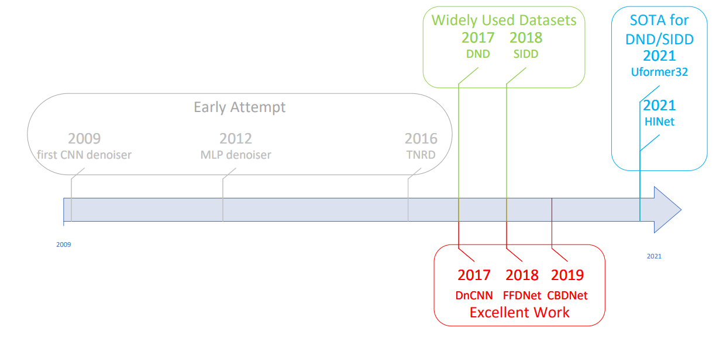
A Brief Intro to Low-Level Vision
TimeLine of Interesting Image Denoising Work(Aritcle Amway)
Early Exploration of DL in Denoising
(fisrt CNN denoiser)Natural image
denoising with convolutional networks, NIPS09
(MLP denoiser) Image denoising: Can plain neural networks compete with BM3D?, CVPR12
(TNRD) Trainable nonlinear reaction diffusion: A flexible framework for fast and effective image restoration, TPAMI16

Slide 11
A Brief Intro to Low-Level Vision
TimeLine of Interesting Image Denoising Work(Aritcle Amway)
Influential DL-based Image Denoise Work
(3000+citation, DnCNN) Beyond a gaussian denoiser: Residual learning of deep cnn for image denoising, TIP17
(FFDNet) FFDNet: Toward a fast and flexible solution for cnn-based image denoising, TIP18
(CBDNet) Toward convolutional blind denoising of real photographs, CVPR19
Familiar Faces
(RIDNet) Real image denoising with feature attention, ICCV19
(AINDNet) Transfer Learning from Synthetic to Real-Noise Denoising with Adaptive Instance Normalization, CVPR20

Slide 12
A Brief Intro to Low-Level Vision
TimeLine of Interesting Image Denoising Work(Aritcle Amway)
Widely Used Dataset – for better understanding noise and data acquisition
(DND) Benchmarking denoising algorithms with real photographs, CVPR17
(SIDD) A high-quality denoising dataset for smartphone cameras, CVPR18
A glance into SOTA
(SOTA on DND) Uformer: A General U-Shaped Transformer for Image Restoration, arxiv21
(SOTA on SIDD) HINet: Half Instance Normalization Network for Image Restoration, CVPRW21

Slide 13
Menu
A Brief Intro to Low-Level Vision
Advanced DL-based Image Denoising Tech.
Assessment: Datasets & Indice
Summary

Slide 14
Advanced DL-based Image Denoising Tech.
Framework
Module Design
Deeper & Wider
Staged Network&
Ensemble based method
Architecture Design
Learning Strategy
Data Acquisition&
Enhancement
Combined with
Traditional Methods
Staged Training /
Transfer Learning
Loss Function Design
Multi-Supervision
DL-based
Image Denoising
Preprocessing
Postprocessing
Noise Model
Self-supervision
Auxiliary Information
CNN as prior
w/ Domain Transformation
w/ Dictionary Learning
w/ Burst Denoising
Notes:
Todo – 可以分出来normalization / regularization方法，BN，AIN，IN

Slide 15
Advanced DL-based Image Denoising Tech.
Architecture Design
Framework
Residual Learning
Recursive Learning
Generative Adversial Network based Denoiser
Transformer based Denoiser
Module Design
Basic Building Block
Enhancement Block
Deeper & Wider
Adaption to Deeper Network
Adaption to Wider Network
Multi-Network
Multi-staged Network
Ensembled Network

Slide 16
Advanced DL-based Image Denoising Tech.
Learning Strategy
Staged Training / Transfer Learning
Loss Function
Pixel Loss – L1, L2
Perception/Feature Loss
DL-based Loss
Penalty/Asymmetric Loss
Total Variation loss
Multi-Supervision
Data Acquisition & Enhancement
Preprocessing - BayerUnify
Postprocessing - RED
Noise Model - CBDNet
Auxiliary Information – FFDNet + CBDNet
Self-supervision – 列点文献

Slide 17
Advanced DL-based Image Denoising Tech.
Combined with Traditional Methods
CNN as a prior
w/ Domain Transformation
w/ Dictionary Learning
w/ Burst Denoising

Slide 18
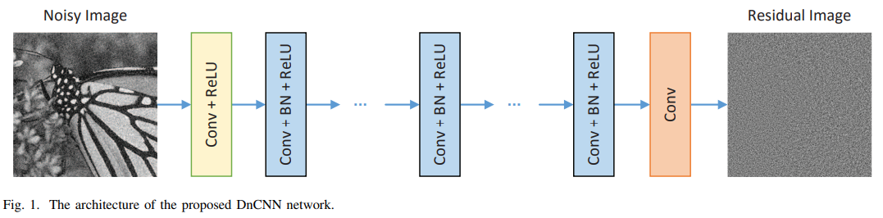
Architecture Design
Framework
Residual Learning - DnCNN
Kai Zhang, et al. Beyond a gaussian denoiser: Residual learning of deep cnn for image denoising. TIP17
Rather than directly outputing the denoised image, choose to predict the residual image, i.e., the difference between the noisy observation and the latent clean image.
When the original mapping is more like an identity mapping, the residual mapping will be much easier to be optimized -> Fast Convergence
Equipped with BN, futher boost the performance -> Gaussian noise only.

Slide 19
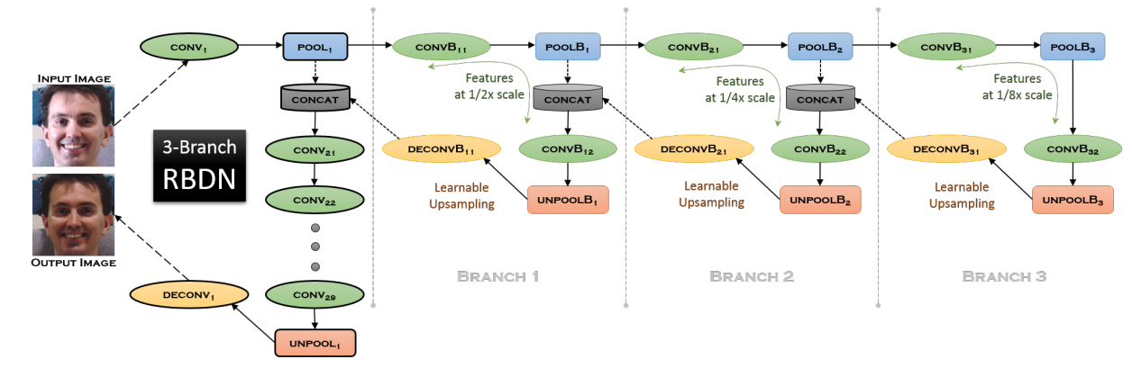
Architecture Design
Framework
Recursive Learning – Weight Sharing
Fully Reuse
Partially Reuse – RBDN
Santhanam et al. Generalized Deep Image to Image Regression, CVPR17
A trade-off between locality and context
A cheap multi-context image representation very early on using an efficient recursive branching scheme with extensive parameter sharing

Slide 20
Architecture Design
Framework
Generative Adversial Network based Denoiser
Chen et al. Image Blind Denoising With Generative Adversarial Network Based Noise Modeling, CVPR18
Lin et al. Real Photographs Denoising With Noise Domain Adaptation and Attentive Generative Adversarial Network, NTIRE19
Cai et al. Residual Channel Attention Generative Adversarial Network for Image Super-Resolution and Noise Reduction, NITRE20
Transformer based Denoiser
Liang et al. SwinIR: Image restoration using swin transformer, ICCVW21
Wang et al. Uformer: A General U-Shaped Transformer for Image Restoration, arxiv21
MLP

Slide 21
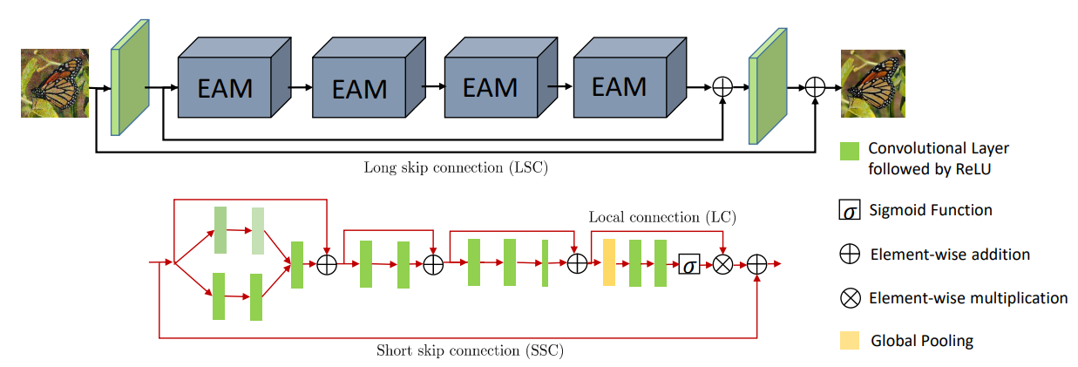
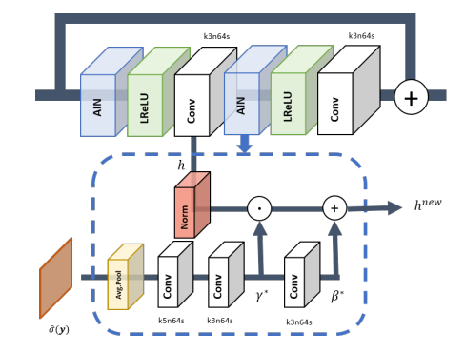
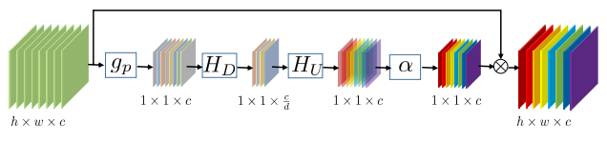


Architecture Design
Module Design
Basic Building Block
Enhancement Block
Attention Mechanism
Channel-wise Attention - RIDNet
Anwar et al. Real Image Denoising with Feature Attention, ICCV19 oral
Channel features in image denoising methods are treated equally -> channel-wise relationship
Feature Attention - AINDNet
Kim et al. AINDNet, CVPR20
Notes:
AINDNet - Transfer Learning from Synthetic to Real-Noise Denoising with Adaptive Instance Normalization

Slide 22
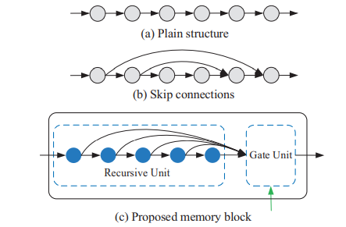
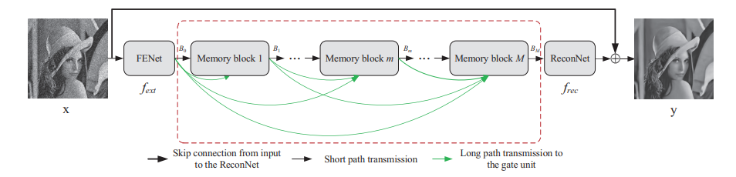
Architecture Design
Deeper & Wider
Adaption to Deeper Network – MemNet
Tai et al. MemNet: A Persistent Memory Network for Image Restoration
Skip connect for deeper model(up to 80 layers)
Enhanced receptive field
Adaption to Wider Network – HINet for test

Slide 23
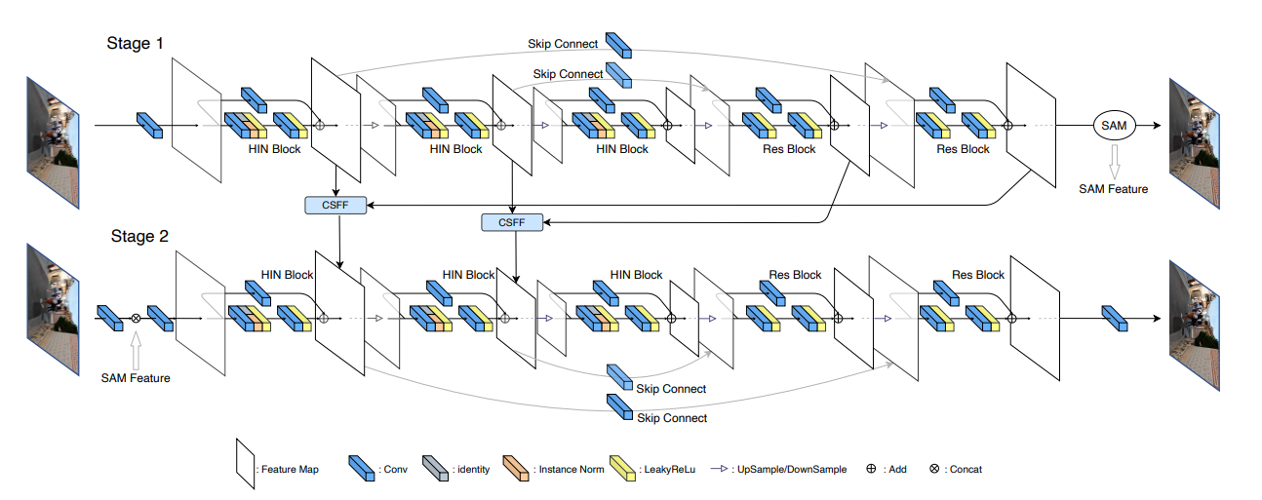
Architecture Design
Multi-Network
Multi-staged Network - HINet
Chen et al. HINet： Half Instance Normalization Network for Image Restoration, NTIRE21
Ensembled Network – HINet
Averaging outputs of 3 independent models
*Multi-Path Network

Slide 24
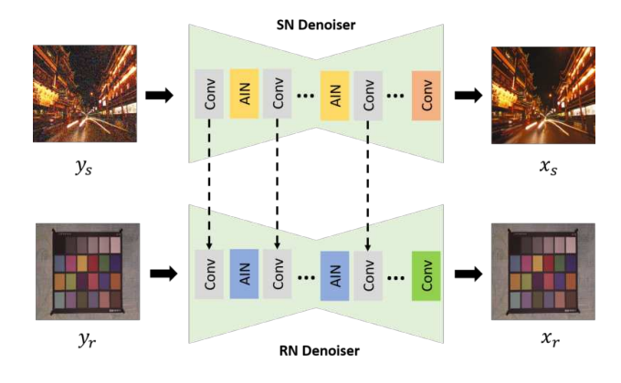
Learning Strategy
Staged Training / Transfer Learning - AINDNet
Kim et al. Transfer Learning from Synthetic to Real-Noise Denoising with Adaptive Instance Normalization, CVPR20
A transfer learning scheme for denoising, which learns the domain-invariant information from SN data and updates affine transform parameters of AIN for the different-domain data -> avoid overfitting to wrong noise distributions or shortage of real noisy image pairs ?
Notes:
可以讲下数据获取的方式？

Slide 25


Learning Strategy
Loss Function
Pixel Loss
L1 Loss
L2 Loss
Charbonnier loss
L1&L2: the L2 loss penalizes larger errors but is more tolerant to small errors, and thus often results in too smooth results. In practice, the L1 loss shows improved performance and convergence over L2 loss
Weakness of pixel loss: doesn’t take image quality (e.g., perceptual quality, textures) into account, the results often lack high-frequency details and are perceptually unsatisfying with oversmooth textures

Slide 26


Learning Strategy
Loss Function
Perception/Feature Loss
DL-based Loss
Measures the semantic differences between images using a pre-trained image classification network
Penalty/Asymmetric Loss
For noise level estimation task, more penalty should be imposed when the estimated noise level is lower than gt.
Total Variation loss
The sum of the absolute differences between neighboring pixels and measures how much noise is in the images
Imposing spatial smoothness

Slide 27
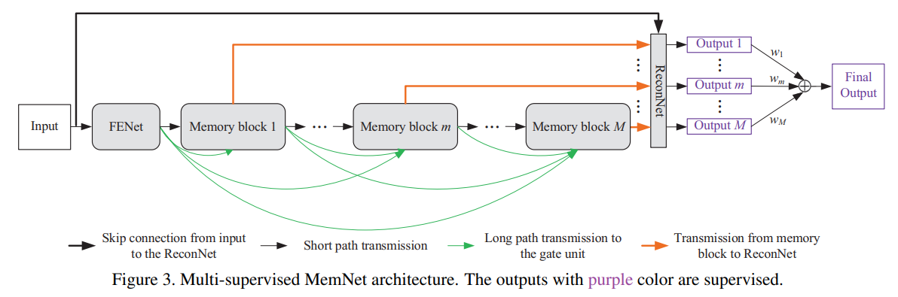

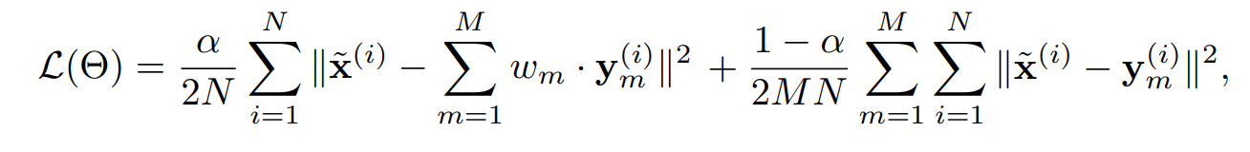
Learning Strategy
Multi-Supervision
Symmetric Constraint on Outputs - MemNet
Tai et al. MemNet: A Persistent Memory Network for Image Restoration
To further explore the features at different states?
Gradual(Asymmetric) Constraint on Outputs / Gradual Denoising

Slide 28
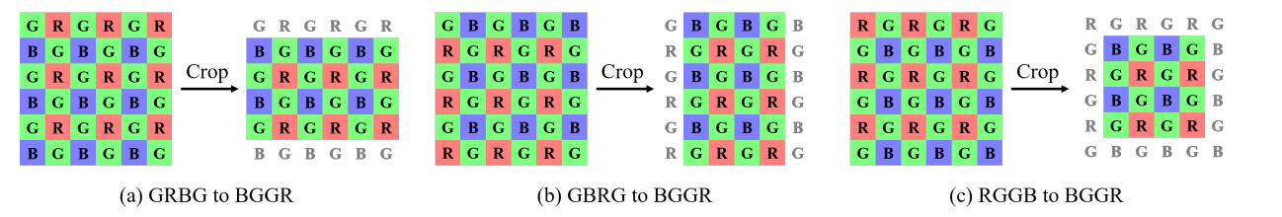
Data Acquisition & Enhancement
Preprocessing
Dataset Augmentation
Liu et al. Learning Raw Image Denoising with Bayer Pattern Unification and Bayer Preserving Augmentation, NTIRE19
Bayer Pattern Unification (BayerUnify)
Bayer Preserving Augmentation (BayerAug)
Postprocessing
Output Averaging / Self-Ensemble
Rotations with different angles (0°, 90°, 180°, 270°) and horizontal flipping are applied to get a set of 8 images. Feed them into the model and averaging the outputs.
Notes:
RED – Mao et al. Image restoration using very deep convolutional encoder-decoder networks with symmetric skip connections, NIPS16

Slide 29


Data Acquisition & Enhancement
Noise Model
Heteroscedastic Gaussian + ISP Simulation - CBDNet
Guo et al. Toward Convolutional Blind Denoising of Real Photographs, CVPR19
Poisson-Gaussian: A reasonable noise model for raw imaging sensors
Photon sensing noise(shot noise) can be modeled as Poisson
Remaining stationary disturbances can be modeled as Gaussian
Heteroscedastic Gaussian: An approximation for Poisson-Gaussian
ISP further increases the complexity of noise and makes it spatially and chromatically correlated.
f(·) stands for camera response function (CRF) uniformly sampled from the 201 CRFs

Slide 30
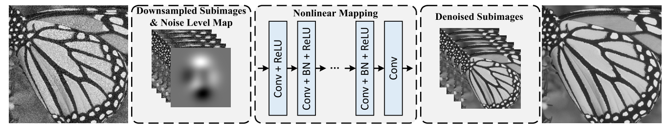
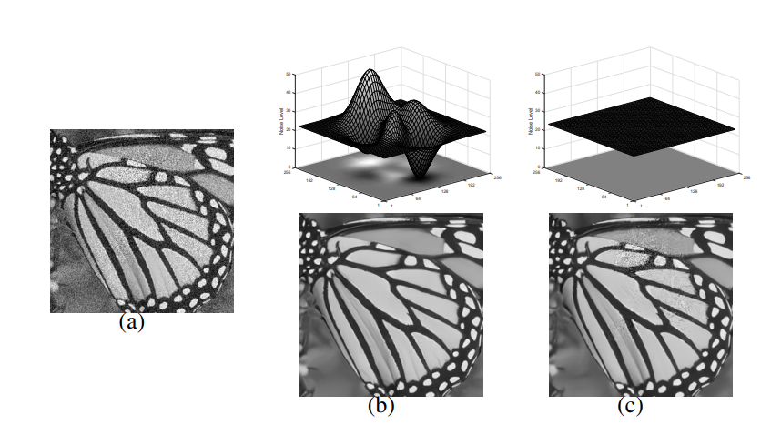
Data Acquisition & Enhancement
Auxiliary Information
Noise Level Map -> spatially variant noise
Blind denoising of real noisy images involves two stages, i.e., noise estimation and non-blind denoising
Zhang et al. FFDNet: Toward a Fast and Flexible Solution for CNN based Image Denoising. TIP18

Slide 31
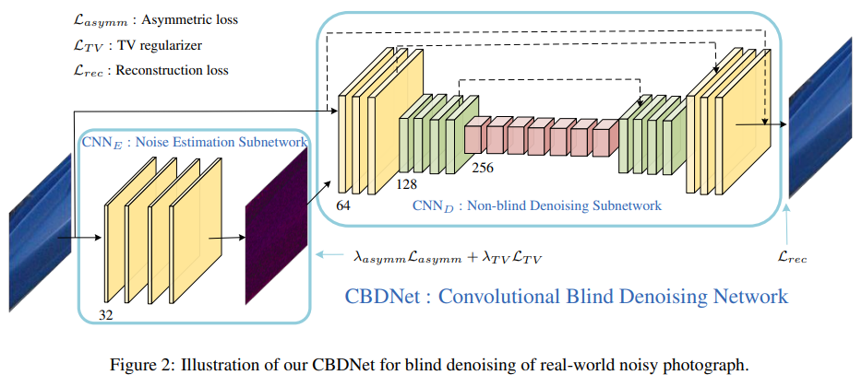
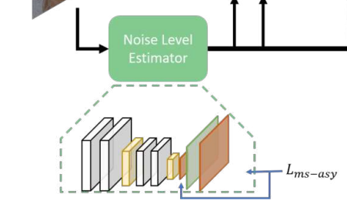
Data Acquisition & Enhancement
Auxiliary Information
Noise Level Map - Evolution
Auto-Computed NLM – CBDNet
Advanced NN for NLM computing – e.g. AINDNet
Self-supervision – N2N, N2V, N2C, Noiser2N, Neighbor2Neighbor

Slide 32
Combined with Traditional Methods
CNN as a prior
Zhang et al. Learning Deep CNN Denoiser Prior for Image Restoration, CVPR17
w/ Domain Transformation
Chang et al.Hyper-Laplacian Regularized Unidirectional Low-Rank Tensor Recovery for Multispectral Image Denoising, CVPR17
Liu et al. Densely Self-Guided Wavelet Network for Image Denoising, NTIRE20
w/ Dictionary Learning
Zheng et al. Deep Convolutional Dictionary Learning for Image Denoising, CVPR21
w/ Burst Denoising
Mildenhall et al.Burst Denoising with Kernel Prediction Networks, CVPR18
Rong et al. Burst Denoising via Temporally Shifted Wavelet Transforms, ECCV20

Slide 33
Menu
A Brief Intro to Low-Level Vision
Advanced DL-based Image Denoising Tech.
Assessment: Datasets & Indice
Summary

Slide 34
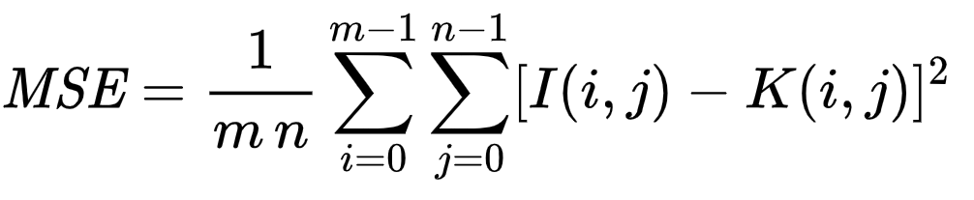
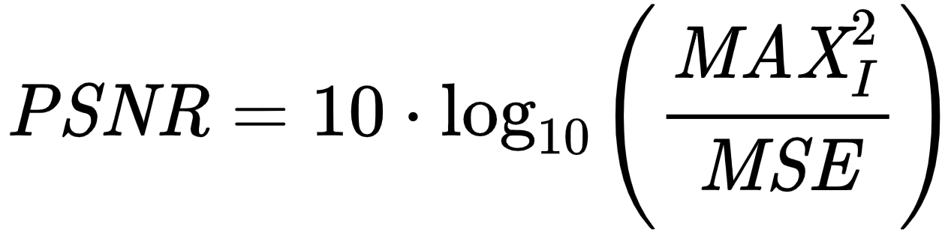
Assessment: Datasets & Indice
Indice
Objective Image Quality Assessment
Peak signal-to-noise ratio (PSNR)
currently the most widely used evaluation criteria
only caring about the differences between corresponding pixels instead of visual perception

Slide 35
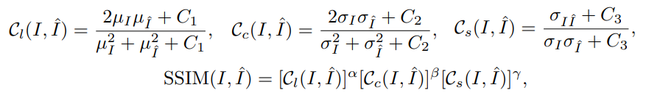
Assessment: Datasets & Indice
Indice
Objective Image Quality Assessment
Structural Similarity(SSIM)
proposed for measuring the structural similarity between images, based on independent comparisons in terms of luminance, contrast, and structures
better meets the requirements of perceptual assessment, and is also widely used
Subjective Image Quality Assessment
Learning-based Perceptual Quality
Other IQA Methods (MS-SSIM, FSIM, NIQE, etc.)
Notes:
the luminance and contrast are estimated as the mean and standard deviation of the image intensity, the image structure is represented by the normalized pixel values, whose correlations (i.e., inner product) measure the structural similarity, equivalent to the correlation coefficient between I and I_hat, alpha beta, gamma are control parameters for adjusting the relative importance

Slide 36
Assessment: Datasets & Indice
Datasets
DND
4 cameras
50 scenes
50 pairs of photos
Better postprocessing than RENOIR
Low noise level
 | Unpaired Data | Paired Data
Gray image dataset | Set12, BSD68, BSD500 | -
Color image dataset | CBSD68, Kodak24, Waterloo Exploration Database, DIV2K, MIT-Adobe FiveK, RNI15, NC12, ImageNet, McMaster | RENOIR, SIDD, DND, Nam, PolyU
SIDD
5 cameras
10 scenes
200 pairs of photos
(160 for train, 40 for test)
More Pairs, better postprocessing

Slide 37
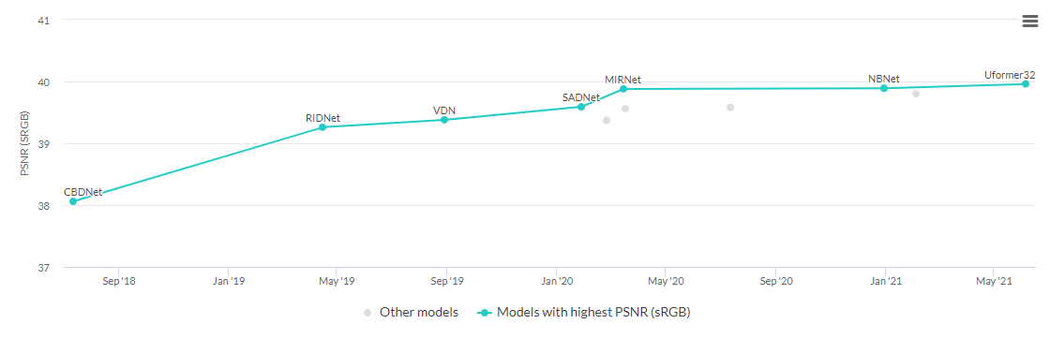

Assessment: Datasets & Indice
Benchmarking
DND

Slide 38
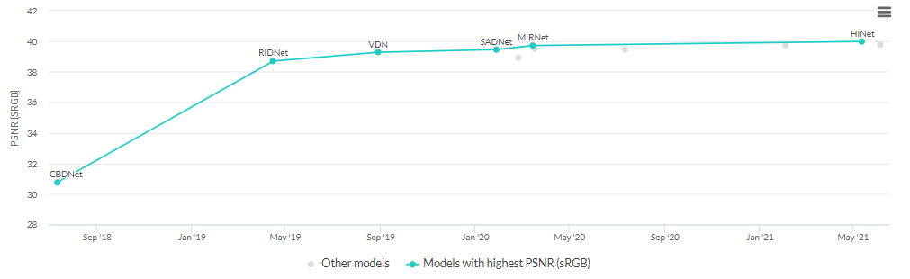
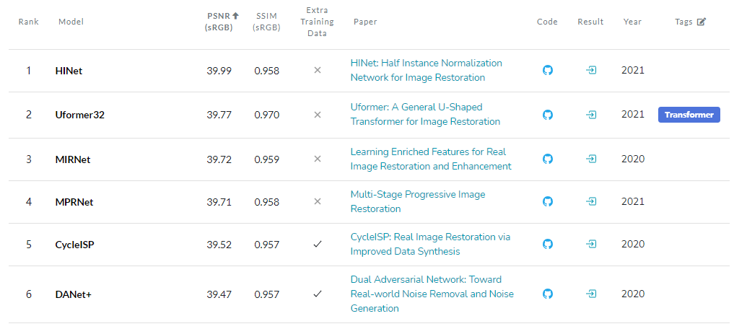
Assessment: Datasets & Indice
Benchmarking
SIDD

Slide 39
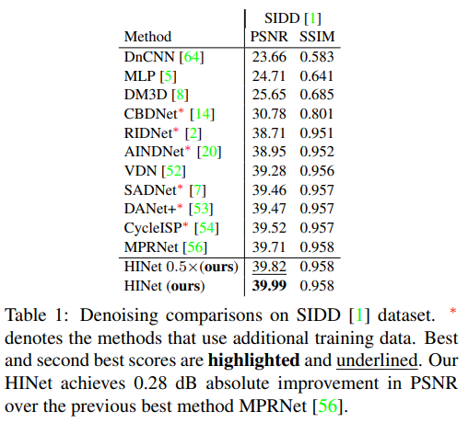
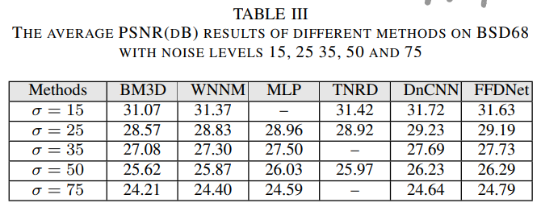
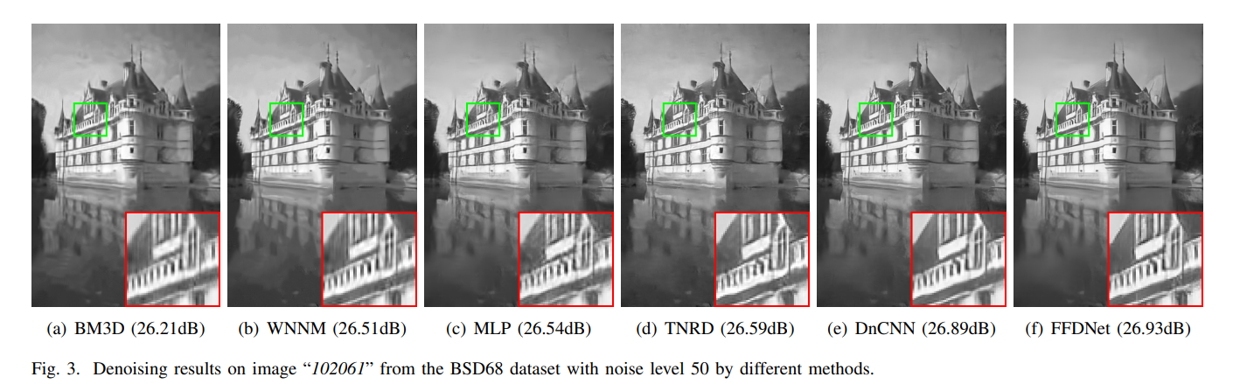
Assessment: Datasets & Indice
What do image denoising practitioners care?
Performance
Perceptural Result
Speed
Model Size(params, ops)

Slide 40
Menu
A Brief Intro to Low-Level Vision
Advanced DL-based Image Denoising Tech.
Assessment: Datasets & Indice
Summary

Slide 41
Summary
Framework
Module Design
Deeper & Wider
Staged Network&
Ensemble based method
Architecture Design
Learning Strategy
Data Acquisition&
Enhancement
Combined with
Traditional Methods
Staged Training /
Transfer Learning
Loss Function Design
Multi-Supervision
DL-based
Image Denoising
Preprocessing
Postprocessing
Noise Model
Self-supervision
Auxiliary Information
CNN as prior
w/ Domain Transformation
w/ Dictionary Learning
w/ Burst Denoising

Slide 42

Summary
Advice for pals interested in LLCV:
What’s remaining in Image Denoising?
Performance
AWNI denoising seems to come to an end.
Real Noise Image Datesets seem to have been over-exploited
Data Acquisition
New Datasets? -> expensive and expert knowledge demanding
Acquisiton of multi-scene, multi-device pairs of images
Ground Truth of high quality
Synthesis Method
More accurate Noise Model
More accurate Noise Level Estimation
Non-paired Images? -> Self-supervision
Resort back to Tradition

