Slide 1
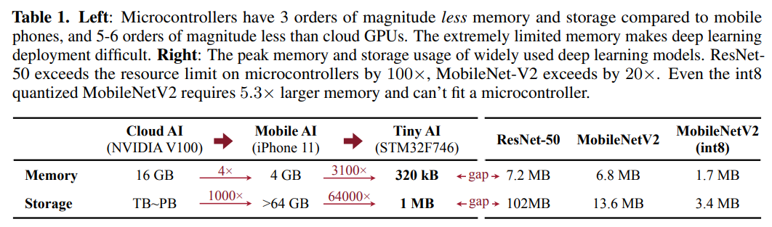
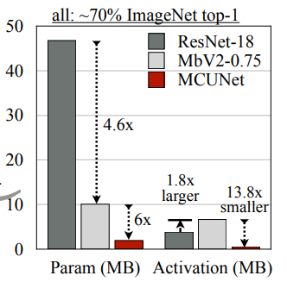
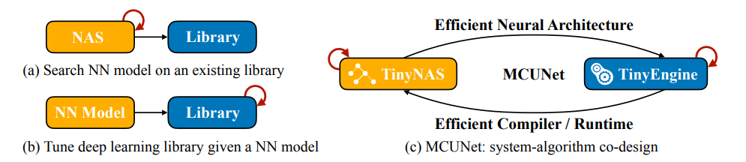
MCUNet: Tiny Deep Learning on IoT Devices
一句话总结：联合设计架构搜索(TinyNAS)与轻量推理库(TinyEngine)实现NN在IoT上的部署（推理）
故事：
解决方案：联合进行NAS/inference library设计满足memory&storage限制
TinyNAS：涉及不同输入resolution/通道width的搜索空间，需满
足budget；在同样的内存限制下搜FLOPs最多的架构
TinyEngine：削减不必要内存开销，给TinyNAS释放搜索空间
IoT设备(MCU)上只有SRAM和FLASH，没有DRAM，且容量与GPU/移动设备相差较大，SRAM限制推理内存，FLASH限制模型容量，普通模型塞不下
效果：

Slide 2
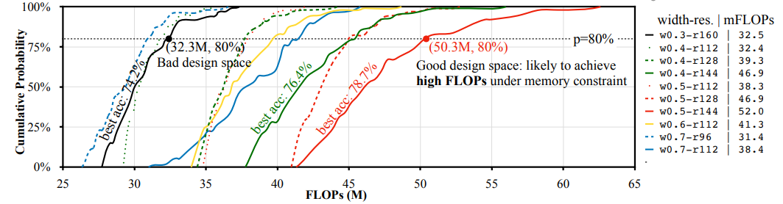
MCUNet: Tiny Deep Learning on IoT Devices
TinyNAS：Two-Stage NAS
Optimizes the Search Space(Search Space Pruning)
Based on one insight: design space that is more likely to produce high FLOPs models under the memory constraint gives higher model capacity, thus more likely to achieve high accuracy
Evaluate the quality of the search space by randomly sampling m networks from the search space and analyzing the computation distribution of the satisfying models - collect the CDF of FLOPs
12 × 9 = 108 possible search space configurations, sample m = 1000 networks for each config, choose the search space with the largest average FLOPs
(Normal) NAS - Resource-constrained model specialization
one-shot NAS / one super network(mobile search space) with weight sharing / weight sharing
use TinyEngine to optimize the memory scheduling to measure the optimal memory usage
Notes:
U-Net shortcut reduction
Hardware-aware

Slide 3
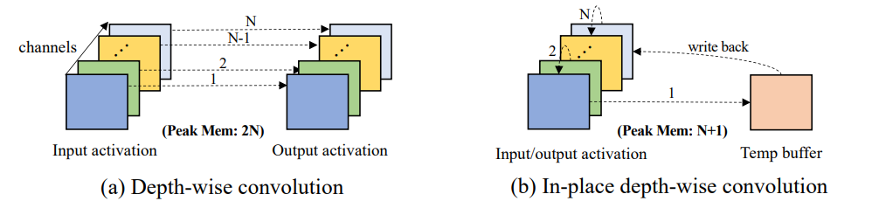
MCUNet: Tiny Deep Learning on IoT Devices
TinyEngine：A Memory-Efficient (model-adaptive) Inference Library
Insight: different deep learning frameworks (libraries) will only affect the inference speed but not the accuracy, while for TinyML the efficiency of the inference library matters a lot to both the latency and accuracy of the searched model
Most frameworks rely on an interpreter to interpret the network graph at runtime, which will consume a lot of SRAM and Flash
The optimization is performed at layer-level, which fails to utilize the overall network architecture information to further reduce memory usage
From interpretation to code generation*
TinyEngine only compiles the operations used by a given model into binary
Model-adaptive memory scheduling**
memory scheduling to the model-level statistics; tile the computation loop nests
Computation kernel specialization
specializes the kernel optimizations for different layers***
In-place depth-wise convolution****
Notes:
* Most existing inference libraries are interpreter-based —— pros: cross-platform development cons: extra runtime memory
** Existing inference libraries schedule the memory for each layer solely based on the layer itself
*** loops tiling is based on the kernel size and available memory, which is different for each layer; the inner loop unrolling is also specialized for different kernel sizes to eliminate the branch instruction overheads; Operation fusion is performed for Conv+Padding+ReLU+BN layers
**** once the computation of a channel is completed, the input activation of the channel can be overwritten and used to store the output activation of another channel, allowing activation of depth-wise convolutions to be updated in-place

Slide 4
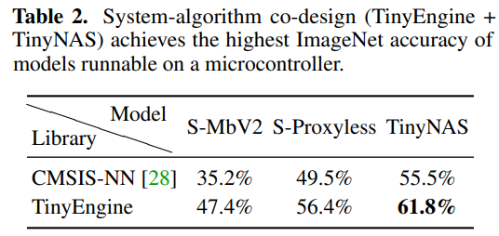
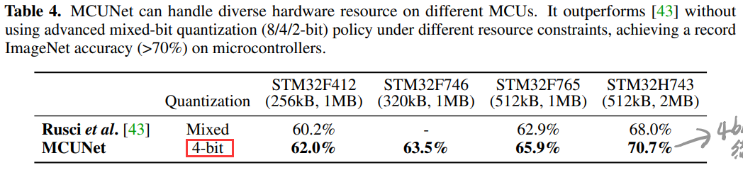
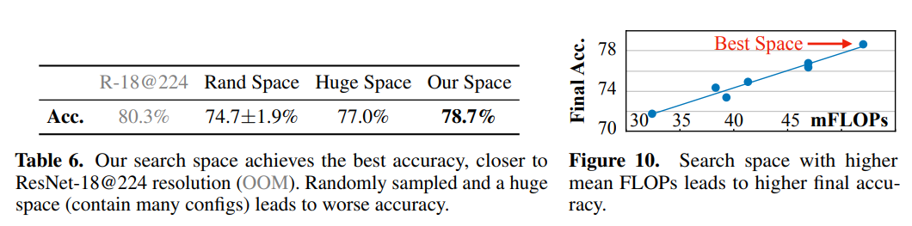
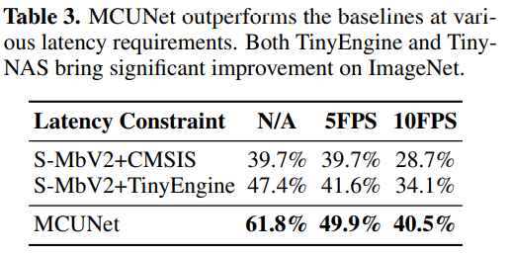
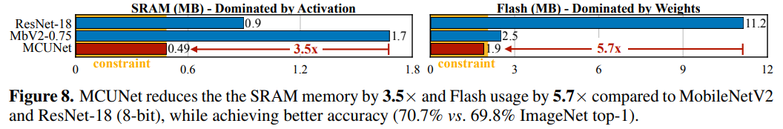
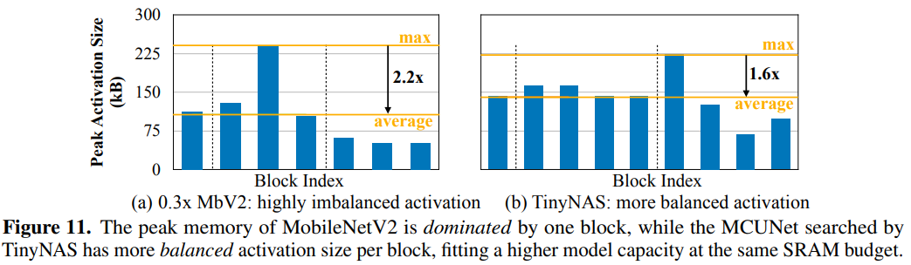
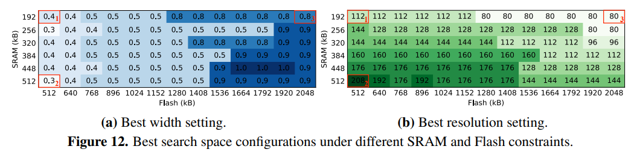
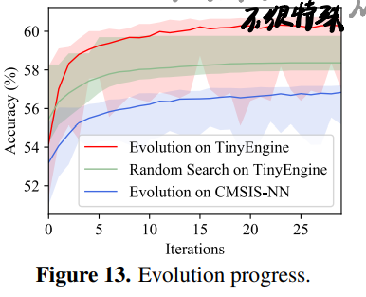
MCUNet: Tiny Deep Learning on IoT Devices
效果拔群：
Ablation：
Search space optimization matters
Per-block peak memory analysis
Sensitivity analysis on search space optimization
Evolution search
Notes:
还有4.3 Visual&Audio Wake Words, 4.4 Object Detection on MCUs上的结果，不是很关注

Slide 5
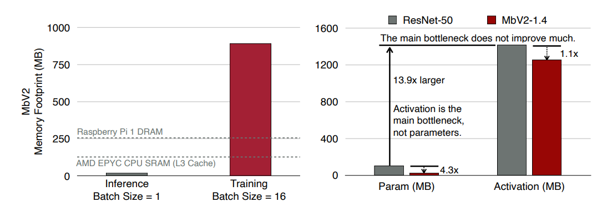
TinyTL: Reduce Activations, Not Trainable Parameters for Efficient On-Device Learning
一句话总结：设计一种参数更新方法与辅助模块，减少更新时内存占用，实现在端设备上的模型更新
故事：On-device learning requires a small memory footprint to fit the tight memory constraint of edge devices. Existing work focus on reducing the number of trainable parameters, while the major bottleneck is the activations.
TinyTL
Freezes the weights while only learns the bias modules -> No need to store the intermediate activations
Introduce a new memory-efficient bias module - lite residual module -> Maintain the adaptation capacity
Combined with feature extractor adaptation (套了一个once-for-all network)

Slide 6
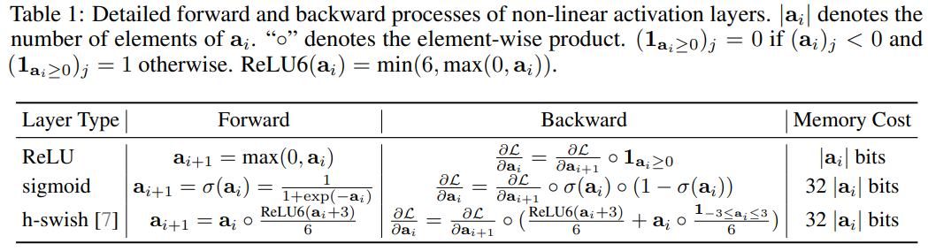
TinyTL: Reduce Activations, Not Trainable Parameters for Efficient On-Device Learning
TinyTL
Freeze the weights, Update the b
Assuming the i^{th} layer is a linear layer and batch size is 1:
intermediate activations dominate the memory footprint are only required to compute the gradient of the weights -> only update bias with weights frozen
Non-linear activation layers like sigmoid and h-swish are not memory-efficient in backpropagation -> only use ReLU like activation funcs.

Slide 7
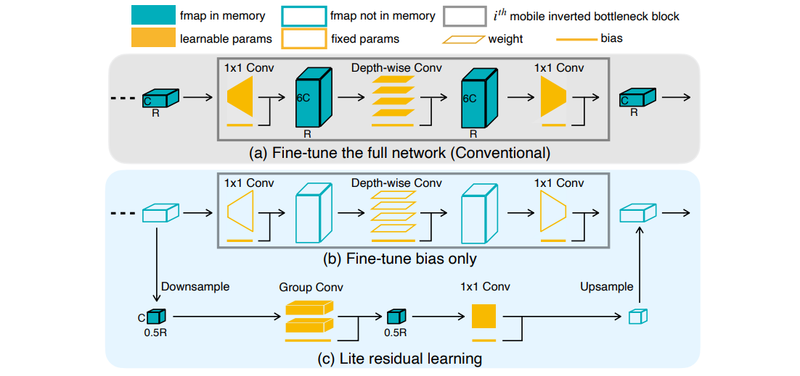
TinyTL: Reduce Activations, Not Trainable Parameters for Efficient On-Device Learning
TinyTL
Lite Residual Learning - memory-efficient bias modules to refine the intermediate feature maps
only requires to store the reduced activations rather than the full activations
Other design details
Normalization Layers*: BN -> GN(group normalization)
Feature Extractor Adaptation: once-for-all network** to adaptively select the specialized feature extractor that best fits the target transfer dataset. (sparsely activated)
Width: depth-wise conv -> group conv
Resolution: average pooling & average pooling
Notes:
* BN requires a large batch size to have accurate running statistics estimation during training, which is not suitable for on-device learning; moreover, the data may come in a streaming fashion in on-device learning, which requires a training batch size of 1. In contrast to BN, GN can handle a small training batch size as the running statistics in GN are computed independently for different inputs.
** a once-for-all network is a special kind of neural network that is sparsely activated, from which many different sub-networks can be derived without
retraining by sparsely activating parts of the model according to the architecture configuration while the weights are shared.

Slide 8
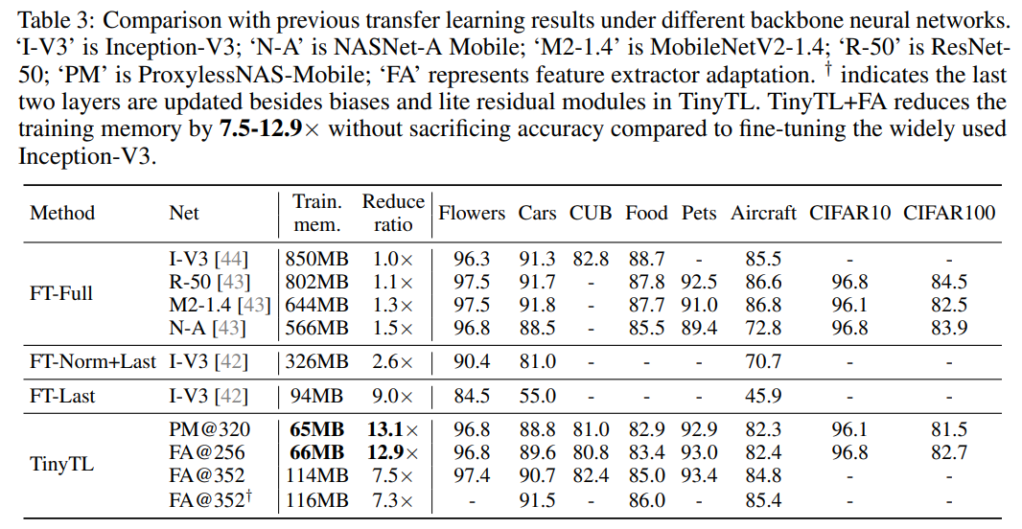
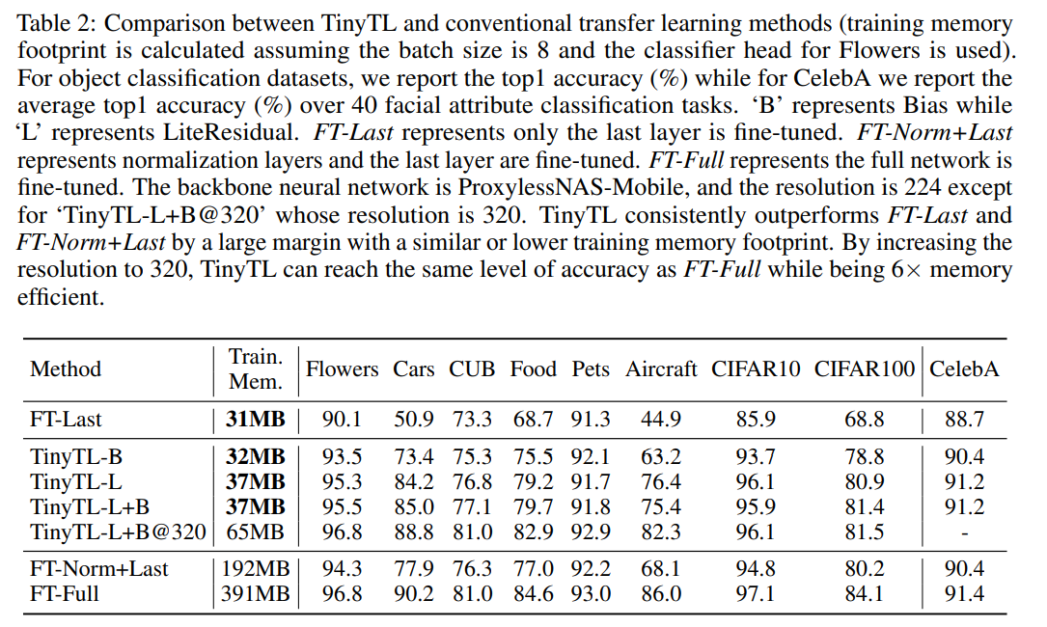
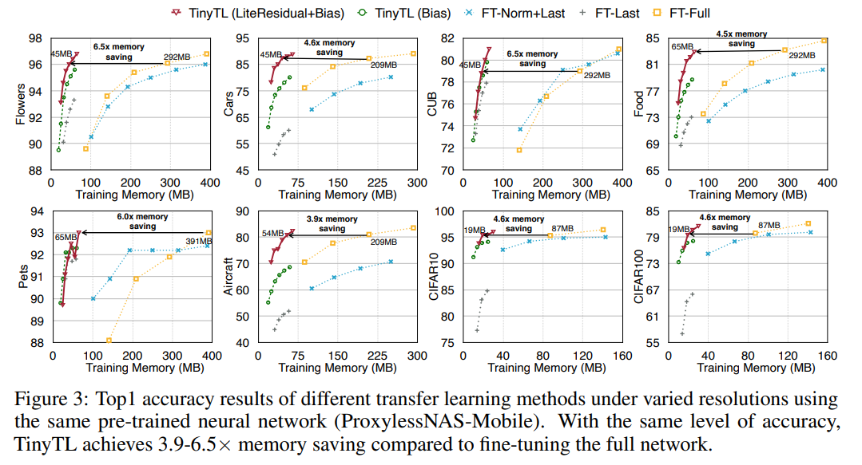
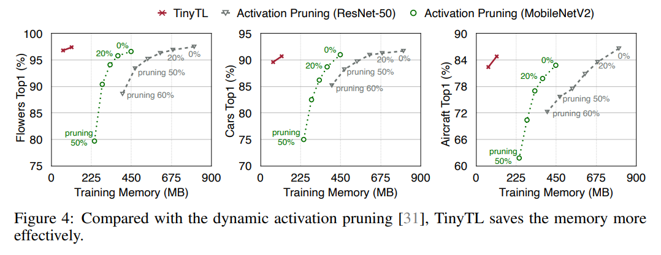
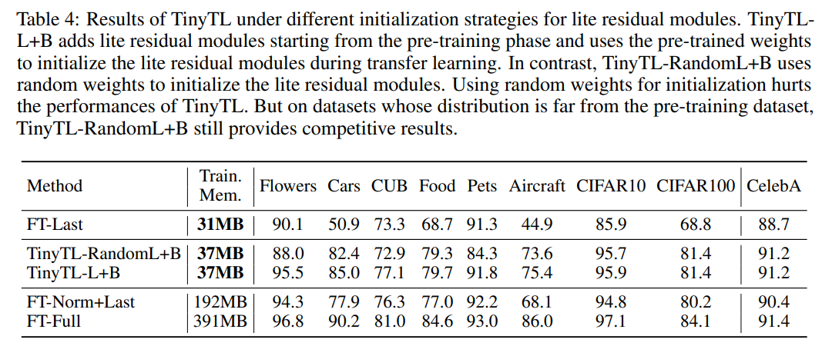
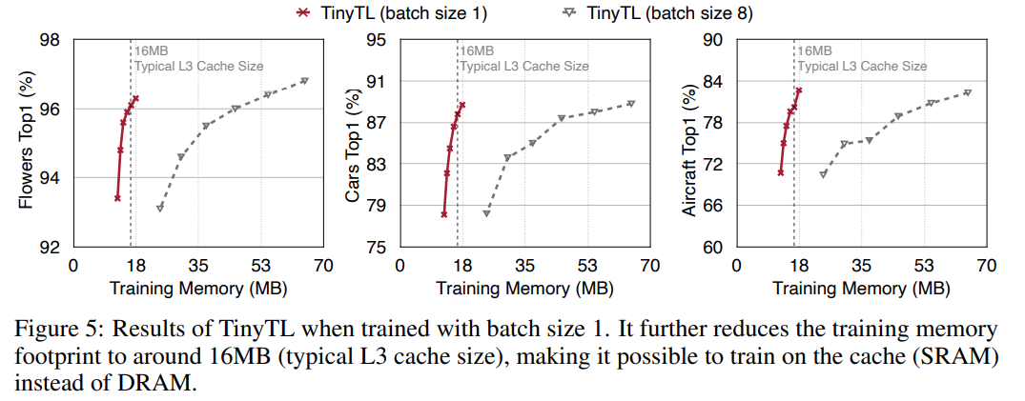
TinyTL: Reduce Activations, Not Trainable Parameters for Efficient On-Device Learning
效果
Ablation
Combining TinyTL and Feature Extractor Adaptation
Comparison with Dynamic Activation Pruning
Initialization for Lite Residual Modules
Results of TinyTL under Batch Size 1

