Slide 1

Image Denoising Search
Xiangsheng Shi
2021-7-1

Slide 2
Index
Deep Learning for Image Denoising
Preliminary
four types of denoising methods
U-Net : A Typical Architecture for Image Restoration
Recent works of reference value
Benchmark & Insights

Slide 3
Deep Learning for Image Denoising
Image Restoration: noise(low light, etc.), blur, rain, mosaic…
Traditional Denoising Method:
Block-Matching and 3D Filtering
Non-locally Centralized Sparse Representation (NCSR)
Markov Random Field (MRF)
Weighted Nuclear Norm Minimization (WNNM)
Cascade of Shrinkage Fields (CSF)
…
Drawbacks:
optimization methods for the test phase
manual setting parameters
a certain model for single denoising task
Deep Learning for Image Denoising: A Survey
https://arxiv.org/abs/1810.05052

Slide 4

Deep Learning for Image Denoising
Notions:
*Kernel Modeling Super-Resolution
Categories:
additive white noisy-image denoising
blind noisy image denoising
hybrid noisy image denoising
real noisy image denoising
Typical Models:
CNN(Residual Block/U-Net)
GAN
$$y=x+μ$$
Deep Learning on Image Denoising: An overview
https://arxiv.org/abs/1912.13171

Slide 5
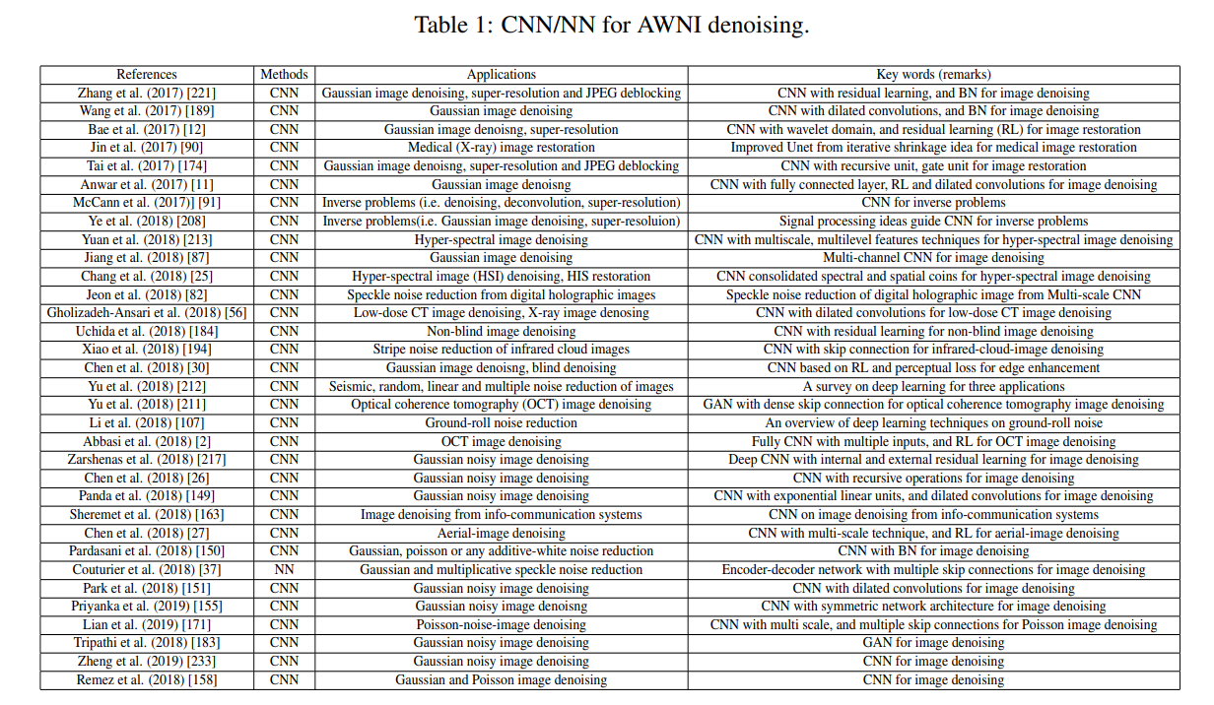
Deep Learning for Image Denoising
Additive White Noisy-Image Denoising(AWNI)
Type of Noise: Gaussian, Poisson, Salt, Pepper, etc.
NN for AWNI denoising(architecture design)
fusing features from multiple inputs
- parts(patches), perspectives(e.g. multiple scales), channels of a sample
Changing the loss function
- characteristic of nature images(e.g. Euclidean + perceptual loss)
Increasing depth or width of the CNN
- enlarged receptive field size / model capacity
Adding some auxiliary plug-ins into CNNs
- expressive ability: activation function, dilated convolution, etc.
Using skip connections or cascaded operations into CNNs
- complementary information for deep layer
Deep Learning on Image Denoising: An overview
https://arxiv.org/abs/1912.13171

Slide 6
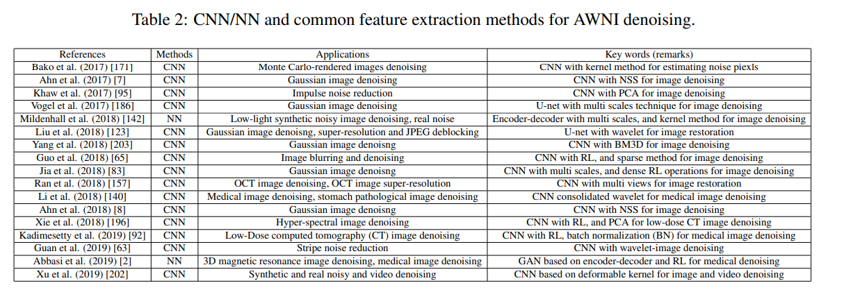
Deep Learning for Image Denoising
Additive White Noisy-Image Denoising(AWNI)
NN + common feature extraction methods
weak edge-information
- transformation domain
non-linear
- kernel method
high dimensional
- CNN + dimensional reduction method(e.g. PCA)
non-salient
- CNN + signal processing idea
high computational cost
- CNN + nature of image(e.g. NSS)
Deep Learning on Image Denoising: An overview
https://arxiv.org/abs/1912.13171

Slide 7
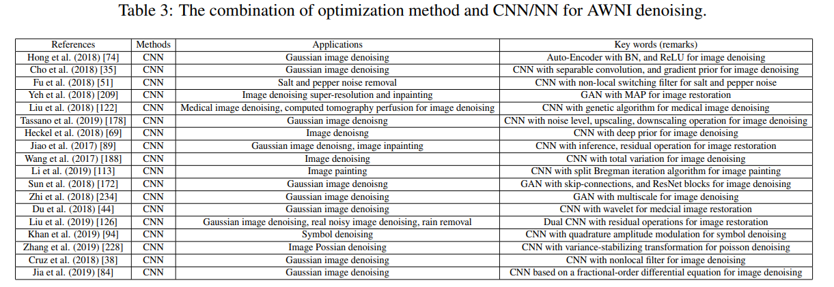
Deep Learning for Image Denoising
Additive White Noisy-Image Denoising(AWNI)
NN + optimization method
insight:
optimization methods: good perform. yet manual setting
discriminative learning: fast yet not flexible
improving denoising speed
GAN + MAP
greedy and transfer learning strategies + CNN
…
improving the denoising performance
dual-stage CNN + feature matching
CNN + total variation
CNN + Split Bregman iteration algorithm
…
Deep Learning on Image Denoising: An overview
https://arxiv.org/abs/1912.13171

Slide 8
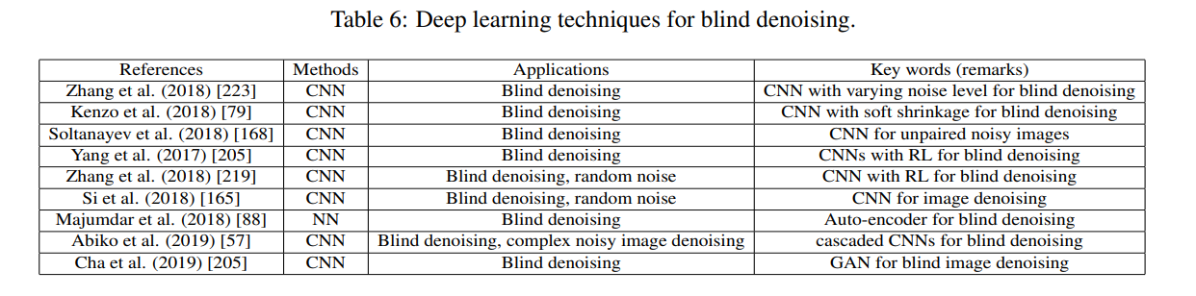
Deep Learning for Image Denoising
Blind Denoising
CNN as noise level estimator
FFDNet takes noise level and noise as the input
Soltanayev et al. use CNNs to estimate noise for unpaired noisy image
Yang et al. used known noise level to train a denoiser
Architecture modification for blind denoising
CNN + Residual for random noise attenuation problem
Majumdar et al. use auto-encoder for blind denoising
Deep Learning on Image Denoising: An overview
https://arxiv.org/abs/1912.13171

Slide 9
Deep Learning for Image Denoising
Hybrid Noisy Image Denoising
Inspection:
Not popular then?
Weak significance?
Hard to compare – no such dataset?
Deep Learning on Image Denoising: An overview
https://arxiv.org/abs/1912.13171

Slide 10
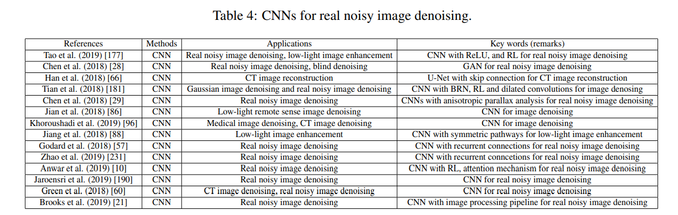
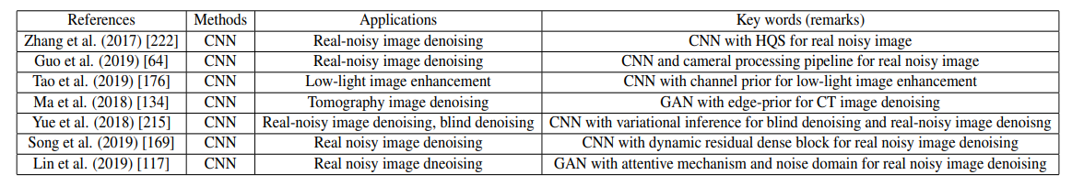
Deep Learning for Image Denoising
Real Noisy Image Denoising
end-to-end CNN(architecture)
- multiscale & phased features
skip connection / residual structure
recurrent connections
CNN + image prior
Deep Learning on Image Denoising: An overview
https://arxiv.org/abs/1912.13171

Slide 11
Deep Learning for Image Denoising
Datasets
Smartphone Image Denoising Dataset(SIDD)
See-in-the-Dark(SID)
 | Training set | Test set
Gray noisy image dataset | BSD400, Waterloo Exploration Database | Set12, BSD68
Color noisy image dataset | BSD432, SIDD, Waterloo Exploration Database, polyU-Real-World-Noisy-Images dataset | CBSD68, Kodak24, McMaster, cc, DND, NC12, Nam
Deep Learning on Image Denoising: An overview
https://arxiv.org/abs/1912.13171

Slide 12
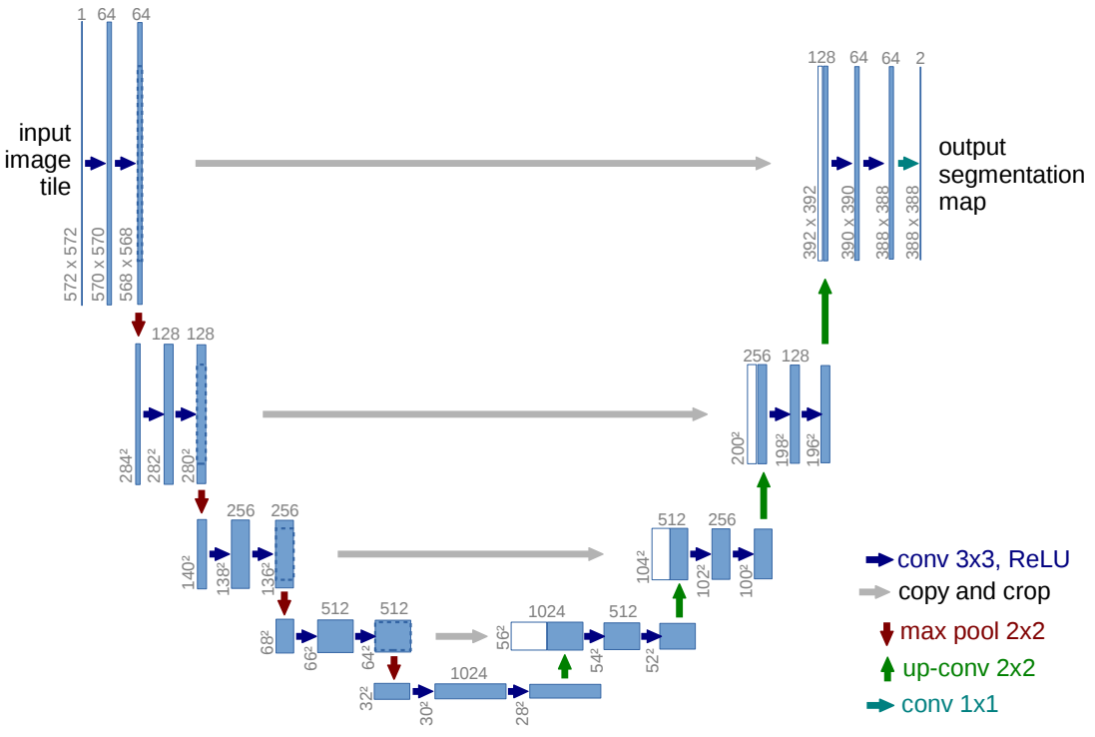
U-Net : A Typical Architecture
Background
ISBI cell tracking challenge 2015 winner
Fully Convolutional Network
Handle with few training images(with data augmentation)
Structure
U-Net: Convolutional Networks for Biomedical Image Segmentation
https://arxiv.org/abs/1505.04597

Slide 13
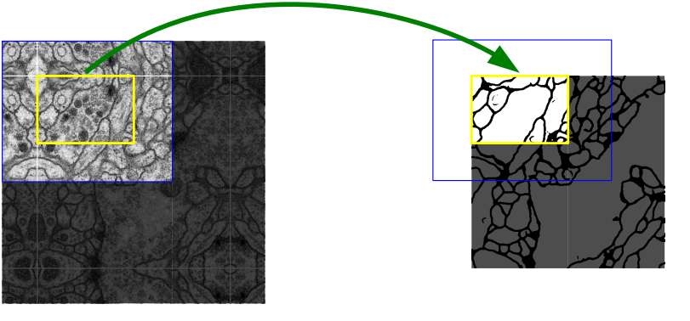

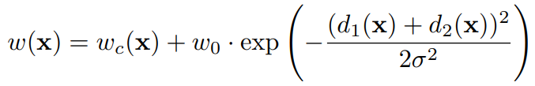
U-Net : A Typical Architecture
Going deeper into U-Net
Overlap-tile strategy
Weighted Loss
Separation of touching objects of the same class
Data Augmentation
elastic deformations
U-Net: Convolutional Networks for Biomedical Image Segmentation
https://arxiv.org/abs/1505.04597

Slide 14
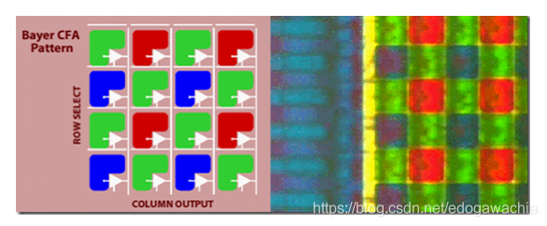
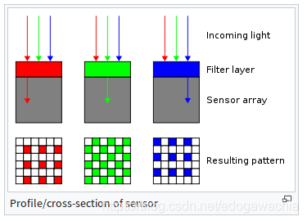
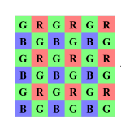
Valuable Reference
Intro to Bayer Pattern
CCD(charge coupled device) / CMOS
Grey Scale Image - > Color Image
Different Patterns:
BGGR
RGBG
GRBG
RGGB
拜耳阵列（Bayer Pattern）简介
https://blog.csdn.net/edogawachia/article/details/84963652

Slide 15
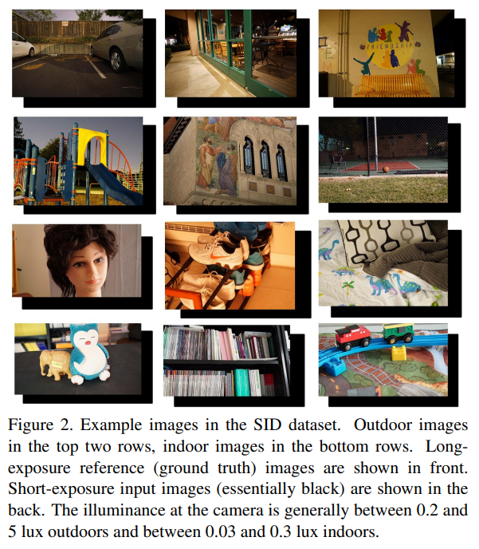
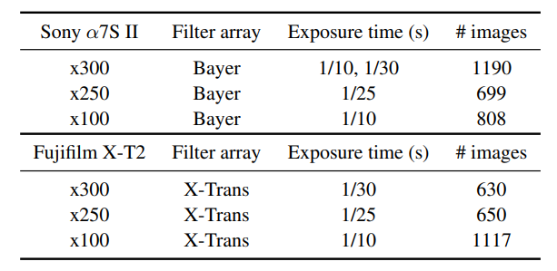
Valuable Reference
Learning to See in the Dark
Datasets – See-in-the-Dark(SID)
Raw sensor data
5094 raw short-exposure images
424 distinct long-exposure reference
images
Taken on Sony α7SII(full-frame
Bayer sensor) & Fuji camera(APS-C
X-Trans sensor)
drawbacks:
Limited data
W/O. humans or dynamic objs
HDR tone mapping
Learning to See in the Dark
https://arxiv.org/abs/1805.01934

Slide 16
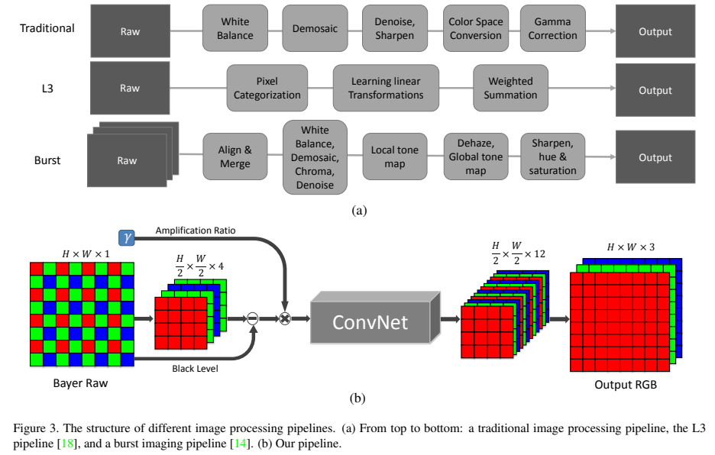
Valuable Reference
Learning to See in the Dark
Designed Pipeline
Architecture: U-Net
L1 Loss
Learning to See in the Dark
https://arxiv.org/abs/1805.01934

Slide 17
Valuable Reference
Learning to See in the Dark
Interesting Findings
Simple architecture & Loss is enough?
Operating directly on raw sensor data is better
Residual structure may degrade performance(*)
Limitations
Amplification ratio must be chosen externally
Weak generalization abilities for different sensors
Not fast enough for real-time processing
Learning to See in the Dark
https://arxiv.org/abs/1805.01934

Slide 18
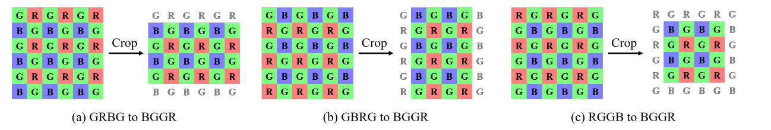
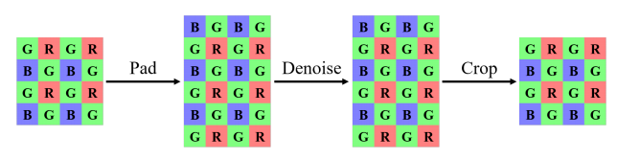
Valuable Reference
Learning Raw Image Denoising with Bayer Pattern Unification and Bayer Preserving Augmentation
NTIRE 2019 workshop - raw denoising track winner
Insight: handle various Bayer patterns from different data sources
Bayer Pattern Unification (BayerUnify)
training
testing
Learning Raw Image Denoising with Bayer Pattern Unification and Bayer Preserving Augmentation
https://arxiv.org/pdf/1904.12945.pdf

Slide 19
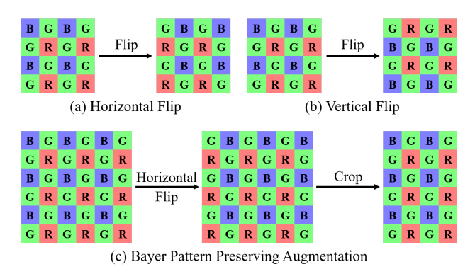
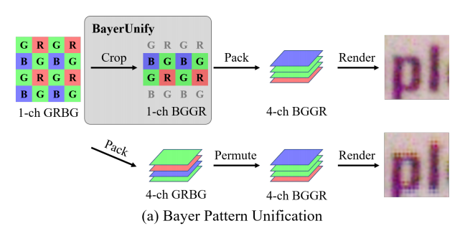
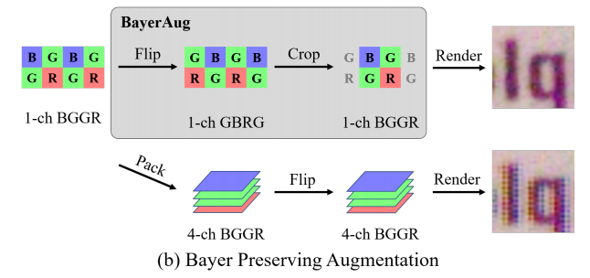
Valuable Reference
Learning Raw Image Denoising with Bayer Pattern Unification and Bayer Preserving Augmentation
Bayer Preserving Augmentation (BayerAug)
Results
Learning Raw Image Denoising with Bayer Pattern Unification and Bayer Preserving Augmentation
https://arxiv.org/pdf/1904.12945.pdf

Slide 20
Valuable Reference
Learning Raw Image Denoising with Bayer Pattern Unification and Bayer Preserving Augmentation
Dataset: SID(5 smartphones, 10 scenes, ~30k images)
Architecture: U-Net
L1 Loss
Learning Raw Image Denoising with Bayer Pattern Unification and Bayer Preserving Augmentation
https://arxiv.org/pdf/1904.12945.pdf

Slide 21
Valuable Reference
HINet: Half Instance Normalization Network for Image Restoration
NTIRE 2021 Image Deblurring Challenge - Track2. JPEG Artifact winner
Different Normalization
Classification: Batch Normalization, IBN
Detection: Layer Normalization in DETR, GroupNorm in FCOS
Style/Domain transfer : Instance Normalization
Insight: Simple application of normalization to low-level computer vision problems can be suboptimal
Possible reasons:
small image patches and small mini-batch size -> unstable BN statistics
scale sensitivity task -> BN in insensitive tasks
HINet: Half Instance Normalization Network for Image Restoration
https://arxiv.org/abs/2105.06086

Slide 22
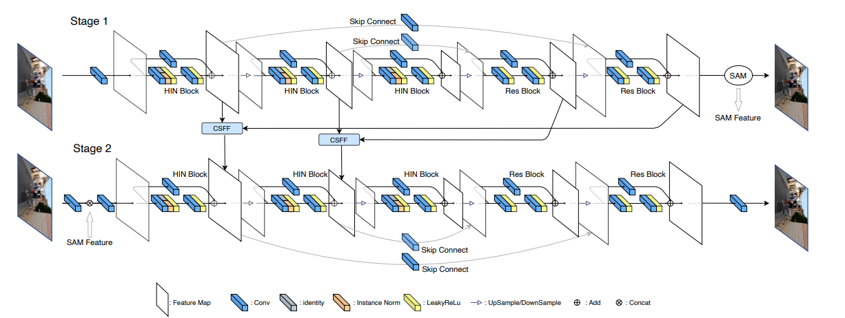
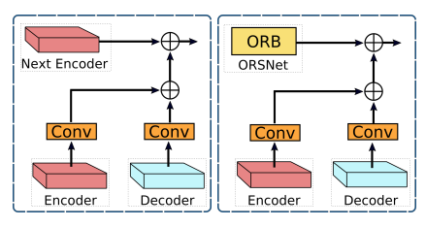
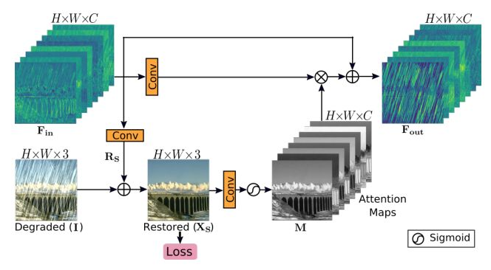
Valuable Reference
HINet: Half Instance Normalization Network for Image Restoration
Architecture Design
cross-stage feature fusion (CSFF) supervised attention module (SAM)
HINet: Half Instance Normalization Network for Image Restoration
https://arxiv.org/abs/2105.06086

Slide 23
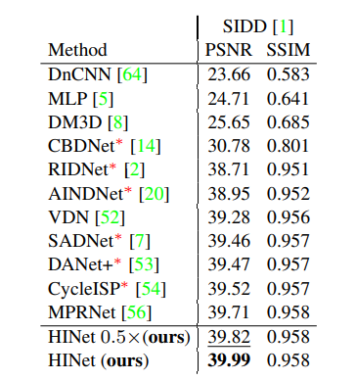
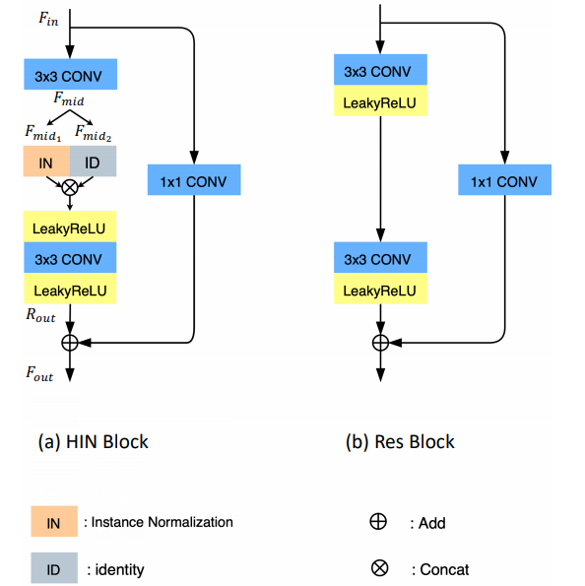

Valuable Reference
HINet: Half Instance Normalization Network for Image Restoration
Half Instance Normalization Block
PSNR loss:
HINet: Half Instance Normalization Network for Image Restoration
https://arxiv.org/abs/2105.06086

Slide 24
Benchmarking & Insights
Insights：
Architectural
No Stem nor FC layer -> Bottleneck Trap?
(No bottleneck or bottleneck everywhere)
U-Net / Res Block-> Simplicity is all you need?
Rethink typical design in high-level vision
(Skip connect & normalization don’t always work)
Denoising Characteristic
- Small input patches & batch size -> hard to optimize with STE?

Slide 25
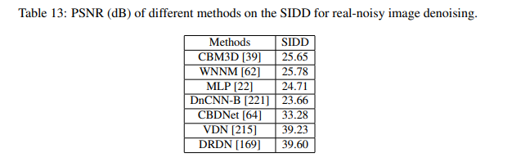
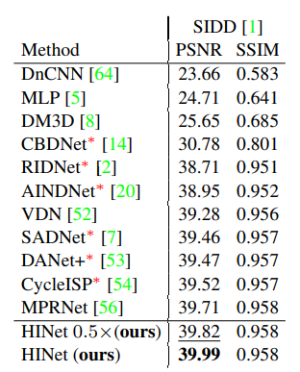
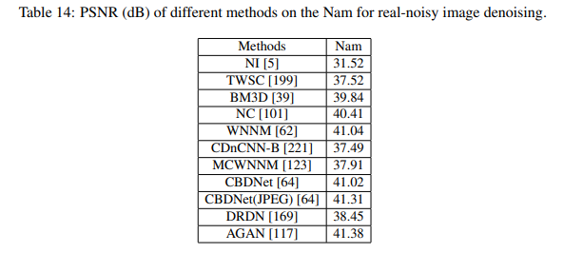
Deep Learning for Image Denoising
Benchmarking
Real Noisy Image Denoising
Deep Learning on Image Denoising: An overview
https://arxiv.org/abs/1912.13171

Slide 26
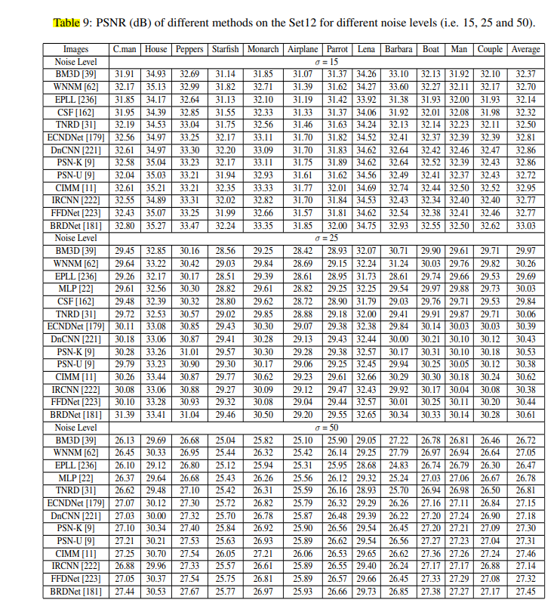
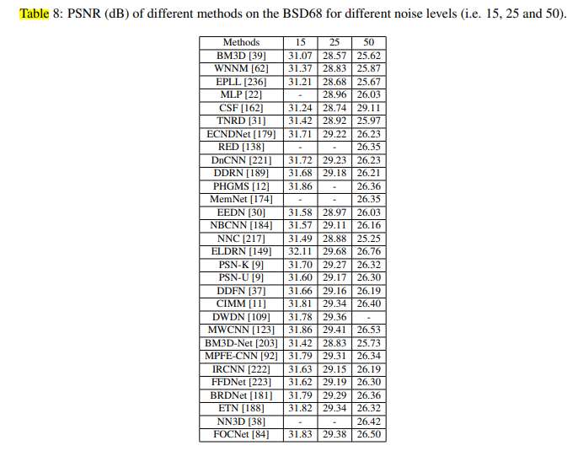
Deep Learning for Image Denoising
Benchmarking
Additive White Noisy-Image Denoising
Deep Learning on Image Denoising: An overview
https://arxiv.org/abs/1912.13171

Slide 27
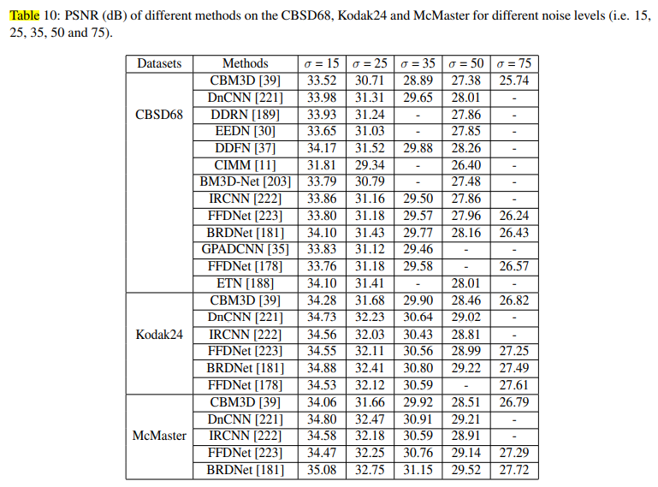
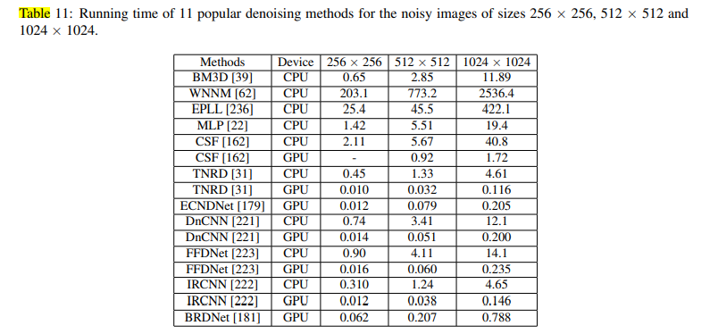
Deep Learning for Image Denoising
Benchmarking
Additive White Noisy-Image Denoising
Deep Learning on Image Denoising: An overview
https://arxiv.org/abs/1912.13171

Slide 28
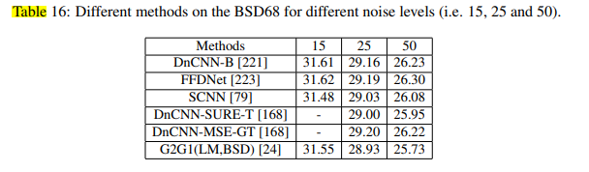
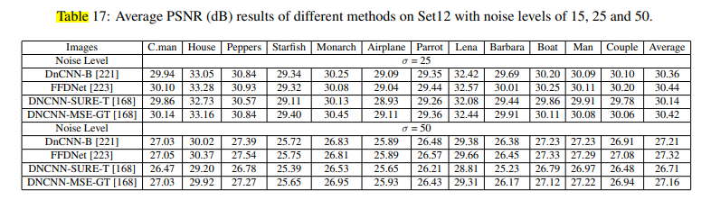
Deep Learning for Image Denoising
Benchmarking
Blind Denoising
Deep Learning on Image Denoising: An overview
https://arxiv.org/abs/1912.13171

Slide 29
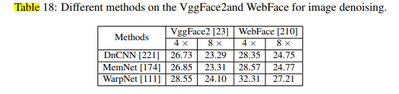
Deep Learning for Image Denoising
Benchmarking
Hybrid-Noisy-Image Denoising
Deep Learning on Image Denoising: An overview
https://arxiv.org/abs/1912.13171

