Slide 1




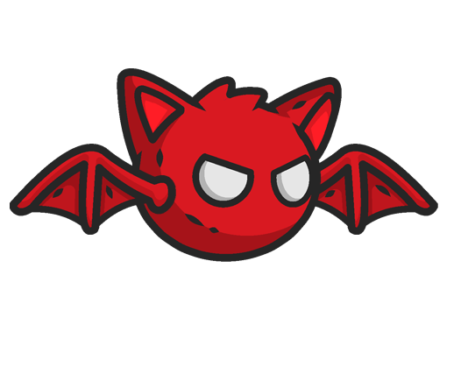
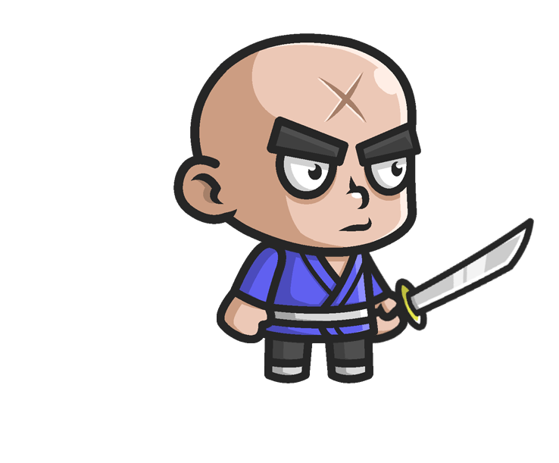
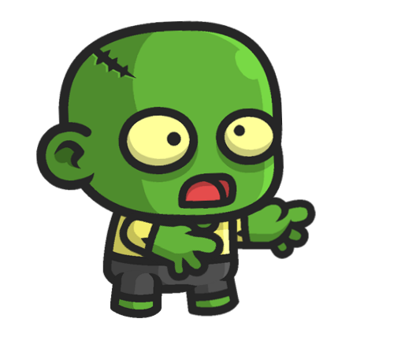
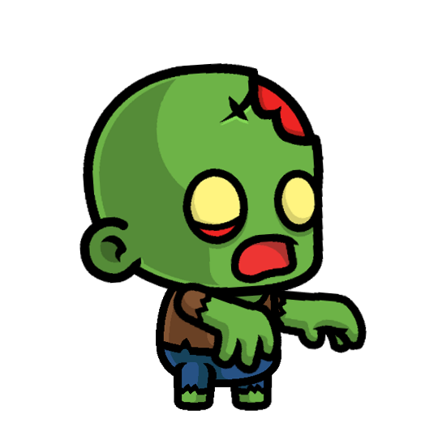
1. Purpose of the game
Defense a castle with your archer from the invasion of enemies
2. Game Control
Pause:
Aim:
Shoot Arrow: Click charge and release
Bomb:
3. How to Play
You need to enter a unique player name before start.
You can eliminate enemies by shooting arrows.
4. Level & Score System
Starts with level 1 Score 0. One enemy by one point.
If you collect 20 points, you clear the level and move on to the next level.
Each fifth level, you can earn bomb to use. (e.g. Level 5 = 1 Bomb, Level 10 = 2 Bomb)
5. Save Game & Load Game
Player name, level, and score are saved automatically to the file CastleDefenseSave.txt.
When you create a Player Name, it initialize with Level 1 and Score 0.
You can load your saved level and score through load game.
If you don’t have any game, the new game will start.
If you hit start new game, the saved level and score will be initialized and overridden.
6. High Score
You can check the top 5 high score on High Score Screen.
7. Enemies
Enemy’s position is random. Moving speed can be increased according to the level you are in.
Red Bat | Samurai | Normal Zombie | Mad Zombie
Level 1, 2, 3, 4 | Level 2, 3, 4 | Level 3, 4 | Level 4

Slide 2
8. Archer & Arrow
Archer’s reload speed and Arrow speed increase according to the level you are in.
9. Castle & Background
Castle and Background image are randomly generated.
If an enemy hit the castle, you’ll lose.
Pause:
Aim:
Shoot Arrow: Click charge and release
Bomb:
3. How to Play
You need to enter a unique player name before start.
You can eliminate enemies by shooting arrows.
4. Level & Score System
Starts with level 1 Score 0. One enemy by one point.
If you collect 20 points, you clear the level and move on to the next level.
Each fifth level, you can earn bomb to use. (e.g. Level 5 = 1 Bomb, Level 10 = 2 Bomb)
5. Save Game & Load Game
Player name, level, and score are saved automatically to the file CastleDefenseSave.txt.
When you create a Player Name, it initialize with Level 1 and Score 0.
You can load your saved level and score through load game.
If you don’t have any game, the new game will start.
If you hit start new game, the saved level and score will be initialized and overridden.
6. High Score
You can check the top 5 high score on High Score Screen.
7. Enemies
Enemy’s position is random. Moving speed can be increased according to the level you are in.
8. Archer & Arrow
Red Bat | Samurai | Normal Zombie | Mad Zombie

