Slide 1
Course : Computational Biology
Effective Period : June 2022
Proteomics

Slide 2
Learning Objectives
Translation & Proteomics
Amino Acids
Peptide Bond, Peptide Plane, and Ramachandran Plot
Protein Structure and Function
Bioinformatic Analyses Involving Protein Sequences

Slide 3
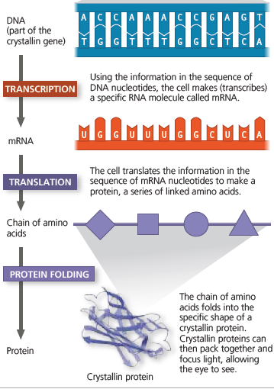
Translation and Proteomics
Three different aspects of life sciences which are Genomics, Proteomics, and Metabolomics makes the integration of all these aspects is well known to be a System Biology
In Translation, the sequence of nucleotides in the mRNA is "translated" into a sequence of amino acids in a polypeptide (protein chain).
Proteins (polypeptides) are translated from the mRNA, which carries the amino acid sequence information for the polypeptide.
Keywords:
Omics, Proteomics, Amino Acids, Polypeptide, Protein

Slide 4
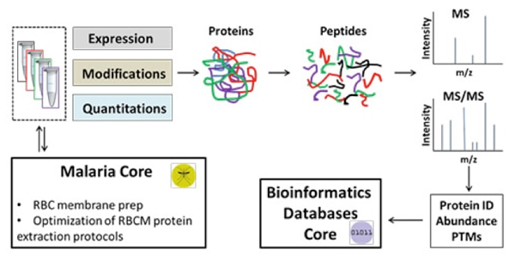
Translation and Proteonomics
Studies of the structure and function of proteins. What they do, what they interact with, and how they contribute to life processes The term proteomics refers to the study of sets of proteins and their properties. (The entire set of proteins expressed by a given cell, tissue, or organism is called a proteome.)
The term "proteome", a portmanteau of protein and genome, was coined by Marc Wilkins in 1994 and broadly defined as the total set of proteins that could be expressed in a sample or organism at a given time or the set of proteins that can be detected by some method.
This varies with time and distinct requirements, or stresses. The related term ''proteomics‘’ is now widely identified as one of the omics- the set of post-genomic technologies which seek to further understand the genome in the molecules it encodes, their functions, interactions and connected properties

Slide 5
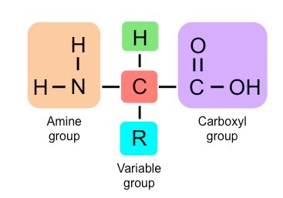
Amino Acids
Proteins are comprised of long chains of recurring monomers called amino acids. There are 20 different amino acids which are universal to all living organisms
Amino acids share a common basic structure, with a central carbon atom bound to:
An amine group (NH₂)
A carboxylic acid group (COOH)
A hydrogen atom (H)
A variable side chain (R)
All amino acids are –amino acids. They are called -amino acids because the amino group (aNH2) is attached to the -carbon atom—that is, the carbon atom linked to the carbonyl carbon of the carboxyl group (aCOOH).
The basic formula of an amino acid is shown here

Slide 6
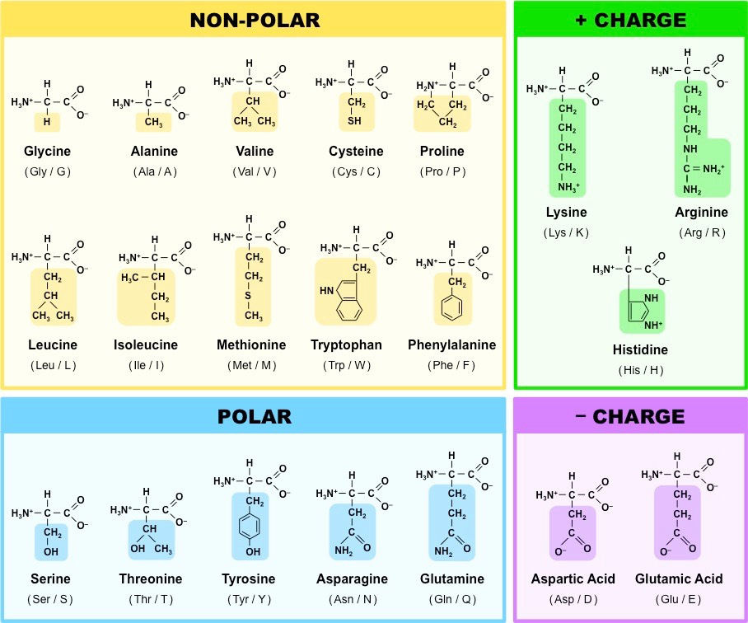
Amino Acids : Chemical Structure

Slide 7
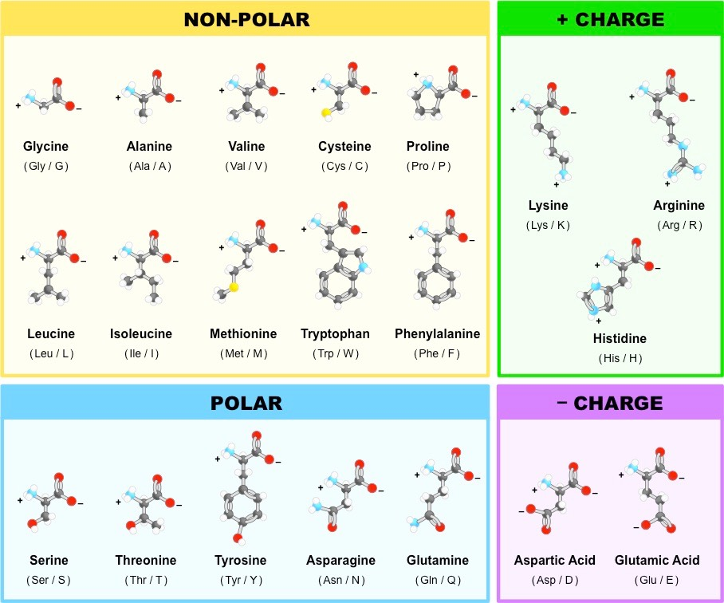
Amino Acids : Molecular Representation

Slide 8
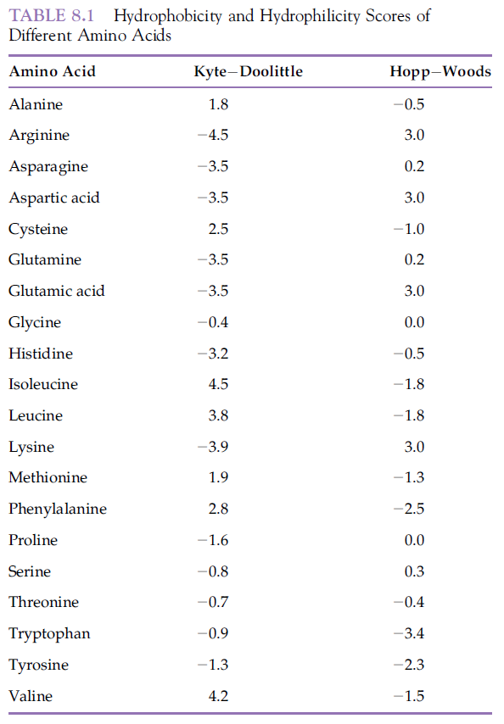
Amino Acids : Molecular Representation
The R-group of an amino acid determines whether it is hydrophobic or hydrophilic. Hydropathy. For example, proteins that are localized in an aqueous environment have hydrophobic amino acids (and their hydrophobic R groups) located towards the center of the molecule, away from water.
Hydropathy is an important determinant of protein folding. One of the most widely usedhydropathy plots is that of Kyte and Doolittle (1982). The standard Kyte and Doolittle plot is a hydrophobicity plot.
Hopp and Woods hydrophilicity/antigenicity plot. In this plot, hydrophilic amino acids get positive scores, and hydrophobic amino acids get negative scores

Slide 9
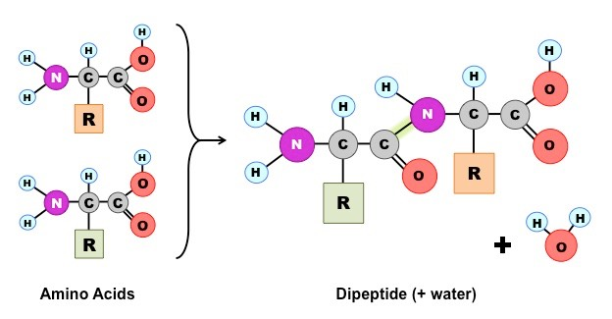
Amino Acids
Amino acids can be linked together in any sequence giving a huge range of possible polypeptides
Amino acids are joined together on the ribosome to form long chains called polypeptides, which make up proteins. Each type of amino acid differs in the composition of the variable side chain.
These side chains will have distinct chemical properties (e.g. charged, non-polar, etc.) and hence cause the protein to fold and function differently according to its specific position within the polypeptide chain As most natural polypeptide chains contain between 50 – 2000 amino acid residues, organisms are capable of producing a huge range of possible polypeptides

Slide 10
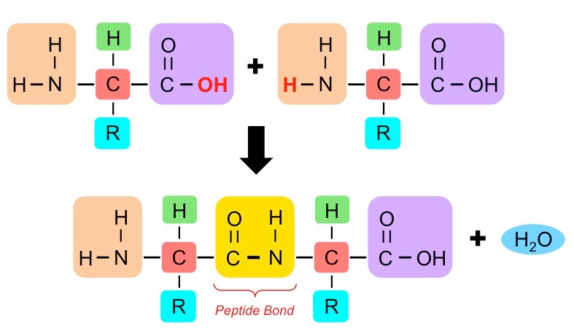
The Peptide Bond
Linkage between Amino Acids—The Peptide Bond
Peptide bonds are formed between the amine and carboxylic acid groups of adjacent amino acids
The amine group loses a hydrogen atom (H) and the carboxylic acid loses a hydroxyl (OH) – this forms water (H₂O)

Slide 11
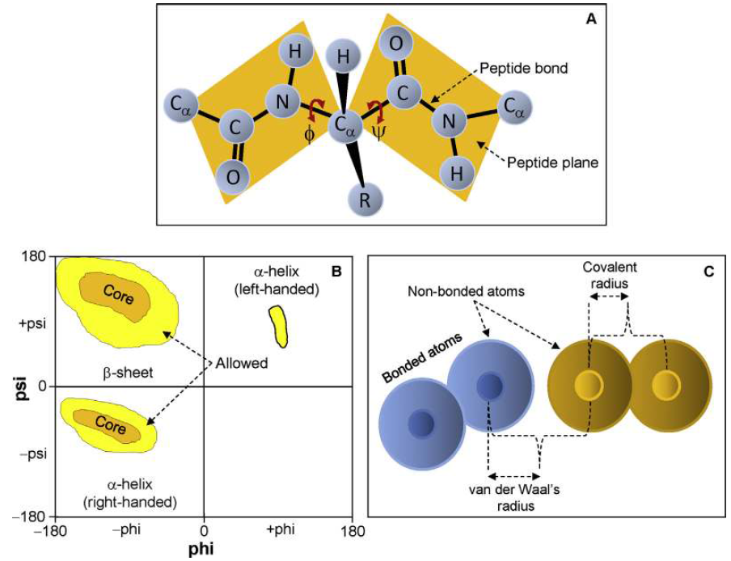
The Peptide Bond
Amino acids are linked together by peptide bonds (alpha peptide bonds), which are simply amide linkages between the NH2 and COOH groups of neighboring amino acids. The peptide bond has unique characteristics, which contribute to the overall structure of proteins.
The CaC bonds are not rigid and they can freely rotate, being only limited by the size and character of the R groups. In lysine, the -amino group (Figure 1.6D) also participates in the formation of a peptide bond, which is called an isopeptide bond because it does not involve the usual -amino group.
The angle of rotation (also called torsion angle or dihedral angle) around the NaC bond is called phi () and that around the CaC bond is called psi ()
(A) Peptide bond, peptide plane, phi and psi angles, and bond rotation involving two amino acids. (B) Diagram of a typical Ramachandran plot (/ plot). (C) In computing a Ramachandran plot, atoms are treated as hard spheres whose dimensions correspond to their van der Waals radii. The van der Waals radius and covalent radius are depicted for comparison.

Slide 12
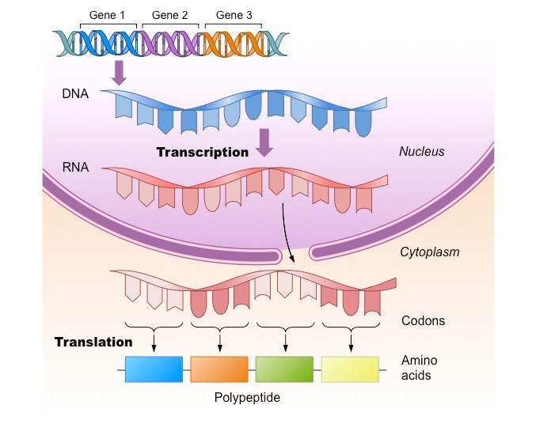
One Gene One Polypeptide
The amino acid sequence of polypeptides is coded for by genes
Typically, one gene will code for one polypeptide – however there are exceptions to this rule:
Genes may be alternatively spliced to generate multiple polypeptide variants
Genes encoding tRNA sequences are transcribed but never translated
Genes may be mutated (their base sequence is changed) and consequently produce an alternative polypeptide sequence
Identification
Functional Analysis
Data Sharing
Quantification

Slide 13
Protein Structure and Function
Proteins govern most biological processes and functions. Recently, much attention has been paid to study the entire protein sets available in a cell.
The term "proteome", a portmanteau of protein and genome, was coined by Marc Wilkins in 1994 and broadly defined as the total set of proteins that could be expressed in a sample or organism at a given time or the set of proteins that can be detected by some method. This varies with time and distinct requirements, or stresses.
The related term ''proteomics'' was originally coined by Marc Wilkins and colleagues and is now widely identified as one of the omics- the set of post-genomic technologies which seek to further understand the genome in the molecules it encodes, their functions, interactions and connected properties.

Slide 14
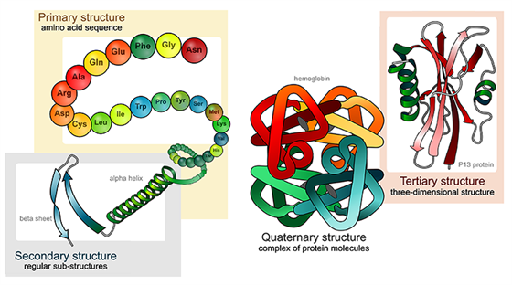
Protein Structure and Function
Proteins have four levels of structure: Primary, Secondary, Tertiary, and Quaternary. Each polypeptide chain, called a subunit, has its own primary, secondary, and tertiary structure
The amino acid sequence determines the three-dimensional conformation of a protein. Amino acids are covalently joined via peptide bonds to form long chains called polypeptides

Slide 15
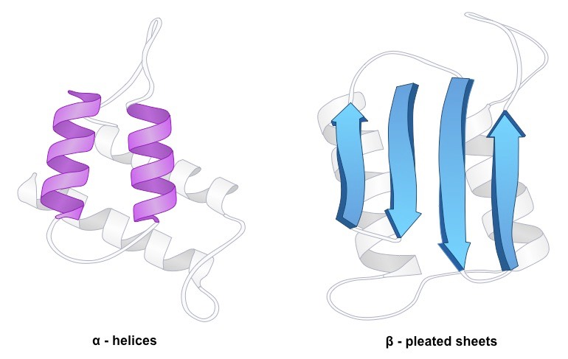
Protein Structure and Function
The order of the amino acid sequence is called the primary structure and determines the way the chain will fold. Different amino acid sequences will fold into different configurations due to the chemical properties of the variable side chains
Secondary structure refers to the conformation of the polypeptide backbone. Amino acid sequences will commonly fold into two stable configurations, called secondary structures
Alpha helices occur when the amino acid sequence folds into a coil / spiral arrangement
Beta-pleated sheets occur when the amino acid sequence adopts a directionally-oriented staggered strand conformation
Both α-helices and β-pleated sheets result from hydrogen bonds forming between non-adjacent amine and carboxyl groups.
Note :
Where no secondary structure exists, the polypeptide chain will form a random coil

Slide 16
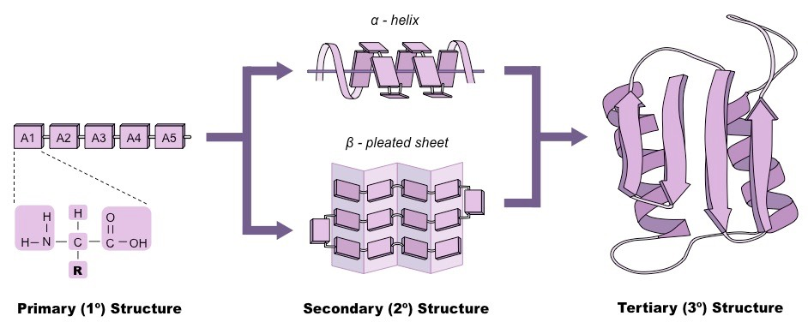
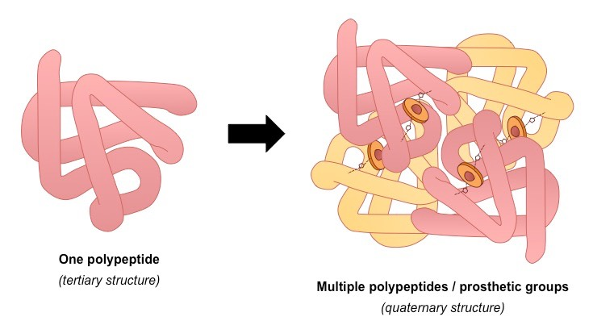
Protein Structure and Function
The amino acid sequence determines the three-dimensional conformation of a protein
Tertiary structure of a protein refers to its three-dimensional structure—that is, further folding of the secondary structure in the three-dimensional space.
Quaternary structure refers to a structure achieved by proteins composed of more than one polypeptide chain.

Slide 17
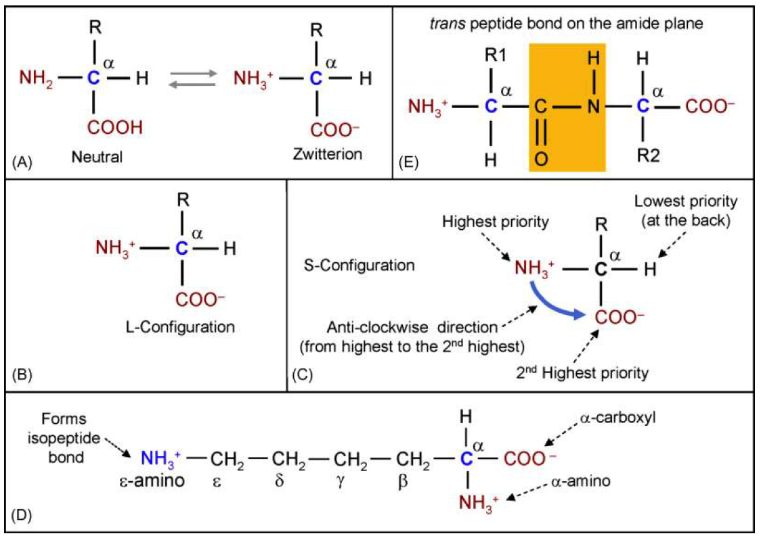
Protein Structure and Function
Amino acid structure and peptide bond. All amino acids except glycine (in which R = H) are chiral because the -carbon is asymmetric. (A) Basic formula of amino acids; (B) L-configuration of amino acid per Fischer’s system; (C) S-configuration of amino acid per CahnIngoldPrelog rules; (D) the numbering of carbon atoms for lysine; (E) the peptide bond is a trans bond on the amide plane (in color).

Slide 18
Protein Structure and Function
The 3D structures of many proteins and other biological macromolecules have been determined using various techniques of modern structural biology. These
structures are deposited in the PDB (Protein Data
Bank) database and are given a PDB ID. The PDB ID
is a four-character unique identifier, consisting of numbers
and letters, assigned to a protein or other biological
macromolecule submitted to the PDB. The PDB is
an archive of the structure of proteins and other biological
macromolecules; the structures have been
determined using techniques like X-ray crystallography,
nuclear magnetic resonance (NMR) spectroscopy,
and cryo-electron microscopy. After structural information
is submitted to the PDB, the submission is
annotated and publicly released by the wwPDB
(http://www.wwpdb.org/). As of July 30, 2013, there
were 92,689 structures in the PDB.

Slide 19
Bioinformatics in Proteomics research
Identification
Functional Analysis
Data Sharing
Quantification
identify peptides, proteins, and their modifications
annotate the data with existing biological knowledge, and
share the data using online repositories. Finally,
the different techniques for quantifying peptides and proteins will be introduced.

Slide 20
Bioinformatics in Proteomics research
Diabetes research
Tumor metastasis
Nutrition research
Fetal and maternal medicine
Renal disease diagnosis
Neurology
Urological cancer research
Antibody profiling for study and treatment disease
With years’ experience in advanced experiment equipments, Creative Proteomics can provide the following bioinformatics services in proteomics:
Functional annotation and enrichment analysis
Clustering analysis
Network analysis
Statistical analysis
Proteomic analysis of post-translational modifications

Slide 21
References
Lesk, Arthur M.. (2014). Introduction to Bioinformatics. 4. Oxford University Press, United Kingdom. ISBN: 978-0199651566. (*)
Choudhuri, S.. (2014) Bioinformatics for Beginners: Genes, Genomes, Molecular Evolution, Databases and Analytical Tools. Elsevier. ISBN 978-0124104716.
Simon, E. J.. (2020). Biology : The Core. 3rd Edition. Pearson: Hoboken, NJ. ISBN 9780134891514
https://ib.bioninja.com.au/

