Slide 1
A Fuzzy Logic Controller Controls a Smart Lighting System for Energy Savings
電機3A 109206532 王昱達
電機4A 108303517 張家豪
電機3A 109302025 盧欣靖
電機3A 109501510 林采玟
電機4A 108303526 劉亦修
電機3A 108601205 王佑恩

Slide 2
TABLE OF CONTENTS
01
02
03
04
05
06
Introduction
System Structure
Goal Functions
Constraints
The Designed Fuzzy Logic Controller
Conclusion

Slide 3
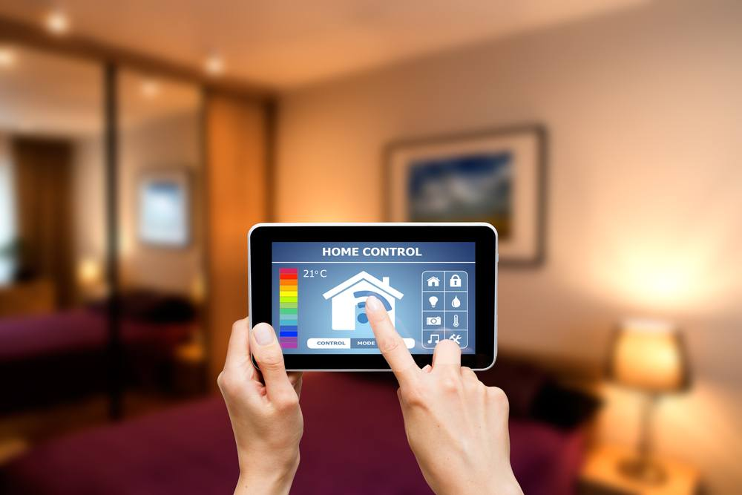
01
INTRODUCTION

Slide 4
INTRODUCTION
From 2021 9th International Renewable and Sustainable Energy Conference
Electric lighting consumes 20-40% of all electricity consumed in buildings
Use fuzzy logic lighting control
Reducing lighting energy consumption, and maintaining lighting comfort (Output)
Taking into account the Daylight and the areas' real-time status

Slide 5
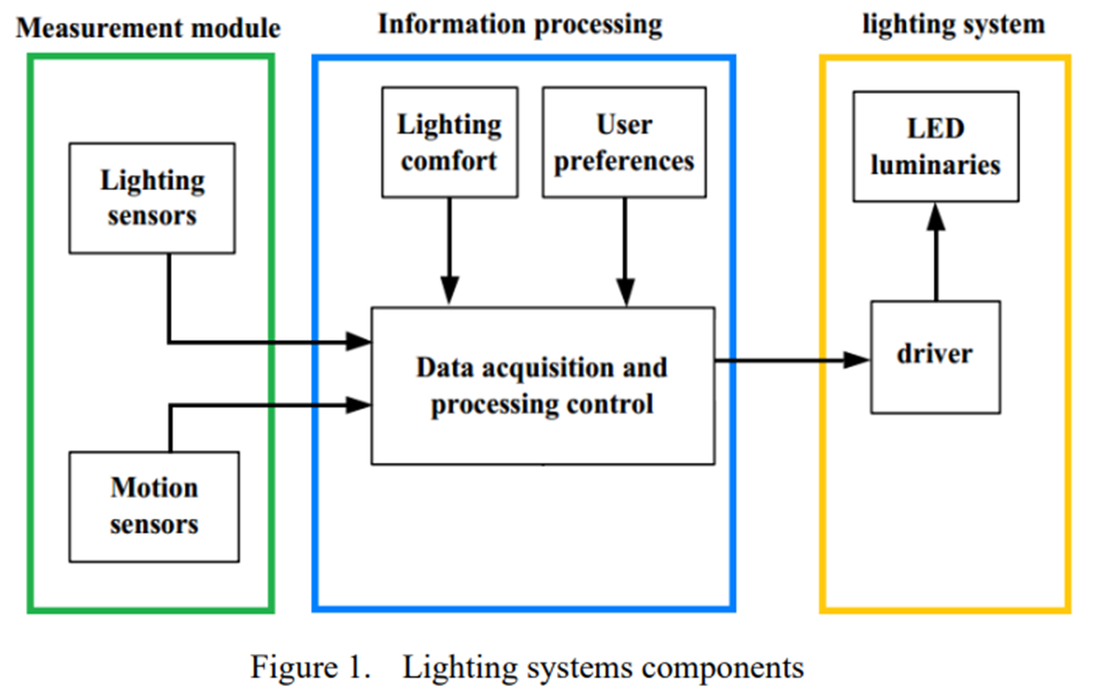
02
System
Structure

Slide 6
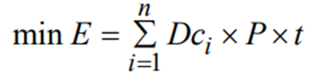
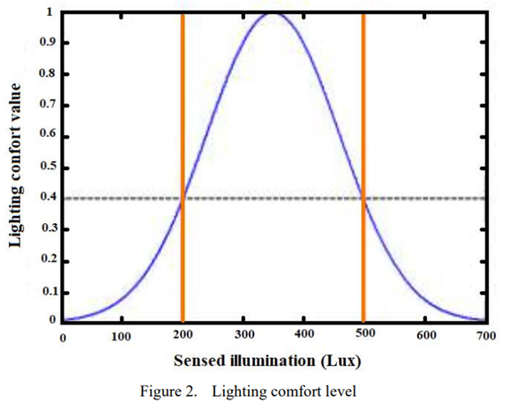
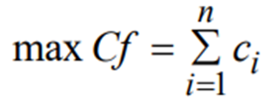
03
03
1.
Minimize Energy Consumption
Goal Functions
2.
Maximize Comfort Value

Slide 7
04
CONSTRAINTS
Constraints on Control
Lighting Comfort constraint

Slide 8
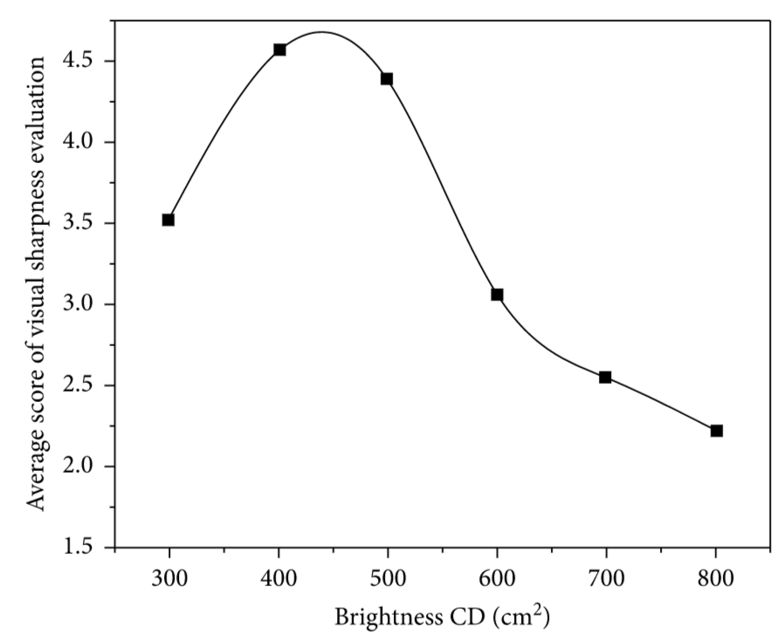

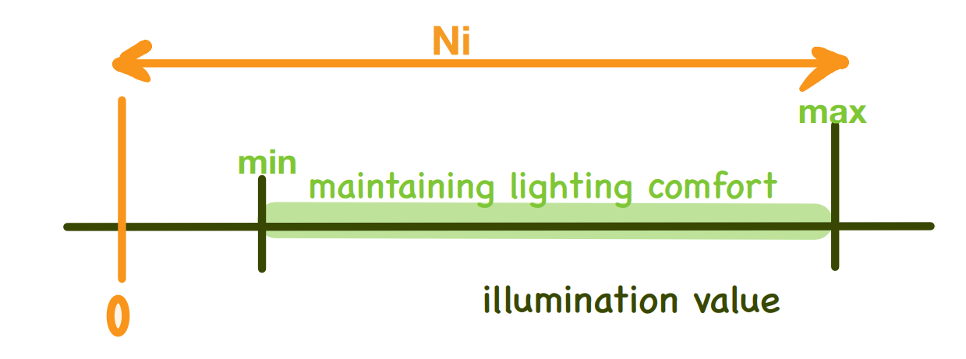
A. Constraints on Control
Daylight
Can not be controlled, but can be measured.
Can not provide adequate lighting values in the room.
the lighting value is below the comfortable value.
(based on Emax)
Illumination value：

Slide 9

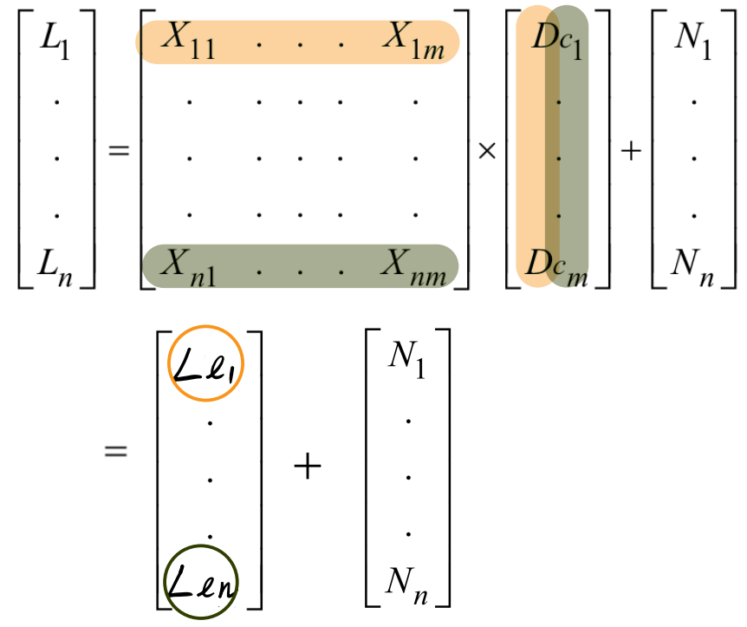
A. Constraints on Control
Illumination value
considering
m (LED luminaries)
n (room area)
Total contribution of every luminaries in each room area n
Contribution of daylight in each room area n
extending

Slide 10
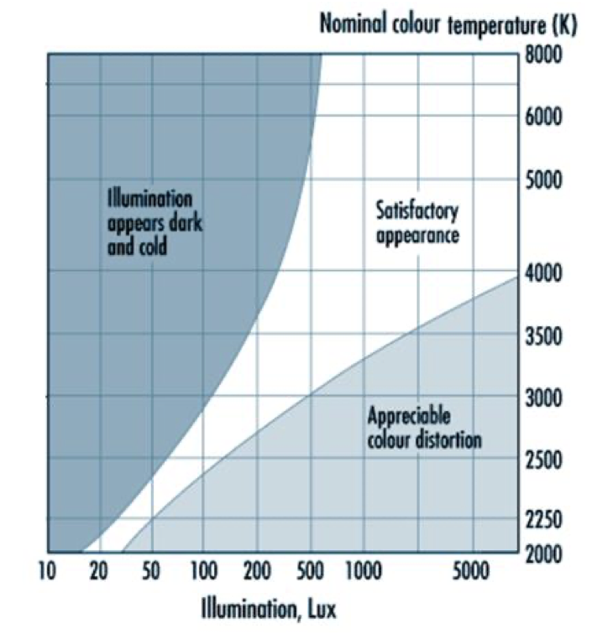
B. Lighting comfort constraint
Lighting comfort parameter
Color temperature
Illumination
Comfort diagram
*electric lamps
Daylight white: 6000k
Neutral white: 4000k
Warm white: 3000k
Low level of illumination, low color temperature

Slide 11
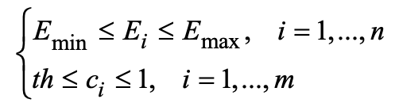
B. Lighting comfort constraint
Lighting comfort constraints
room(1), room(2), ⋯⋯, room(n)
lamp, candle, ⋯⋯, light bulb (total m luminaries)
*Consider lighting comfort
Emin : lower limit of illumination
Emax : upper limit of illumination
Ei : total illumination value in room i
th: least intensity of light visible to the eyes
Ci: level of lighting comfort for user

Slide 12
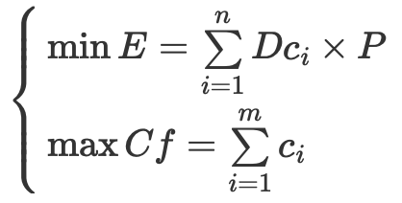
B. Lighting comfort constraint
Main objectives
To decrease energy usage
To meet the lighting needs of the users
Objective functions(Take daylight into consideration)
E: overall energy consumption
n: rooms
DCi: duty cycle of all LEDs
P: luminary power consumption
Cf: lighting comfort
Ci: level of lighting comfort for the user
M: luminaries

Slide 13
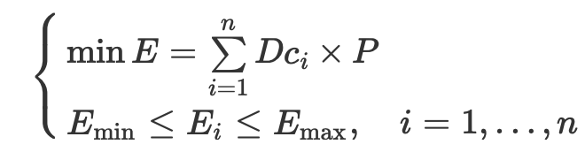
B. Lighting comfort constraint
Objective functions
Minimize energy consumption

Slide 14
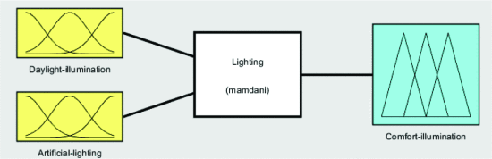
B. Lighting comfort constraint
Fuzzy Logic controller for the lighting system
Resilient
Easy to construct
Lighting comfort
A subjective measure of user’s contentment
Difficult to categorize accurately with boundaries

Slide 15
05
THE DESIGNED FUZZY LOGIC CONTROLLER
A. Fuzzification
B. Inference
C. Defuzzification

Slide 16
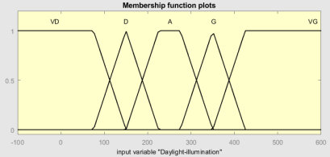
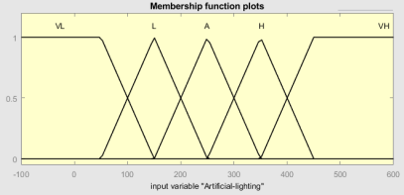
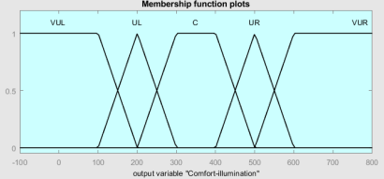
A. Fuzzification
2 Inputs : DI and AL
(DI:Daylight illumination ranks
AL:Artificial lighting ranks)
1 output : CI
(CI:comfort illumination ranks)
The definition(ranks) of figures are based on the EN 12464-1 standard
Each Variable defines five fuzzy subsets
Very Dark (VD), Dark (D), Average (A), Good (G), and Very Good (VG)
Very Low (VL), Low (L), Average (A), High(H), and Very High (VH)
Very Uncomfortable Left (VUL), Uncomfortable Left (UL), Comfortable (C), Uncomfortable Right (UR), and Very Uncomfortable Right (VUR)
page.20
Notes:
Artificial Lighting處，paper裡好像有寫錯

Slide 17
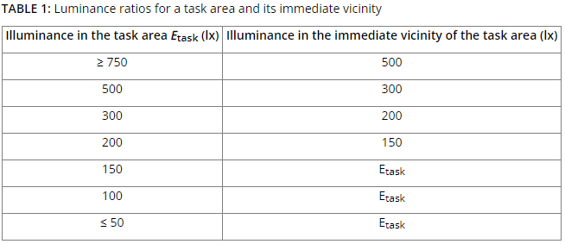
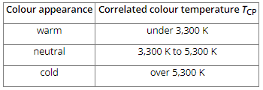
A. Fuzzification
The SFS-EN 12461-1:2011 standard
．The minimum required illuminance levels for the task area and its surroundings
．Illuminance in the surrounding areas must be no less than a third of the illuminance in the immediate vicinity of the task area
．The illuminance uniformity value must be no less than 0.4 in the immediate vicinity and no less than 0.1 in the background
Reference[1] : https://www.ensto.com/downloads/tools/lighting-guide/the-indoor-lighting-standard-sfs-en-12464-12011/

Slide 18
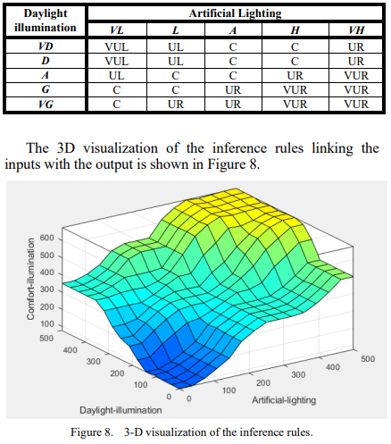
B. Inference
Mamdani technique
．A method to create a control system by synthesizing a set of linguistic control rules obtained from experienced human operators
．Output of each rule is a fuzzy set.
．Well-suited to expert system applications (where the rules are created from human expert knowledge, ex : medical diagnostics)
page.20

Slide 19
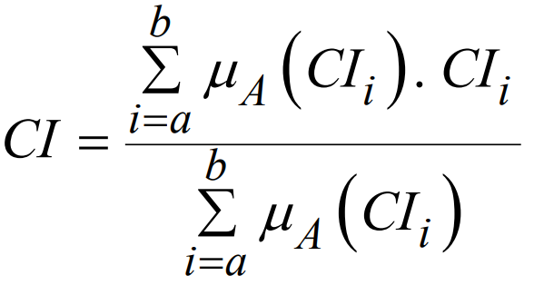


C. Defuzzification
Defuzzification is the process of obtaining a single number from the output of the aggregated fuzzy set. It is used to transfer fuzzy inference results into a crisp output.
In our case, we use the most popular technique, which is the centroid method (COG: center of gravity). The defuzzified output COG can be written as:
Where CI is the comfortable illumination value, is the ith term's activation degree, and is the centroid position.

Slide 20
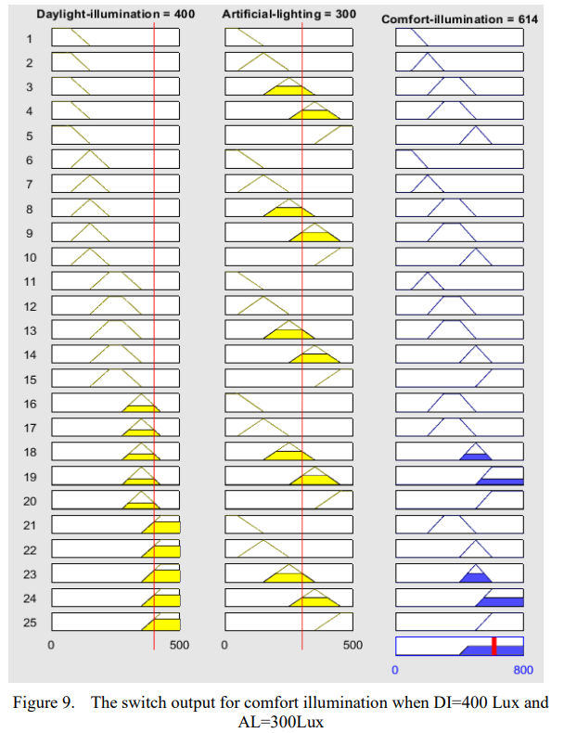
C. Defuzzification
In this work, the Fuzzy controller for controlling the lighting comfort of a room (building area) was built using the Mamdani inference system, as discussed earlier.
Figure 5. Fuzzy relation for the first input DI
The fuzzy control rules

Slide 21
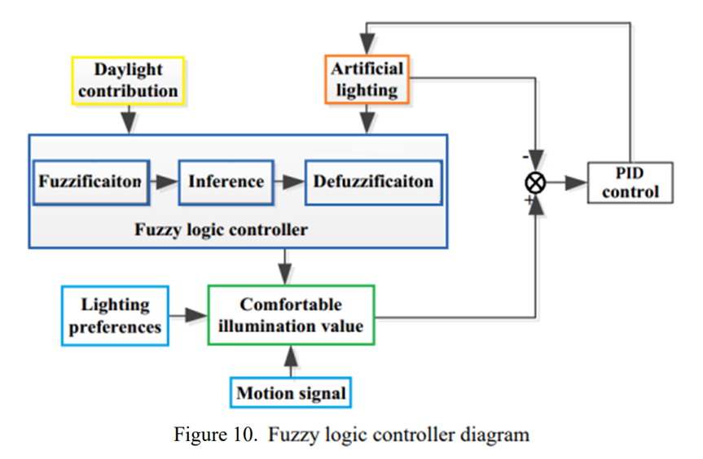
C. Defuzzification
According to figure 9, the comfort illumination is at 614 Lux, which is a value that is beyond the user's comfort, so in this case, the PID controller (fig 10) controls the artificial lighting in a way to decrease the comfort illumination until it reaches the maximum limit value set by the user.

Slide 22
06
CONCLUSION

Slide 23
CONCLUSION
The two key factors in creating a lighting system are saving lighting energy and fulfilling the user's lighting comfort
Significant energy savings can be realized based on varied lighting choices
The perspective of this work is to integrate this application into an intelligent smart home system with IoT
Expensive

Slide 24
THANKS!

